Slide 1
Juniper Apstra 4.2.1 EVE-NG Virtual Lab Demo Video series companion guide Video 3: Day-0 Virtual Device Profiles and Agents
Colin Doyle, Sr. CE AMER
See the complete video walkthrough on YouTube at: https://www.youtube.com/@5minutejunos
Ask questions at the Juniper Elevate Community using the hashtag #5minutejunos
Adapted from v4.0.0 documentation originally compiled by: - Raymond Lam, SSE APAC - Tony Chan, SSE APAC

Slide 2
Agenda
Prepping your Lab
Day-0 Fabric Onboarding
Virtual Device Profile Verification
Virtual Device Profile Cloning
Onboarding Virtual Nodes
Create ASN Pool and IP Pools
Create Logical Devices and Interface Maps
Create Rack Types
Create Templates
Create Blueprints
Day-1 Service Provisioning
Create Routing Zones
Create Virtual Networks
Assign Virtual Network to Switchports
Add Server Links
Data Center Interconnect
DCI Addendum: Direct Peering
Core/WAN Connectivity
Internet Connectivity
Day-2 Operational Scenarios
Incorrect Cable Patch (RCA, LLDP Link Discovery, Time Voyager)
Config Deviation Checking
Apply custom config through Configlet
View Telemetry Data
Hardware Replacement
Future Documentation
Firewall Service Chaining
Cluster with Service Block
Type-5 Route (fabric integrated) with MNHA
VLAN Stitching
vEvo Fabric

Slide 3
Day-0 Fabric Onboarding
Virtual Device Profile Verification
Virtual Device Profile Cloning
Onboarding Virtual Nodes
Create ASN Pool and IP Pools
Create Logical Devices and Interface Maps
Create Rack Types
Create Templates
Create Blueprints

Slide 4
Virtual Device Profile Creation
Apstra 4.2.1 ships with support for 4 different virtual Juniper switch platforms:
Juniper vEX
Juniper vQFX
vJunos-switch ← used in this lab
vJunosEvolved
vJunos-switch and vJunosEvolved both support way more ports than we need for our lab. While not required, this guide will clone these two device profiles and define different ports. It’s fair to ask “why”?
It’s good to understand the workflow for creating a new device profile. E.g., if you are using an older version of Apstra, you will need to clone the EX9214 profile for vJunos-switch, and/or the PTX10001-36MR profile for vJunosEvolved.
Less ports in the Device Profile means less ports in the Logical Devices and Interface Maps which makes configuration screens much less “busy” when taking screenshots for this guide.
Additional interfaces mean additional virtual server resources used. It’s probably negligible if those ports aren’t active, but still…

Slide 5
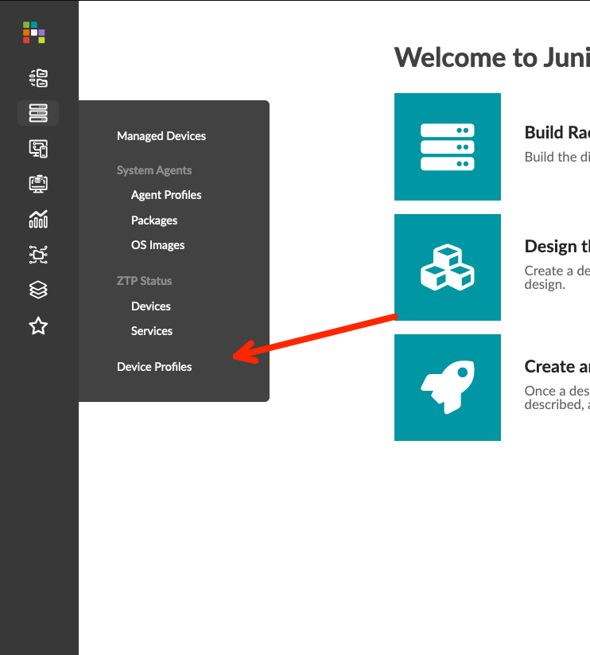
Virtual Device Profile Verification
Navigate to Devices > Device Profiles
Check for vJunos/vEvo Device Profiles
Verify the supported OS version regex configuration includes 23.x. The default values for the Device Pofiles we are using should match the following:
vJunos-switch: .*
vJunosEvolved: ^.+-EVO$
Note: This verification is mostly for anyone running an earlier version than 4.2
Screenshot

Slide 6
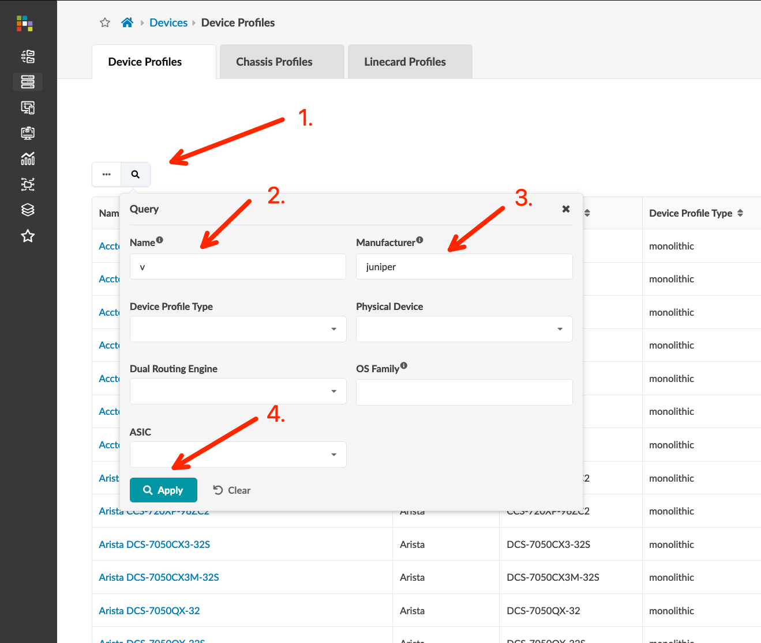
Virtual Device Profile Verification
Navigate to Devices > Device Profiles
Check for vJunos/vEvo Device Profiles
Verify the supported OS version regex configuration includes 23.x. The default values for the Device Pofiles we are using should match the following:
vJunos-switch: .*
vJunosEvolved: ^.+-EVO$
Note: This verification is mostly for anyone running an earlier version than 4.2
Screenshot

Slide 7
Virtual Device Profile Verification
Navigate to Devices > Device Profiles
Check for vJunos/vEvo Device Profiles
Verify the supported OS version regex configuration includes 23.x. The default values for the Device Pofiles we are using should match the following:
vJunos-switch: .*
vJunosEvolved: ^.+-EVO$
Note: This verification is for anyone running a version of Apstra earlier than 4.2.0
Screenshot

Slide 8
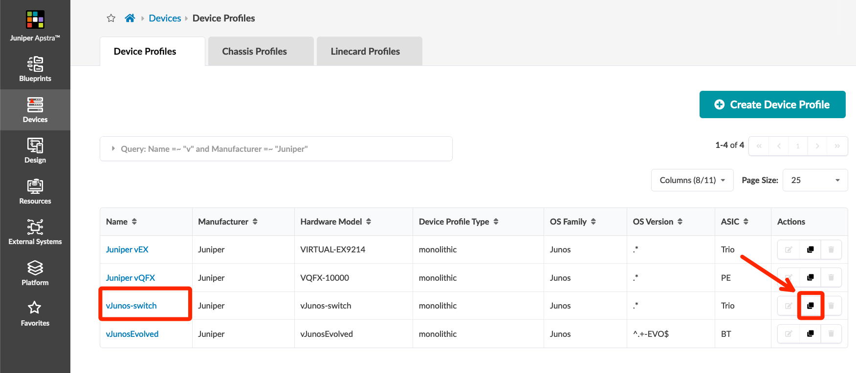
Virtual Device Profile Cloning
From the Device Profile view showing the 4 predefined virtual Juniper switch Device Profiles, click the “Clone” button on the vJunos-switch row
On the Summary menu, change the name to vJunos-lab
Select the Ports menu option, scroll to the right of the port display, drag the corner bracket to the left until you have only 10 ports, then click port “1” and drag to port 10 to select all ports
Verify the Display IDs shows the 1-10 range, click the “-” to zero-index the range, then click “Clone”
OPTIONAL: Return to the Device Profiles screen, filter for v and manufacturer Juniper, and click the “Clone” button on the vJunosEvolved row
On the Summary menu, change the name to vJunosEvo-lab
Select the Ports menu option. No salvaging this one – click the “Delete” button for Panel #1, then click the "Add Panel” button
Drag the corner bracket to select 12 ports, then click port 1 to open the interface configuration
Screenshot

Slide 9
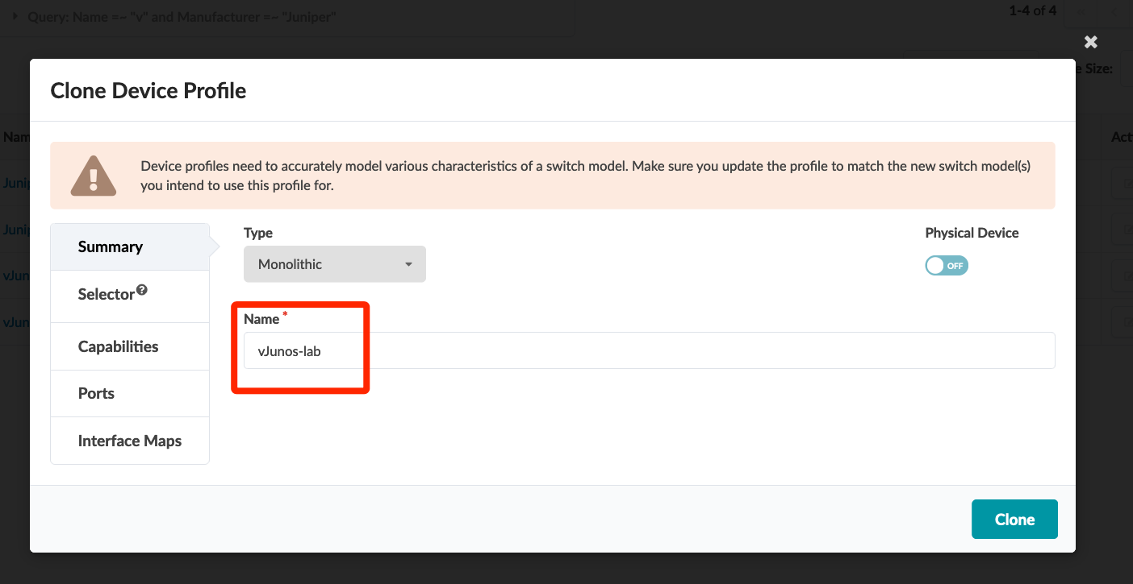
Virtual Device Profile Cloning
From the Device Profile view showing the 4 predefined virtual Juniper switch Device Profiles, click the “Clone” button on the vJunos-switch row
On the Summary menu, change the name to vJunos-lab
Select the Ports menu option, scroll to the right of the port display, drag the corner bracket to the left until you have only 10 ports, then click port “1” and drag to port 10 to select all ports
Verify the Display IDs shows the 1-10 range, click the “-” to zero-index the range, then click “Clone”
OPTIONAL: Return to the Device Profiles screen, filter for v and manufacturer Juniper, and click the “Clone” button on the vJunosEvolved row
On the Summary menu, change the name to vJunosEvo-lab
Select the Ports menu option. No salvaging this one – click the “Delete” button for Panel #1, then click the "Add Panel” button
Drag the corner bracket to select 12 ports, then click port 1 to open the interface configuration
Screenshot

Slide 10
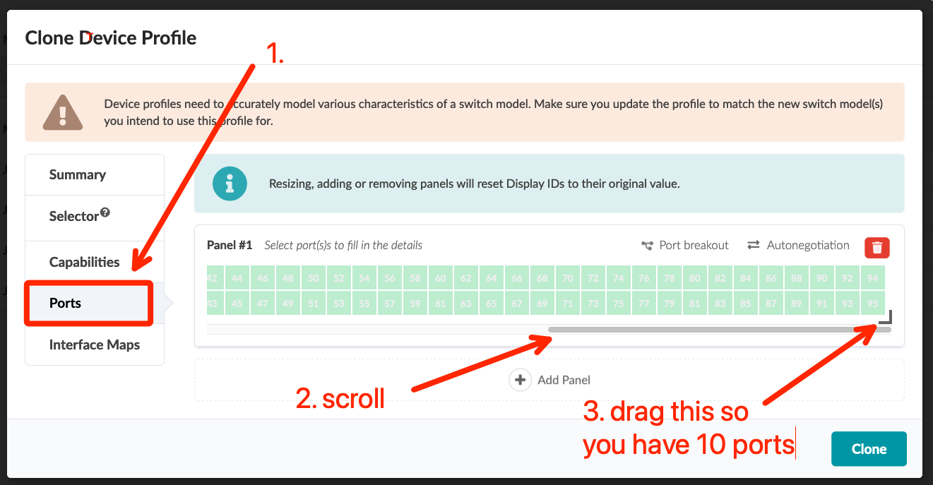
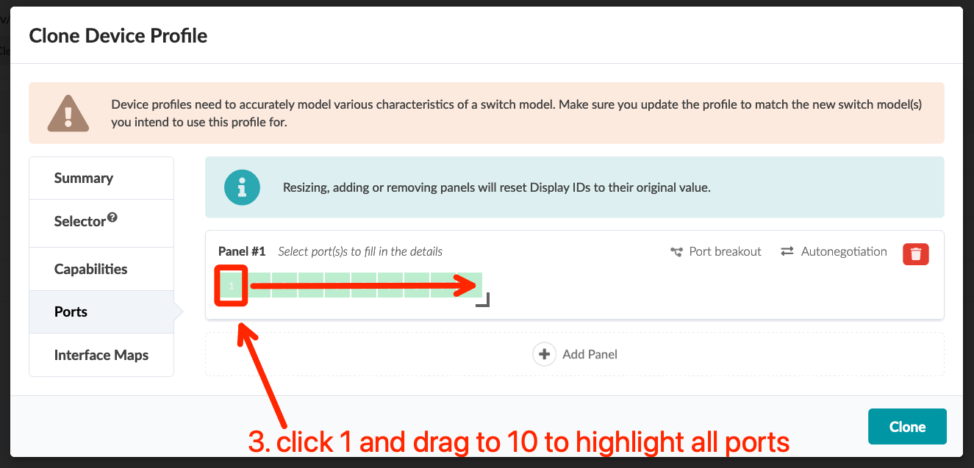
Virtual Device Profile Cloning
From the Device Profile view showing the 4 predefined virtual Juniper switch Device Profiles, click the “Clone” button on the vJunos-switch row
On the Summary menu, change the name to vJunos-lab
Select the Ports menu option, scroll to the right of the port display, drag the corner bracket to the left until you have only 10 ports, then click port “1” and drag to port 10 to select all ports
Verify the Display IDs shows the 1-10 range, click the “-” to zero-index the range, then click “Clone”
OPTIONAL: Return to the Device Profiles screen, filter for v and manufacturer Juniper, and click the “Clone” button on the vJunosEvolved row
On the Summary menu, change the name to vJunosEvo-lab
Select the Ports menu option. No salvaging this one – click the “Delete” button for Panel #1, then click the "Add Panel” button
Drag the corner bracket to select 12 ports, then click port 1 to open the interface configuration
Screenshot

Slide 11
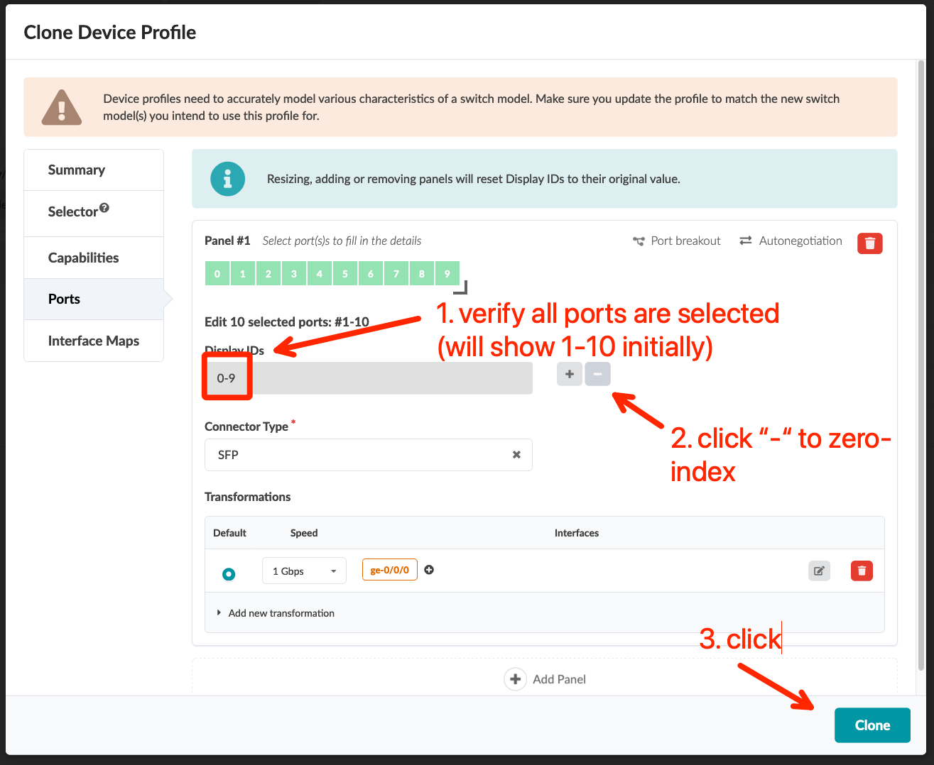
Virtual Device Profile Cloning
From the Device Profile view showing the 4 predefined virtual Juniper switch Device Profiles, click the “Clone” button on the vJunos-switch row
On the Summary menu, change the name to vJunos-lab
Select the Ports menu option, scroll to the right of the port display, drag the corner bracket to the left until you have only 10 ports, then click port “1” and drag to port 10 to select all ports
Verify the Display IDs shows the 1-10 range, click the “-” to zero-index the range, then click “Clone”
OPTIONAL: Return to the Device Profiles screen, filter for v and manufacturer Juniper, and click the “Clone” button on the vJunosEvolved row
On the Summary menu, change the name to vJunosEvo-lab
Select the Ports menu option. No salvaging this one – click the “Delete” button for Panel #1, then click the "Add Panel” button
Drag the corner bracket to select 12 ports, then click port 1 to open the interface configuration
Screenshot

Slide 12
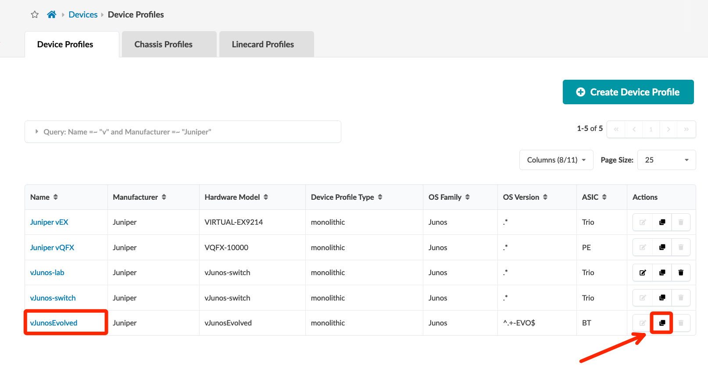
Virtual Device Profile Cloning (optional vEvo Device Profile)
From the Device Profile view showing the 4 predefined virtual Juniper switch Device Profiles, click the “Clone” button on the vJunos-switch row
On the Summary menu, change the name to vJunos-lab
Select the Ports menu option, scroll to the right of the port display, drag the corner bracket to the left until you have only 10 ports, then click port “1” and drag to port 10 to select all ports
Verify the Display IDs shows the 1-10 range, click the “-” to zero-index the range, then click “Clone”
OPTIONAL: Return to the Device Profiles screen, filter for v and manufacturer Juniper, and click the “Clone” button on the vJunosEvolved row
On the Summary menu, change the name to vJunosEvo-lab
Select the Ports menu option. No salvaging this one – click the “Delete” button for Panel #1, then click the "Add Panel” button
Drag the corner bracket to select 12 ports, then click port 1 to open the interface configuration
Screenshot

Slide 13
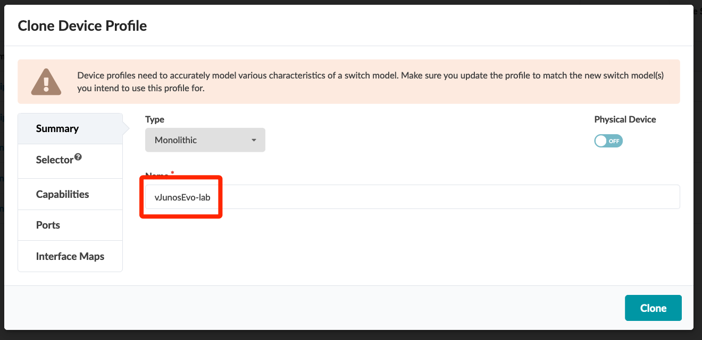
Virtual Device Profile Cloning (optional vEvo Device Profile)
From the Device Profile view showing the 4 predefined virtual Juniper switch Device Profiles, click the “Clone” button on the vJunos-switch row
On the Summary menu, change the name to vJunos-lab
Select the Ports menu option, scroll to the right of the port display, drag the corner bracket to the left until you have only 10 ports, then click port “1” and drag to port 10 to select all ports
Verify the Display IDs shows the 1-10 range, click the “-” to zero-index the range, then click “Clone”
OPTIONAL: Return to the Device Profiles screen, filter for v and manufacturer Juniper, and click the “Clone” button on the vJunosEvolved row
On the Summary menu, change the name to vJunosEvo-lab
Select the Ports menu option. No salvaging this one – click the “Delete” button for Panel #1, then click the "Add Panel” button
Drag the corner bracket to select 12 ports, then click port 1 to open the interface configuration
Screenshot

Slide 14
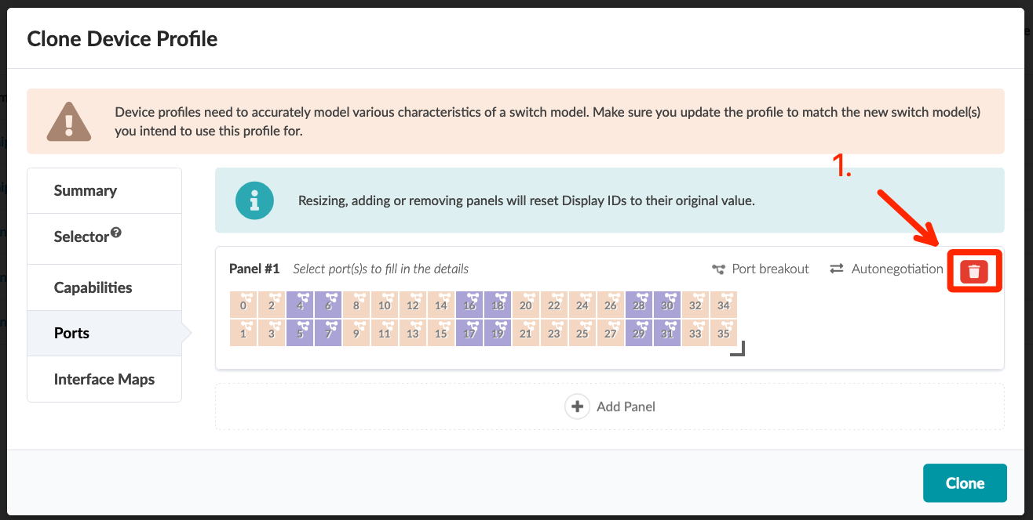
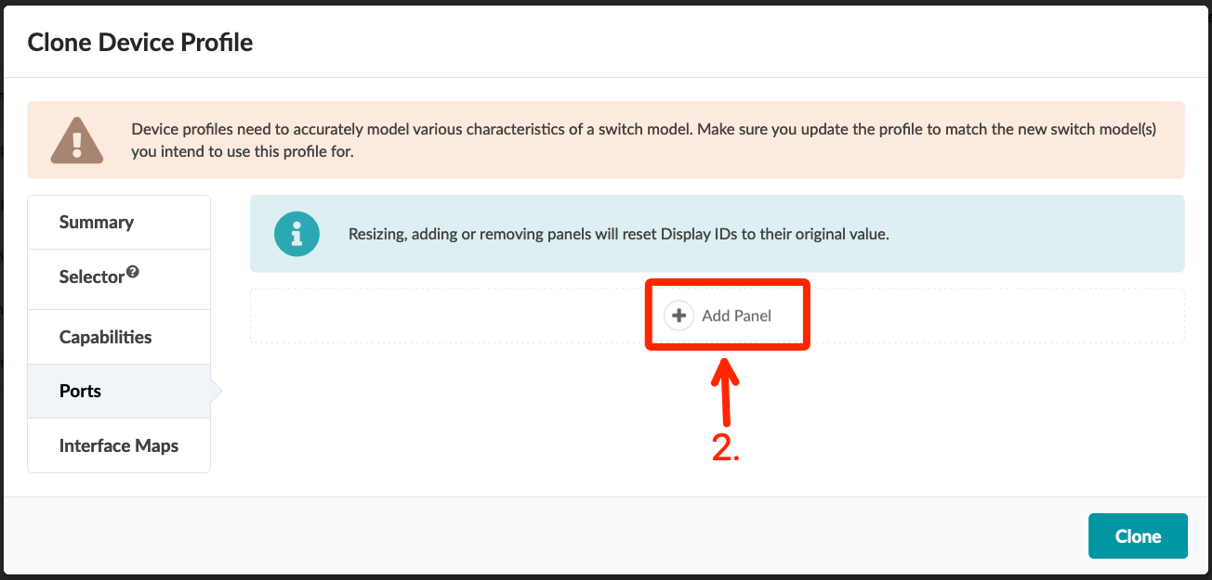
Virtual Device Profile Cloning (optional vEvo Device Profile)
From the Device Profile view showing the 4 predefined virtual Juniper switch Device Profiles, click the “Clone” button on the vJunos-switch row
On the Summary menu, change the name to vJunos-lab
Select the Ports menu option, scroll to the right of the port display, drag the corner bracket to the left until you have only 10 ports, then click port “1” and drag to port 10 to select all ports
Verify the Display IDs shows the 1-10 range, click the “-” to zero-index the range, then click “Clone”
OPTIONAL: Return to the Device Profiles screen, filter for v and manufacturer Juniper, and click the “Clone” button on the vJunosEvolved row
On the Summary menu, change the name to vJunosEvo-lab
Select the Ports menu option. No salvaging this one – click the “Delete” button for Panel #1, then click the "Add Panel” button
Drag the corner bracket to select 12 ports, then click port 1 to open the interface configuration
Screenshot

Slide 15
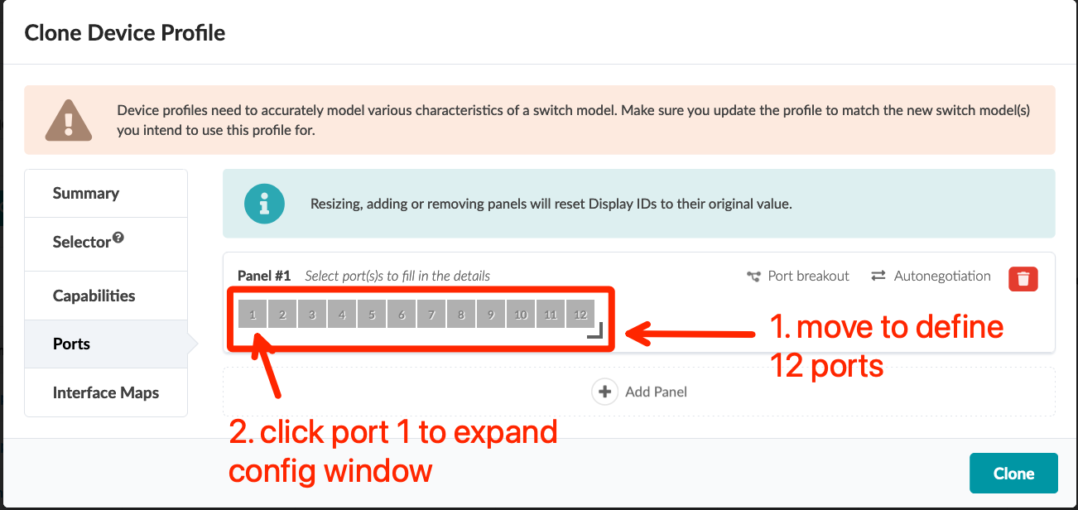
Virtual Device Profile Cloning (optional vEvo Device Profile)
From the Device Profile view showing the 4 predefined virtual Juniper switch Device Profiles, click the “Clone” button on the vJunos-switch row
On the Summary menu, change the name to vJunos-lab
Select the Ports menu option, scroll to the right of the port display, drag the corner bracket to the left until you have only 10 ports, then click port “1” and drag to port 10 to select all ports
Verify the Display IDs shows the 1-10 range, click the “-” to zero-index the range, then click “Clone”
OPTIONAL: Return to the Device Profiles screen, filter for v and manufacturer Juniper, and click the “Clone” button on the vJunosEvolved row
On the Summary menu, change the name to vJunosEvo-lab
Select the Ports menu option. No salvaging this one – click the “Delete” button for Panel #1, then click the "Add Panel” button
Drag the corner bracket to select 12 ports, then click port 1 to open the interface configuration
Screenshot

Slide 16
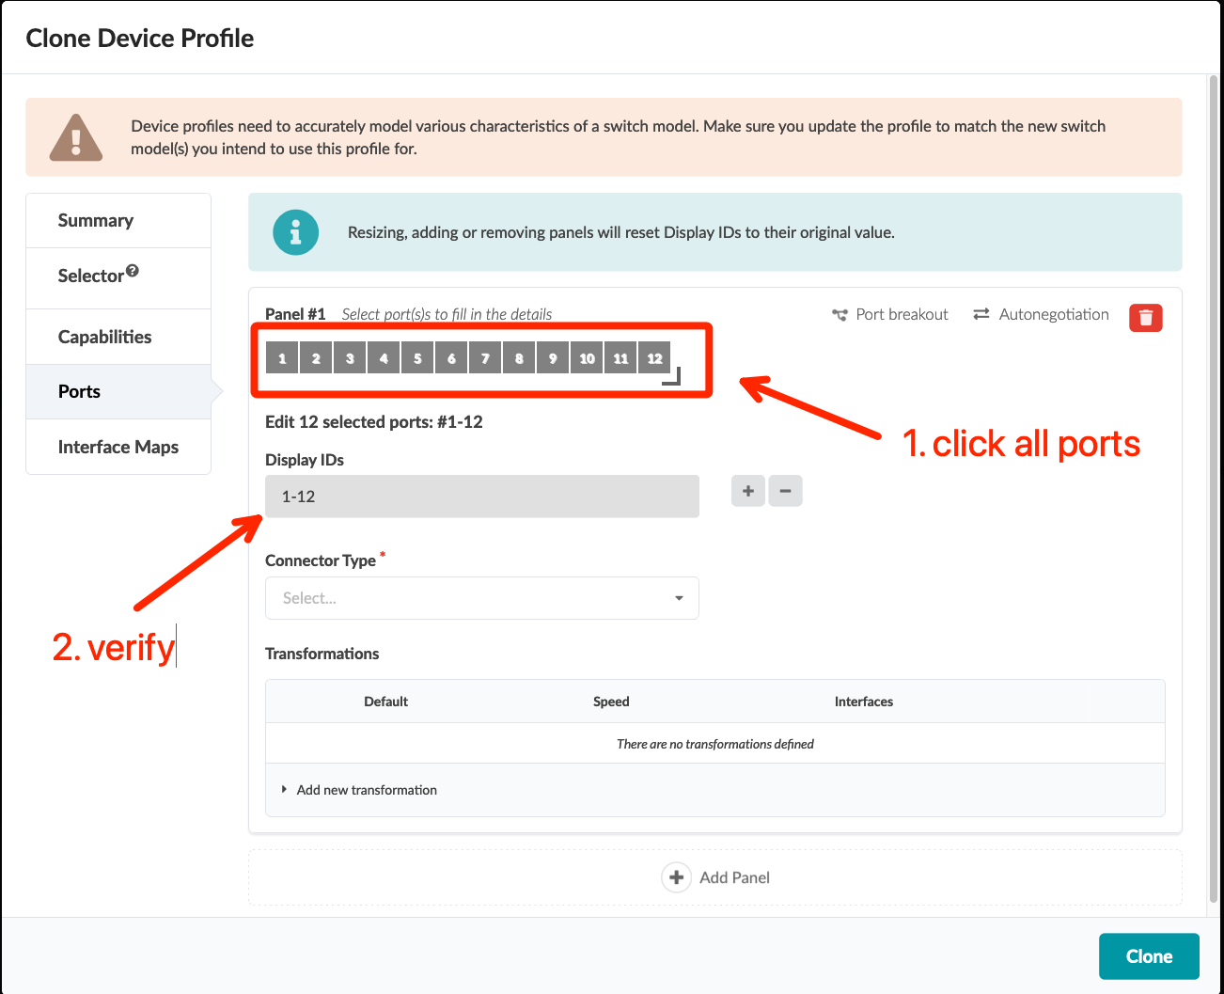
Virtual Device Profile Cloning (optional vEvo Device Profile)
…continued…
Use your mouse to click each of the 12 ports so your Display ID box has the range “1-12”
Click the “-” (minus) button next to Display IDs to zero-index all interfaces
Set the Connector Type to QSFP28
Click the Add new transformation menu arrow and add the following information
Speed: 100 Gbps
Name template: et-0/0/<display_id>
and click the “Add Transformation” button
click the “Edit” button, replace the text in the Setting column with the following…
{"global": {"speed": ""}, "interface": {"speed": ""}}
…then click the “Save” button
Click the “Clone” button
Screenshot

Slide 17
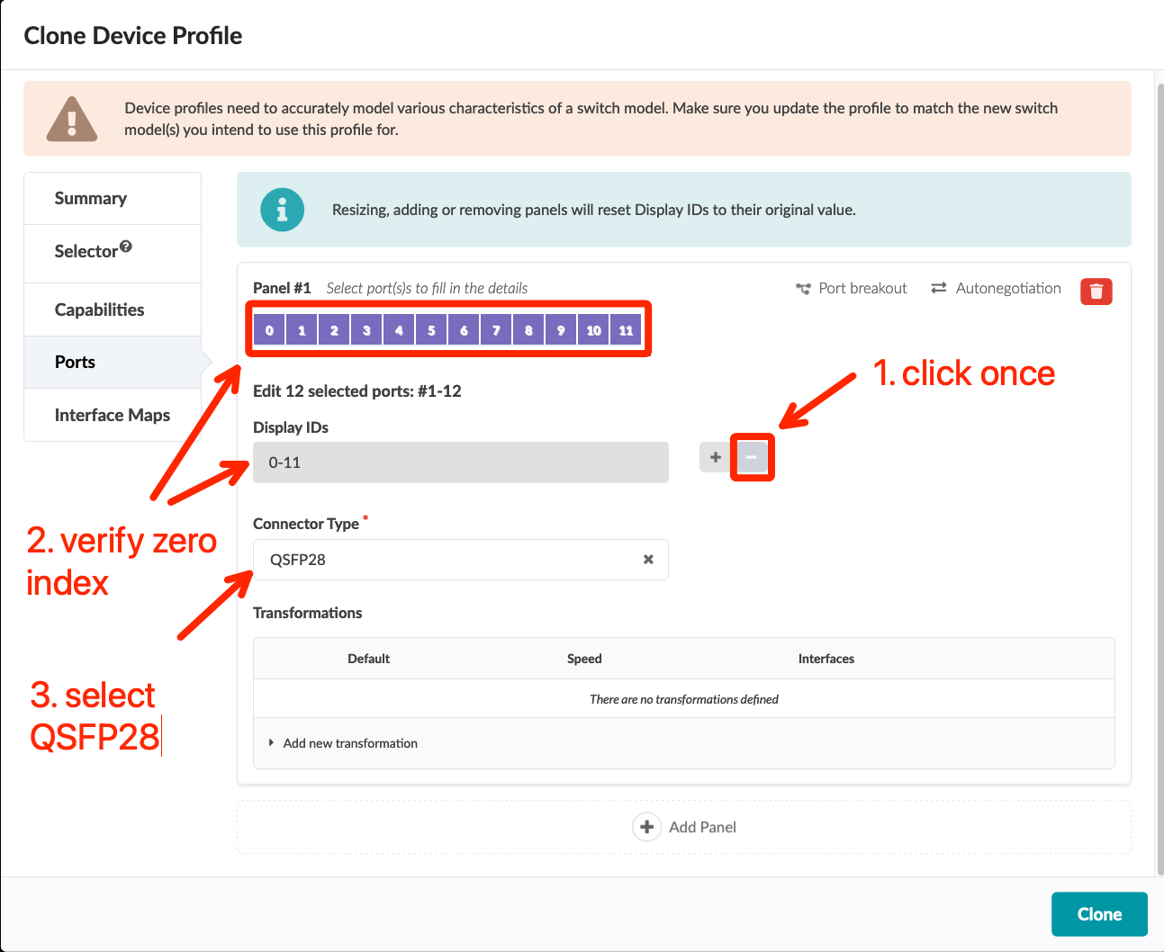
Virtual Device Profile Cloning (optional vEvo Device Profile)
…continued…
Use your mouse to click each of the 12 ports so your Display ID box has the range “1-12”
Click the “-” (minus) button next to Display IDs to zero-index all interfaces
Set the Connector Type to QSFP28
Click the Add new transformation menu arrow and add the following information
Speed: 100 Gbps
Name template: et-0/0/<display_id>
and click the “Add Transformation” button
click the “Edit” button, replace the text in the Setting column with the following…
{"global": {"speed": ""}, "interface": {"speed": ""}}
…then click the “Save” button
Click the “Clone” button
Screenshot

Slide 18
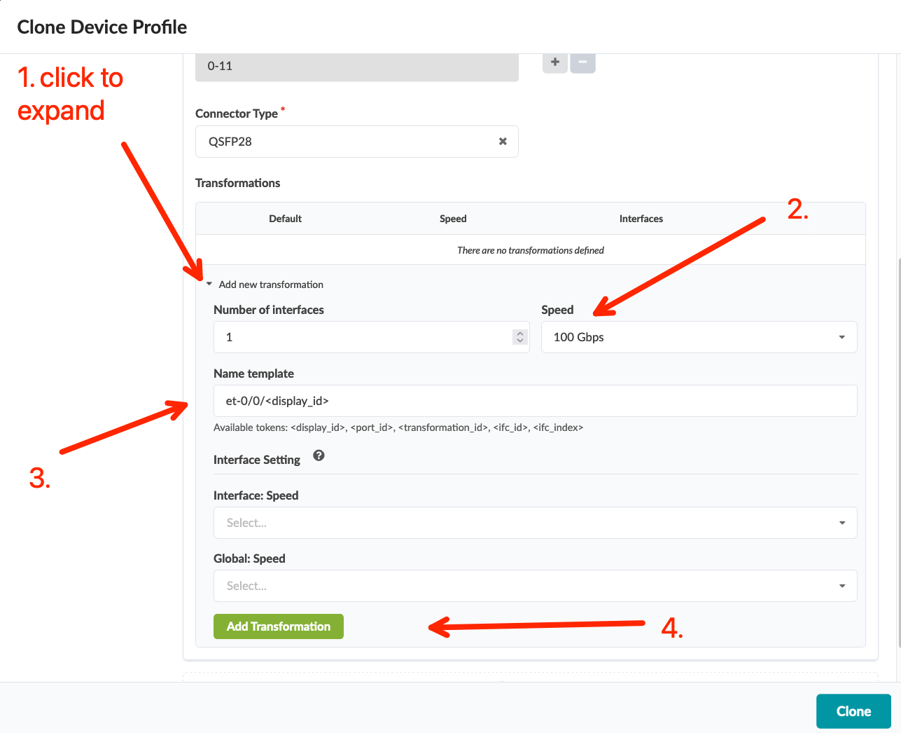
Virtual Device Profile Cloning (optional vEvo Device Profile)
…continued…
Use your mouse to click each of the 12 ports so your Display ID box has the range “1-12”
Click the “-” (minus) button next to Display IDs to zero-index all interfaces
Set the Connector Type to QSFP28
Click the Add new transformation menu arrow and add the following information
Speed: 100 Gbps
Name template: et-0/0/<display_id>
and click the “Add Transformation” button
click the “Edit” button, replace the text in the Setting column with the following…
{"global": {"speed": ""}, "interface": {"speed": ""}}
…then click the “Save” button
Click the “Clone” button
Screenshot

Slide 19
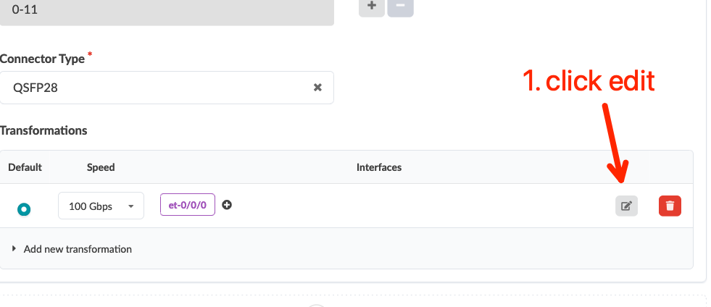
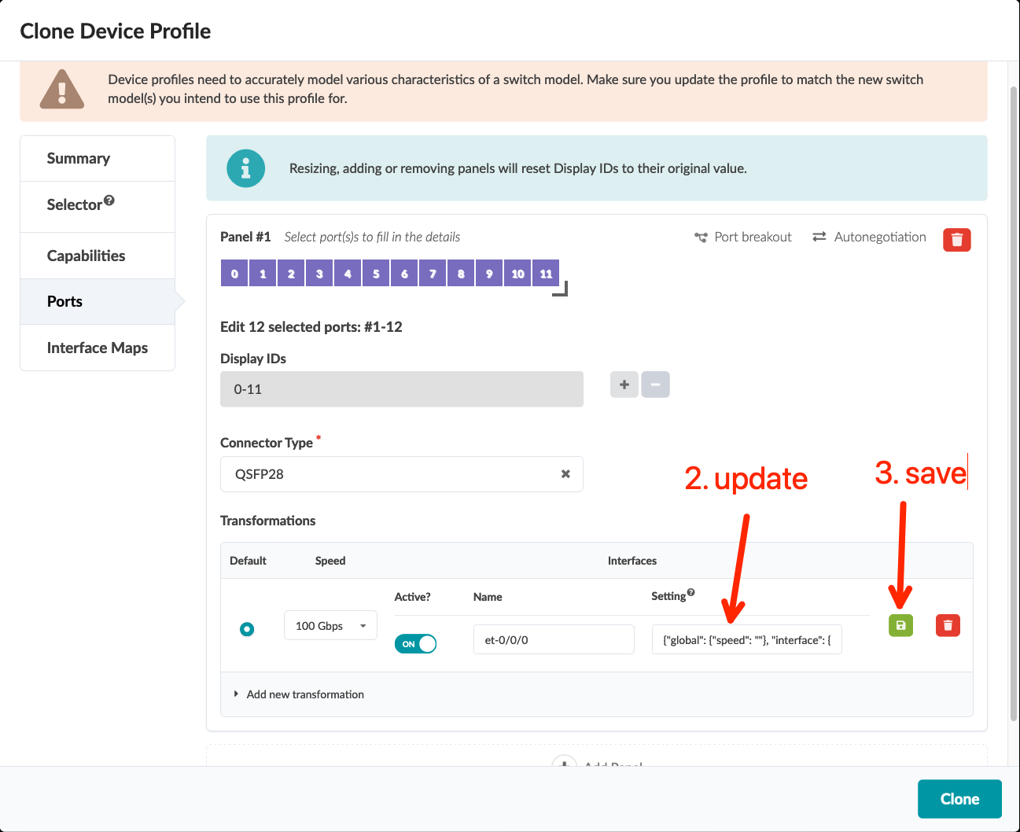
Virtual Device Profile Cloning (optional vEvo Device Profile)
…continued…
Use your mouse to click each of the 12 ports so your Display ID box has the range “1-12”
Click the “-” (minus) button next to Display IDs to zero-index all interfaces
Set the Connector Type to QSFP28
Click the Add new transformation menu arrow and add the following information
Speed: 100 Gbps
Name template: et-0/0/<display_id>
and click the “Add Transformation” button
click the “Edit” button, replace the text in the Setting column with the following…
{"global": {"speed": ""}, "interface": {"speed": ""}}
…then click the “Save” button
Click the “Clone” button
Screenshot

Slide 20
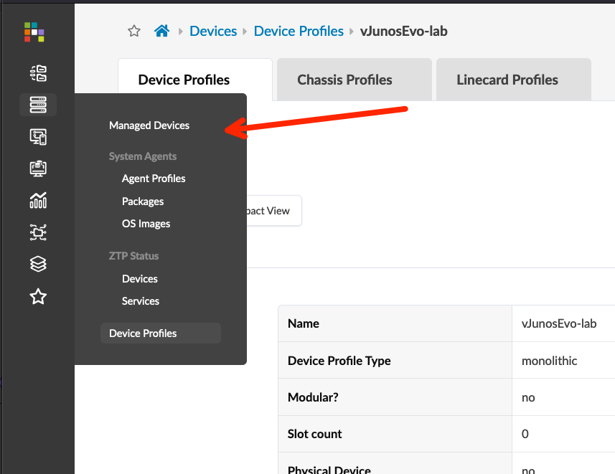
Onboarding Virtual Nodes
We will be deploying off-box agents to our virtual nodes. Navigate to Managed Devices under the Devices menu
Click the “Create Offbox Agent(s)” button
Add the fabric management IP ranges, select Junos as the platform, update the username/password to be aosadmin/Juniper, then click the “Create” button
Wait 5 minutes or so while agents install. You should see the Job State as IN PROGRESS during this time
When the Job State is SUCCESS, click the “check-all” box to select all nodes, click the “Acknowledge selected systems” button, then click the “Confirm” button on the confirmation pop-up screen
Screenshot

Slide 21
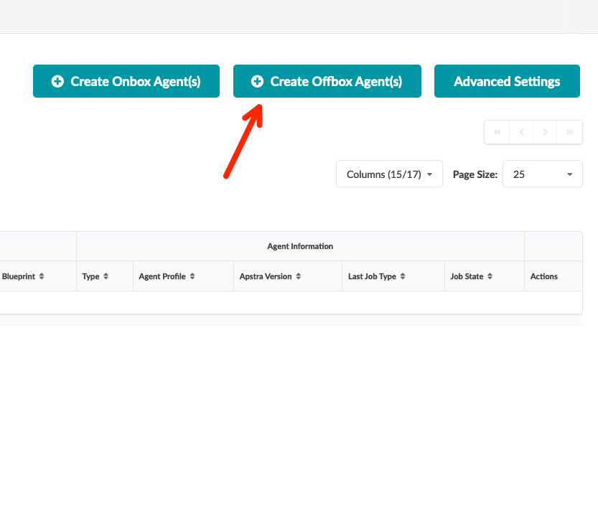
Onboarding Virtual Nodes
We will be deploying off-box agents to our virtual nodes. Navigate to Managed Devices under the Devices menu
Click the “Create Offbox Agent(s)” button
Add the fabric management IP ranges, select Junos as the platform, update the username/password to be aosadmin/Juniper, then click the “Create” button
Wait 5 minutes or so while agents install. You should see the Job State as IN PROGRESS during this time
When the Job State is SUCCESS, click the “check-all” box to select all nodes, click the “Acknowledge selected systems” button, then click the “Confirm” button on the confirmation pop-up screen
Screenshot

Slide 22
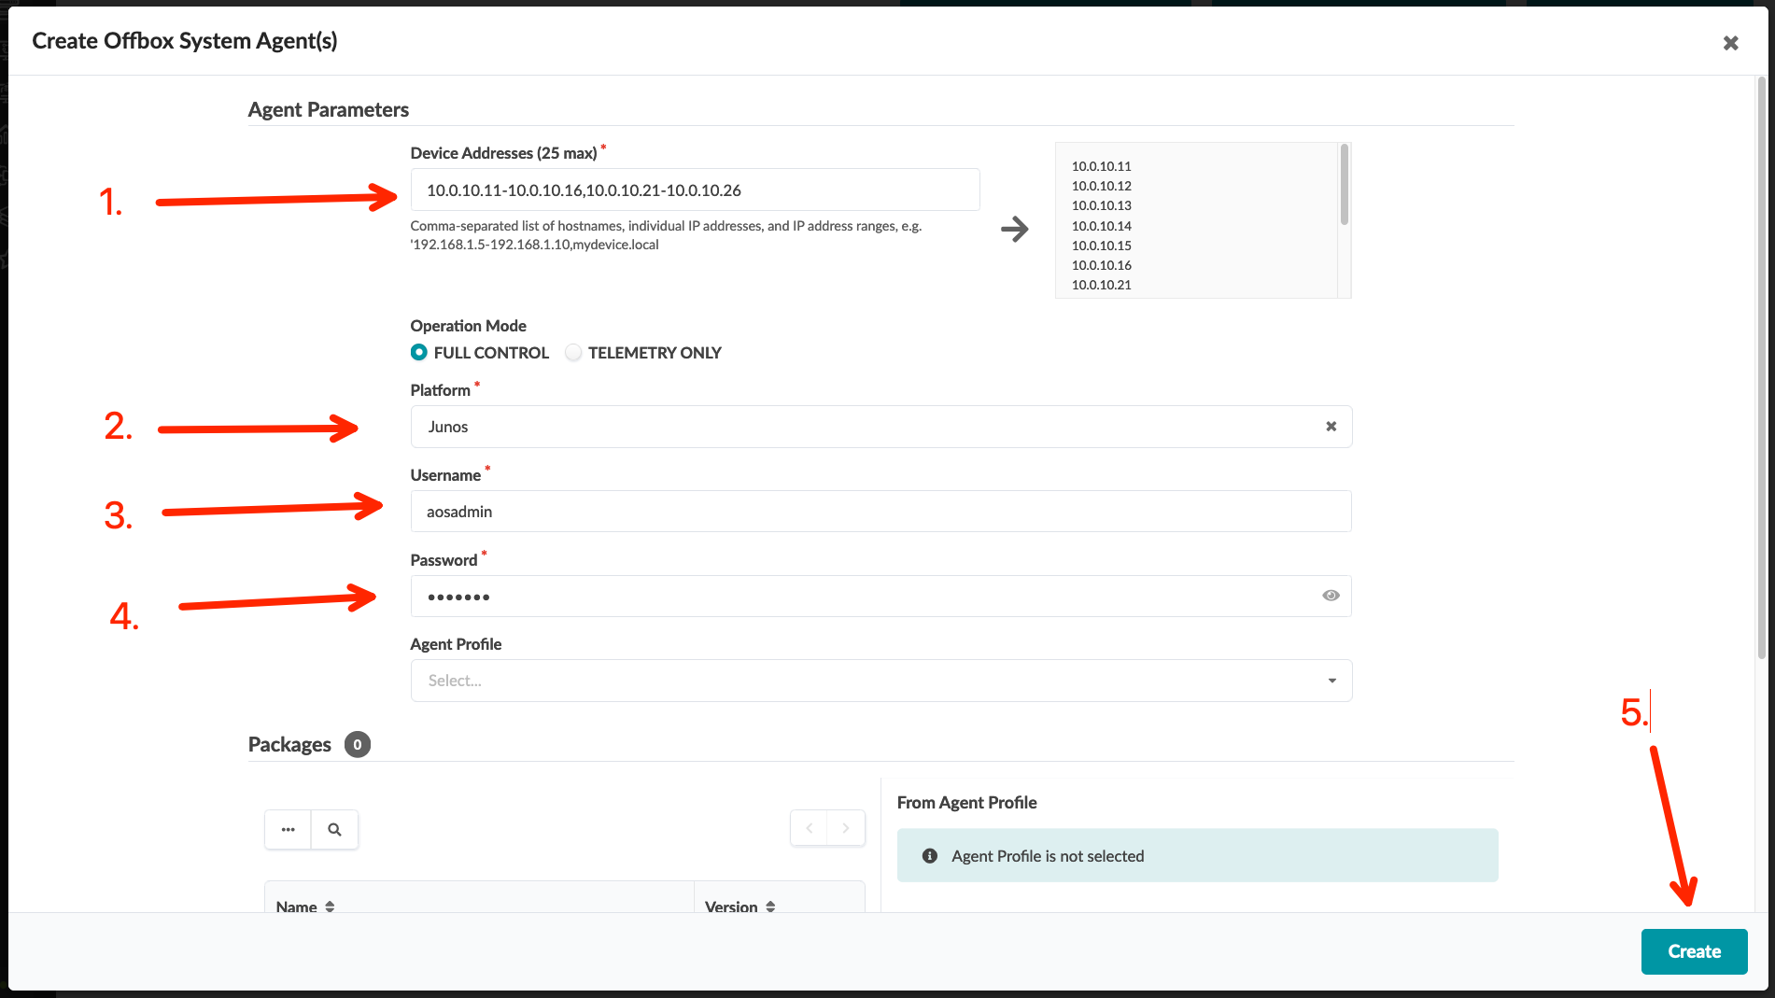
Onboarding Virtual Nodes
We will be deploying off-box agents to our virtual nodes. Navigate to Managed Devices under the Devices menu
Click the “Create Offbox Agent(s)” button
Add the fabric management IP ranges, select Junos as the platform, update the username/password to be aosadmin/Juniper, then click the “Create” button
Wait 5 minutes or so while agents install. You should see the Job State as IN PROGRESS during this time
When the Job State is SUCCESS, click the “check-all” box to select all nodes, click the “Acknowledge selected systems” button, then click the “Confirm” button on the confirmation pop-up screen
Screenshot

Slide 23
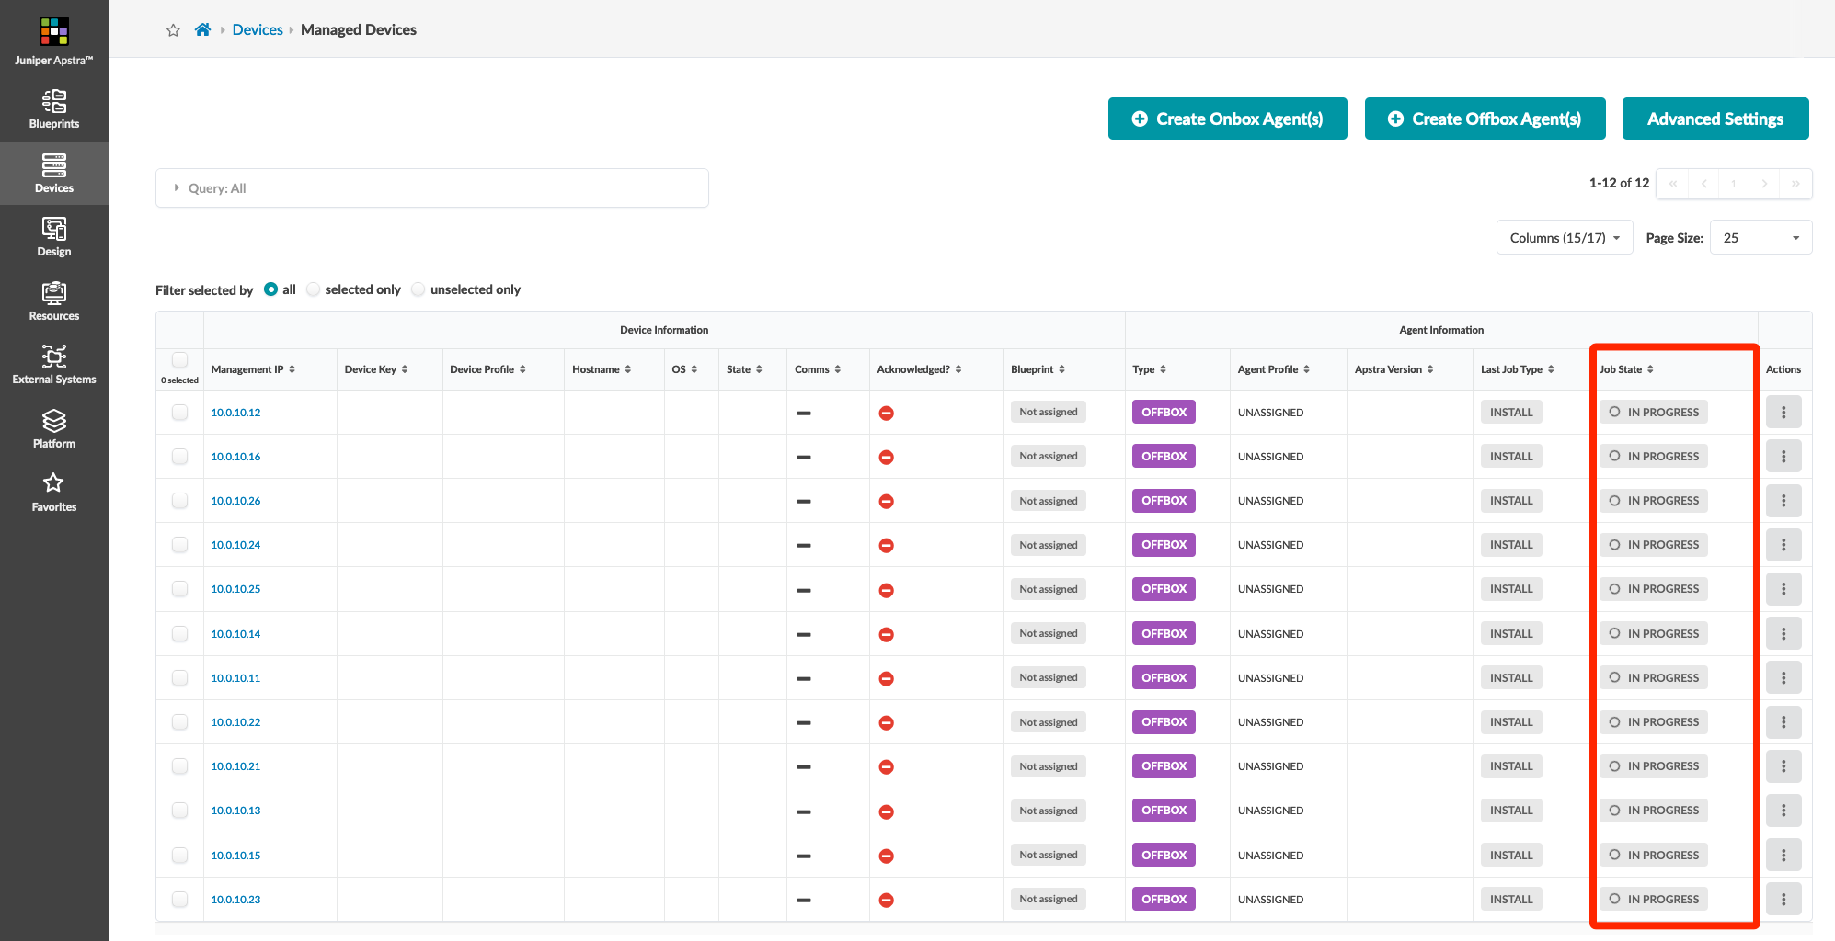
Onboarding Virtual Nodes
We will be deploying off-box agents to our virtual nodes. Navigate to Managed Devices under the Devices menu
Click the “Create Offbox Agent(s)” button
Add the fabric management IP ranges, select Junos as the platform, update the username/password to be aosadmin/Juniper, then click the “Create” button
Wait 5 minutes or so while agents install. You should see the Job State as IN PROGRESS during this time
When the Job State is SUCCESS, click the “check-all” box to select all nodes, click the “Acknowledge selected systems” button, then click the “Confirm” button on the confirmation pop-up screen
Screenshot

Slide 24
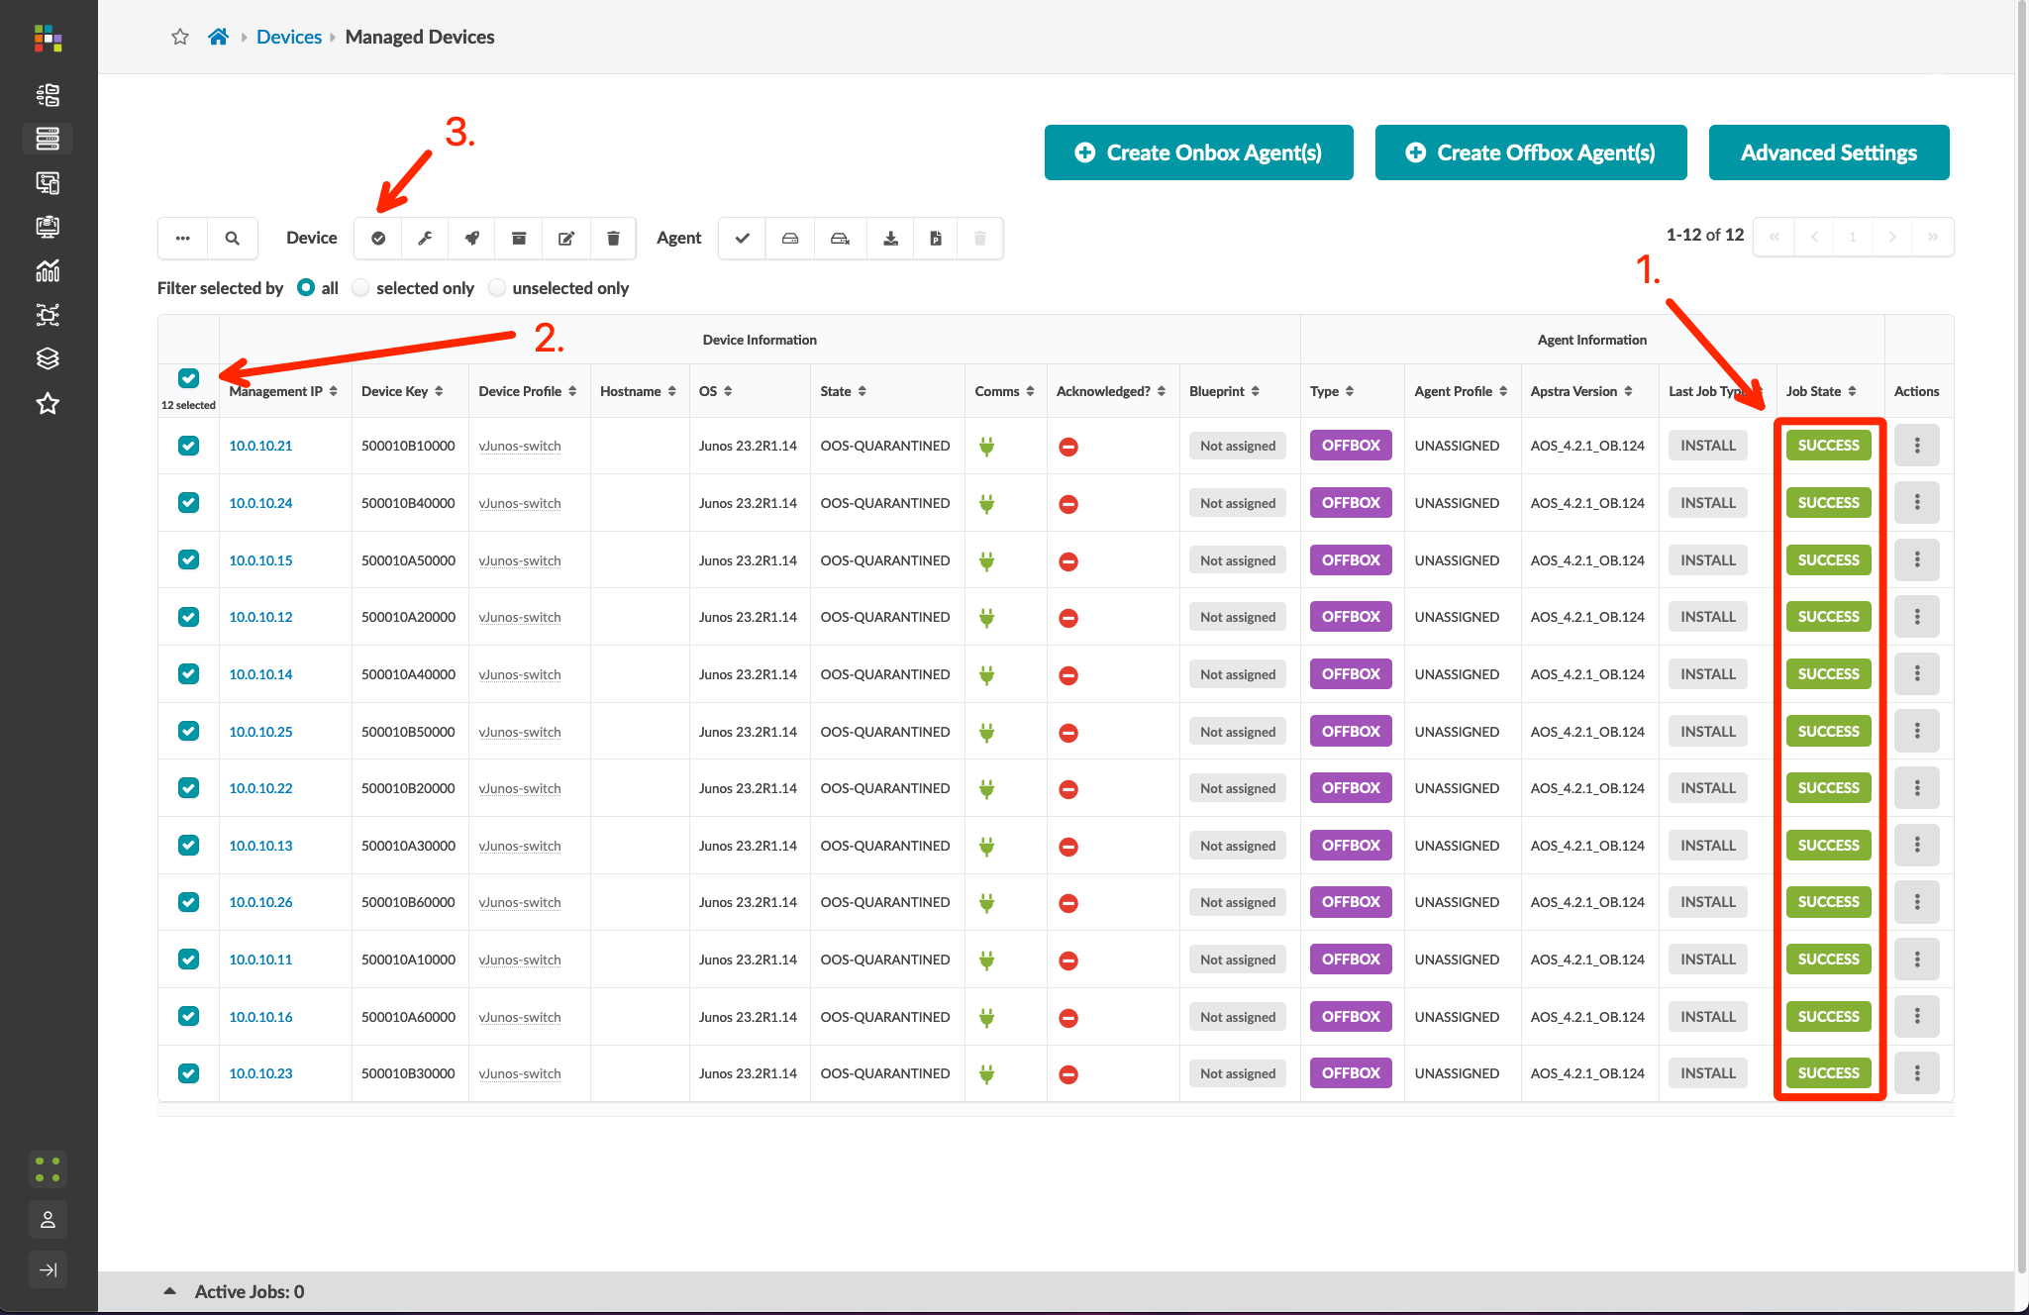
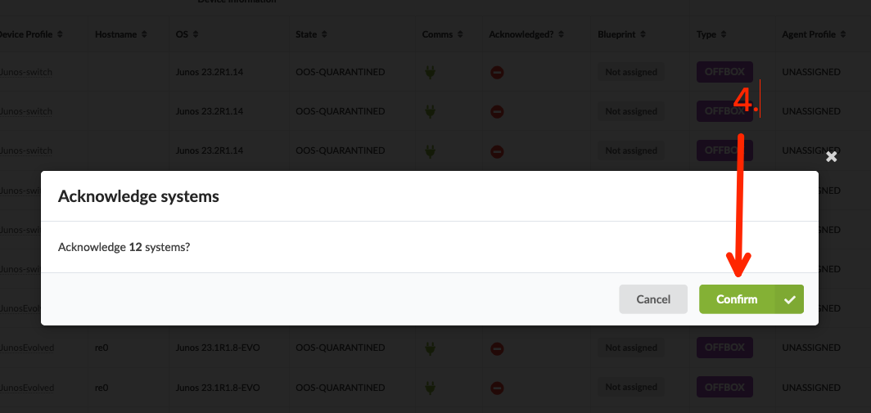
Onboarding Virtual Nodes
We will be deploying off-box agents to our virtual nodes. Navigate to Managed Devices under the Devices menu
Click the “Create Offbox Agent(s)” button
Add the fabric management IP ranges, select Junos as the platform, update the username/password to be aosadmin/Juniper, then click the “Create” button
Wait 5 minutes or so while agents install. You should see the Job State as IN PROGRESS during this time
When the Job State is SUCCESS, click the “check-all” box to select all nodes, click the “Acknowledge selected systems” button, then click the “Confirm” button on the confirmation pop-up screen

Slide 25
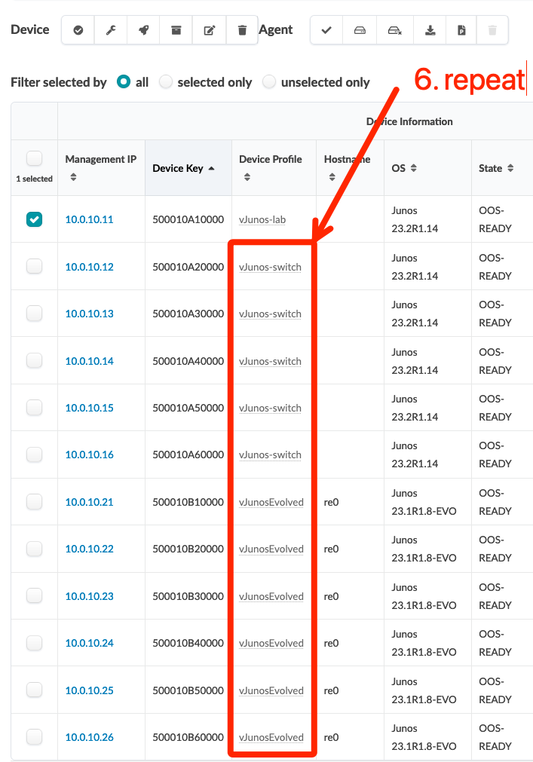
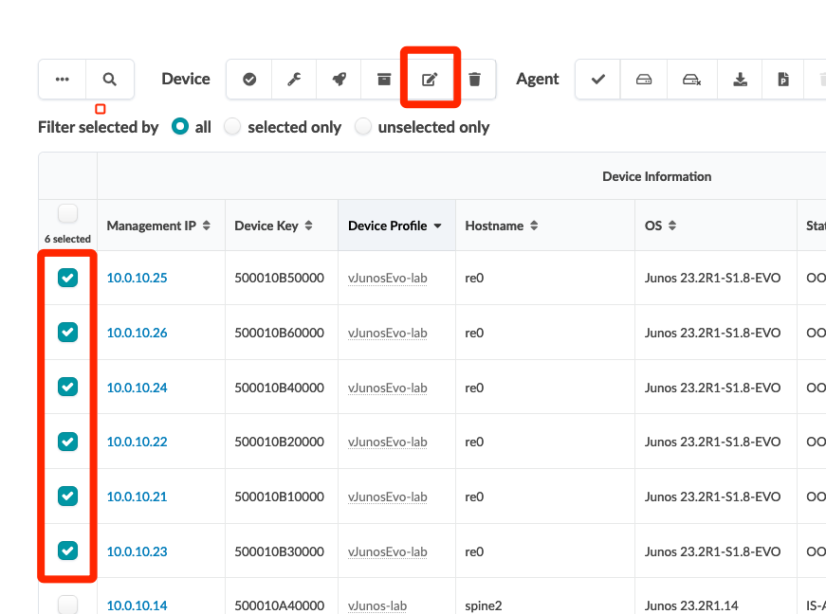
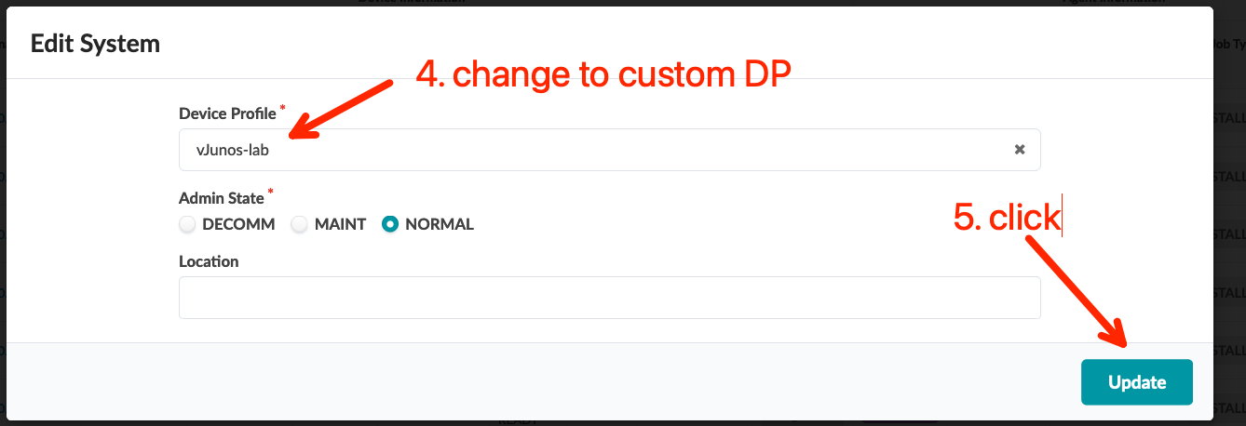
Onboarding Virtual Nodes
Update the Device Profile to match the profiles created in the last section:
Change vJunos-switch profiles to vJunos-lab
Change vJunosEvolved profiles to vEvo-lab if using vEvo
NOTE: You can update multiple agent Device Profiles at the same time by checking the boxes next to the devices you want to update, then clicking the “edit” button in the Device section.

Slide 26
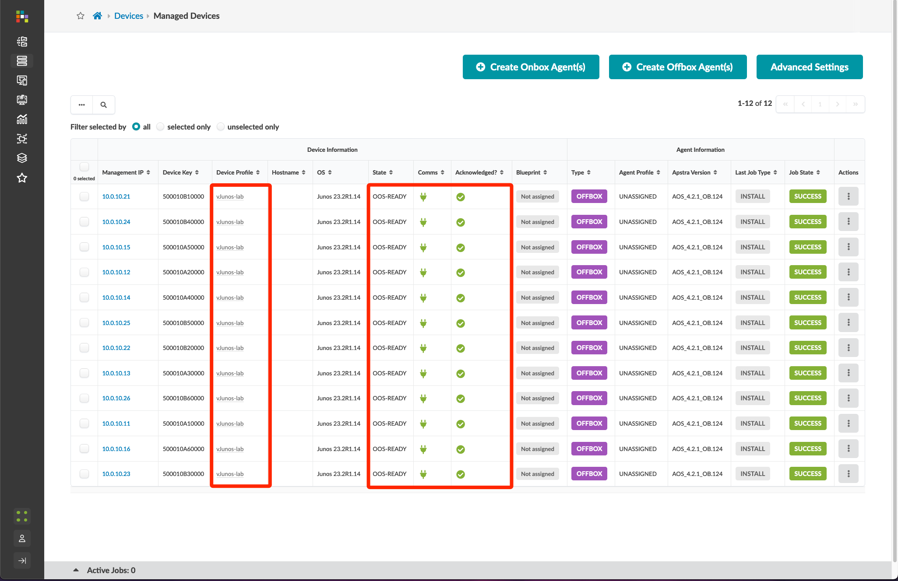
Onboarding Virtual Nodes - Verification

