Slide 1
Juniper Apstra 4.2.1 EVE-NG Virtual Lab Demo Video series companion guide Video 6: Day-1 Deploying Testing Hosts
Colin Doyle, Sr. CE AMER
See the complete video walkthrough on YouTube at: https://www.youtube.com/@5minutejunos
Ask questions at the Juniper Elevate Community using the hashtag #5minutejunos
Adapted from v4.0.0 documentation originally compiled by: - Raymond Lam, SSE APAC - Tony Chan, SSE APAC

Slide 2
Agenda
Prepping your Lab
Day-0 Fabric Onboarding
Virtual Device Profile Verification
Virtual Device Profile Cloning
Onboarding Virtual Nodes
Create ASN Pool and IP Pools
Create Logical Devices and Interface Maps
Create Rack Types
Create Templates
Create Blueprints
Day-1 Service Provisioning
Create Routing Zones
Create Virtual Networks
Assign Virtual Network to Switchports
Add Server Links
Data Center Interconnect
DCI Addendum: Direct Peering
Core/WAN Connectivity
Internet Connectivity
Day-2 Operational Scenarios
Incorrect Cable Patch (RCA, LLDP Link Discovery, Time Voyager)
Config Deviation Checking
Apply custom config through Configlet
View Telemetry Data
Hardware Replacement
Future Documentation
Firewall Service Chaining
Cluster with Service Block
Type-5 Route (fabric integrated) with MNHA
VLAN Stitching
vEvo Fabric

Slide 3
Day-1 Service Provisioning
Create Routing Zones
Create Virtual Networks
Assign Virtual Network to Switchports
Add Testing Hosts
Data Center Interconnect (OTT)
DCI Addendum – Direct Peering
Core Connectivity
Internet Connectivity

Slide 4
Add Testing Hosts
In this section, we’ll boot and configure our vSRX LAG bridge nodes, our uMate hosts, and run some tests to verify connectivity.
Below diagram illustrates the topology of the data center after this section.
DC-A Blueprint
Tenant-1 Routing Zone
DC-B Blueprint
Tenant-1 Routing Zone
ae1
vn101 (192.168.101.0/24)
ae1
vn101 (192.168.101.0/24)
vn102 (192.168.102.0/24)
ae2
vn103 (192.168.103.0/24)
ae2
To A-leaf1
ge-0/0/7
To A-leaf2
ge-0/0/7
To A-leaf1
ge-0/0/8
To A-leaf2
ge-0/0/8
To A-leaf1
ge-0/0/9
To B-leaf1
ge-0/0/7
To B-leaf2
ge-0/0/7
To B-leaf1
ge-0/0/8
To B-leaf2
ge-0/0/8
uMate
A-bms-1_bridge
A-bms-2_bridge
A-bms-3
B-bms-1_bridge
B-bms-2_bridge
vSRX
vSRX
192.168.101.33
vSRX
vSRX
uMate
uMate
uMate
uMate
A-bms-1
A-bms-2
B-bms-1
B-bms-2
192.168.101.11
192.168.102.22
192.168.101.44
192.168.103.55

Slide 5
Add Testing Hosts – Configure vSRX Nodes
Boot and configure A-BMS-1_Bridge, A-BMS-2_Bridge, B-BMS-1_Bridge, and B-BMS-2_Bridge vSRX nodes
Boot and configure A-BMS-1, A-BMS-2, A-BMS-3, B-BMS-1, and B-BMS-2 uMate hosts
Test reachability between uMate hosts

Slide 6
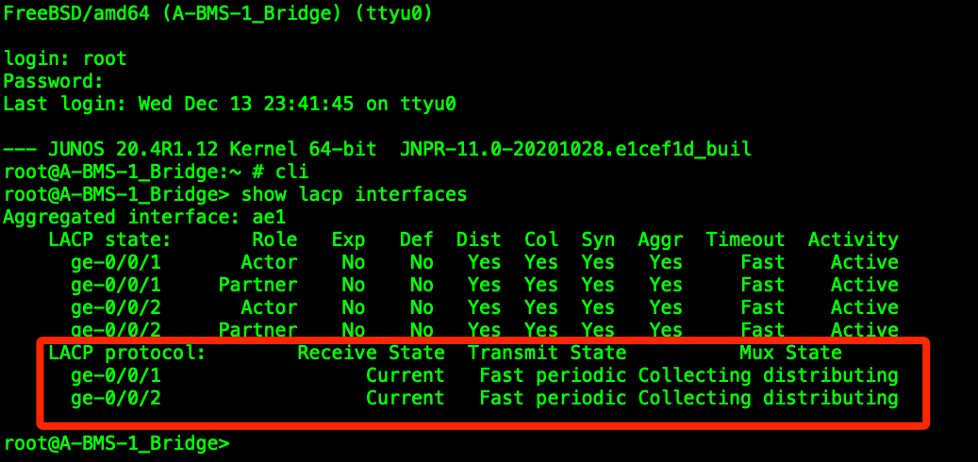
Add Testing Hosts – Configure vSRX Nodes
Boot and configure A-BMS-1_Bridge, A-BMS-2_Bridge, B-BMS-1, and B-BMS-2 vSRX nodes
A-BMS-1_Bridge
Login with root, enter cli, and enter configuration mode
set system root-authentication plain-text-password set password to Juniper
set system host-name A-BMS-1_Bridge
delete security
set security forwarding-options family mpls mode packet-based
set security forwarding-options family inet6 mode packet-based
set interfaces ge-0/0/0 description A-BMS-1
set interfaces ge-0/0/0.0 family ethernet-switching interface-mode access
set interfaces ge-0/0/1 description ae1 gigether-options 802.3ad ae1
copy interfaces ge-0/0/1 to ge-0/0/2
set chassis aggregated-devices ethernet device-count 3
set interfaces ae1 aggregated-ether-options lacp active
set interfaces ae1.0 family ethernet-switching interface-mode access
commit and-quit
request system reboot at now
Login with root/Juniper, enter cli, and check LACP with show lacp interfaces

Slide 7
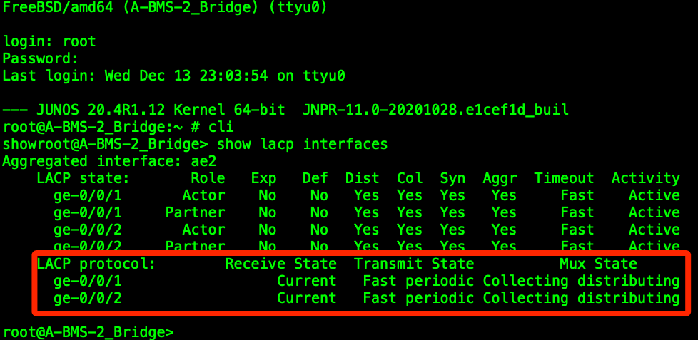
Add Testing Hosts – Configure vSRX Nodes
Boot and configure A-BMS-1_Bridge, A-BMS-2_Bridge, B-BMS-1, and B-BMS-2 vSRX nodes
A-BMS-2_Bridge
Login with root, enter cli, and enter configuration mode
set system root-authentication plain-text-password set password to Juniper
set system host-name A-BMS-2_Bridge
delete security
set security forwarding-options family mpls mode packet-based
set security forwarding-options family inet6 mode packet-based
set interfaces ge-0/0/0 description A-BMS-2
set interfaces ge-0/0/0.0 family ethernet-switching interface-mode access
set interfaces ge-0/0/1 description ae2 gigether-options 802.3ad ae2
copy interfaces ge-0/0/1 to ge-0/0/2
set chassis aggregated-devices ethernet device-count 3
set interfaces ae2 aggregated-ether-options lacp active
set interfaces ae2.0 family ethernet-switching interface-mode access
commit and-quit
request system reboot at now
Login with root/Juniper, enter cli, and check LACP with show lacp interfaces

Slide 8
Add Testing Hosts – Configure vSRX Nodes
Boot and configure A-BMS-1_Bridge, A-BMS-2_Bridge, B-BMS-1, and B-BMS-2 vSRX nodes
B-BMS-1_Bridge
Login with root, enter cli, and enter configuration mode
set system root-authentication plain-text-password set password to Juniper
set system host-name B-BMS-1_Bridge
delete security
set security forwarding-options family mpls mode packet-based
set security forwarding-options family inet6 mode packet-based
set interfaces ge-0/0/0 description B-BMS-1
set interfaces ge-0/0/0.0 family ethernet-switching interface-mode access
set interfaces ge-0/0/1 description ae1 gigether-options 802.3ad ae1
copy interfaces ge-0/0/1 to ge-0/0/2
set chassis aggregated-devices ethernet device-count 3
set interfaces ae1 aggregated-ether-options lacp active
set interfaces ae1.0 family ethernet-switching interface-mode access
commit and-quit
request system reboot at now
Login with root/Juniper, enter cli, and check LACP with show lacp interfaces

Slide 9
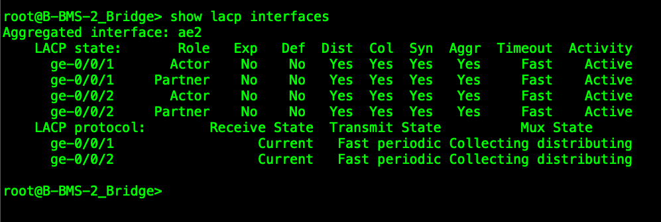
Add Testing Hosts – Configure vSRX Nodes
Boot and configure A-BMS-1_Bridge, A-BMS-2_Bridge, B-BMS-1, and B-BMS-2 vSRX nodes
B-BMS-2_Bridge
Login with root, enter cli, and enter configuration mode
set system root-authentication plain-text-password set password to Juniper
set system host-name B-BMS-2_Bridge
delete security
set security forwarding-options family mpls mode packet-based
set security forwarding-options family inet6 mode packet-based
set interfaces ge-0/0/0 description B-BMS-2
set interfaces ge-0/0/0.0 family ethernet-switching interface-mode access
set interfaces ge-0/0/1 description ae2 gigether-options 802.3ad ae2
copy interfaces ge-0/0/1 to ge-0/0/2
set chassis aggregated-devices ethernet device-count 3
set interfaces ae2 aggregated-ether-options lacp active
set interfaces ae2.0 family ethernet-switching interface-mode access
commit and-quit
request system reboot at now
Login with root/Juniper, enter cli, and check LACP with show lacp interfaces

Slide 10
Add Testing Hosts – Configure uMate Hosts
Boot and configure A-BMS-1_Bridge and A-BMS-2_Bridge vSRX nodes
Boot and configure A-BMS-1, A-BMS-2, A-BMS-3, B-BMS-1, and B-BMS-2 uMate hosts
Test reachability between uMate hosts

Slide 11
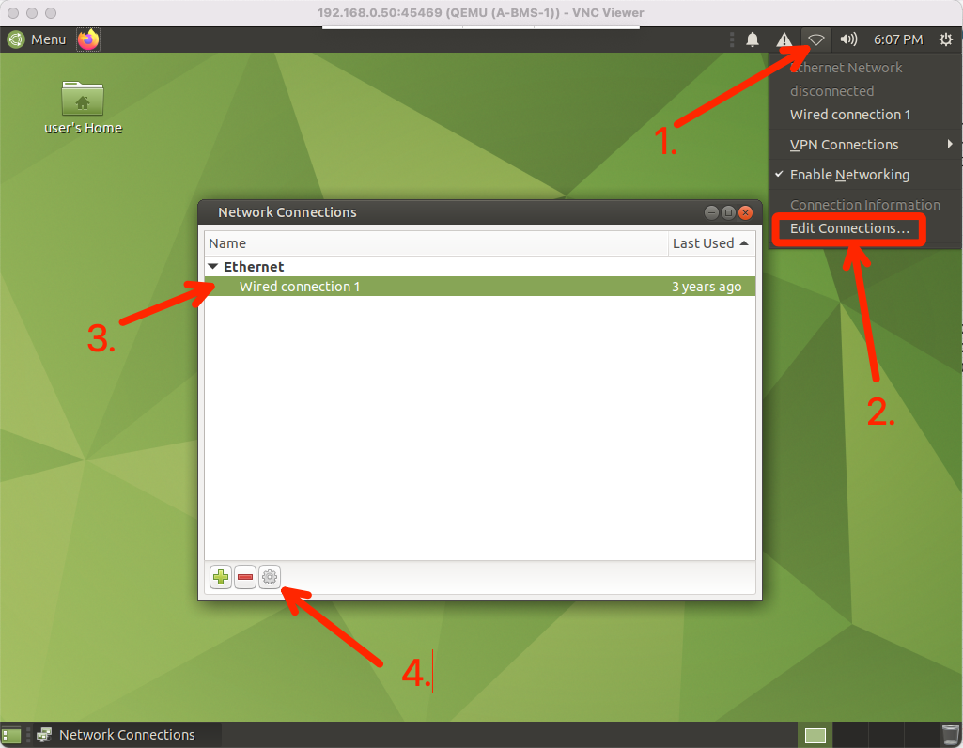
Add Testing Hosts – Configure uMate Hosts
NOTE: I was seeing RFB errors until I set VNC_Viewer to “Picture quality = Medium” and “Scaling = Scale to fit window”.
Boot A-BMS-1, A-BMS-2, A-BMS-3, B-BMS-1, and B-BMS-2 uMate hosts
Configure hosts using the table below
Login with user/Test123
Edit ”Wired connection 1”
Configure IPv4 Settings I intend to connect the lab to the public Internet so I’m including a public DNS server – you can change or omit as it suits your needs.
Host Name | IP Address/CIDR | Default Gateway | Virtual Network (reference only)
A-BMS-1 | 192.168.101.11/24 | 192.168.101.1 | vn101
A-BMS-2 | 192.168.102.22/24 | 192.168.102.1 | vn102
A-BMS-3 | 192.168.101.33/24 | 192.168.101.1 | vn101
B-BMS-1 | 192.168.101.44/24 | 192.168.101.1 | vn101
B-BMS-2 | 192.168.103.55/24 | 192.168.103.1 | vn103

Slide 12
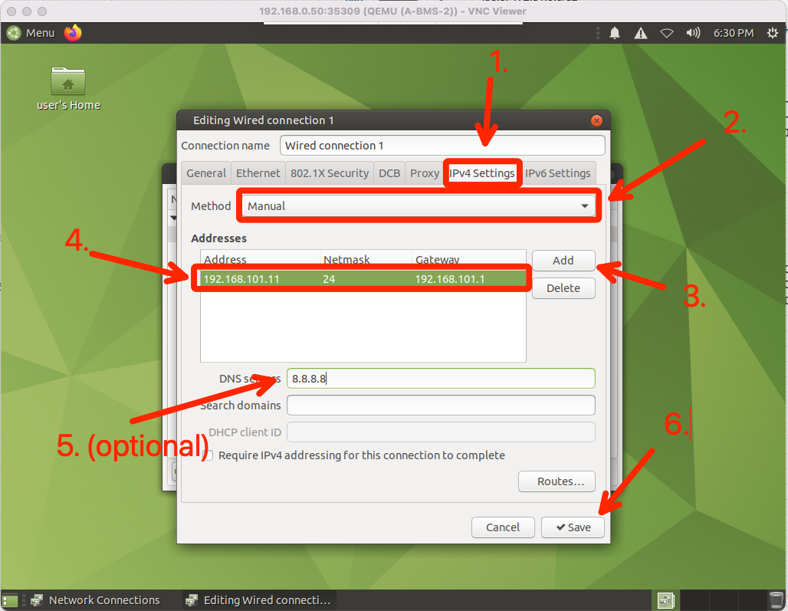
Add Testing Hosts – Configure uMate Hosts
Boot A-BMS-1, A-BMS-2, A-BMS-3, B-BMS-1, and B-BMS-2 uMate hosts
Configure hosts using the table below
Login with user/Test123
Edit ”Wired connection 1”
Configure IPv4 Settings I intend to connect the lab to the public Internet so I’m including a public DNS server – you can change or omit as it suits your needs.
Host Name | IP Address/CIDR | Default Gateway | Virtual Network (reference only)
A-BMS-1 | 192.168.101.11/24 | 192.168.101.1 | vn101
A-BMS-2 | 192.168.102.22/24 | 192.168.102.1 | vn102
A-BMS-3 | 192.168.101.33/24 | 192.168.101.1 | vn101
B-BMS-1 | 192.168.101.44/24 | 192.168.101.1 | vn101
B-BMS-2 | 192.168.103.55/24 | 192.168.103.1 | vn103

Slide 13
Add Testing Hosts – Configure uMate Hosts
Boot and configure A-BMS-1_Bridge and A-BMS-2_Bridge vSRX nodes
Boot and configure A-BMS-1, A-BMS-2, A-BMS-3, B-BMS-1, and B-BMS-2 uMate hosts
Test reachability between uMate hosts (within each fabric – inter-fabric testing will come at the end of the DCI section)

Slide 14
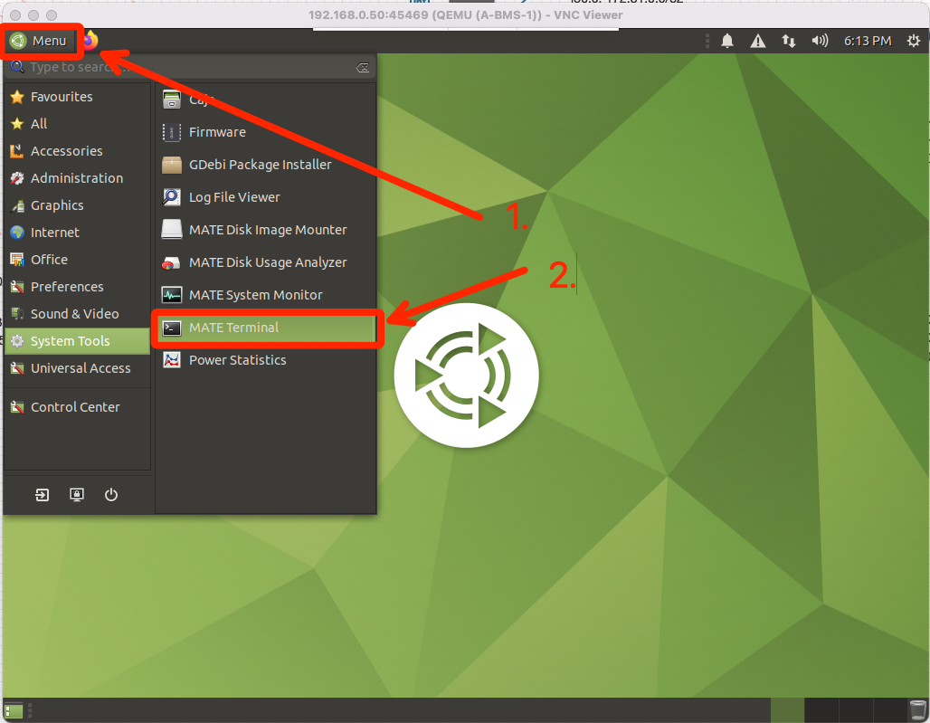
Add Testing Hosts – Configure uMate Hosts
NOTE: I like to drag the MATE Terminal icon to the desktop so it’s slightly faster to get to.
Test reachability between uMate hosts
Open the MATE Terminal
Ping the default gateway
Ping between hosts within each fabric - we’ll test inter-fabric once we finish the DCI config in the next section
Host Name | IP Address/CIDR | Default Gateway | Virtual Network (reference only)
A-BMS-1 | 192.168.101.11/24 | 192.168.101.1 | vn101
A-BMS-2 | 192.168.102.22/24 | 192.168.102.1 | vn102
A-BMS-3 | 192.168.101.33/24 | 192.168.101.1 | vn101
B-BMS-1 | 192.168.101.44/24 | 192.168.101.1 | vn101
B-BMS-2 | 192.168.103.55/24 | 192.168.103.1 | vn103

Slide 15
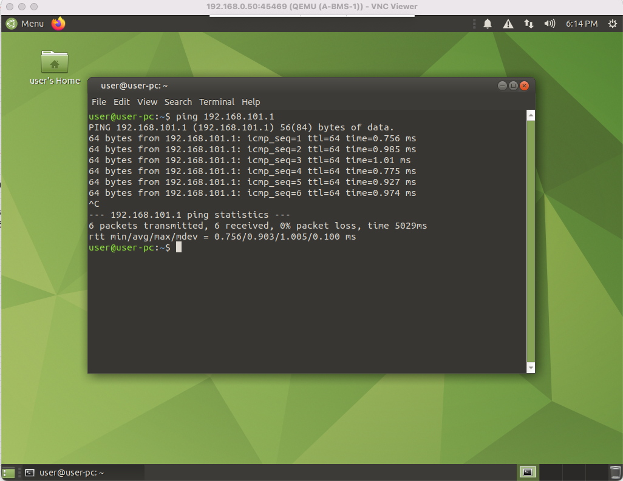
Add Testing Hosts – Configure uMate Hosts
Test reachability between uMate hosts
Open the MATE Terminal
Ping the default gateway
Ping between hosts within each fabric - we’ll test inter-fabric once we finish the DCI config in the next section
Host Name | IP Address/CIDR | Default Gateway | Virtual Network (reference only)
A-BMS-1 | 192.168.101.11/24 | 192.168.101.1 | vn101
A-BMS-2 | 192.168.102.22/24 | 192.168.102.1 | vn102
A-BMS-3 | 192.168.101.33/24 | 192.168.101.1 | vn101
B-BMS-1 | 192.168.101.44/24 | 192.168.101.1 | vn101
B-BMS-2 | 192.168.103.55/24 | 192.168.103.1 | vn103

Slide 16
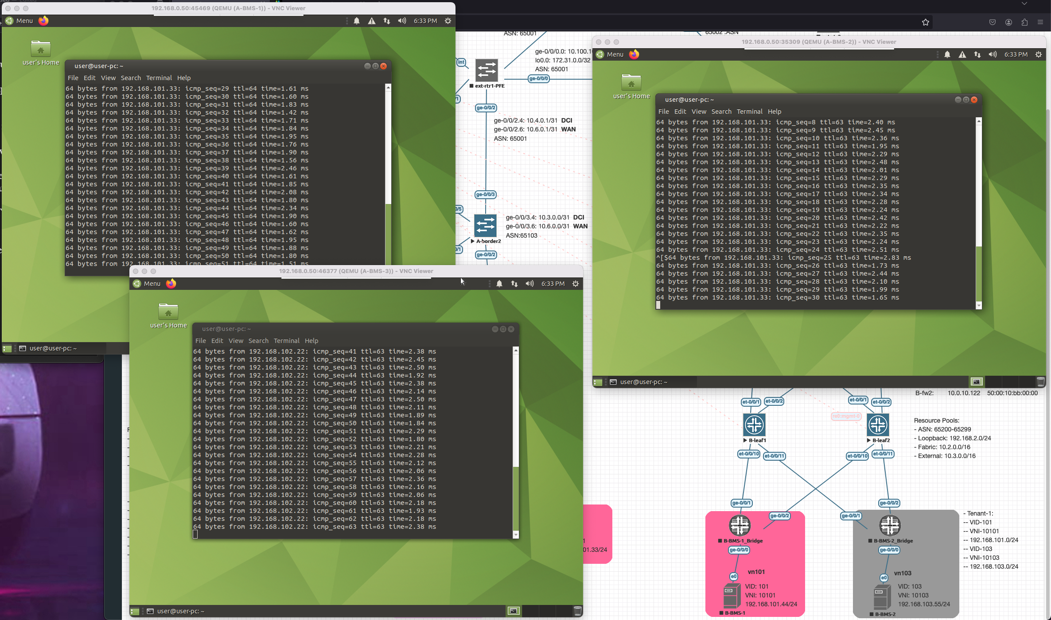
Add Testing Hosts – Configure uMate Hosts
Test reachability between uMate hosts
Open the MATE Terminal
Ping the default gateway
Ping between hosts within each fabric - we’ll test inter-fabric once we finish the DCI config in the next section
Host Name | IP Address/CIDR | Default Gateway | Virtual Network (reference only)
A-BMS-1 | 192.168.101.11/24 | 192.168.101.1 | vn101
A-BMS-2 | 192.168.102.22/24 | 192.168.102.1 | vn102
A-BMS-3 | 192.168.101.33/24 | 192.168.101.1 | vn101
B-BMS-1 | 192.168.101.44/24 | 192.168.101.1 | vn101
B-BMS-2 | 192.168.103.55/24 | 192.168.103.1 | vn103

