Slide 1
Juniper Apstra Virtual Lab Demo
v4.0.0

Slide 2
Access Information

Slide 3
Introduction
There are four sets of Juniper Apstra demo available in APAC SE lab.
Each setup contains switches, firewalls, bare metal servers and VMware hypervisors to simulate two data centers. All the components are in virtualized format and running in a single x86 server over KVM.
The setup can be used to demonstrate the data center fabric lifecycle management from day-0 fabric onboarding, day-1 service provisioning to day-2 maintenance and monitoring through Apstra. Apart from the standard ZTP, VXLAN and VRF provisioning, this can also be used for DCI, firewall service chain, and VMware vCenter integration demonstration.

Slide 4
Agenda
Day-0 Fabric Onboarding
Zero Touch Provisioning
Create ASN Pool and IP Pools
Create Logical Devices and Interface Maps
Create Rack Types
Create Templates
Create Blueprints
Day-1 Service Provisioning
Create Routing Zones
Create Virtual Networks
Assign Virtual Network to Switchports
Add Server Links
Data Center Interconnect
Day-2 Maintenance and Monitoring
Root Cause Identification
Config Deviation Checking
Apply custom config through Configlet
View Telemetry Data
VMware vCenter Integration
Create and Import Virtual Infra Manager
Add Server Links for VMware ESXi servers
View Virtual Machine information
Fabric VLANs Validation
Hypervisor Uplinks Validation

Slide 5
Lab Topology
A-fw cluster
B-fw cluster
A-fw1
A-fw2
ext-rtr1
ext-rtr2
B-fw1
B-fw2
A-border1
A-border2
B-border1
B-border2
apstra-server
A-spine1
A-spine2
B-spine1
B-spine2
apstra-ztp
vcenter
A-leaf1
A-leaf2
B-leaf1
B-leaf2
A-bms1
A-bms2
A-bms3
esxi1
esxi2
B-bms1
B-bms2
DataCenter-A
DataCenter-B

Slide 6
Access to Apstra server and VMware vCenter
Port forwarding and https redirect had been setup so that you don't need any proxy configuration in your browser to access the web GUI of Apstra and VMware vCenter.
Below table shows the IP address of the 4 setup, they are accessible within Juniper VPN network.
Below table shows the Apstra and VMware vCenter access information. (Take psk31 as an example, replace the IP address for another setup).
Demo setup name | IP address
psk31 | 172.27.170.151
psk32 | 172.27.170.152
psk33 | 172.27.170.153
psk34 | 172.27.170.154
Resource | Link | Username | Password
Apstra Web GUI | https://172.27.170.151 | demo | demo (will be changed for each reservation)
Apstra server SSH access | SSH to 172.27.170.151 | demo | demo (will be changed for each reservation)
VMware vCenter | https://172.27.170.151/vcenter | demo | demo (will be changed for each reservation)

Slide 7
Access to Junos devices and other servers
Besides Apstra and VMware vCenter, all other devices can be accessed through Apstra server as the jump host.
Below aliases are configured in Apstra server. To connect to those devices, you just need to SSH to Apstra server, and then type the name of the alias.
Data Center A Junos devices
Data Center B Junos devices
Bare metal servers
A-bms1
A-bms2
A-bms3
B-bms1
B-bms2
SSH | Console
A-spine1 | A-spine1-console
A-spine2 | A-spine2-console
A-border1 | A-border1-console
A-border2 | A-border1-console
A-leaf1 | A-leaf1-console
A-leaf2 | A-leaf2-console
A-fw (SRX master)
A-fw1 (SRX node0) | A-fw1-console
A-fw2 (SRX node1) | A-fw2-console
ext-rtr1 | ext-rtr1-console
SSH | Console
B-spine1 | B-spine1-console
B-spine2 | B-spine2-console
B-border1 | B-border1-console
B-border2 | B-border1-console
B-leaf1 | B-leaf1-console
B-leaf2 | B-leaf2-console
B-fw (SRX master)
B-fw1 (SRX node0) | B-fw1-console
B-fw2 (SRX node1) | B-fw2-console
ext-rtr2 | ext-rtr2-console
Other devices
ztp (Apstra ZTP server)
esxi1
esxi2

Slide 8
Day-0 Fabric Onboarding
Zero Touch Provisioning
Create ASN Pool and IP Pools
Create Logical Devices and Interface Maps
Create Rack Types
Create Templates
Create Blueprints

Slide 9
Zero Touch Provisioning
Apstra provides a ZTP VM which contains DHCP and TFTP services to onboard Junos devices, assign management IP address, upgrade Junos software, apply initial configuration and finally create offbox agents in Apstra automatically.
For the fabric onboarding procedure, user can connect and boot up the switches at any time, the device will go through ZTP process and be added in Apstra managed devices list.
Next, user can select the switches from the managed devices list and add them to a designed and configured data center fabric. This two steps procedure decouples the zero touch provisioning and fabric creation process, and therefore provides greater flexibility when designing and building a data center.
In this demo setup, we've prepared a script to zeroize the vQFX devices. The management subnet of two data centers is different, DHCP relay agent was setup in the underlay hypervisor virtual network, and Apstra is able to carry out ZTP through DHCP relay. It matches with the real scenario in multiple data centers environment.

Slide 10
Zero Touch Provisioning
JUNOS Device
Apstra ZTP VM
Apstra Server VM
DHCP request
DHCP reply to assign IP, Hostname (optional), and config file "junos_apstra_ztp_bootstrap.sh"
Run the shell script "junos_apstra_ztp_bootstrap.sh":
Configure root password: root123
Download the script "ztp.py" from Apstra ZTP VM
Configure "ztp.py" as op script
Run command "op ztp.py" to execute the ztp script
Run the op script "ztp.py":
Delete the DHCP knob under management interface, and then apply a static IP
Configure default route
Gather device info like serial number, model number, OS version
Download ztp config file "ztp.json" from Apstra ZTP VM
Upgrade the software image (optional)
Configure root password specified in ztp.json
Add an user "aosadmin"
Make API call to create agent
Configure management VRF
API call to create agent

Slide 11
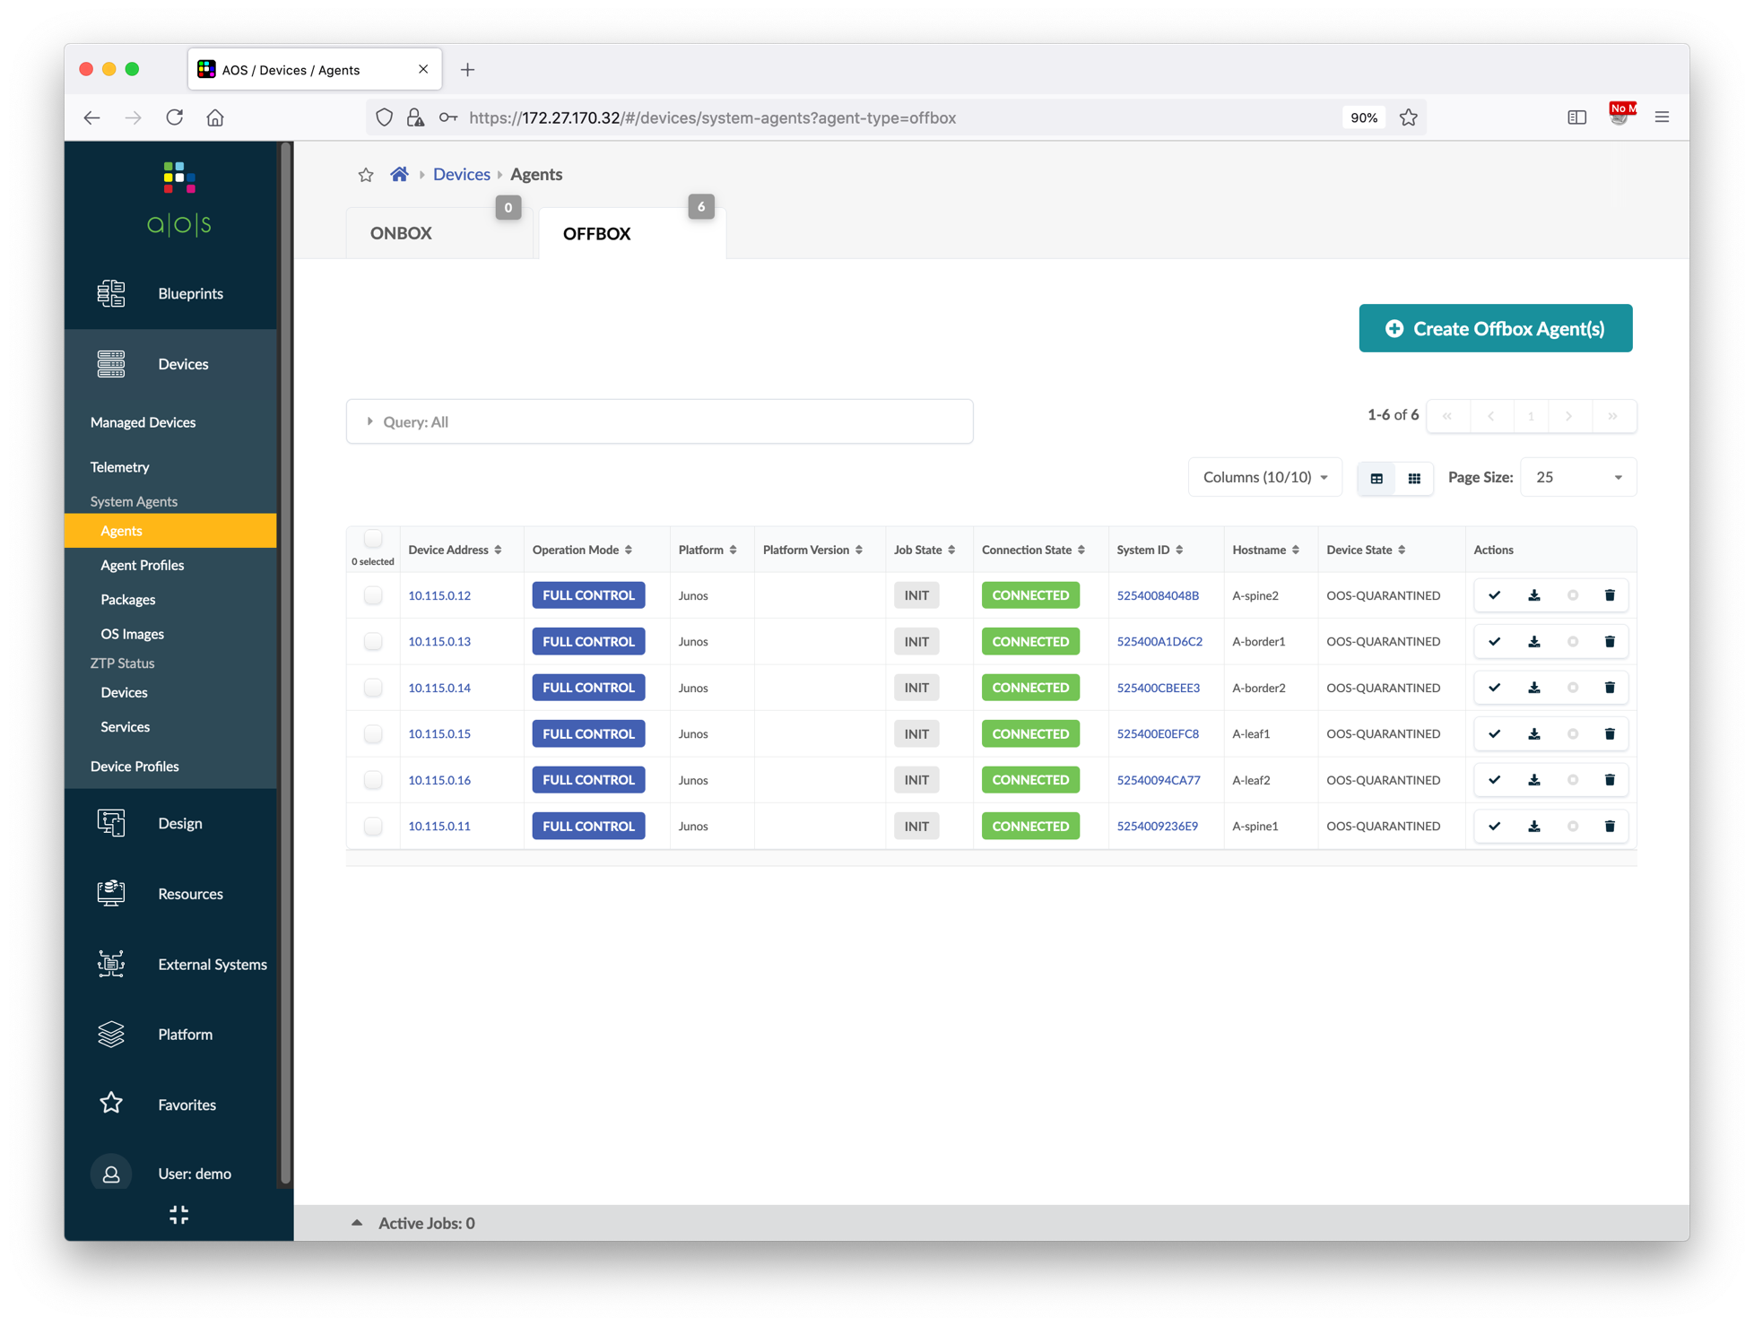
Zero Touch Provisioning
SSH to the Apstra server, run command ./zeroize_vqfx_A.sh to zeroize all vQFX in data center A.
Go to Devices > Agents > OFFBOX
Wait for 5-10 minutes, until all 6 vQFX in data center A are registered as offbox agents in Apstra.
In Apstra server shell, run command ./zeroize_vqfx_B.sh to zeroize all vQFX in data center B.
Wait for 5-10 minutes, until all 6 vQFX in data center B are registered as offbox agents in Apstra.
Go to Devices > Managed Devices, and then acknowledge all the new devices.

Slide 12
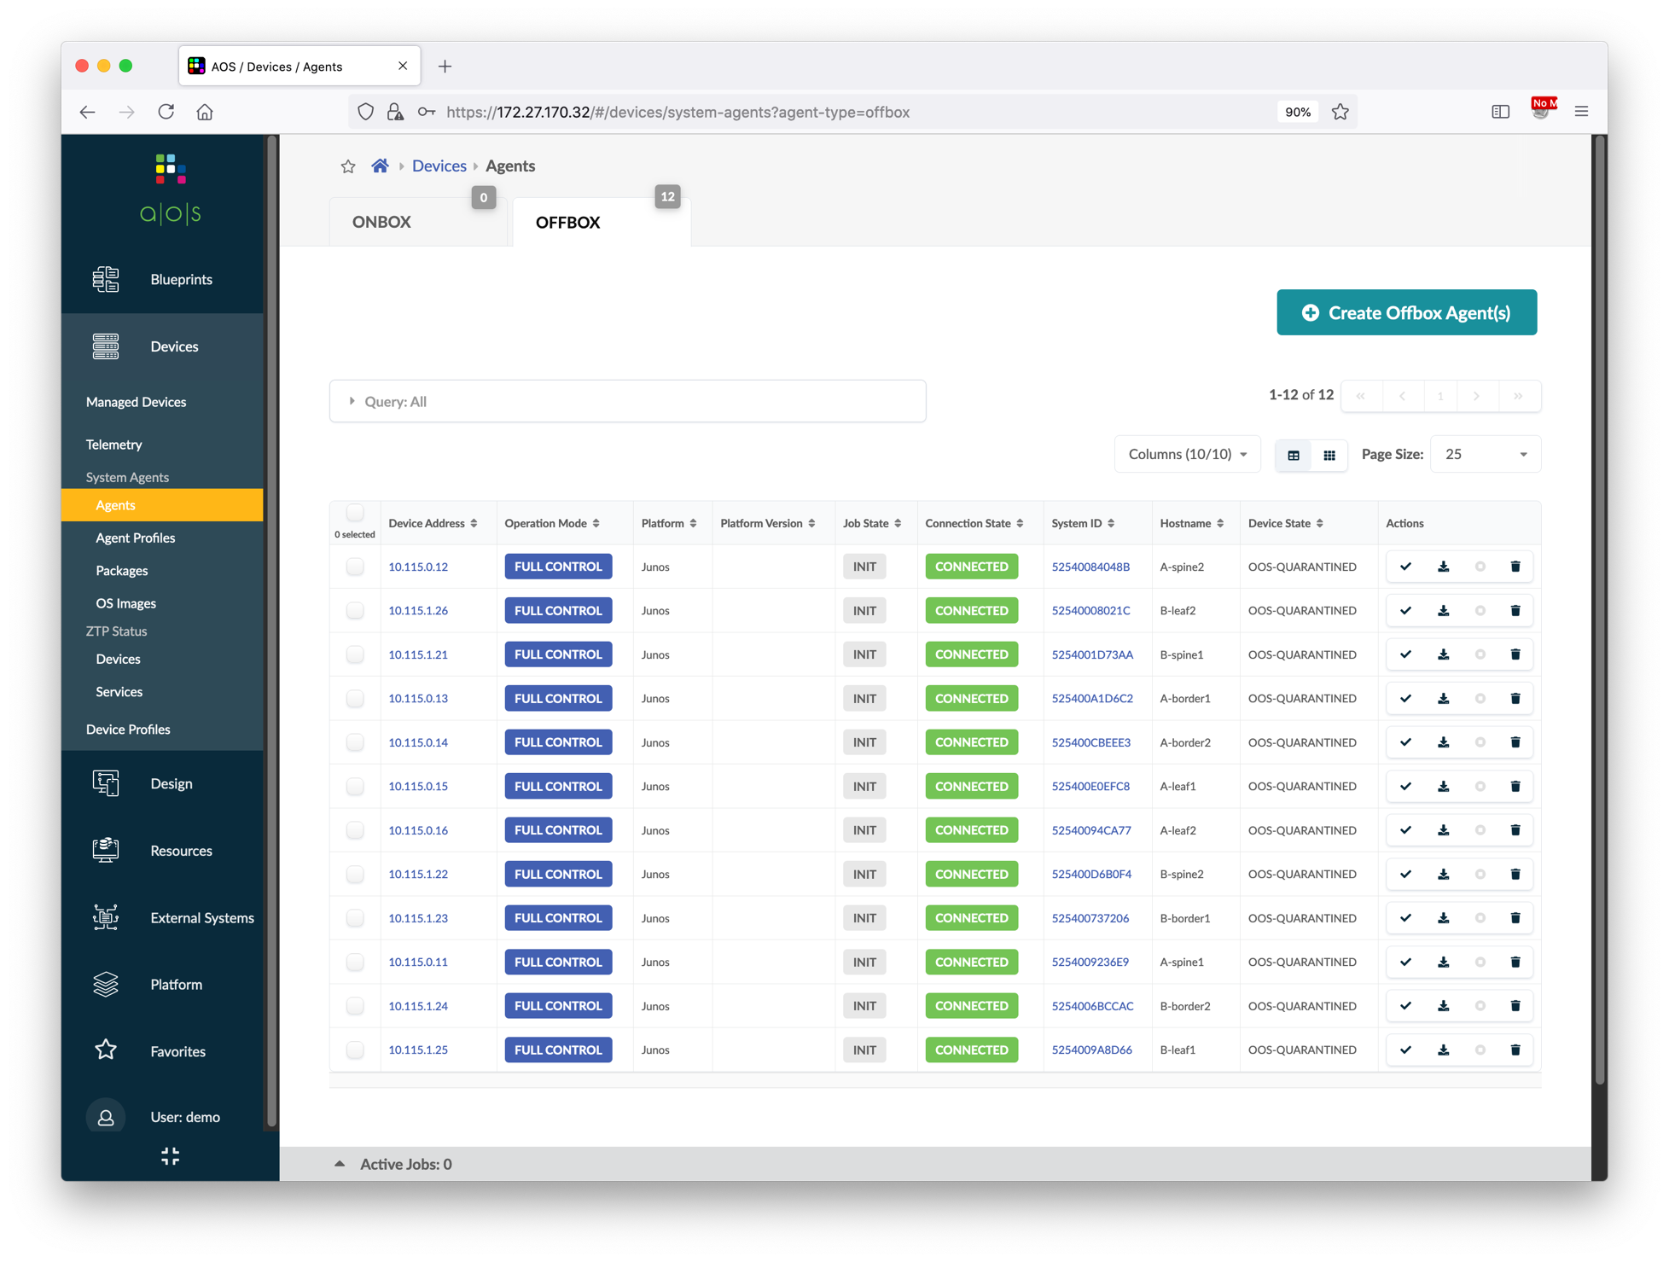
Zero Touch Provisioning
SSH to the Apstra server, run command ./zeroize_vqfx_A.sh to zeroize all vQFX in data center A.
Go to Devices > Agents > OFFBOX
Wait for 5-10 minutes, until all 6 vQFX in data center A are registered as offbox agents in Apstra.
In Apstra server shell, run command ./zeroize_vqfx_B.sh to zeroize all vQFX in data center B.
Wait for 5-10 minutes, until all 6 vQFX in data center B are registered as offbox agents in Apstra.
Go to Devices > Managed Devices, and then acknowledge all the new devices.

Slide 13
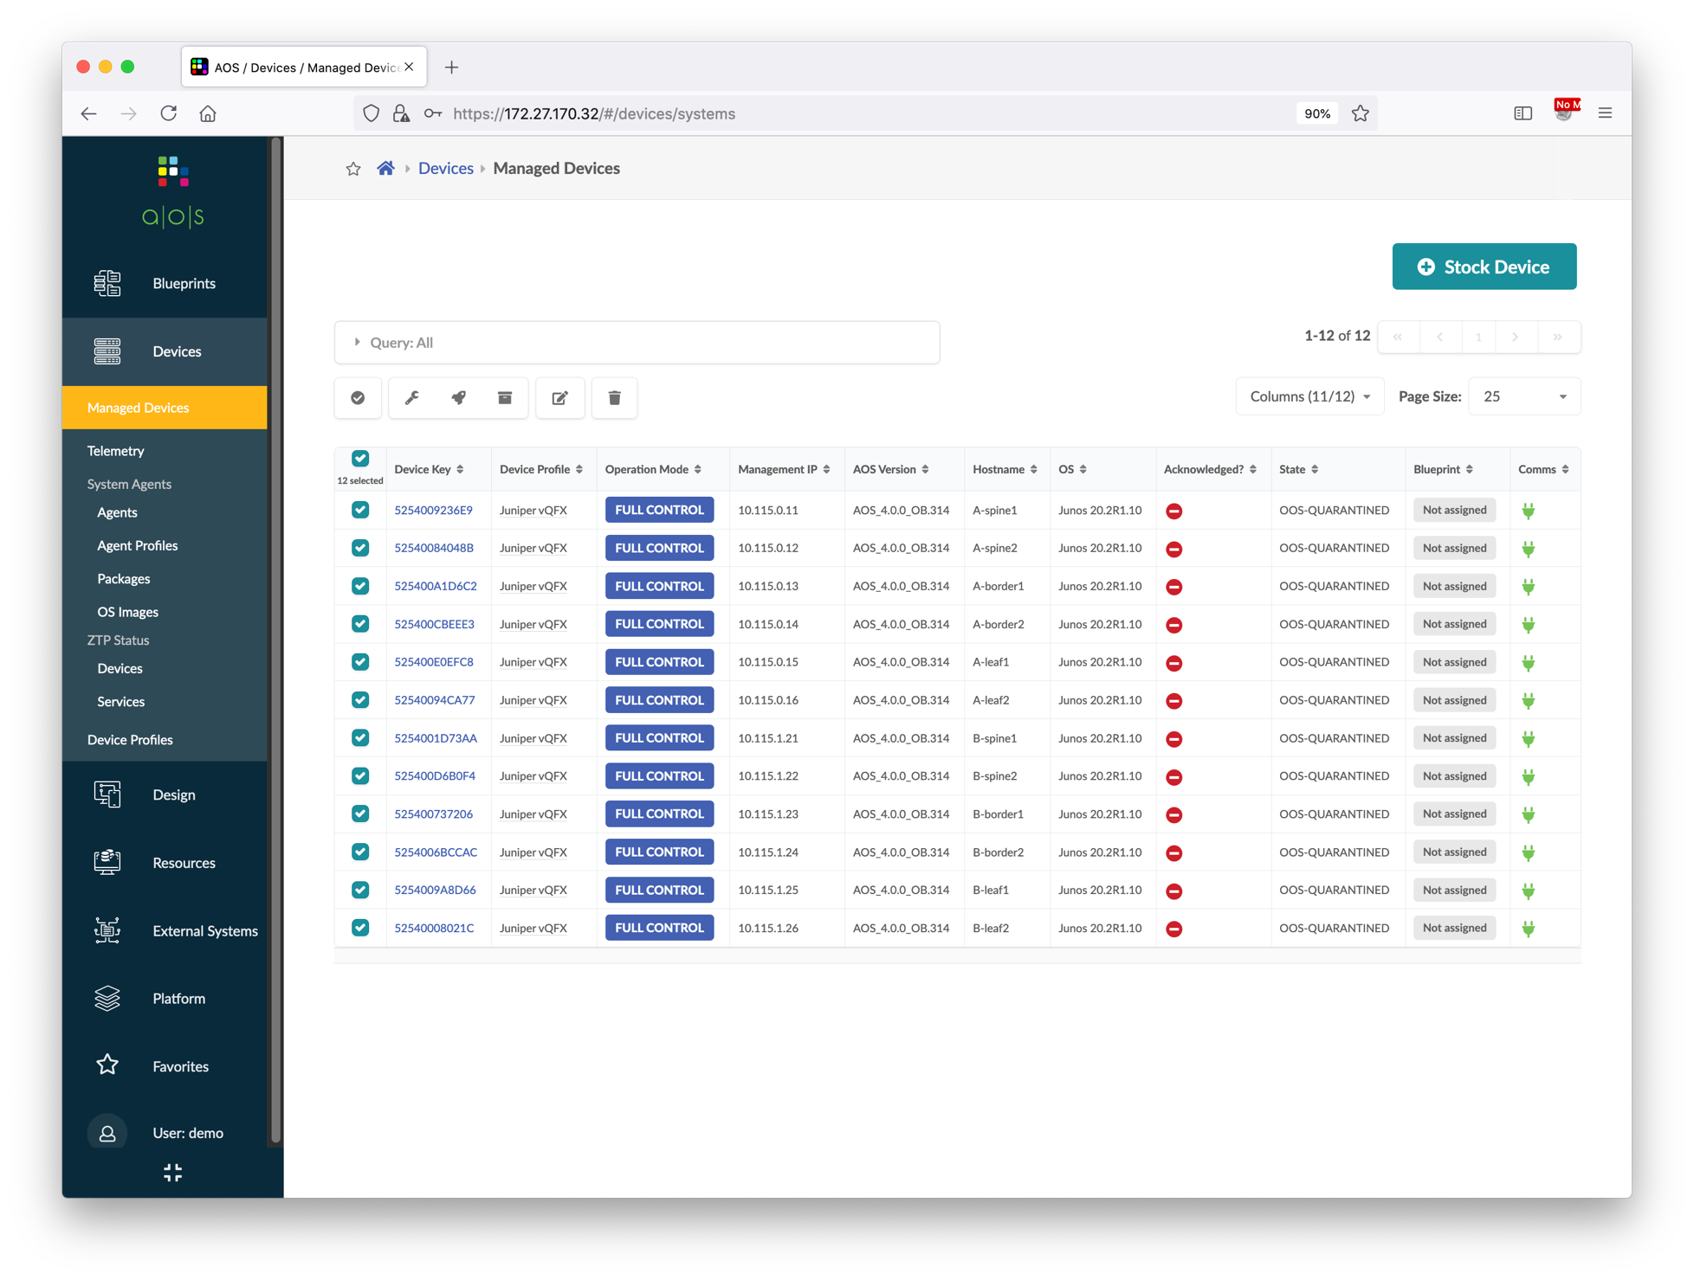
Zero Touch Provisioning
SSH to the Apstra server, run command ./zeroize_vqfx_A.sh to zeroize all vQFX in data center A.
Go to Devices > Agents > OFFBOX
Wait for 5-10 minutes, until all 6 vQFX in data center A are registered as offbox agents in Apstra.
In Apstra server shell, run command ./zeroize_vqfx_B.sh to zeroize all vQFX in data center B.
Wait for 5-10 minutes, until all 6 vQFX in data center B are registered as offbox agents in Apstra.
Go to Devices > Managed Devices, and then acknowledge all the new devices.
②
①

Slide 14
Create ASN Pools and IP Pools
Some resource pools are pre-defined in Apstra, you can use them directly in the blueprint. However, if you want to have a better control over the ASN and IP address range, or want to separate the ranges between different sites, you can define custom resource pools and reference them in the blueprint.
There are two data centers in this demo setup, and we want to use different ASNs and IP subnets in each data center for easier management and troubleshooting. So, for each data center, we're going to define one ASN pool, one IP subnet for device loopback address, and one IP subnet for inter-device fabric link. In addition, we will create one IP subnet for external links that is shared by both data centers.

Slide 15
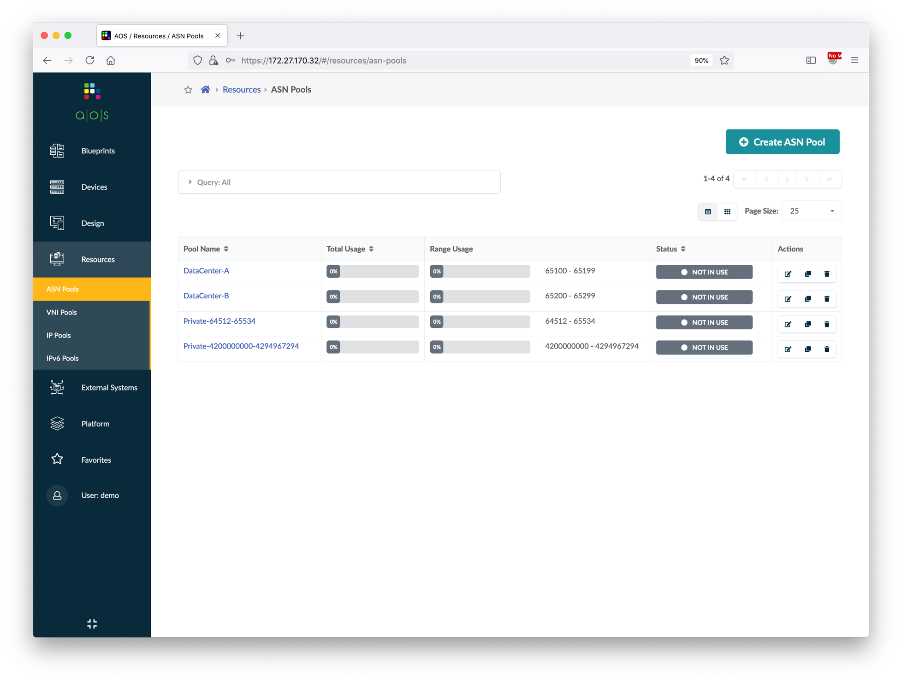
Create ASN Pools and IP Pools
Go to Resources > ASN Pools, and then create below two ASN pools.
Go to Resources > IP Pools, and then create below five IP address pools.
Name | Ranges
DataCenter-A | 65100 – 65199
DataCenter-B | 65200 – 65299
Name | Subnets
DataCenter-A Loopback | 192.168.1.0/24
DataCenter-B Loopback | 192.168.2.0/24
DataCenter-A Fabric | 10.1.0.0/16
DataCenter-B Fabric | 10.2.0.0/16
External Link | 10.3.0.0/16

Slide 16
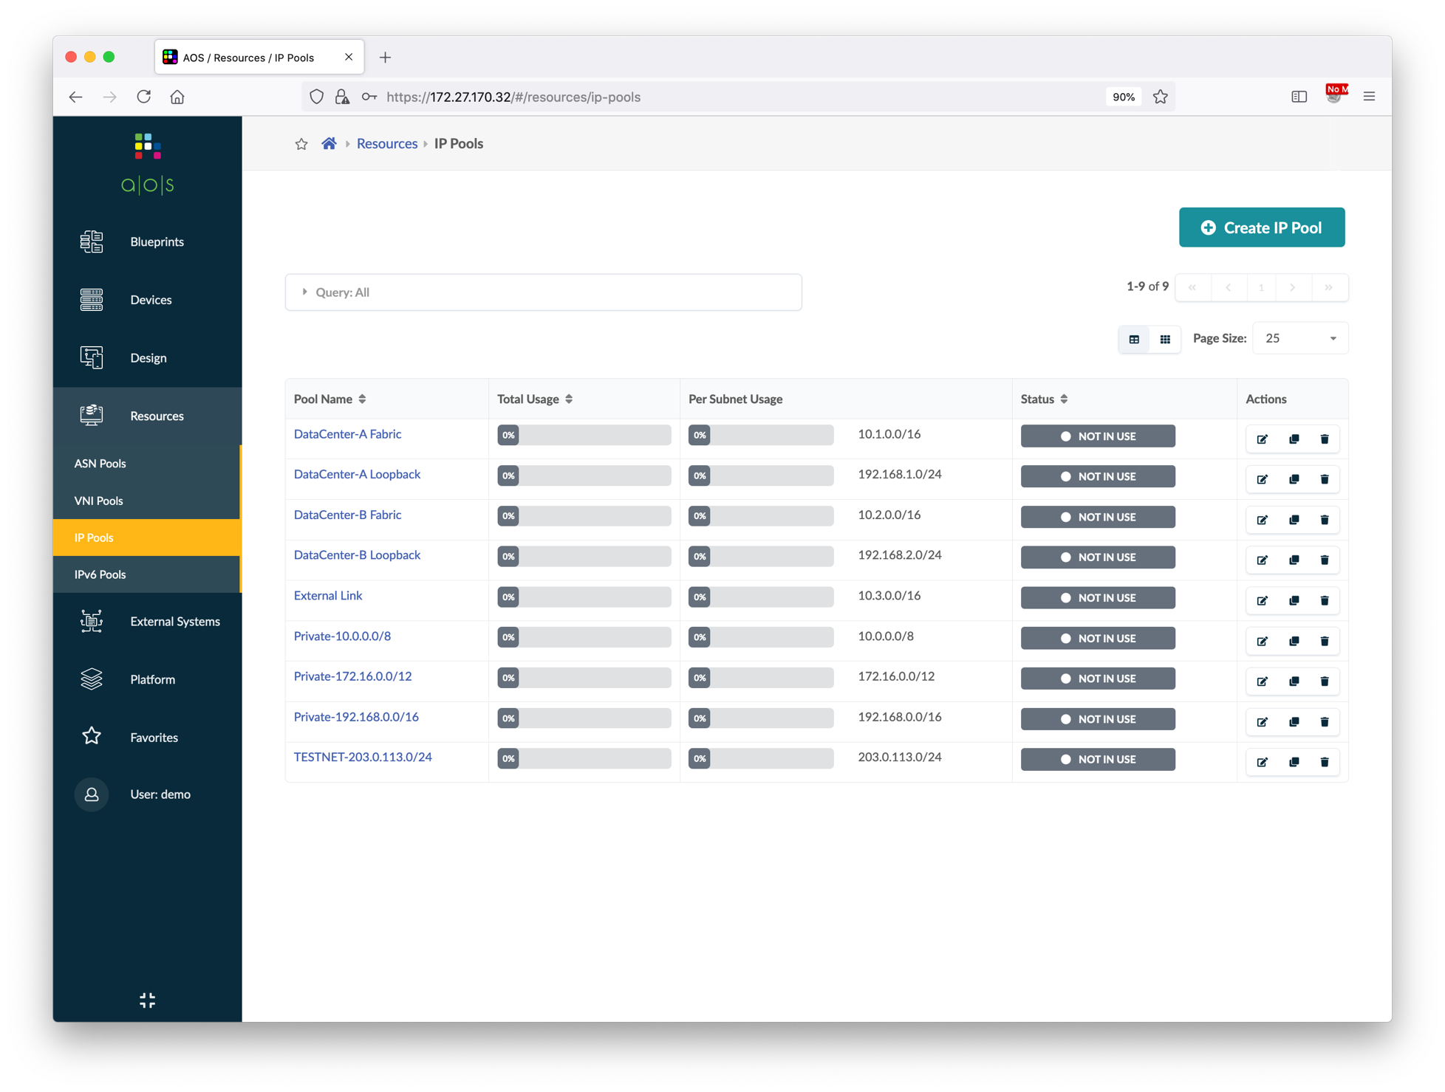
Create ASN Pools and IP Pools
Go to Resources > ASN Pools, and then create below two ASN pools.
Go to Resources > IP Pools, and then create below five IP address pools.
Name | Ranges
DataCenter-A | 65100 – 65199
DataCenter-B | 65200 – 65299
Name | Subnets
DataCenter-A Loopback | 192.168.1.0/24
DataCenter-B Loopback | 192.168.2.0/24
DataCenter-A Fabric | 10.1.0.0/16
DataCenter-B Fabric | 10.2.0.0/16
External Link | 10.3.0.0/16

Slide 17
Create Logical Devices and Interface Maps
Apstra uses logical devices to create abstractions of physical devices and uses interface map to create a link between physical devices (device profiles) and logical devices.
Logical devices specify common device form factors such as number of ports, speeds, and role of each ports.
vQFX used in this demo is a 12x 10G ports virtual switch, so we will create logical devices of 12x 10G ports. Also, we will create one logical device for each device role – Spine and Leaf, each of them will specify the target neighbor device type for each port.
JNPR-12x10-Spine
JNPR-12x10-Leaf
12x 10G ports to Leaf
12x 10G ports to Spine, Generic

Slide 18
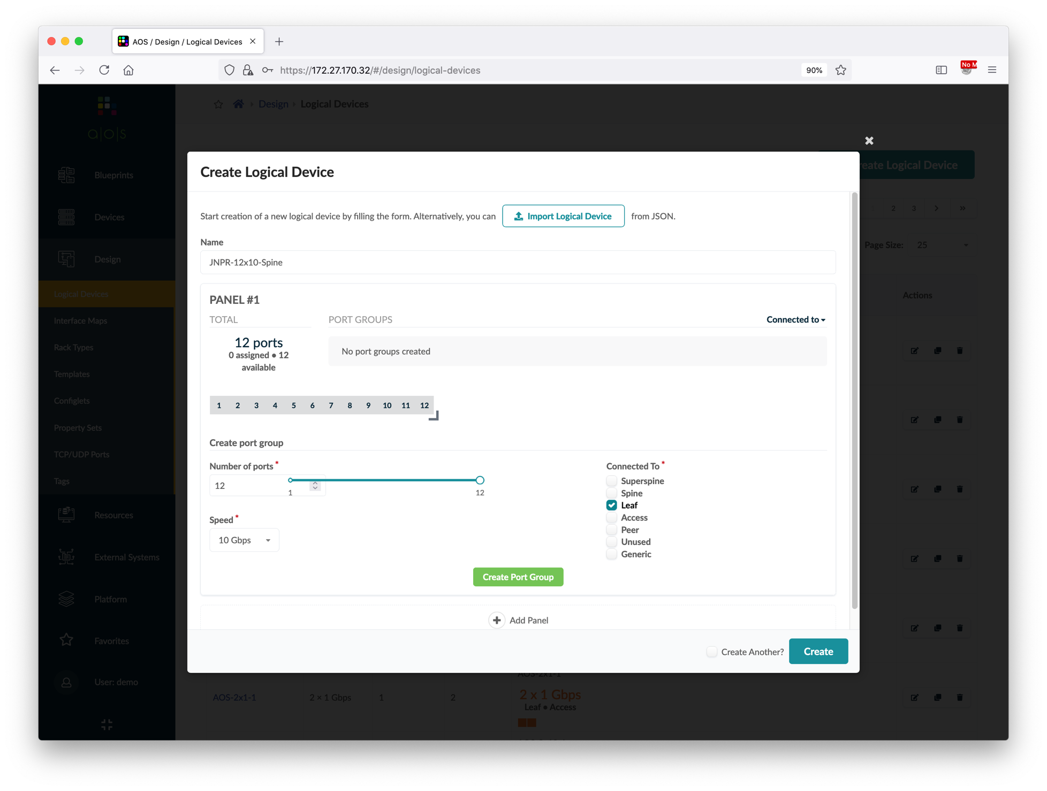
Create Logical Devices and Interface Maps
Go to Design > Logical Devices, and then create below two logical devices.
Click the Query box and filter the name with "JNPR", verify the two newly created logical devices.
Go to Design > Interface Maps, and then create below two interface maps.
Click the Query box and filter the name with "JNPR", verify the two newly created interface maps.
Name | # of Ports | Connected To
JNPR-12x10-Spine | 12 | Leaf
JNPR-12x10-Leaf | 12 | Spine, Generic
①
Type the name
②
Drag the line to 12 ports
③
Choose the connected devices
Logical device | Device profile
JNPR-12x10-Spine | Juniper vQFX
JNPR-12x10-Leaf | Juniper vQFX
④
⑤

Slide 19
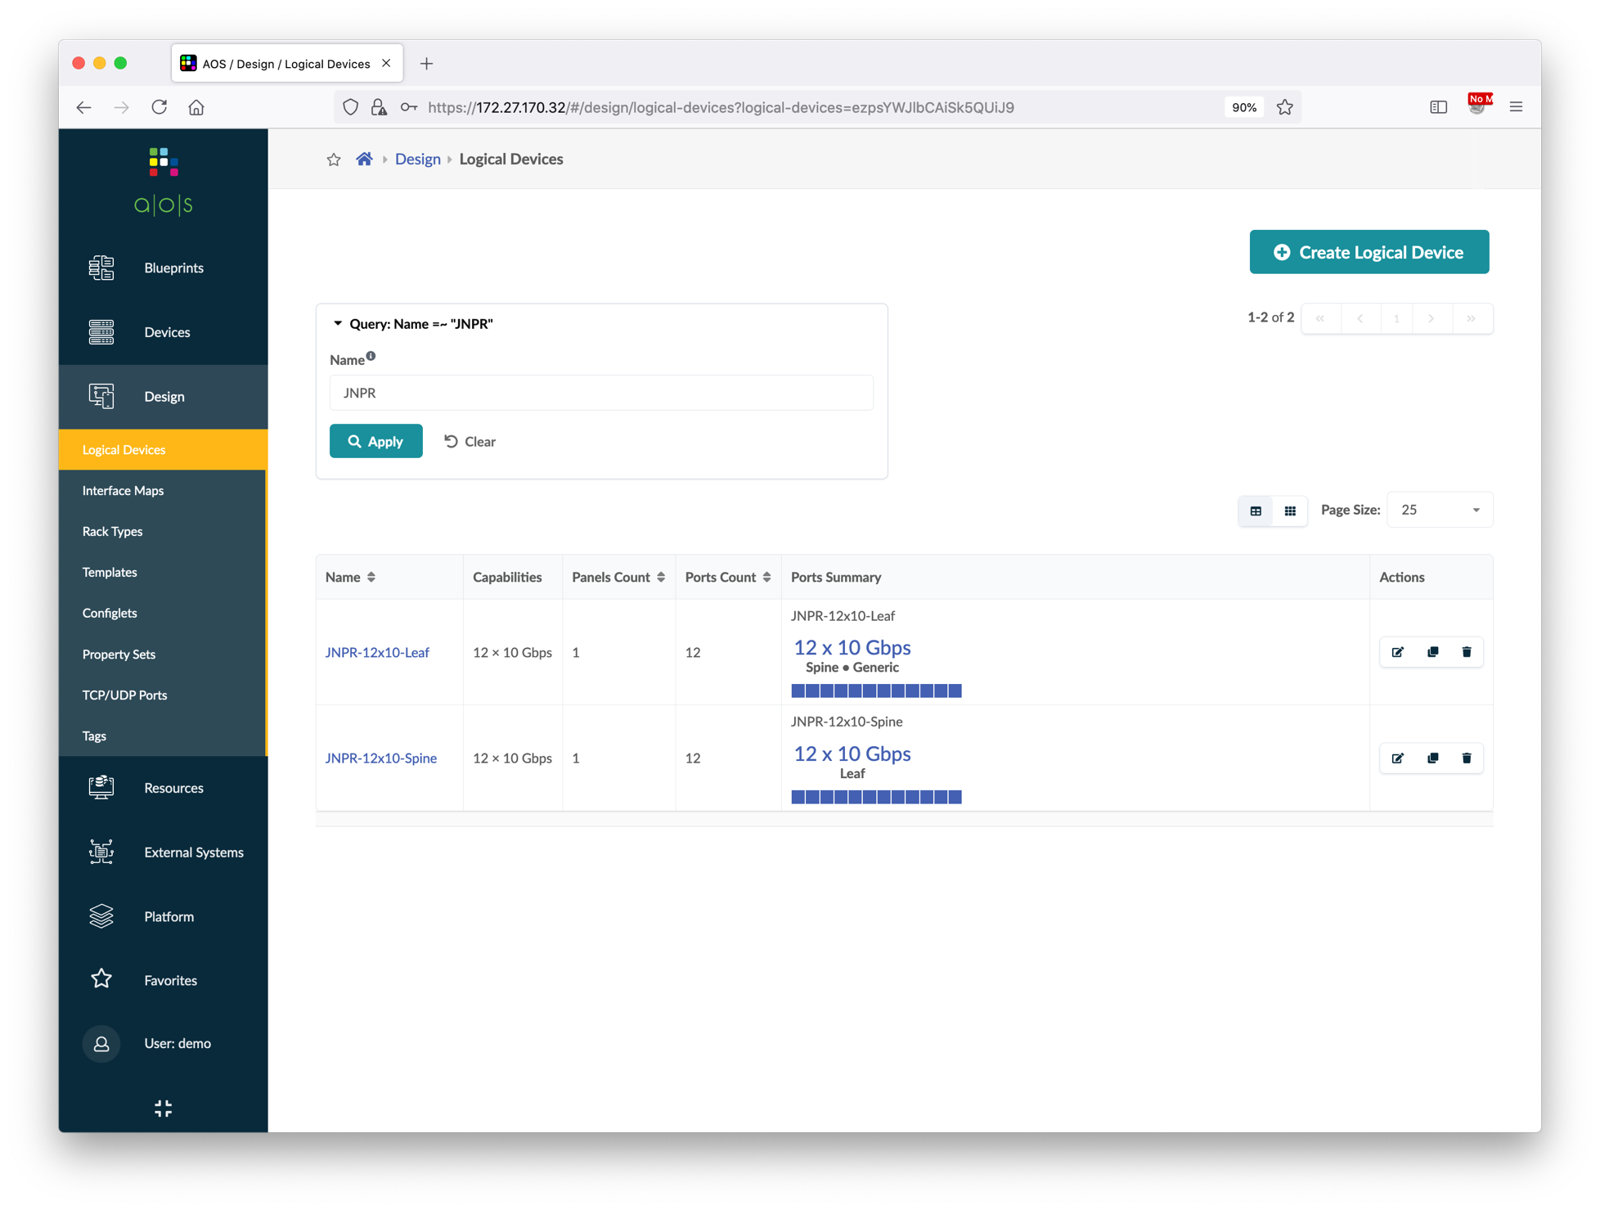
Create Logical Devices and Interface Maps
Go to Design > Logical Devices, and then create below two logical devices.
Click the Query box and filter the name with "JNPR", verify the two newly created logical devices.
Go to Design > Interface Maps, and then create below two interface maps.
Click the Query box and filter the name with "JNPR", verify the two newly created interface maps.
Name | # of Ports | Connected To
JNPR-12x10-Spine | 12 | Leaf
JNPR-12x10-Leaf | 12 | Spine, Generic
Logical device | Device profile
JNPR-12x10-Spine | Juniper vQFX
JNPR-12x10-Leaf | Juniper vQFX

Slide 20
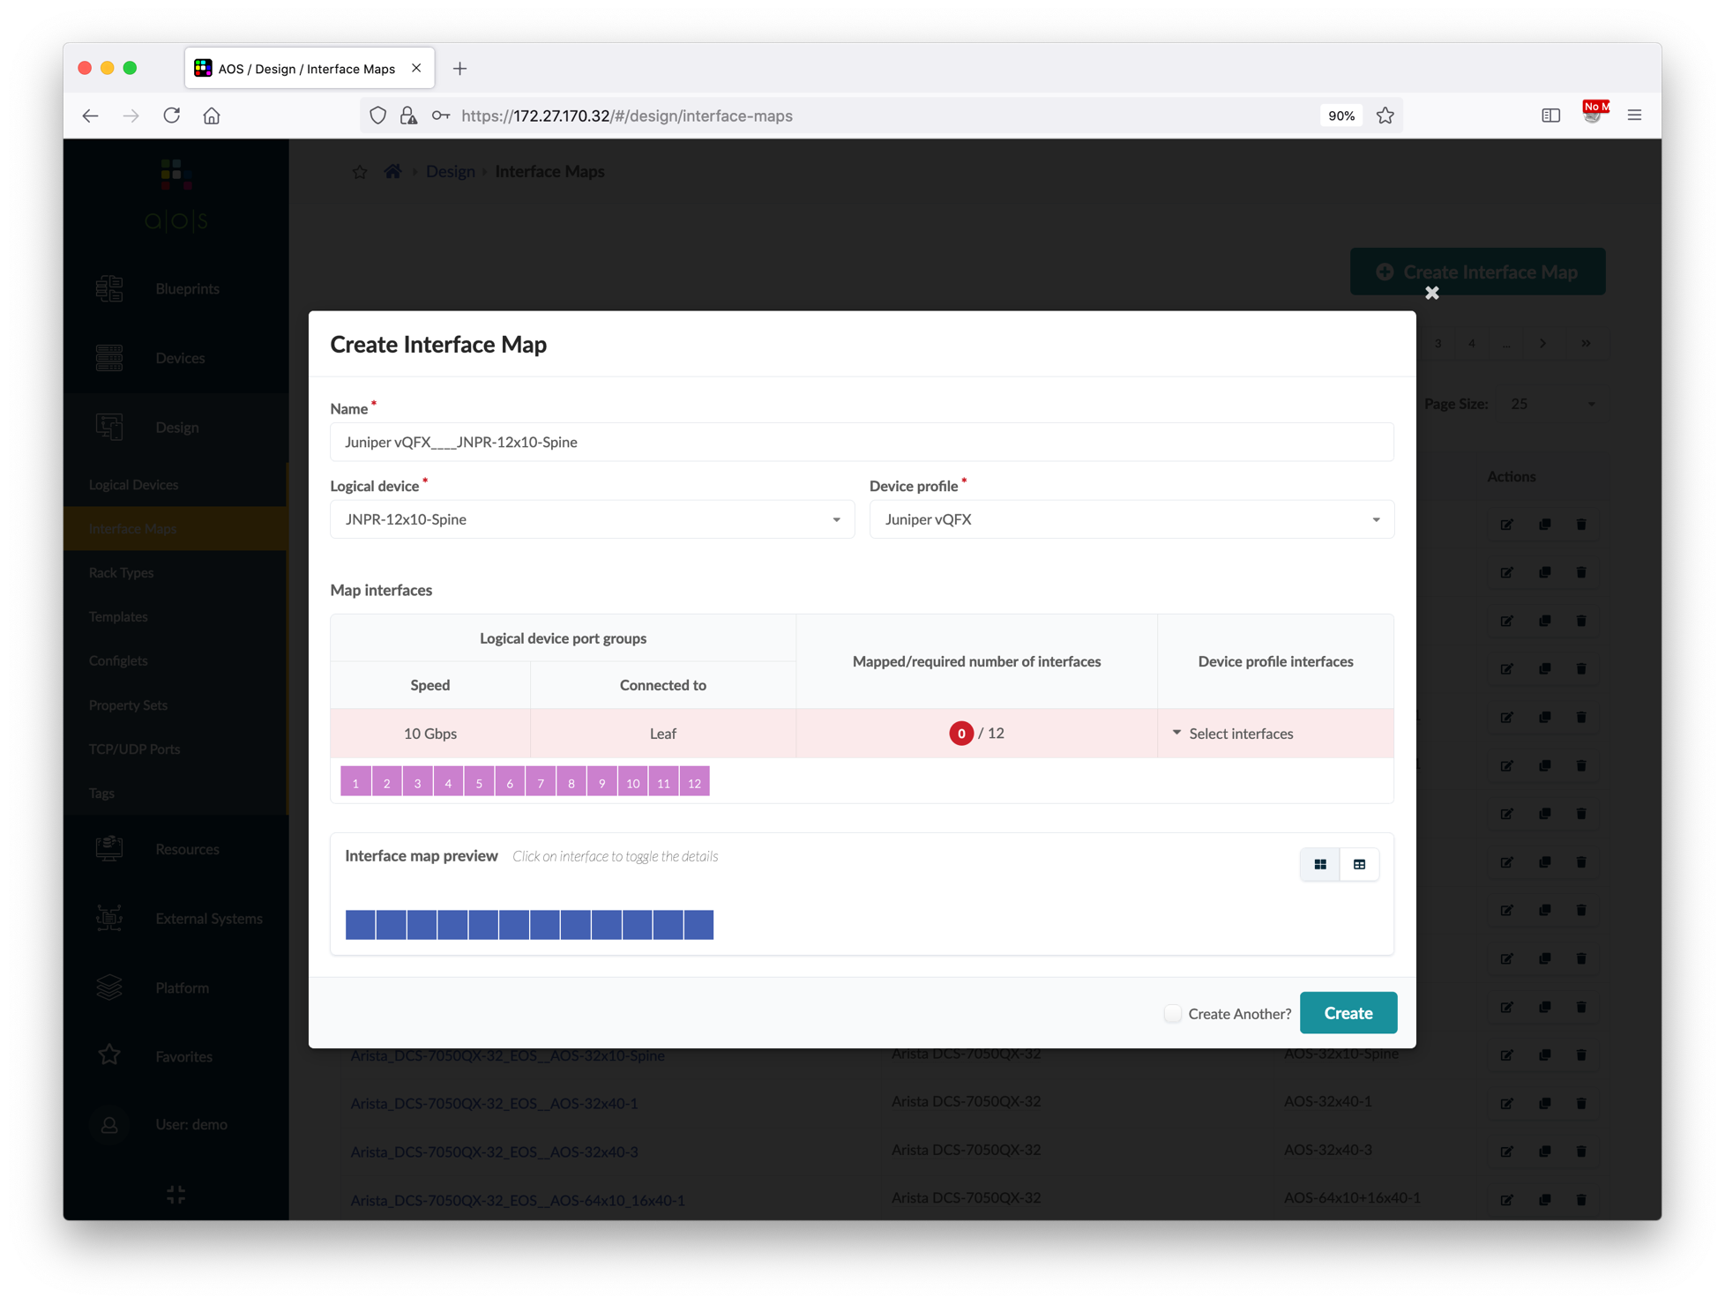
Create Logical Devices and Interface Maps
Go to Design > Logical Devices, and then create below two logical devices.
Click the Query box and filter the name with "JNPR", verify the two newly created logical devices.
Go to Design > Interface Maps, and then create below two interface maps.
Click the Query box and filter the name with "JNPR", verify the two newly created interface maps.
Name | # of Ports | Connected To
JNPR-12x10-Spine | 12 | Leaf
JNPR-12x10-Leaf | 12 | Spine, Generic
①
No need to type, name will be auto-gen
②
Choose the LD
③
Choose Juniper vQFX
Logical device | Device profile
JNPR-12x10-Spine | Juniper vQFX
JNPR-12x10-Leaf | Juniper vQFX
④
⑤
Drag from 1 to 12
⑥

Slide 21
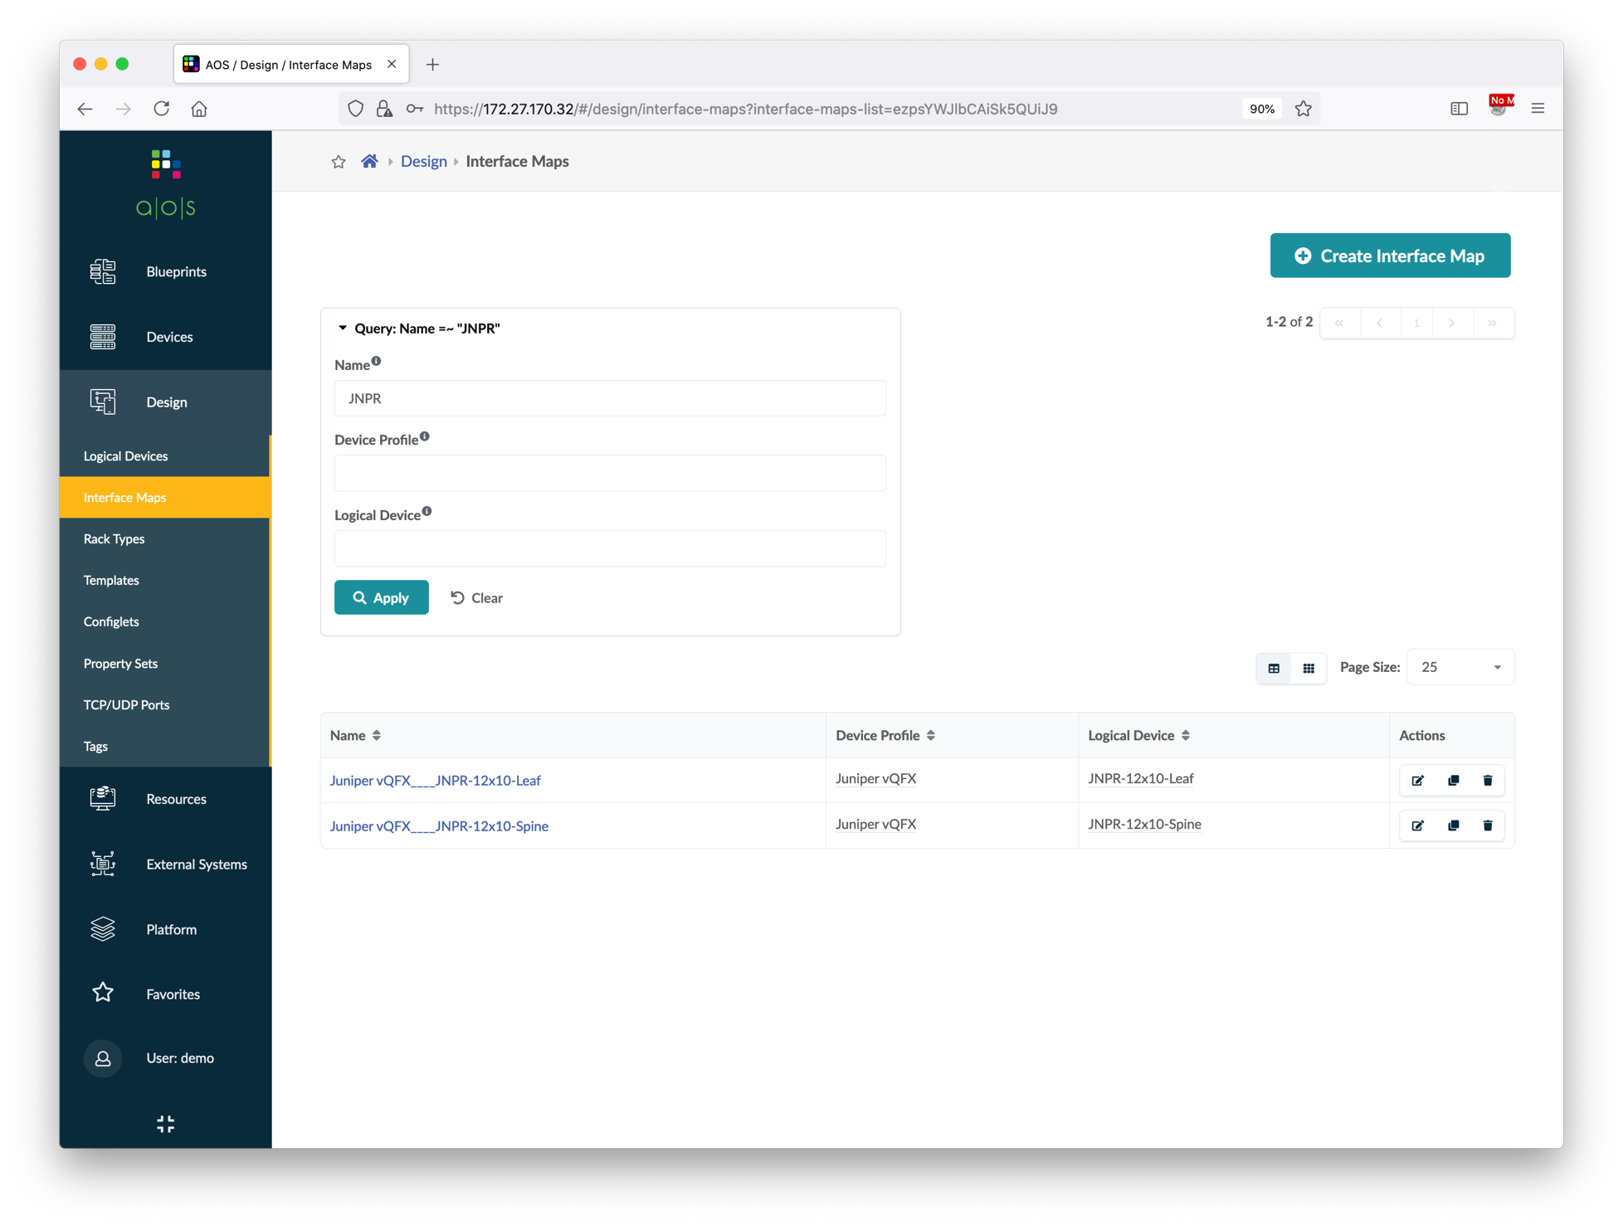
Create Logical Devices and Interface Maps
Go to Design > Logical Devices, and then create below two logical devices.
Click the Query box and filter the name with "JNPR", verify the two newly created logical devices.
Go to Design > Interface Maps, and then create below two interface maps.
Click the Query box and filter the name with "JNPR", verify the two newly created interface maps.
Name | # of Ports | Connected To
JNPR-12x10-Spine | 12 | Leaf
JNPR-12x10-Leaf | 12 | Spine, Generic
Logical device | Device profile
JNPR-12x10-Spine | Juniper vQFX
JNPR-12x10-Leaf | Juniper vQFX

Slide 22
Create Rack Types
Apstra uses rack types as logical representations of racks. In this demo, there are two types of rack, one is border rack which is used to connect external systems like DCI gateway and firewall, another is server rack which is used to connect compute resources like bare metal servers.
External generic systems must be added in the blueprint, so we will create a border rack type with two leaf switches only; and for server rack, we will define two servers in the rack type definition, each server has one single uplink to a leaf switch.
Border Rack
Define two switches per rack, without any external connections.
Server Rack
Define two switches per rack, and then define two servers in the rack type definition, each server has one single uplink to a leaf switch.
border1
border2
leaf1
leaf2
bms1
bms2
All grey boxes will be created inside the blueprint later.
fw1
fw2
ext-rtr
bms3
esxi1
esxi2

Slide 23
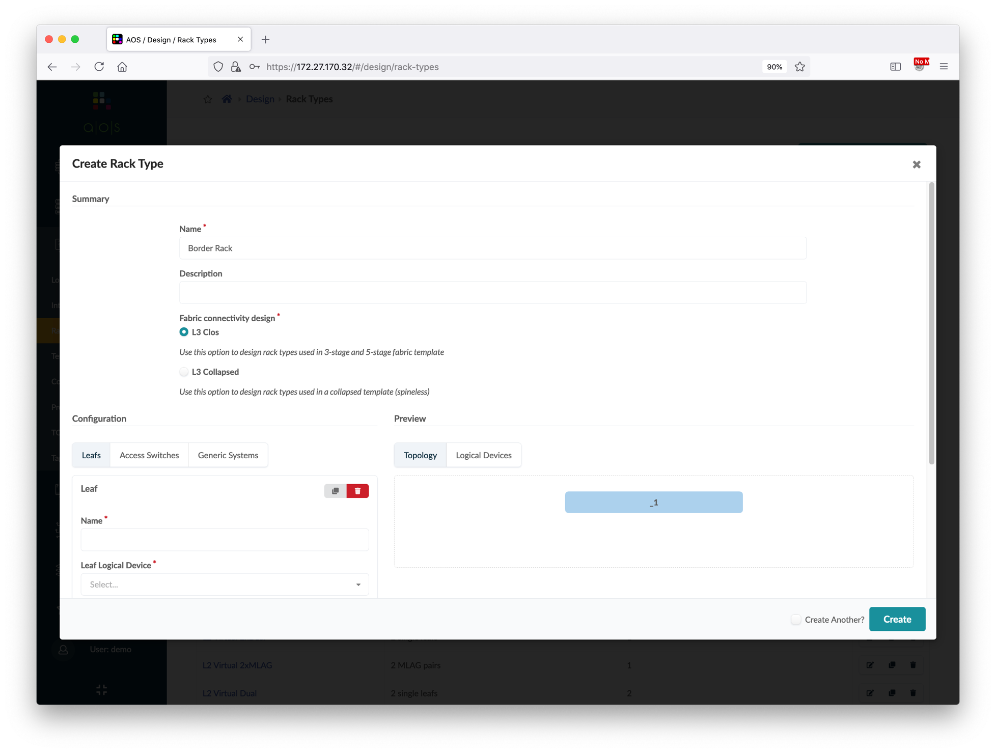
Create Border Rack Types
Go to Design > Rack Types, and then create below border rack type.
Name | Border Rack
Fabric Connectivity Design | L3 Clos
Leaf Name | switch
Leaf Logical Device | JNPR-12x10-Leaf
Redundancy Protocol | ESI
①
Type the rack type name
②
Scroll down

Slide 24
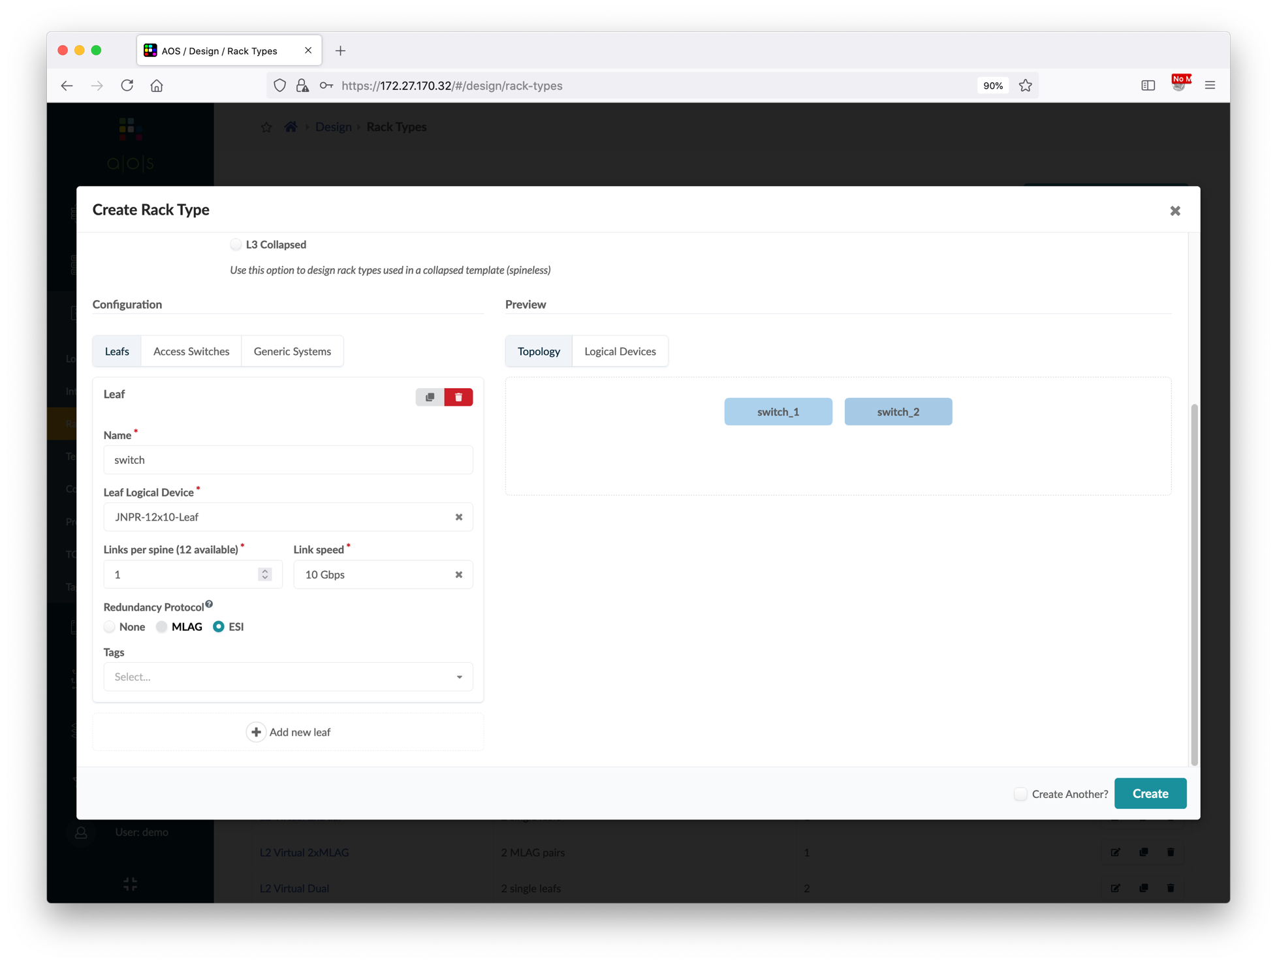
Create Border Rack Types
Go to Design > Rack Types, and then create below border rack type.
Name | Border Rack
Fabric Connectivity Design | L3 Clos
Leaf Name | switch
Leaf Logical Device | JNPR-12x10-Leaf
Redundancy Protocol | ESI
①
Type the name
②
Choose the LD
③
Choose ESI
④

Slide 25
Create Server Rack Types
Go to Design > Rack Types, and then create below server rack type.
Click Add new generic system group and input server information.
Click Add logical ink and input server link information.
Name | Server Rack
Fabric Connectivity Design | L3 Clos
Leaf Name | switch
Leaf Logical Device | JNPR-12x10-Leaf
Redundancy Protocol | ESI
①
Type the rack type name
②
Scroll down
Generic System Name | server1
Generic System Count | 1
Logical Device | AOS-1x10-1
Logical Link Name | switch1-link1
Attachment Type | Single-Homed
Peer Leaf | First

Slide 26
Create Server Rack Types
Go to Design > Rack Types, and then create below server rack type.
Click Add new generic system group and input server information.
Click Add logical ink and input server link information.
Name | Server Rack
Fabric Connectivity Design | L3 Clos
Leaf Name | switch
Leaf Logical Device | JNPR-12x10-Leaf
Redundancy Protocol | ESI
④
①
Type the name
Generic System Name | server1
Generic System Count | 1
Logical Device | AOS-1x10-1
②
Choose the LD
③
Choose ESI
Logical Link Name | switch1-link1
Attachment Type | Single-Homed
Peer Leaf | First

Slide 27
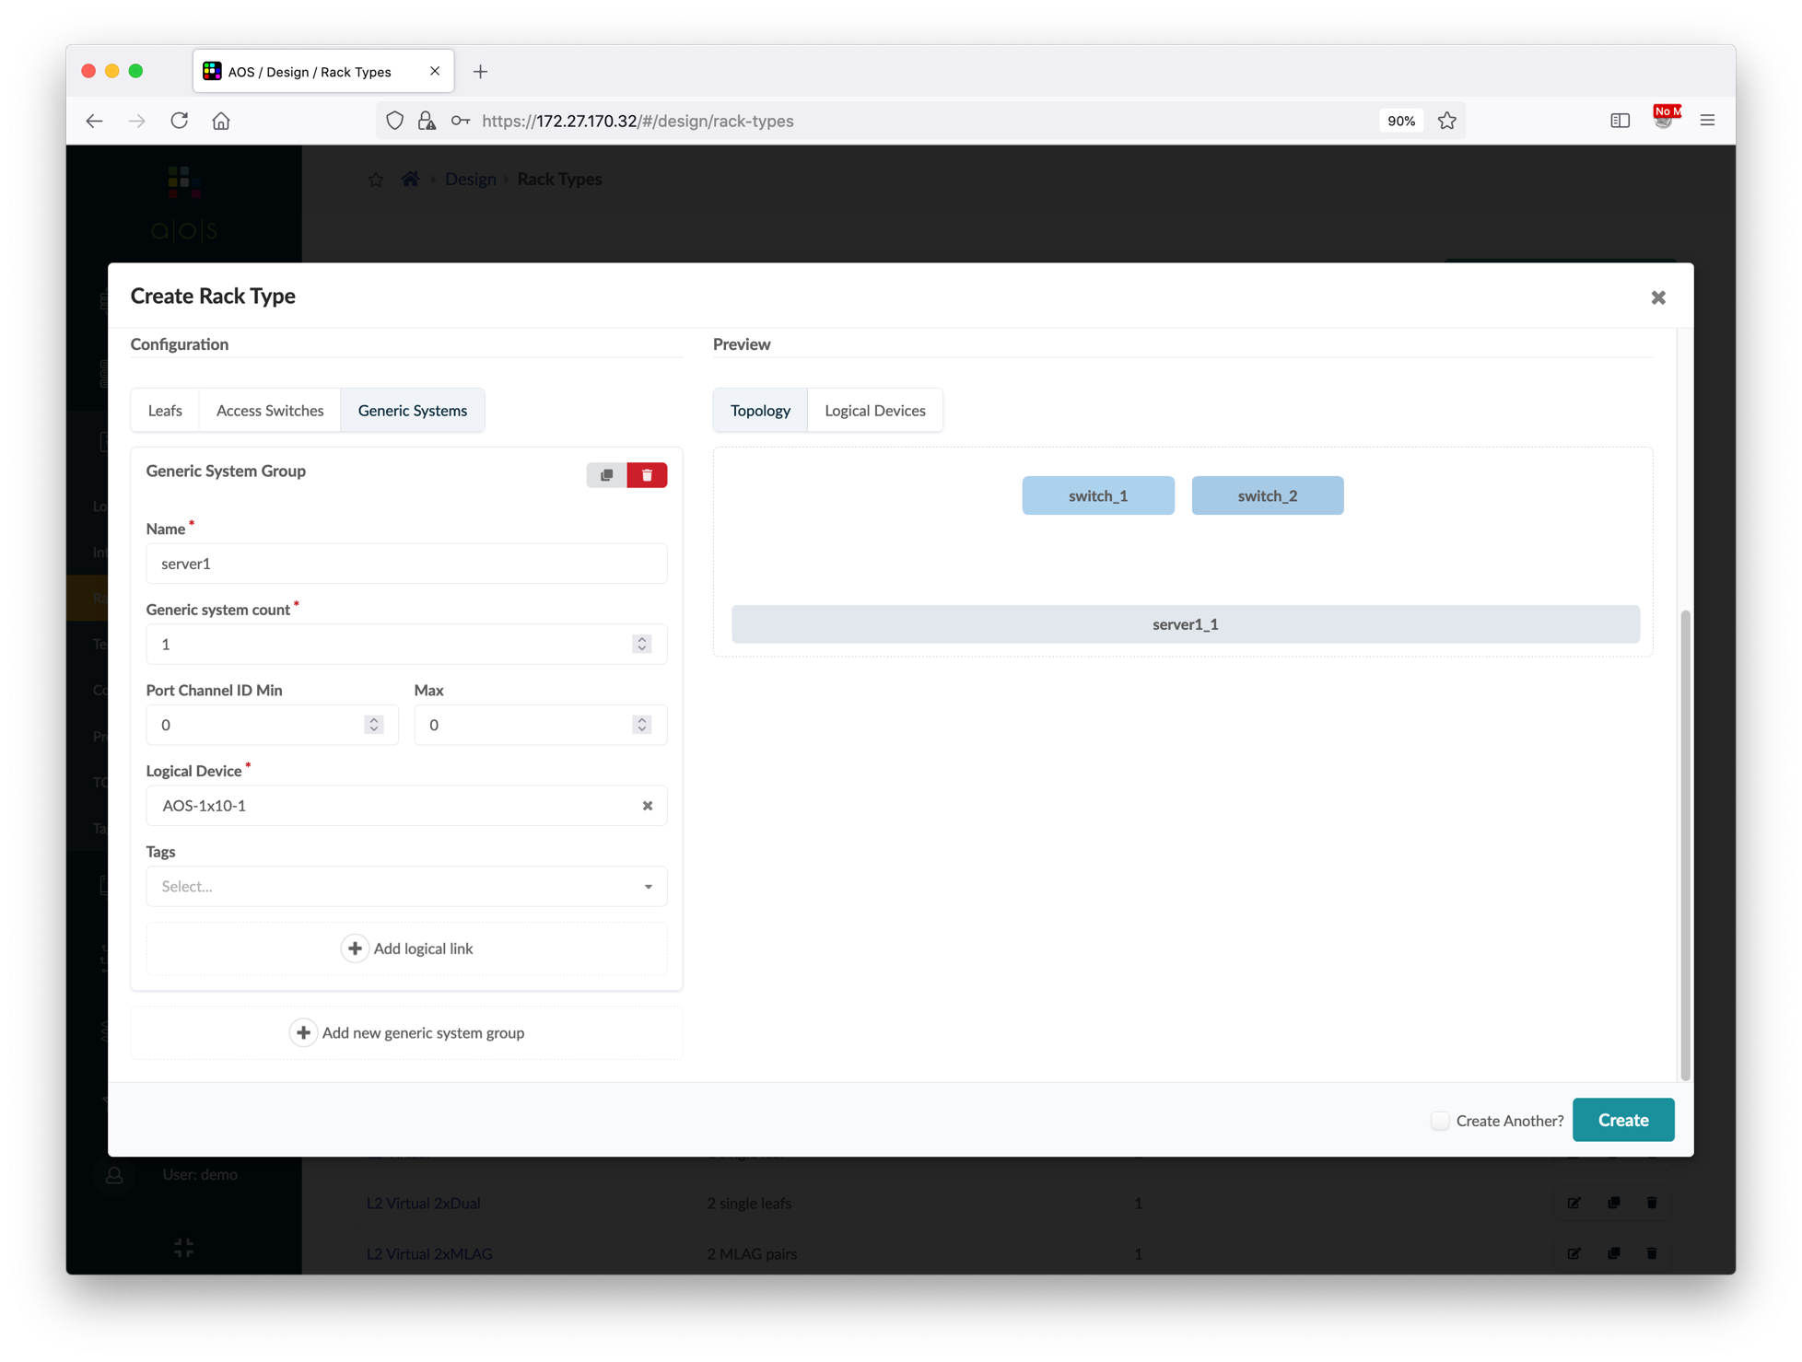
Create Server Rack Types
Go to Design > Rack Types, and then create below server rack type.
Click Add new generic system group and input server information.
Click Add logical ink and input server link information.
Name | Server Rack
Fabric Connectivity Design | L3 Clos
Leaf Name | switch
Leaf Logical Device | JNPR-12x10-Leaf
Redundancy Protocol | ESI
②
Type the name
Generic System Name | server1
Generic System Count | 1
Logical Device | AOS-1x10-1
③
Choose the LD
④
Logical Link Name | switch1-link1
Attachment Type | Single-Homed
Peer Leaf | First
①

Slide 28
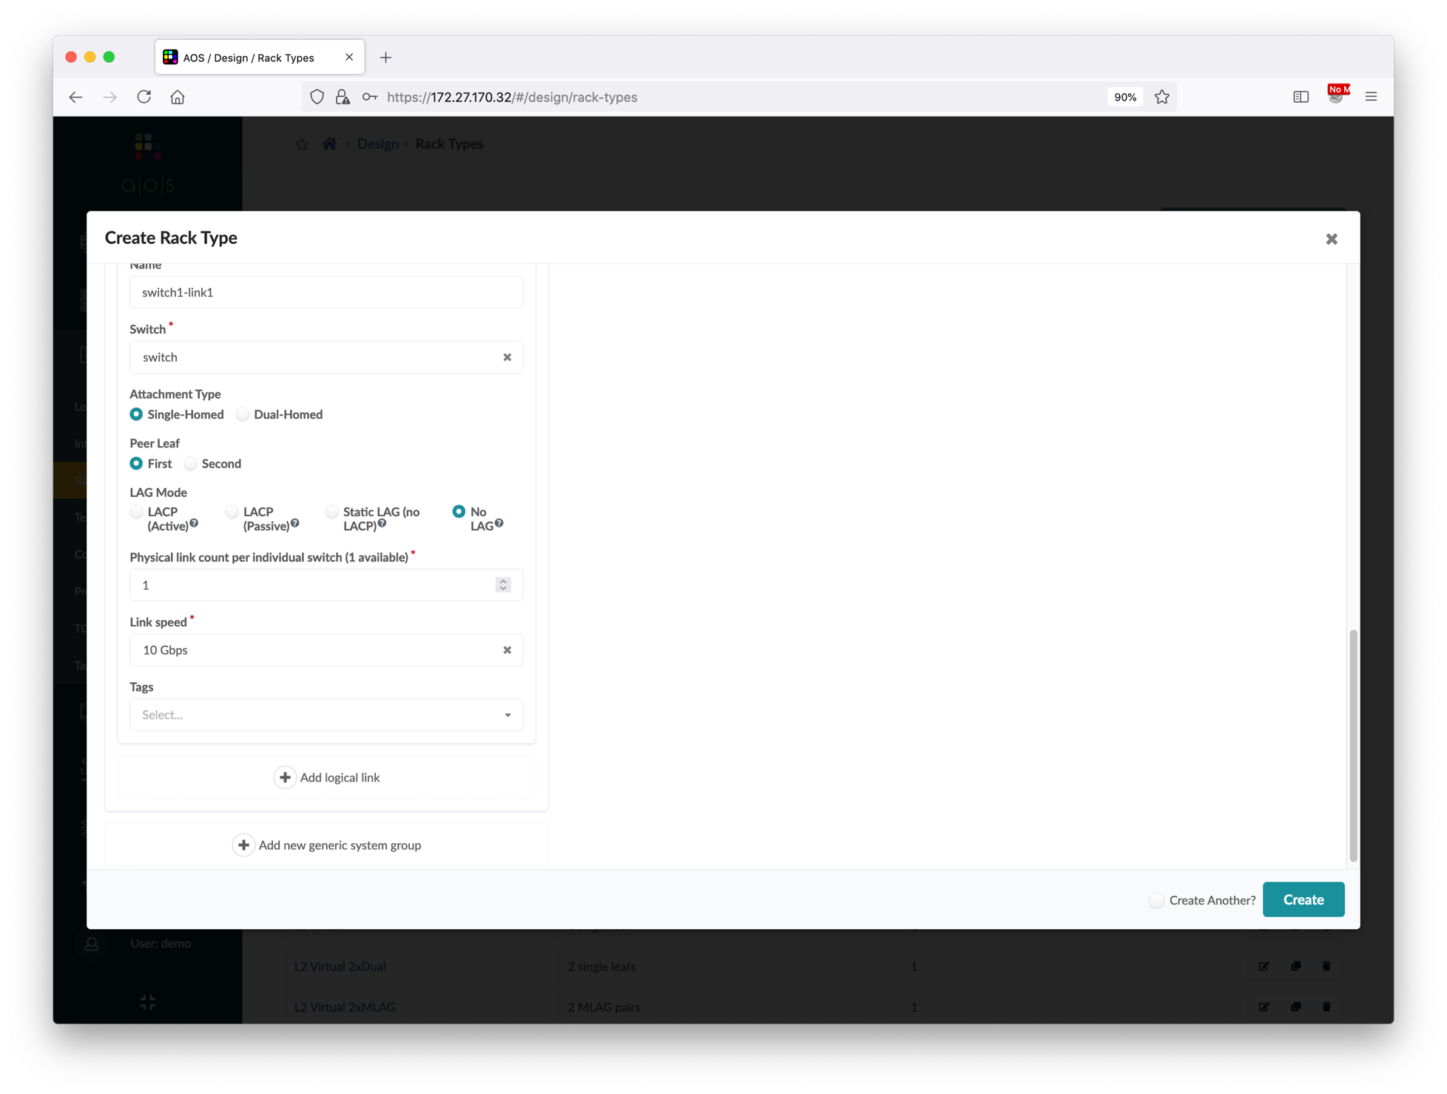
Create Server Rack Types
Go to Design > Rack Types, and then create below server rack type.
Click Add new generic system group and input server information.
Click Add logical ink and input server link information.
Name | Server Rack
Fabric Connectivity Design | L3 Clos
Leaf Name | switch
Leaf Logical Device | JNPR-12x10-Leaf
Redundancy Protocol | ESI
①
Type the name
Generic System Name | server1
Generic System Count | 1
Logical Device | AOS-1x10-1
Logical Link Name | switch1-link1
Attachment Type | Single-Homed
Peer Leaf | First
②

Slide 29
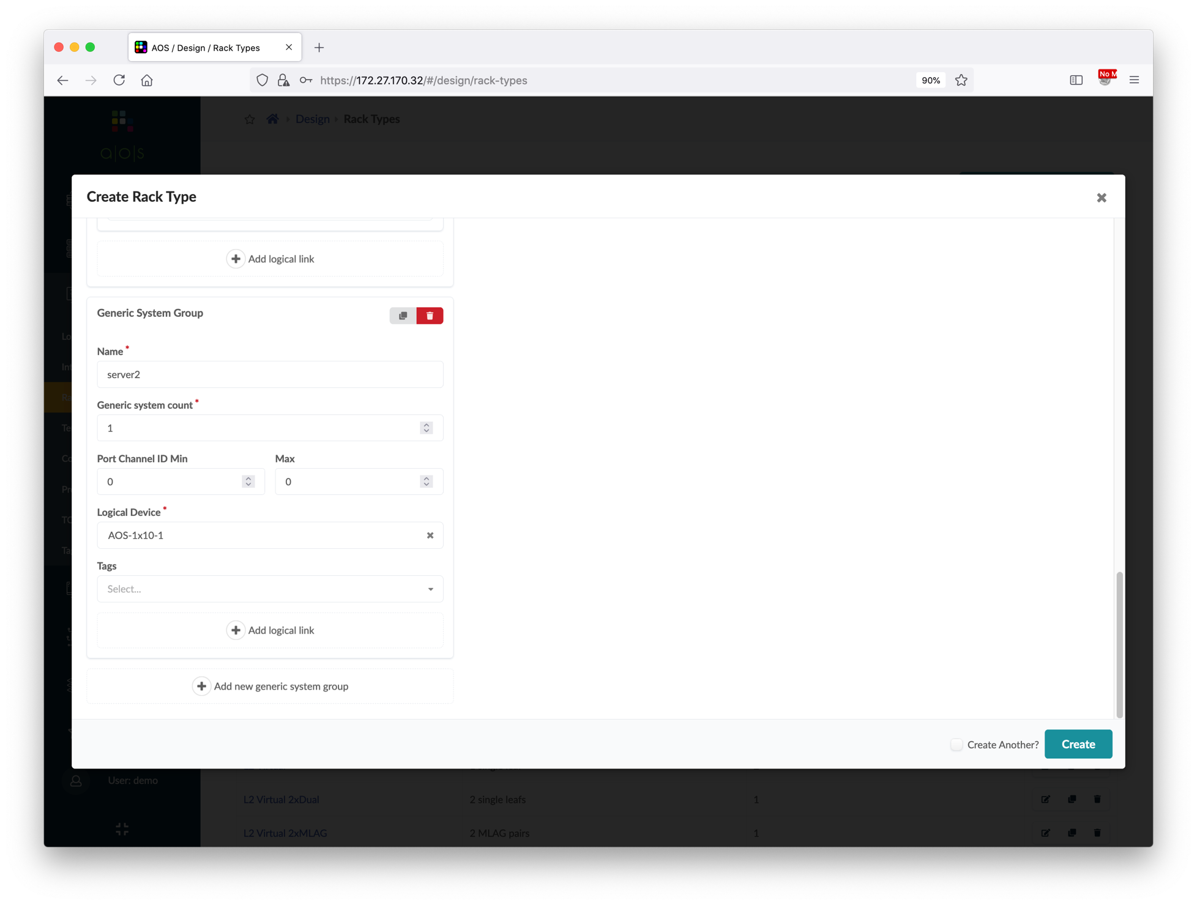
Create Server Rack Types
Click Add new generic system group to add another server.
Click Add logical link and input server link information of another server.
Verify the topology is the same as the screenshot.
Generic System Name | server2
Generic System Count | 1
Logical Device | AOS-1x10-1
①
Type the name
Logical Link Name | switch2-link1
Attachment Type | Single-Homed
Peer Leaf | Second
②
Choose the LD
③

Slide 30
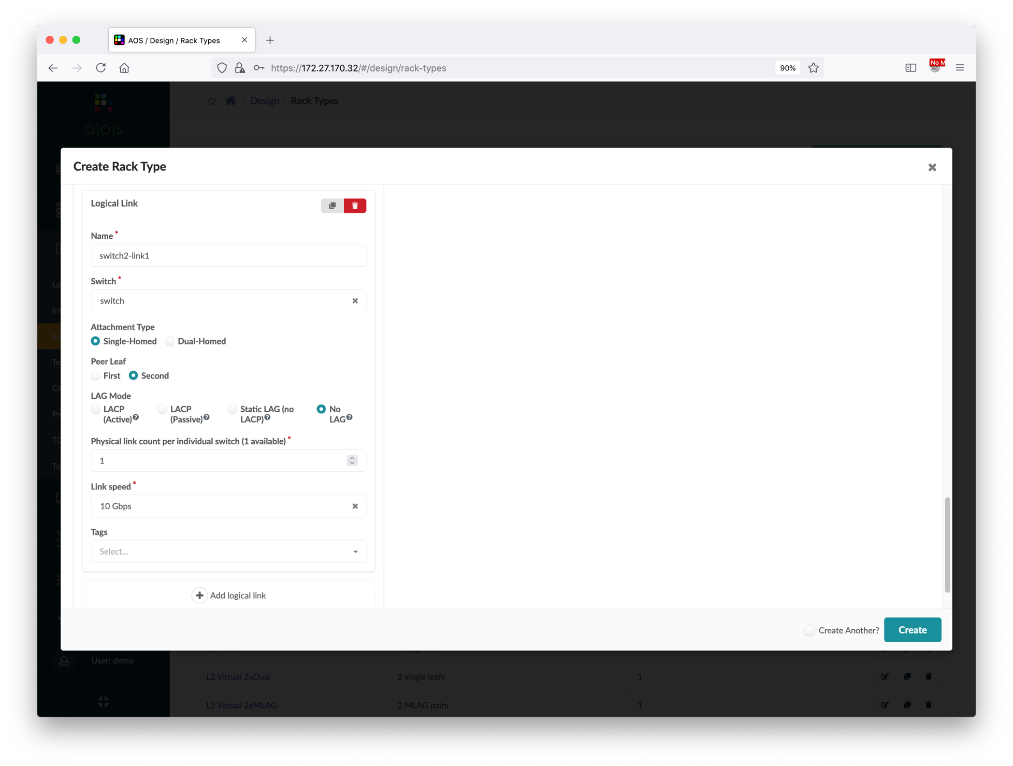
Create Server Rack Types
Click Add new generic system group to add another server.
Click Add logical link and input server link information of another server.
Verify the topology is the same as the screenshot.
Generic System Name | server2
Generic System Count | 1
Logical Device | AOS-1x10-1
①
Type the name
Logical Link Name | switch2-link1
Attachment Type | Single-Homed
Peer Leaf | Second
②
Choose the second peer leaf
③
Scroll up

Slide 31
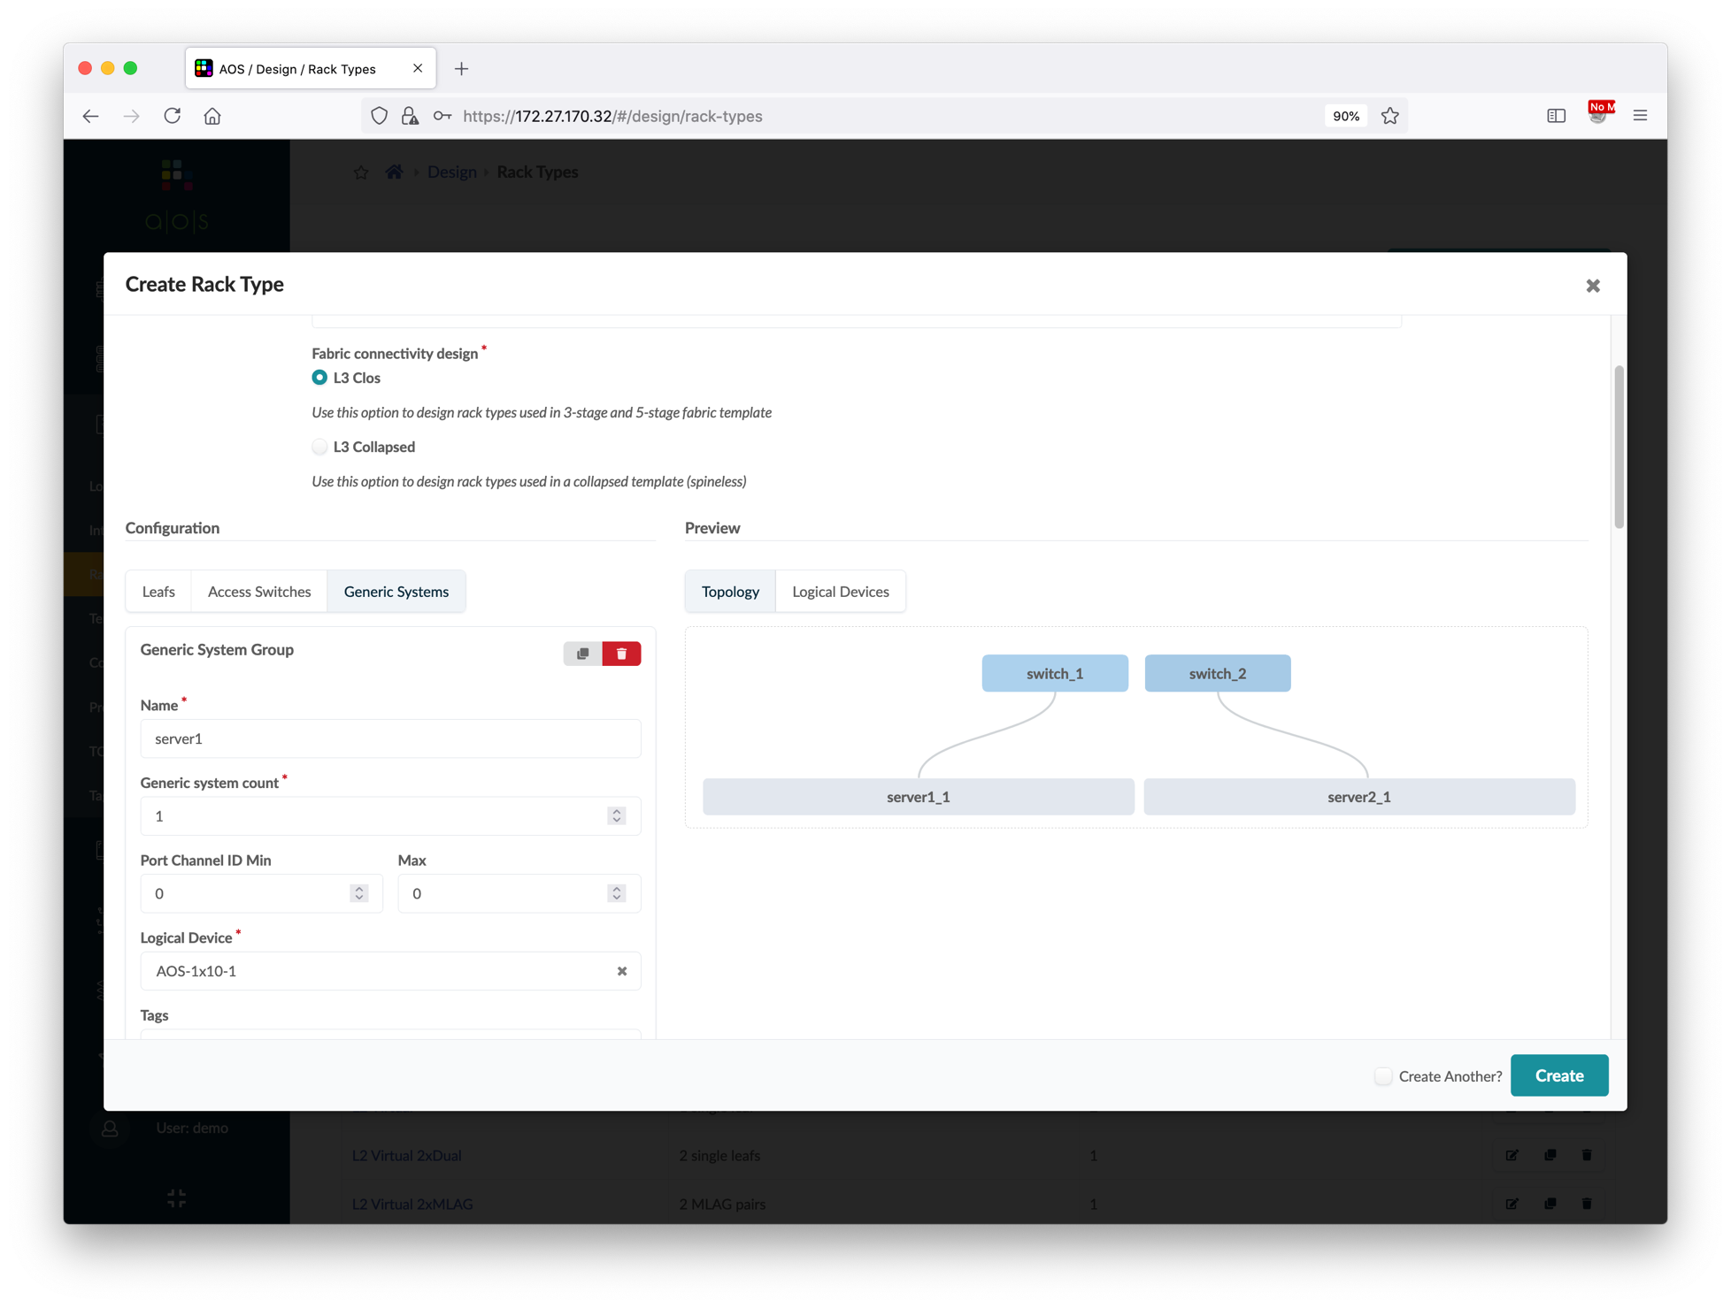
Create Server Rack Types
Click Add new generic system group to add another server.
Click Add logical link and input server link information of another server.
Verify the topology is the same as the screenshot.
Generic System Name | server2
Generic System Count | 1
Logical Device | AOS-1x10-1
Logical Link Name | switch2-link1
Attachment Type | Single-Homed
Peer Leaf | Second
①

Slide 32
Create Templates
Apstra uses templates to build typical rack designs, and it's the logical representation of a data center. In the demo setup, each data center has one pair of spine switch, one border rack and one server rack. We will create the template with these specifications.
JNPR EVPN Template
spine1
spine2
border1
border2
leaf1
leaf2
bms1
bms2
Border Rack
Server Rack

Slide 33
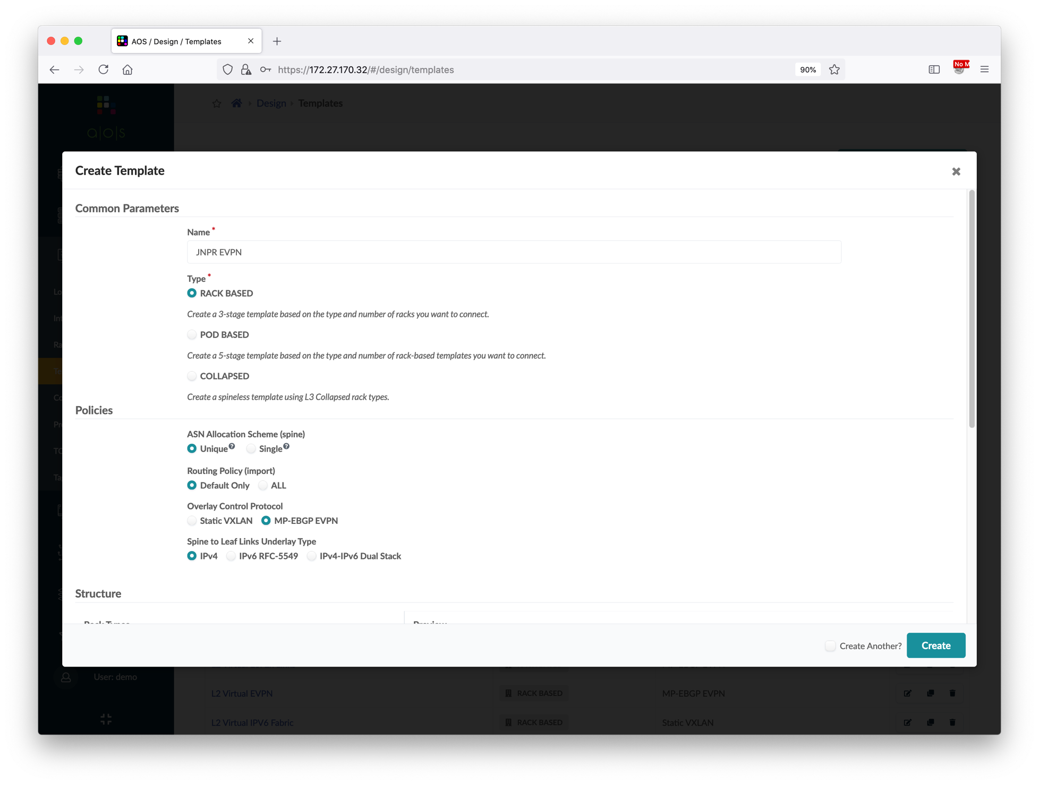
Create Templates
Go to Design > Templates, and the create a new template.
Continue the template configuration as below.
Name | JNPR EVPN
Type | RACK BASED
ASN Allocation Scheme | Unique
Routing Policy | Default Only
Overlay Control Protocol | MP-EBGP EVPN
Spine to Leaf Links Underlay Type | IPv4
①
Type the name
③
Scroll down
Rack Types #1 | Border Rack
Rack Count #1 | 1
Rack Types #2 | Server Rack
Rack Count #2 | 1
Spine Logical Device | JNPR-12x10-Spine
Spines Count | 2
②
Choose protocol

Slide 34
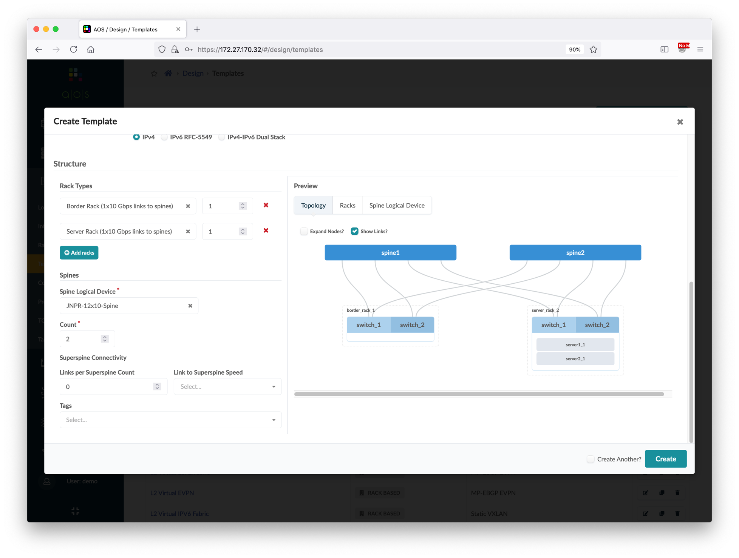
Create Templates
Go to Design > Templates, and the create a new template.
Continue the template configuration as below.
Name | JNPR EVPN
Type | RACK BASED
ASN Allocation Scheme | Unique
Routing Policy | Default Only
Overlay Control Protocol | MP-EBGP EVPN
Spine to Leaf Links Underlay Type | IPv4
②
Choose rack type and input rack count
⑤
Display links for verification
①
Add one more rack
Rack Types #1 | Border Rack
Rack Count #1 | 1
Rack Types #2 | Server Rack
Rack Count #2 | 1
Spine Logical Device | JNPR-12x10-Spine
Spines Count | 2
③
Choose spine LD
④
Input spine count
⑥

Slide 35
Create Blueprints
We can create a blueprint based on a template. A blueprint is the actual object to represent a data center. In the demo setup, there are two date centers, so we will create two blueprints based on the template we created in previous step.
After creating the blueprint, the first task is to assign the ASN and IP pool resources to various objects like spine/leaf ASN, spine/leaf loopback address and fabric link address.
Next, we will assign the interface map to link the logical devices in the blueprint to a device profile, which is vQFX in our case. And last, we will select the physical device from the managed devices list and assign to each logical device.
DataCenter-A Blueprint
DataCenter-B Blueprint
A-spine1
A-spine2
B-spine1
B-spine2
A-border1
A-border1
A-leaf1
A-leaf2
B-border1
B-border1
B-leaf1
B-leaf2
A-bms1
A-bms2
B-bms1
B-bms2
Border Rack
Server Rack
Border Rack
Server Rack

Slide 36
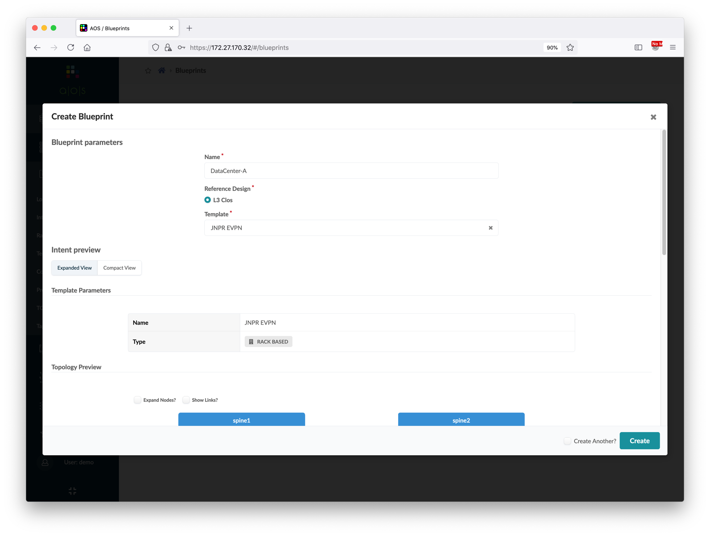
Create Blueprints
Go to Blueprints, and then create a new blueprint.
A new blueprint is created, click it to edit basic parameters such as ASN, IP, device, etc.
Select the ASN Pool, IP Pool that were defined in previous steps for this new blueprint.
Name | DataCenter-A
Template | JNPR EVPN
①
Type the name
②
Choose the template
Resource Type | Pool Name
ASNs – Spines | DataCenter-A
ASNs – Leafs | DataCenter-A
Loopback IPs – Spines | DataCenter-A Loopback
Loopback IPs – Leafs | DataCenter-A Loopback
Link IPs – Spines<->Leafs | DataCenter-A Fabric
③

Slide 37
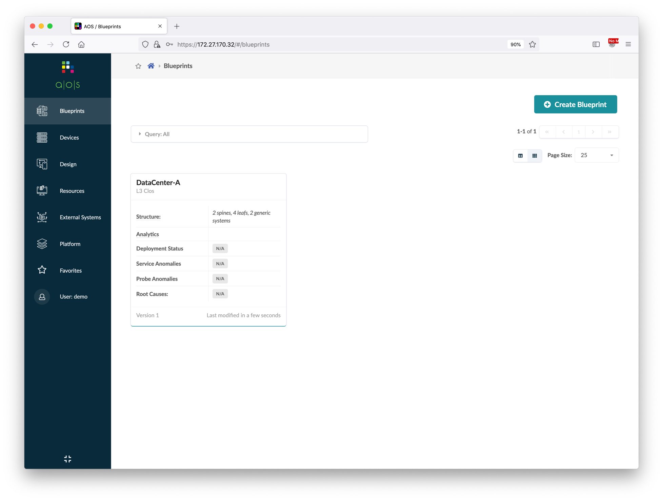
Create Blueprints
Go to Blueprints, and then create a new blueprint.
A new blueprint is created, click it to edit basic parameters such as ASN, IP, device, etc.
Select the ASN Pool, IP Pool that were defined in previous steps for this new blueprint.
Name | DataCenter-A
Template | JNPR EVPN
①
Click the name
Resource Type | Pool Name
ASNs – Spines | DataCenter-A
ASNs – Leafs | DataCenter-A
Loopback IPs – Spines | DataCenter-A Loopback
Loopback IPs – Leafs | DataCenter-A Loopback
Link IPs – Spines<->Leafs | DataCenter-A Fabric

Slide 38
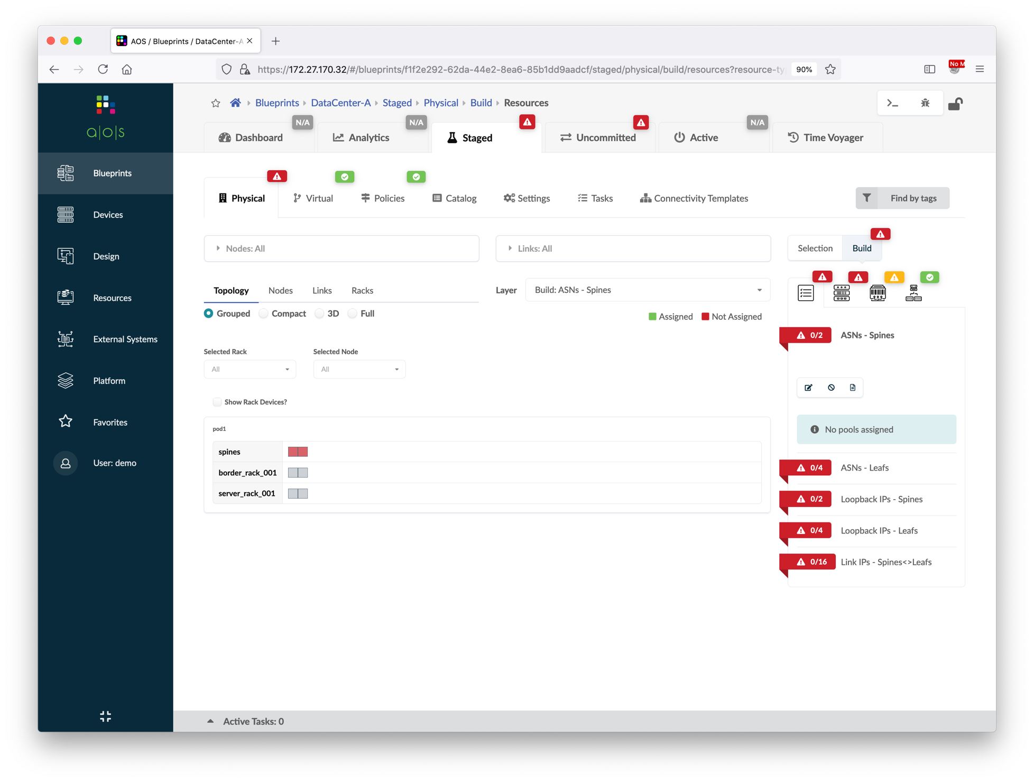
Create Blueprints
Go to Blueprints, and then create a new blueprint.
A new blueprint is created, click it to edit basic parameters such as ASN, IP, device, etc.
Select the ASN Pool, IP Pool that were defined in previous steps for this new blueprint.
Name | DataCenter-A
Template | JNPR EVPN
①
②
Resource Type | Pool Name
ASNs – Spines | DataCenter-A
ASNs – Leafs | DataCenter-A
Loopback IPs – Spines | DataCenter-A Loopback
Loopback IPs – Leafs | DataCenter-A Loopback
Link IPs – Spines<->Leafs | DataCenter-A Fabric
③

Slide 39
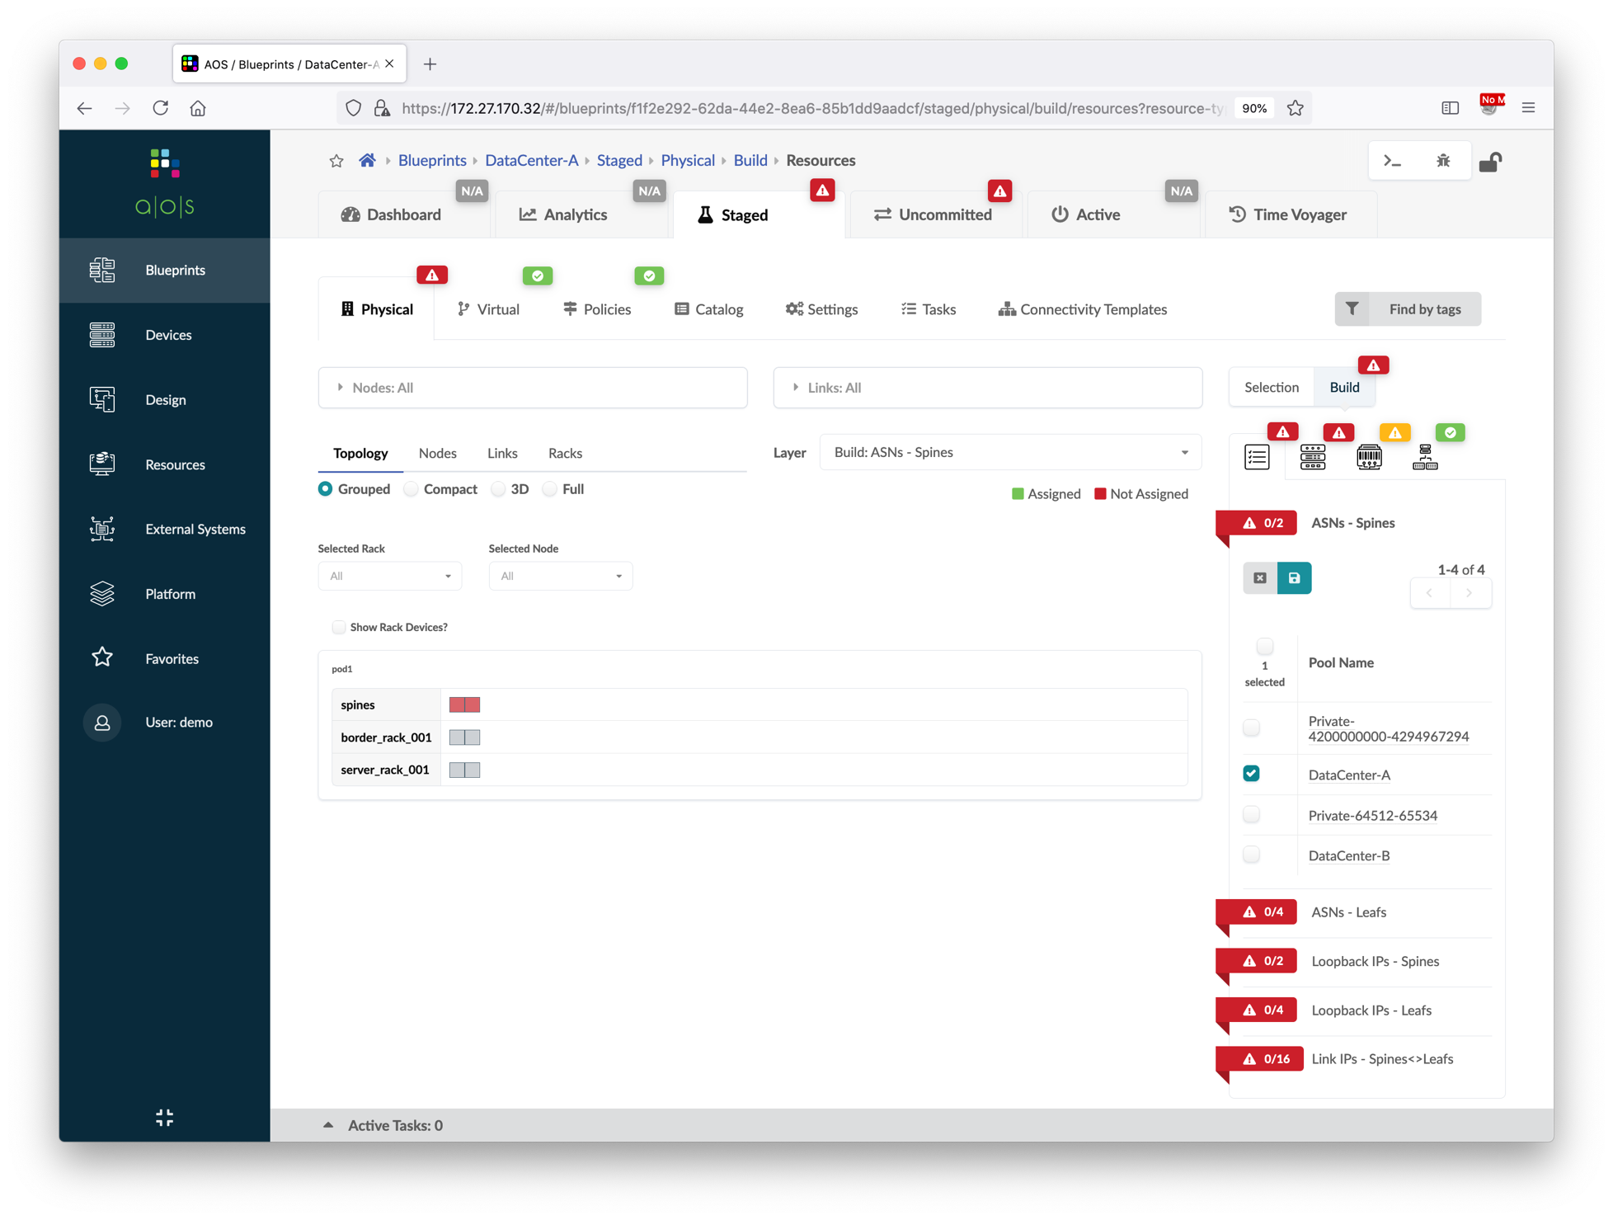
Create Blueprints
Go to Blueprints, and then create a new blueprint.
A new blueprint is created, click it to edit basic parameters such as ASN, IP, device, etc.
Select the ASN Pool, IP Pool that were defined in previous steps for this new blueprint.
Name | DataCenter-A
Template | JNPR EVPN
Resource Type | Pool Name
ASNs – Spines | DataCenter-A
ASNs – Leafs | DataCenter-A
Loopback IPs – Spines | DataCenter-A Loopback
Loopback IPs – Leafs | DataCenter-A Loopback
Link IPs – Spines<->Leafs | DataCenter-A Fabric
⑤
④

Slide 40
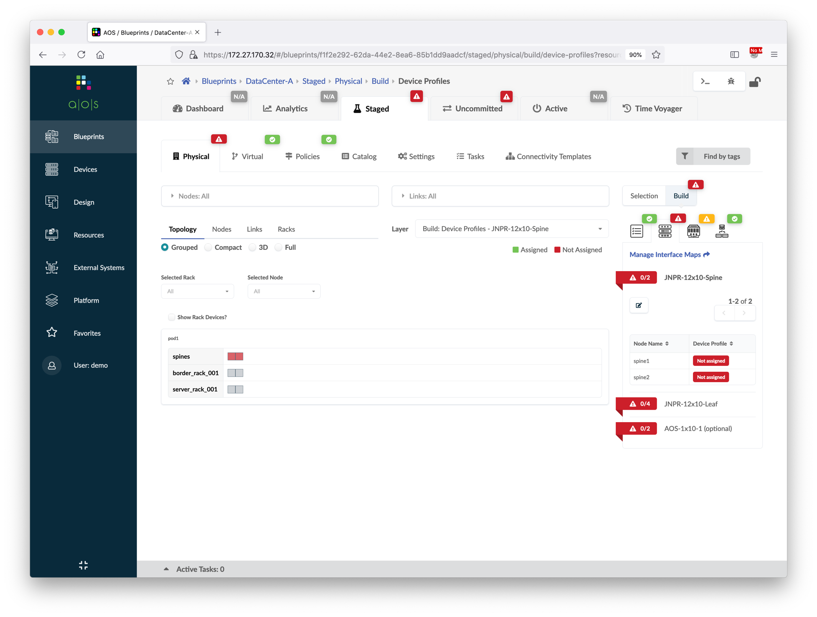
Create Blueprints
Select the interface map and device profile of each logical device.
Please note that there is no need to assign the interface map of AOS-1x10-1.
Device Name | Interface Map
spine1 | Juniper vQFX____JNPR-12x10-Spine
spine2 | Juniper vQFX____JNPR-12x10-Spine
border_rack_001_leaf1 | Juniper vQFX____JNPR-12x10-Leaf
border_rack_001_leaf2 | Juniper vQFX____JNPR-12x10-Leaf
server_rack_001_leaf1 | Juniper vQFX____JNPR-12x10-Leaf
server_rack_001_leaf2 | Juniper vQFX____JNPR-12x10-Leaf
①
②
③

Slide 41
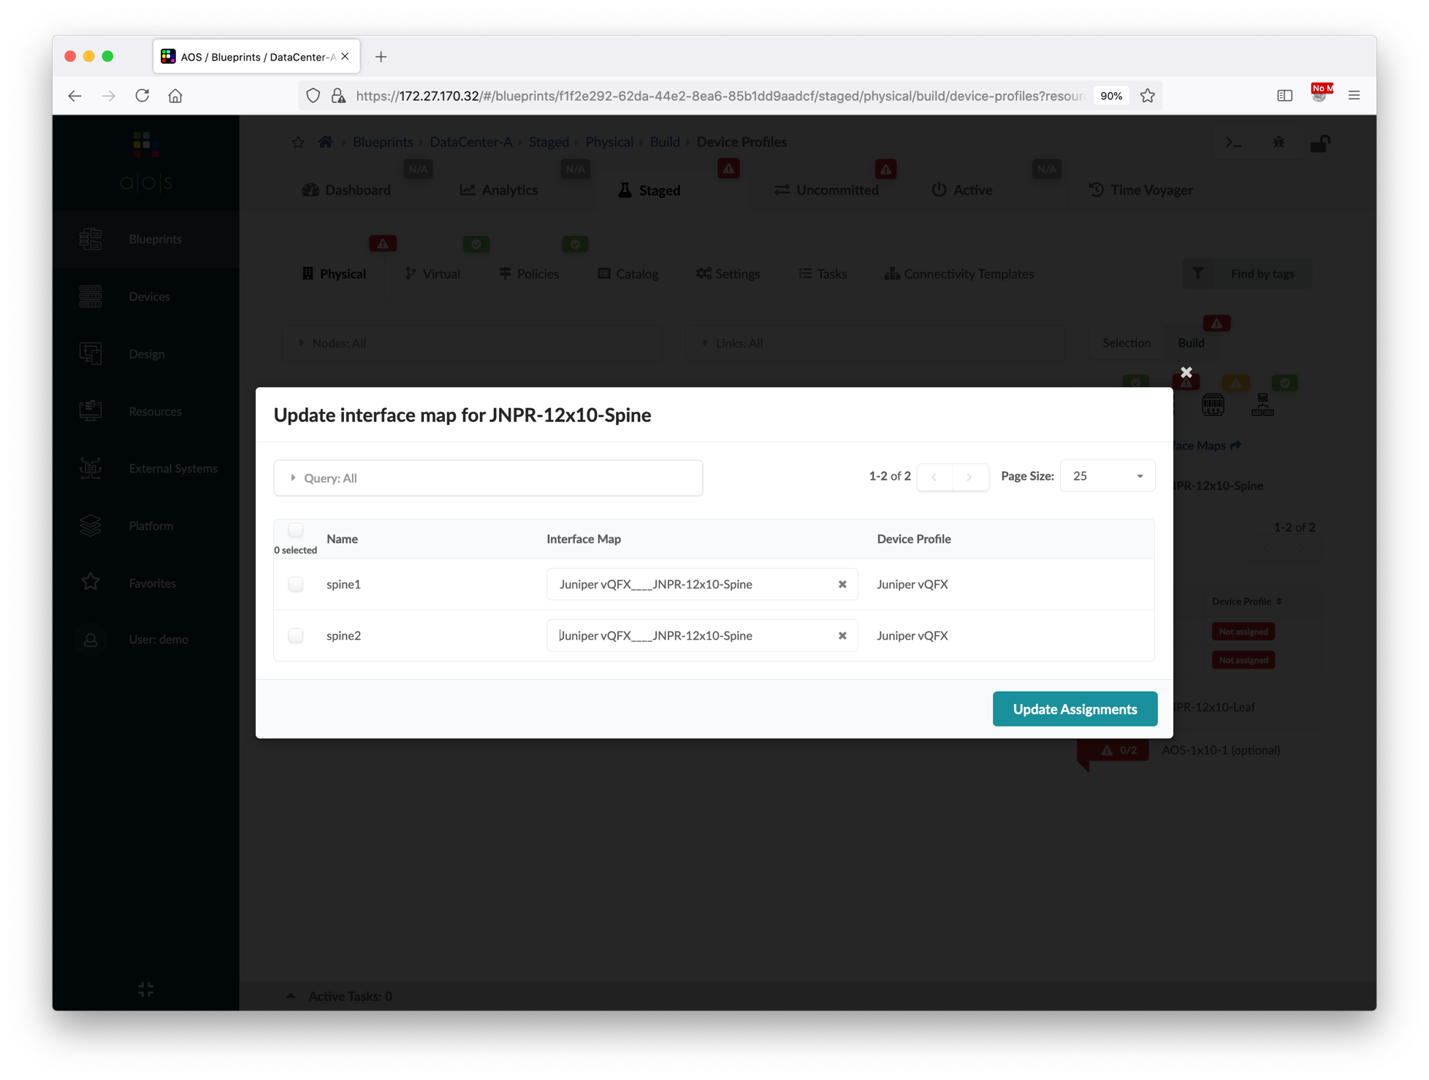
Create Blueprints
Select the interface map and device profile of each logical device.
Please note that there is no need to assign the interface map of AOS-1x10-1.
Device Name | Interface Map
spine1 | Juniper vQFX____JNPR-12x10-Spine
spine2 | Juniper vQFX____JNPR-12x10-Spine
border_rack_001_leaf1 | Juniper vQFX____JNPR-12x10-Leaf
border_rack_001_leaf2 | Juniper vQFX____JNPR-12x10-Leaf
server_rack_001_leaf1 | Juniper vQFX____JNPR-12x10-Leaf
server_rack_001_leaf2 | Juniper vQFX____JNPR-12x10-Leaf
①
Select interface map
②

Slide 42
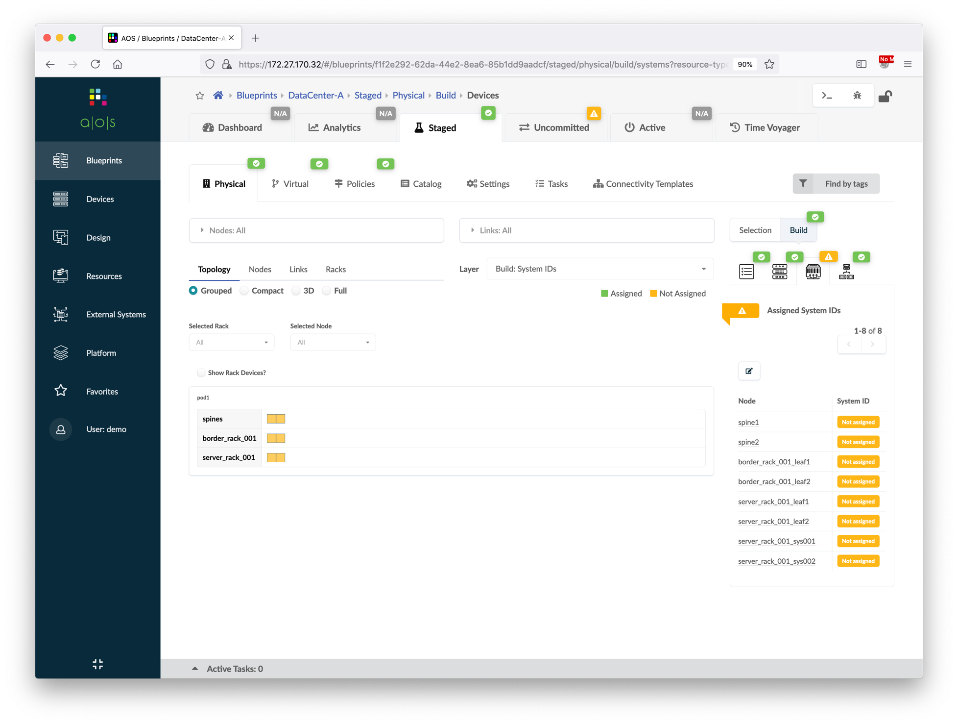
Create Blueprints
Select the physical device of each node.
Please note that there is no need to assign the physical device of generic system nodes.
Device Name | System ID
spine1 | XXXXXXXXXXXX (10.xxx.0.11)
spine2 | XXXXXXXXXXXX (10.xxx.0.12)
border_rack_001_leaf1 | XXXXXXXXXXXX (10.xxx.0.13)
border_rack_001_leaf2 | XXXXXXXXXXXX (10.xxx.0.14)
server_rack_001_leaf1 | XXXXXXXXXXXX (10.xxx.0.15)
server_rack_001_leaf2 | XXXXXXXXXXXX (10.xxx.0.16)
①
②
③

Slide 43
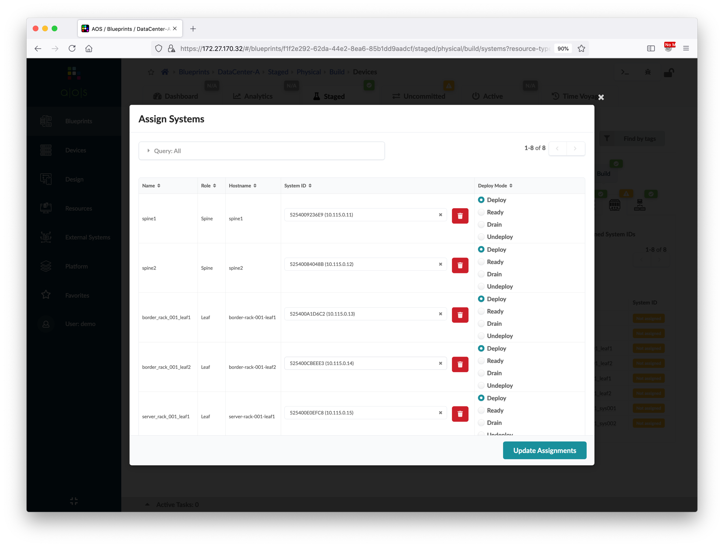
Create Blueprints
Select the physical device of each node.
Please note that there is no need to assign the physical device of generic system nodes.
Device Name | System ID
spine1 | XXXXXXXXXXXX (10.xxx.0.11)
spine2 | XXXXXXXXXXXX (10.xxx.0.12)
border_rack_001_leaf1 | XXXXXXXXXXXX (10.xxx.0.13)
border_rack_001_leaf2 | XXXXXXXXXXXX (10.xxx.0.14)
server_rack_001_leaf1 | XXXXXXXXXXXX (10.xxx.0.15)
server_rack_001_leaf2 | XXXXXXXXXXXX (10.xxx.0.16)
①
Select physical device
②

Slide 44
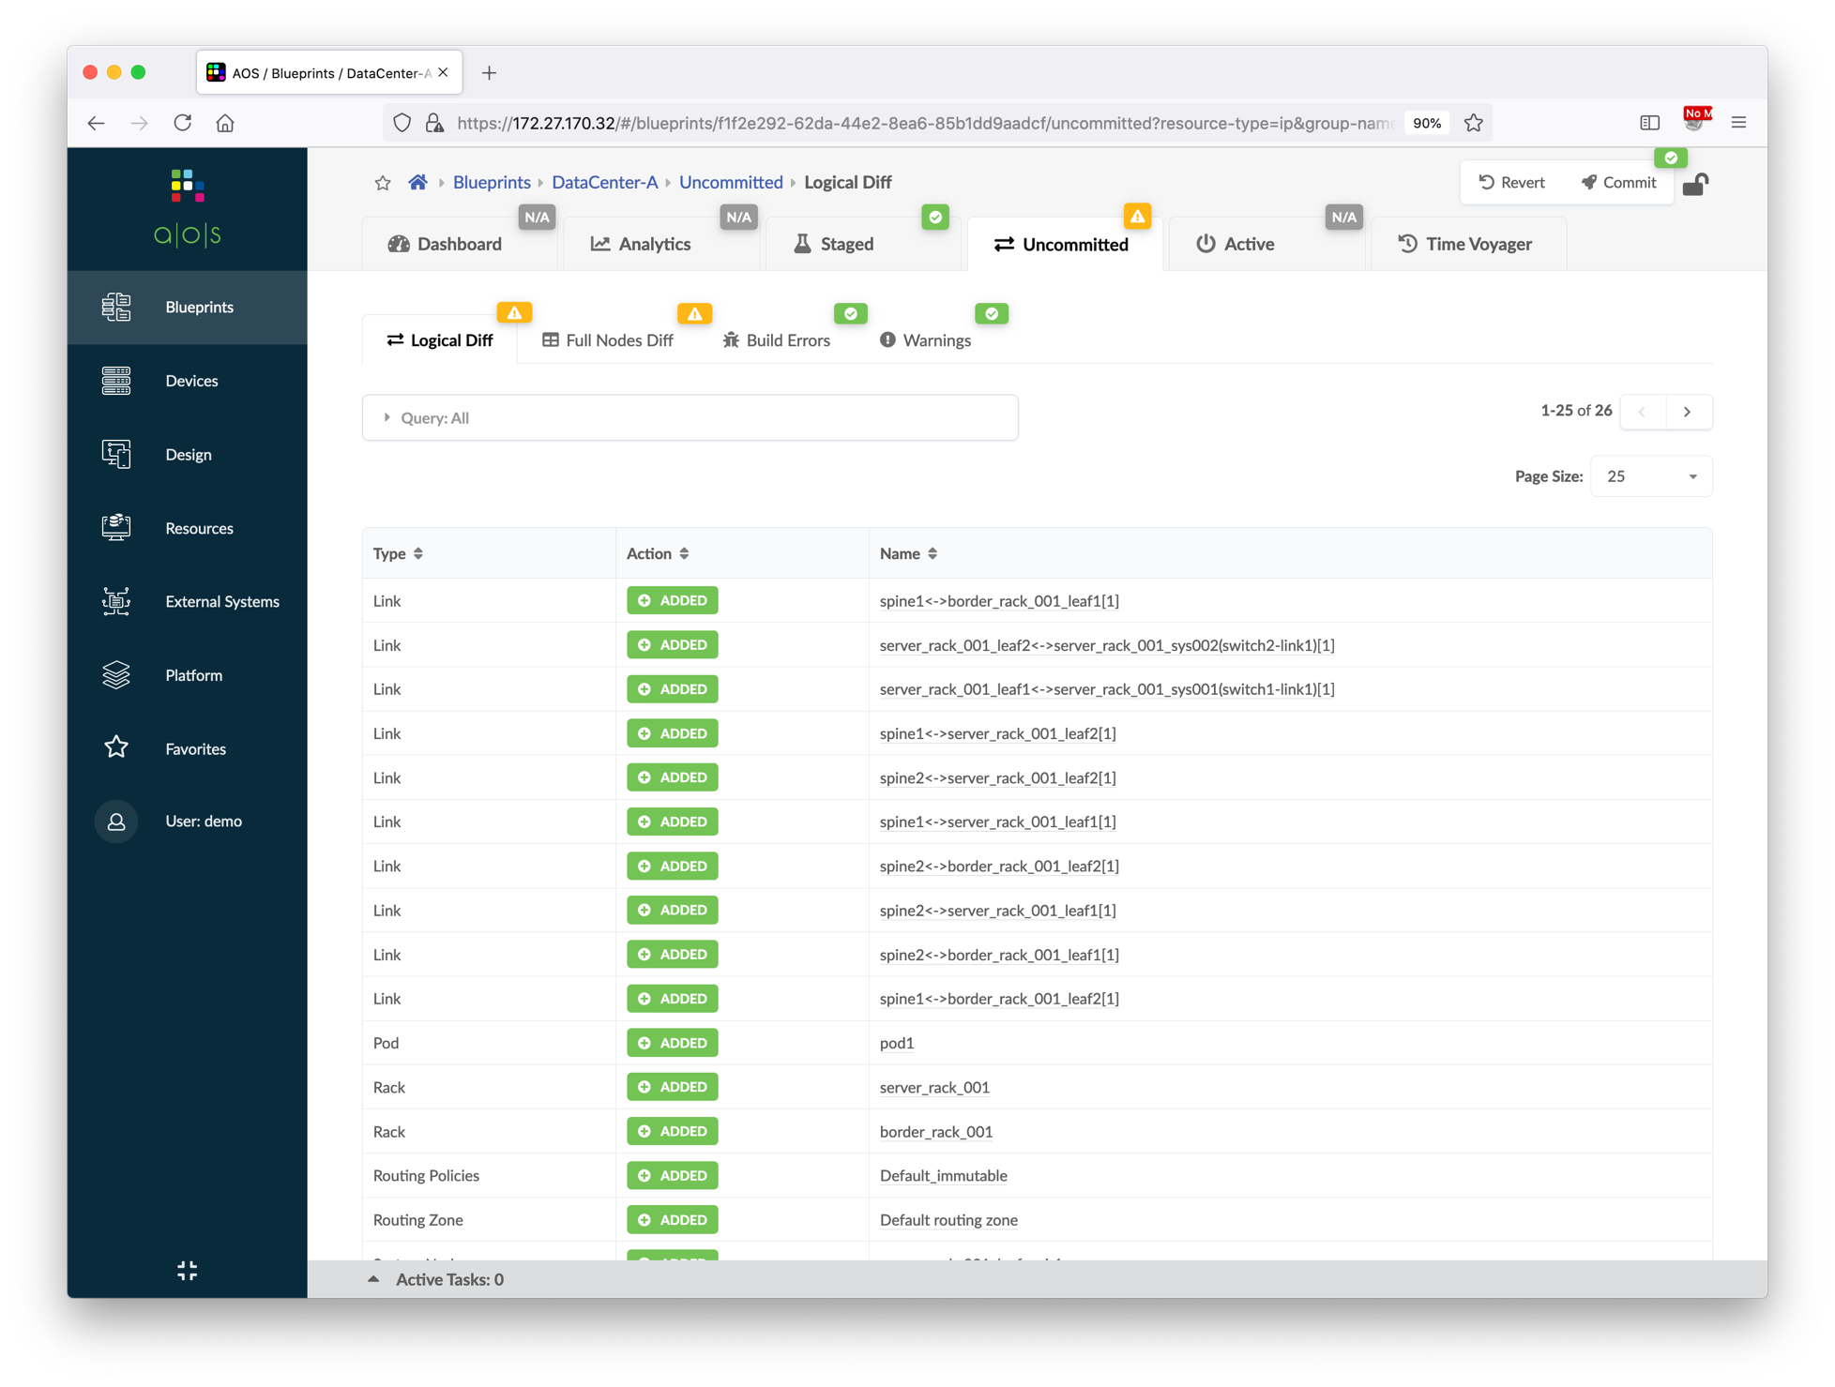
Create Blueprints
Verify the Staged icon is in green.
Commit the blueprint.
By default, the memory threshold of device system health probe is 80%, and sometimes the memory utilization of vQFX RE is ~90%, raise the threshold value to get rid of the high memory anomaly.
Verify all the status are green in the Blueprints > Dashboard.
Login to the vQFX devices and verify all BGP neighbors are established.
②
③
①
Verify the icon is green

Slide 45
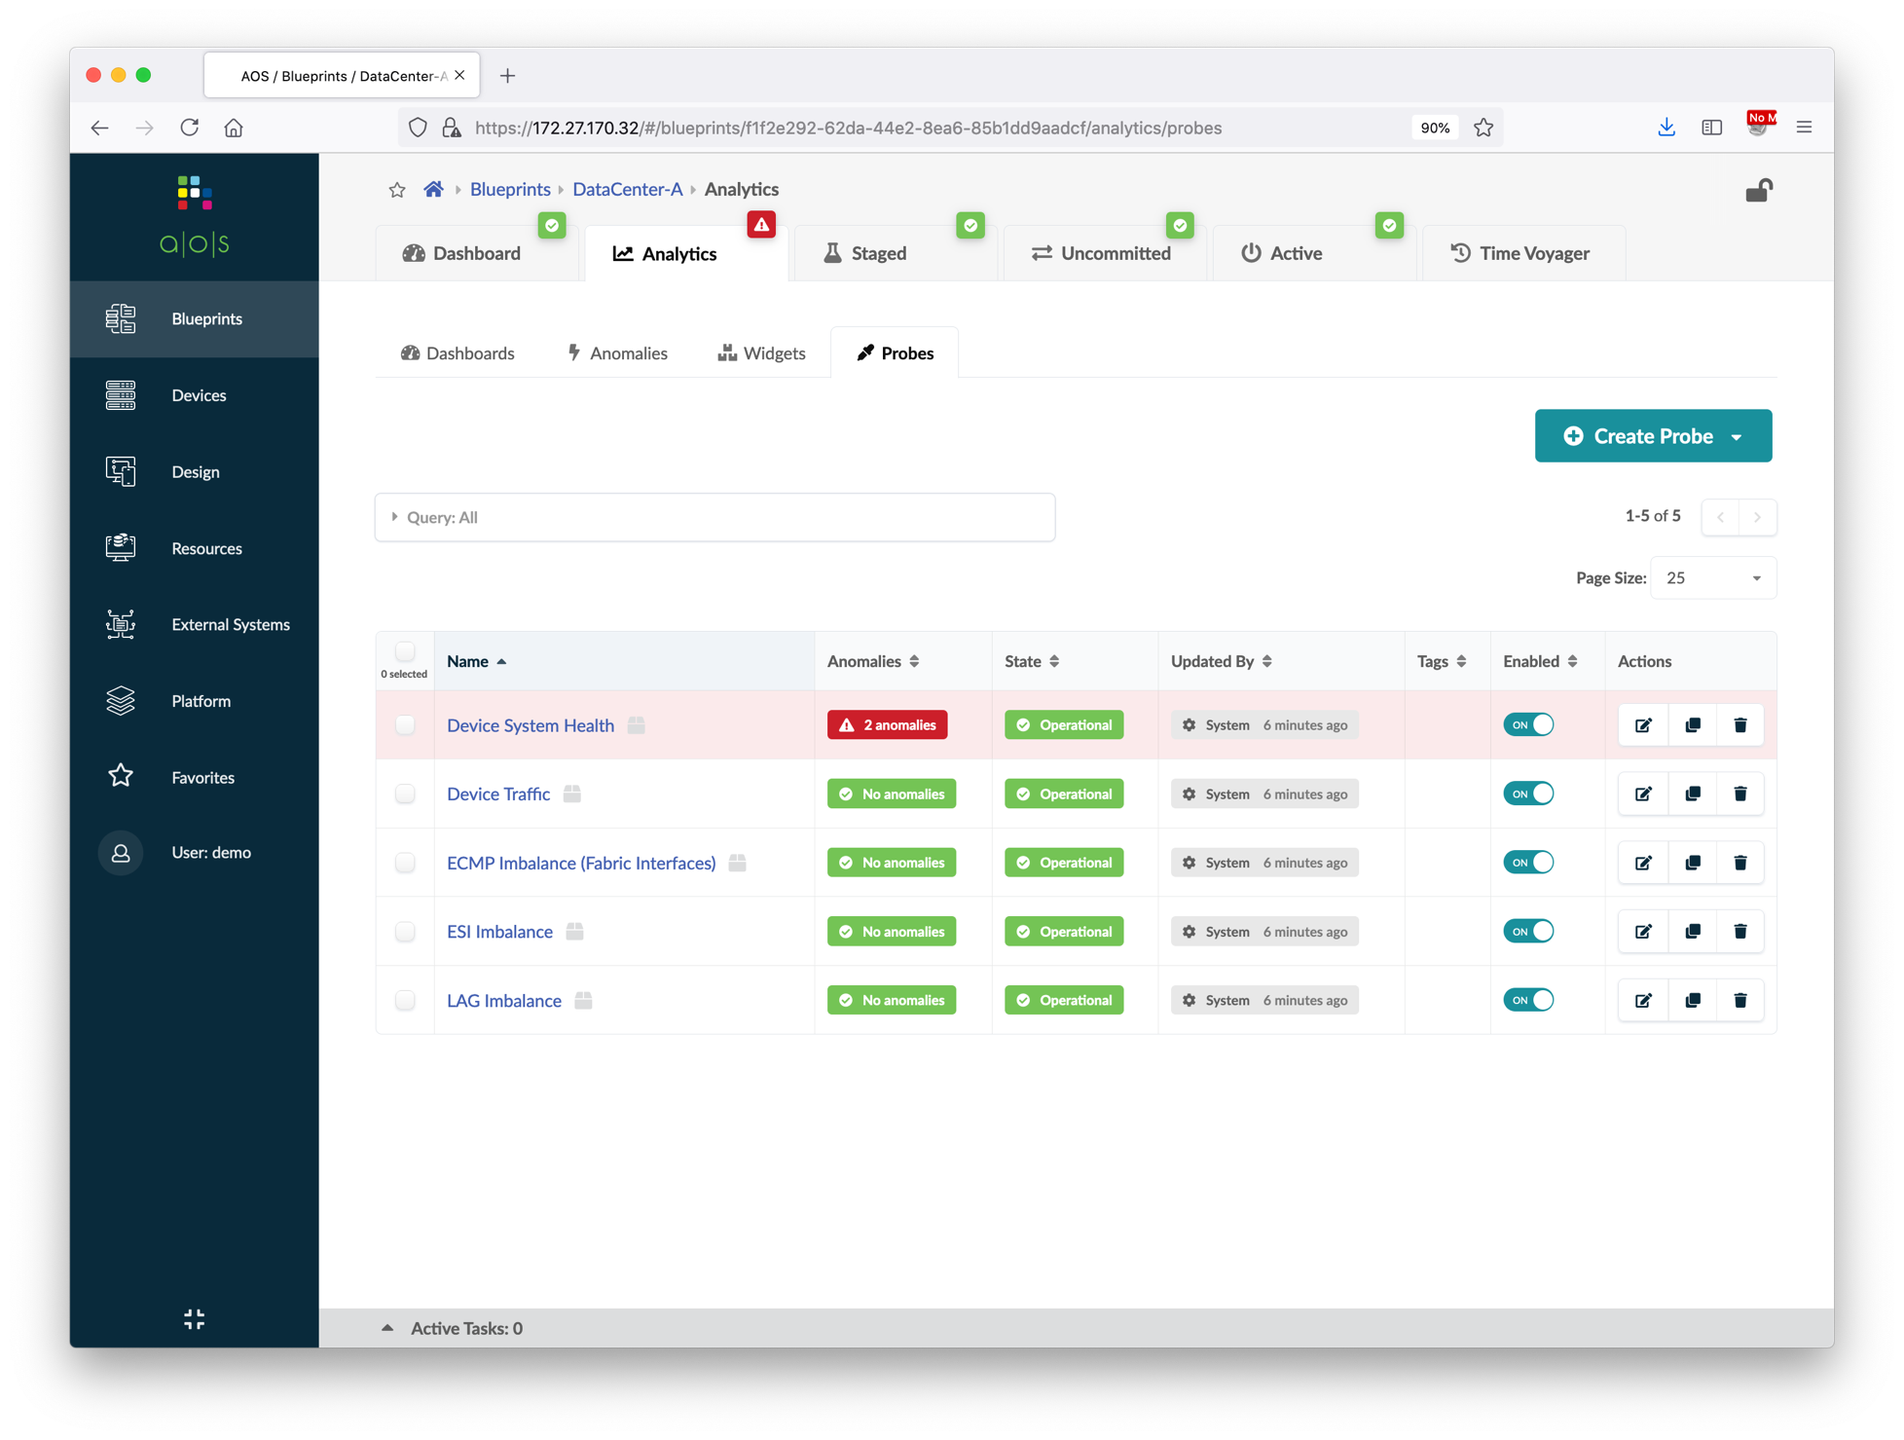
Create Blueprints
Verify the Staged icon is in green.
Commit the blueprint.
By default, the memory threshold of device system health probe is 80%, and sometimes the memory utilization of vQFX RE is ~90%, raise the threshold value to get rid of the high memory anomaly.
Verify all the status are green in the Blueprints > Dashboard.
Login to the vQFX devices and verify all BGP neighbors are established.
①
②
③

Slide 46
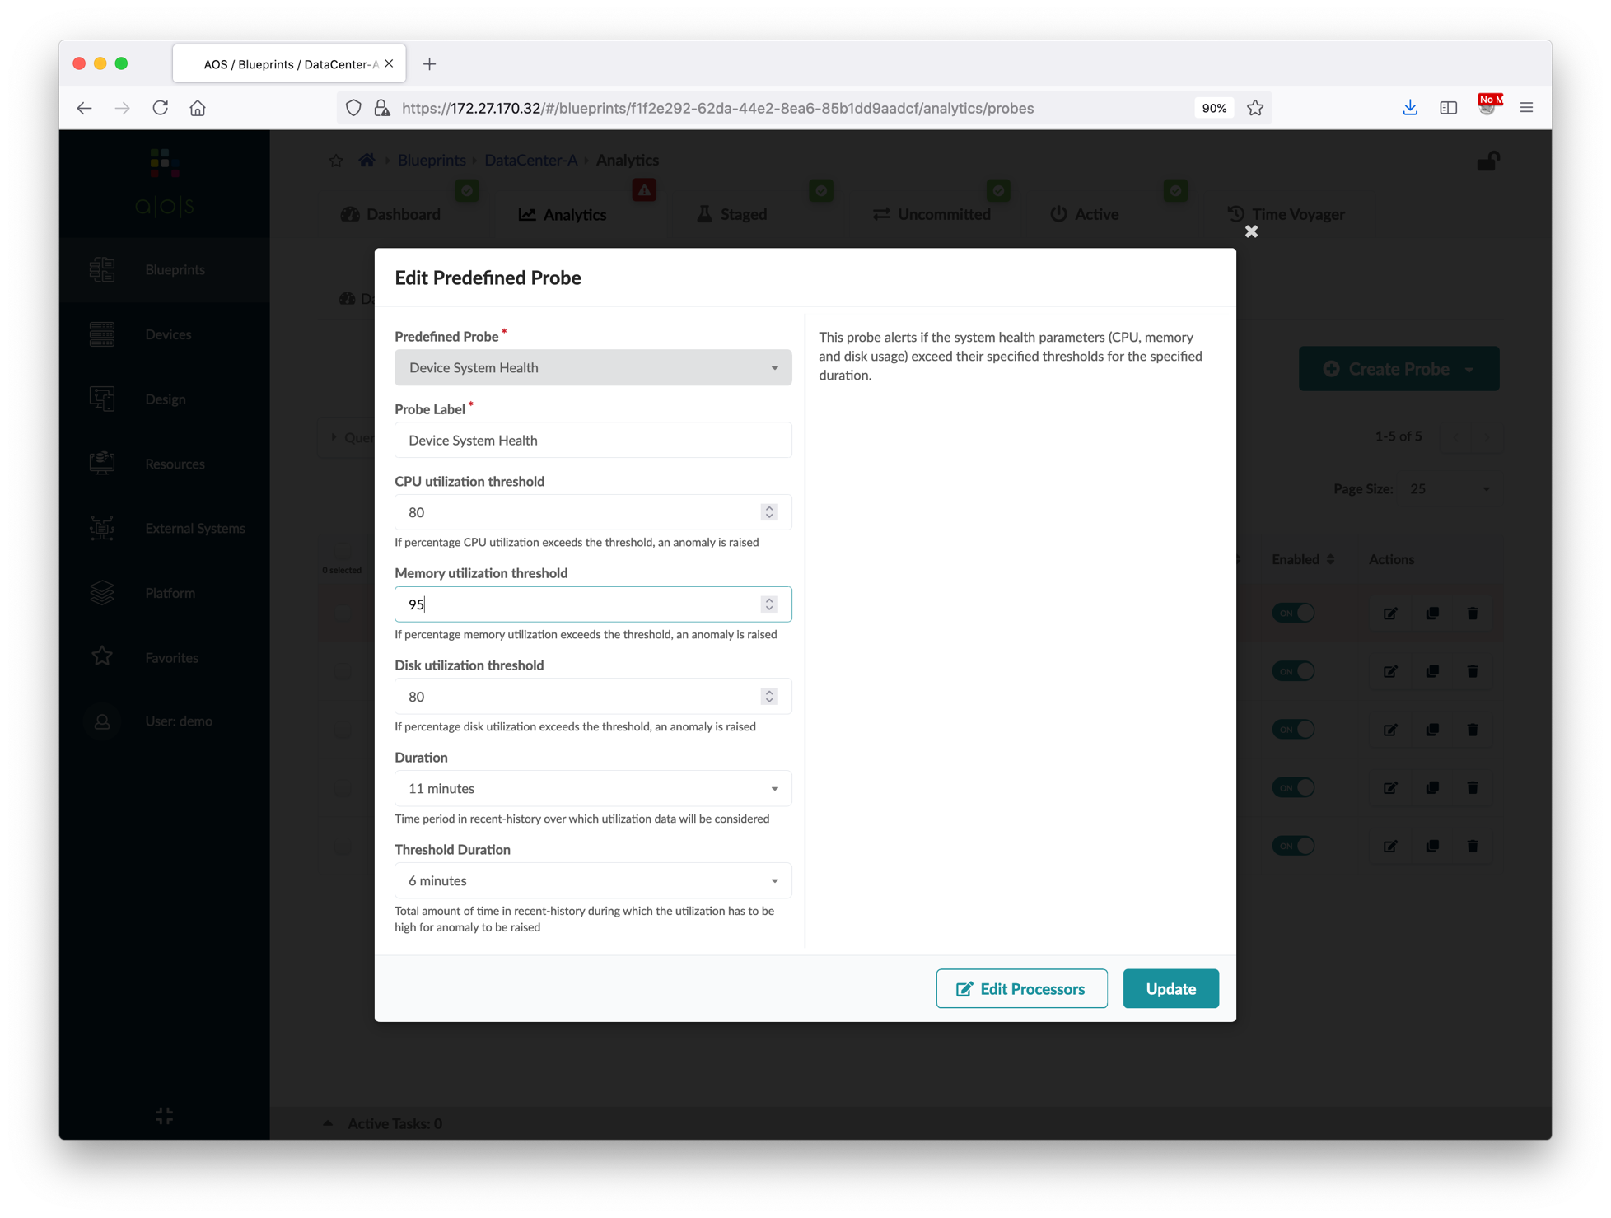
Create Blueprints
Verify the Staged icon is in green.
Commit the blueprint.
By default, the memory threshold of device system health probe is 80%, and sometimes the memory utilization of vQFX RE is ~90%, raise the threshold value to get rid of the high memory anomaly.
Verify all the status are green in the Blueprints > Dashboard.
Login to the vQFX devices and verify all BGP neighbors are established.
①
Change to 95
②

Slide 47
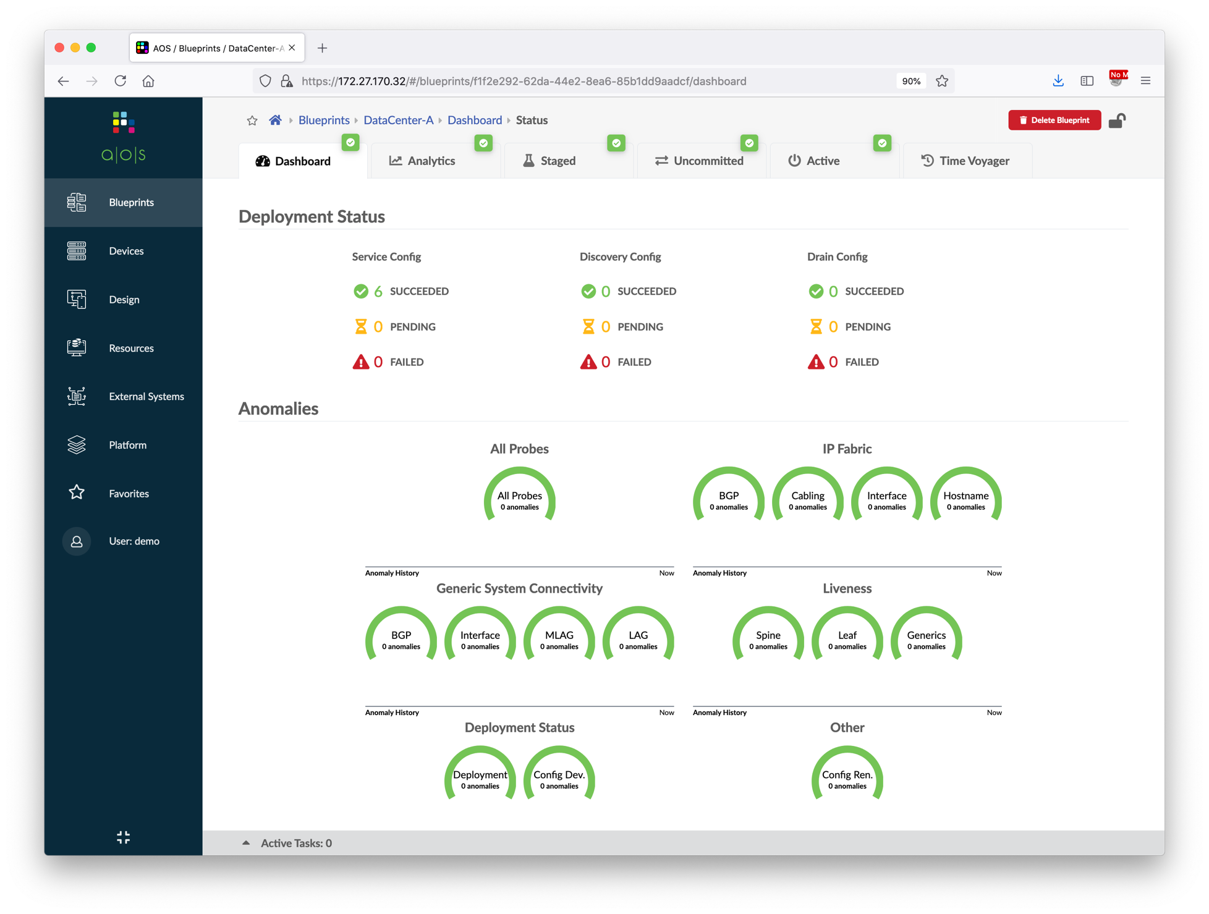
Create Blueprints
Verify the Staged icon is in green.
Commit the blueprint.
By default, the memory threshold of device system health probe is 80%, and sometimes the memory utilization of vQFX RE is ~90%, raise the threshold value to get rid of the high memory anomaly.
Verify all the status are green in the Blueprints > Dashboard.
Login to the vQFX devices and verify all BGP neighbors are established.

Slide 48
Create Blueprints
Repeat the steps to create another blueprint for DataCenter-B.
Use the resource pools with "DataCenter-B" prefix in the resource assignment.
Assign the physical devices with IP address 10.xxx.1.21 to 10.xxx.1.26 to DataCenter-B.
Verify that you had got the similar output to the screenshot on right hand side.

Slide 49
Day-1 Service Provisioning
Create Routing Zones
Create Virtual Networks
Assign Virtual Network to Switchports
Add Server Links
Data Center Interconnect
Firewall Service Chain

Slide 50
Create Routing Zones
A routing zone in Apstra refers to a routing instance in Junos device.
When creating a virtual network, we must assign it to a routing zone which cannot be change later. So, before we create the first virtual network, we need to create a routing zone.
Below diagram illustrates the topology of the data center after this section.
DataCenter-A Blueprint
Tenant-1 Routing Zone

Slide 51
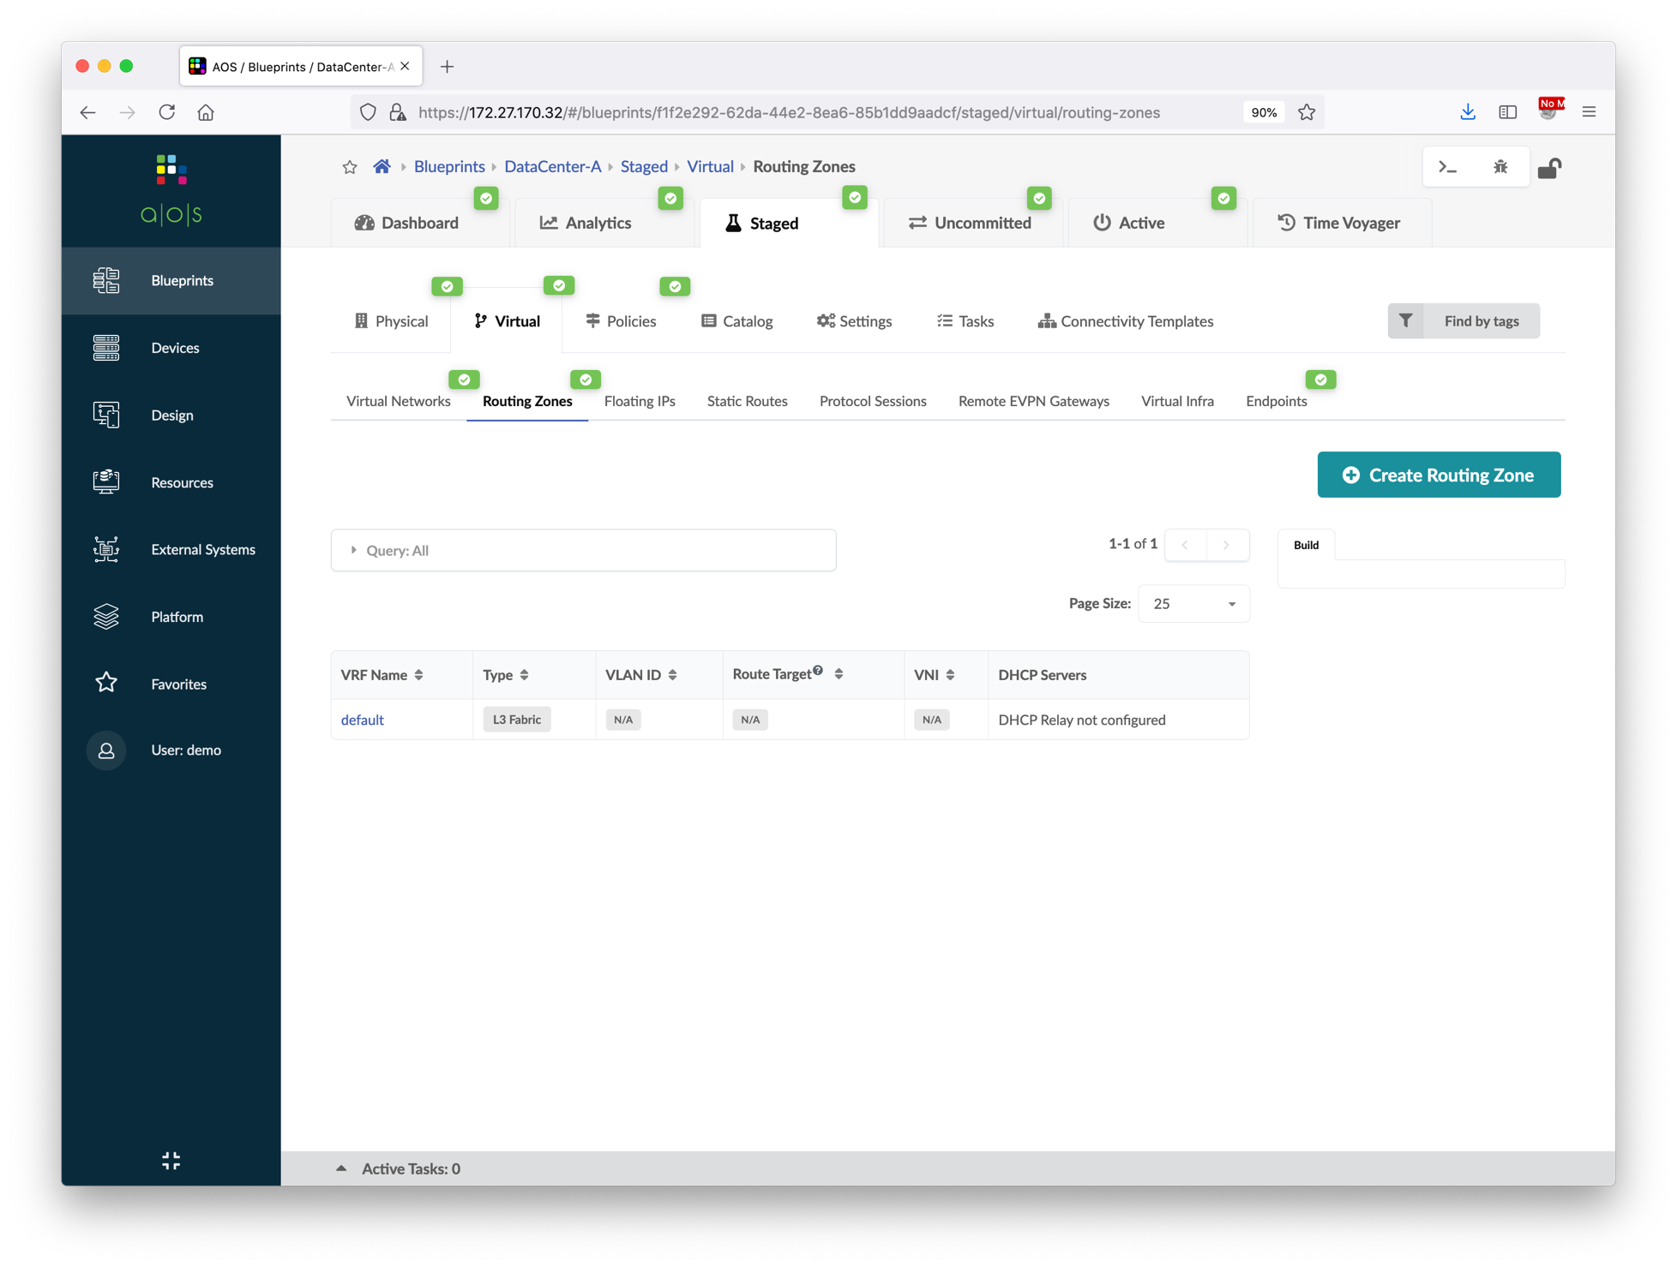
Create Routing Zones
Go to Blueprints > DataCenter-A > Staged > Virtual > Routing Zones, and then create below routing zone.
After creating the routing zone, we need to assign a loopback IP address pool to it, choose DataCenter-A Loopback.
①
VRF Name | Tenant-1
VLAN ID | 10
VNI | 10010
②
③
④

Slide 52
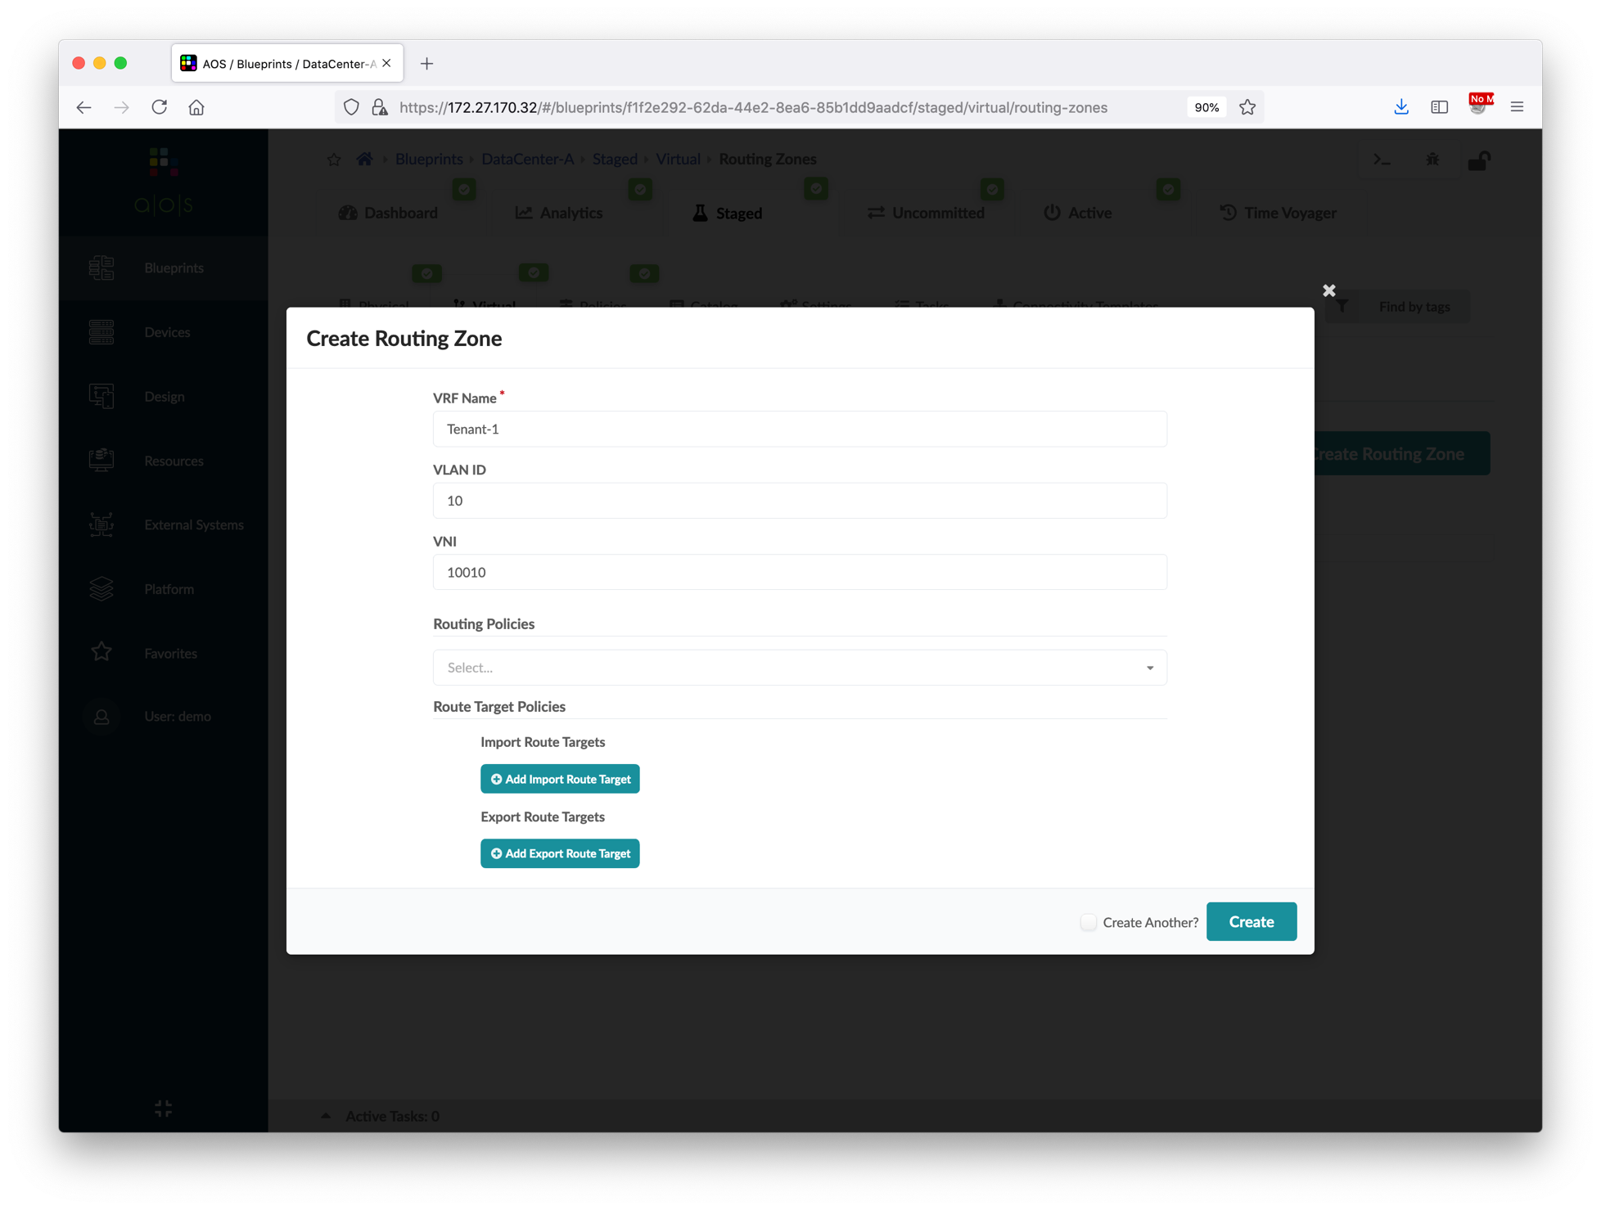
Create Routing Zones
Go to Blueprints > DataCenter-A > Staged > Virtual > Routing Zones, and then create below routing zone.
After creating the routing zone, we need to assign a loopback IP address pool to it, choose DataCenter-A Loopback.
VRF Name | Tenant-1
VLAN ID | 10
VNI | 10010
①
Input VRF name, VLAN ID and VNI
②

Slide 53
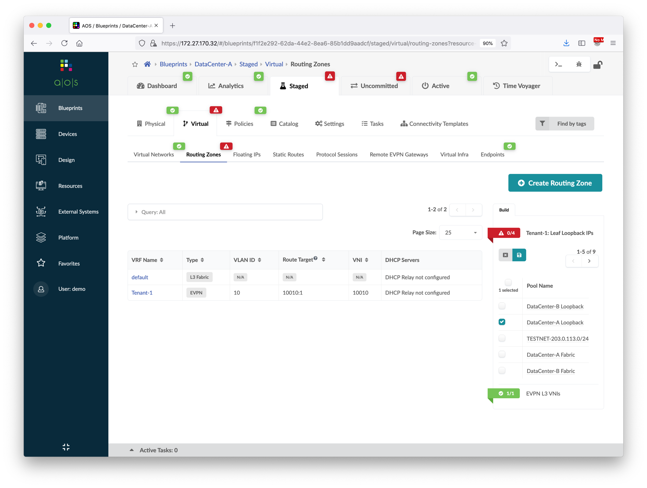
Create Routing Zones
Go to Blueprints > DataCenter-A > Staged > Virtual > Routing Zones, and then create below routing zone.
After creating the routing zone, we need to assign a loopback IP address pool to it, choose DataCenter-A Loopback.
VRF Name | Tenant-1
VLAN ID | 10
VNI | 10010
①
③
②

Slide 54
Create Virtual Networks
Next, we will create two virtual networks in Tenant-1.
Below diagram illustrates the topology of the data center after this section.
DataCenter-A Blueprint
Tenant-1 Routing Zone
vn101 (192.168.101.0/24)
vn102 (192.168.102.0/24)

Slide 55
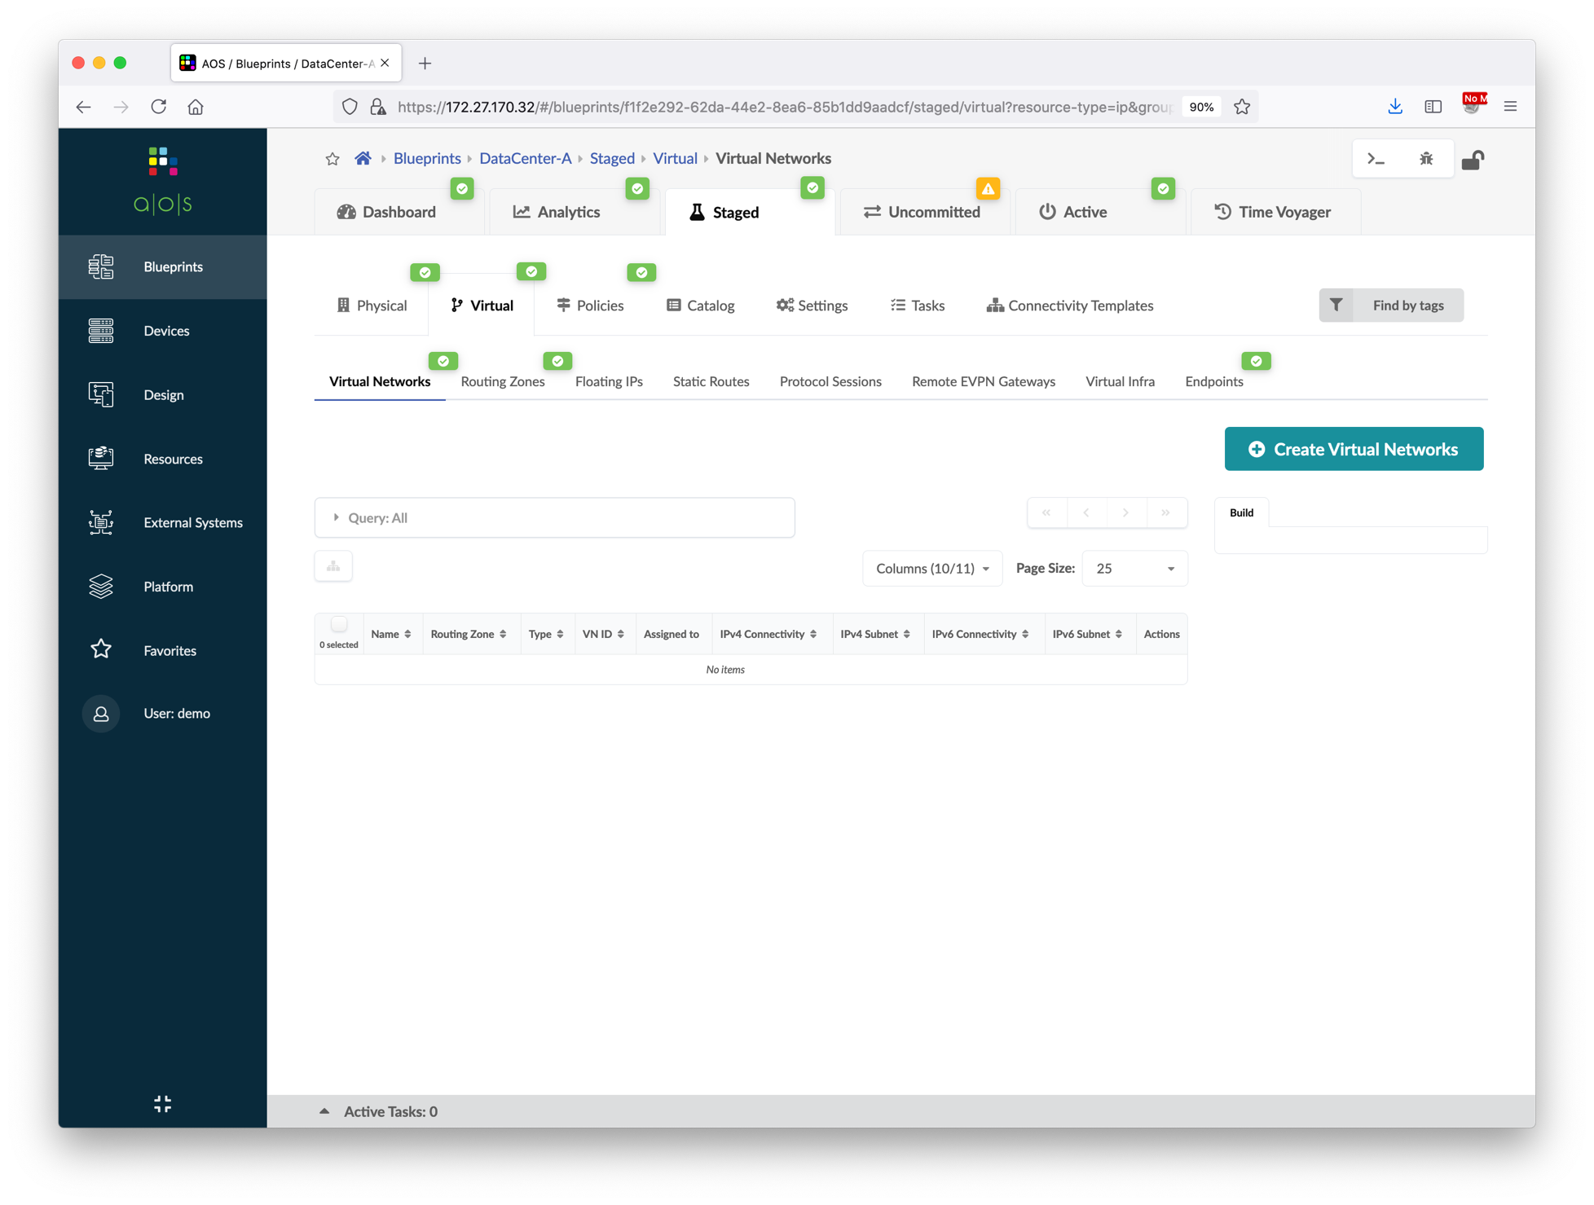
Create Virtual Networks
Go go Blueprints > DataCenter-A > Staged > Virtual > Virtual Networks, and then create below two virtual networks.
Type | VXLAN | VXLAN
Name | vn101 | vn102
Routing Zone | Tenant-1 | Tenant-1
VNI(s) | 10101 | 10102
Set same VLAN ID on all leafs? | Yes | Yes
VLAN ID (on leafs) | 101 | 102
IPv4 Subnet | 192.168.101.0/24 | 192.168.102.0/24
Virtual Gateway IPv4 | 192.168.101.1 | 192.168.102.1
Create Connectivity Templates for | Untagged | Untagged
Assign To Rack | server_rack_001_leaf_pair1 | server_rack_001_leaf_pair1
①
②

Slide 56
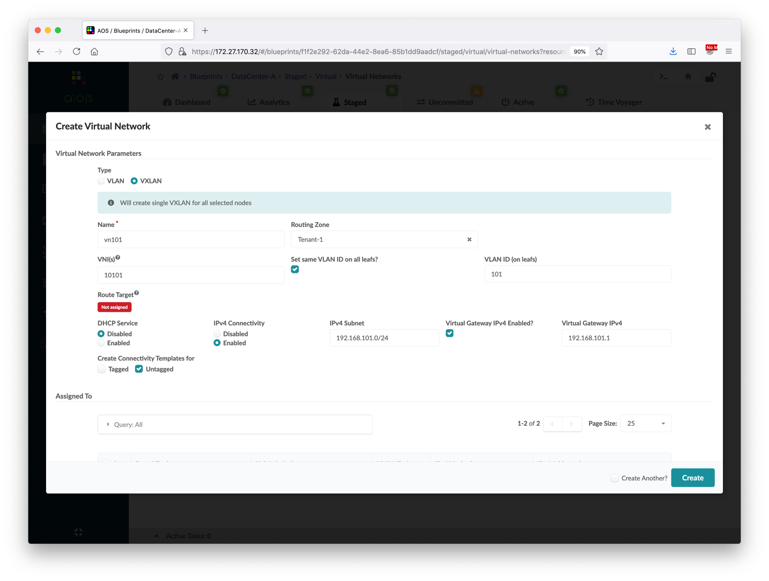
Create Virtual Networks
Go go Blueprints > DataCenter-A > Staged > Virtual > Virtual Networks, and then create below two virtual networks.
Type | VXLAN | VXLAN
Name | vn101 | vn102
Routing Zone | Tenant-1 | Tenant-1
VNI(s) | 10101 | 10102
Set same VLAN ID on all leafs? | Yes | Yes
VLAN ID (on leafs) | 101 | 102
IPv4 Subnet | 192.168.101.0/24 | 192.168.102.0/24
Virtual Gateway IPv4 | 192.168.101.1 | 192.168.102.1
Create Connectivity Templates for | Untagged | Untagged
Assign To Rack | server_rack_001_leaf_pair1 | server_rack_001_leaf_pair1
①
Choose VXLAN
②
Input Name, Routing Zone, VNI
④
Input VLAN ID
③
⑤
Input subnet and gateway
⑥
⑦
Scroll down

Slide 57
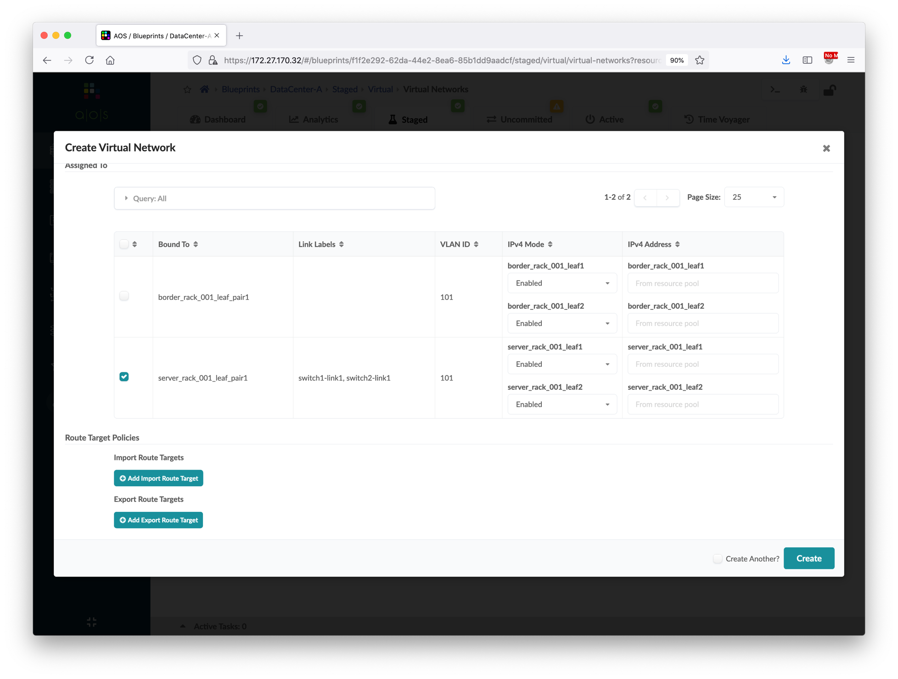
Create Virtual Networks
Go go Blueprints > DataCenter-A > Staged > Virtual > Virtual Networks, and then create below two virtual networks.
Type | VXLAN | VXLAN
Name | vn101 | vn102
Routing Zone | Tenant-1 | Tenant-1
VNI(s) | 10101 | 10102
Set same VLAN ID on all leafs? | Yes | Yes
VLAN ID (on leafs) | 101 | 102
IPv4 Subnet | 192.168.101.0/24 | 192.168.102.0/24
Virtual Gateway IPv4 | 192.168.101.1 | 192.168.102.1
Create Connectivity Templates for | Untagged | Untagged
Assign To Rack | server_rack_001_leaf_pair1 | server_rack_001_leaf_pair1
①
②

Slide 58
Assign Virtual Network to Switchports
When creating the virtual networks, we have chosen to create untagged connectivity template automatically. With connectivity templates you can apply various network configurations to devices connected to generic systems. The auto-gen untagged connectivity template will be used to assign untagged VLAN to a switch port.
Below diagram illustrates the topology of the data center after this section.
DataCenter-A Blueprint
Tenant-1 Routing Zone
vn101 (192.168.101.0/24)
vn102 (192.168.102.0/24)
To A-leaf1
xe-0/0/2
To A-leaf2
xe-0/0/2
A-bms1
A-bms2
192.168.101.11
192.168.102.22

Slide 59
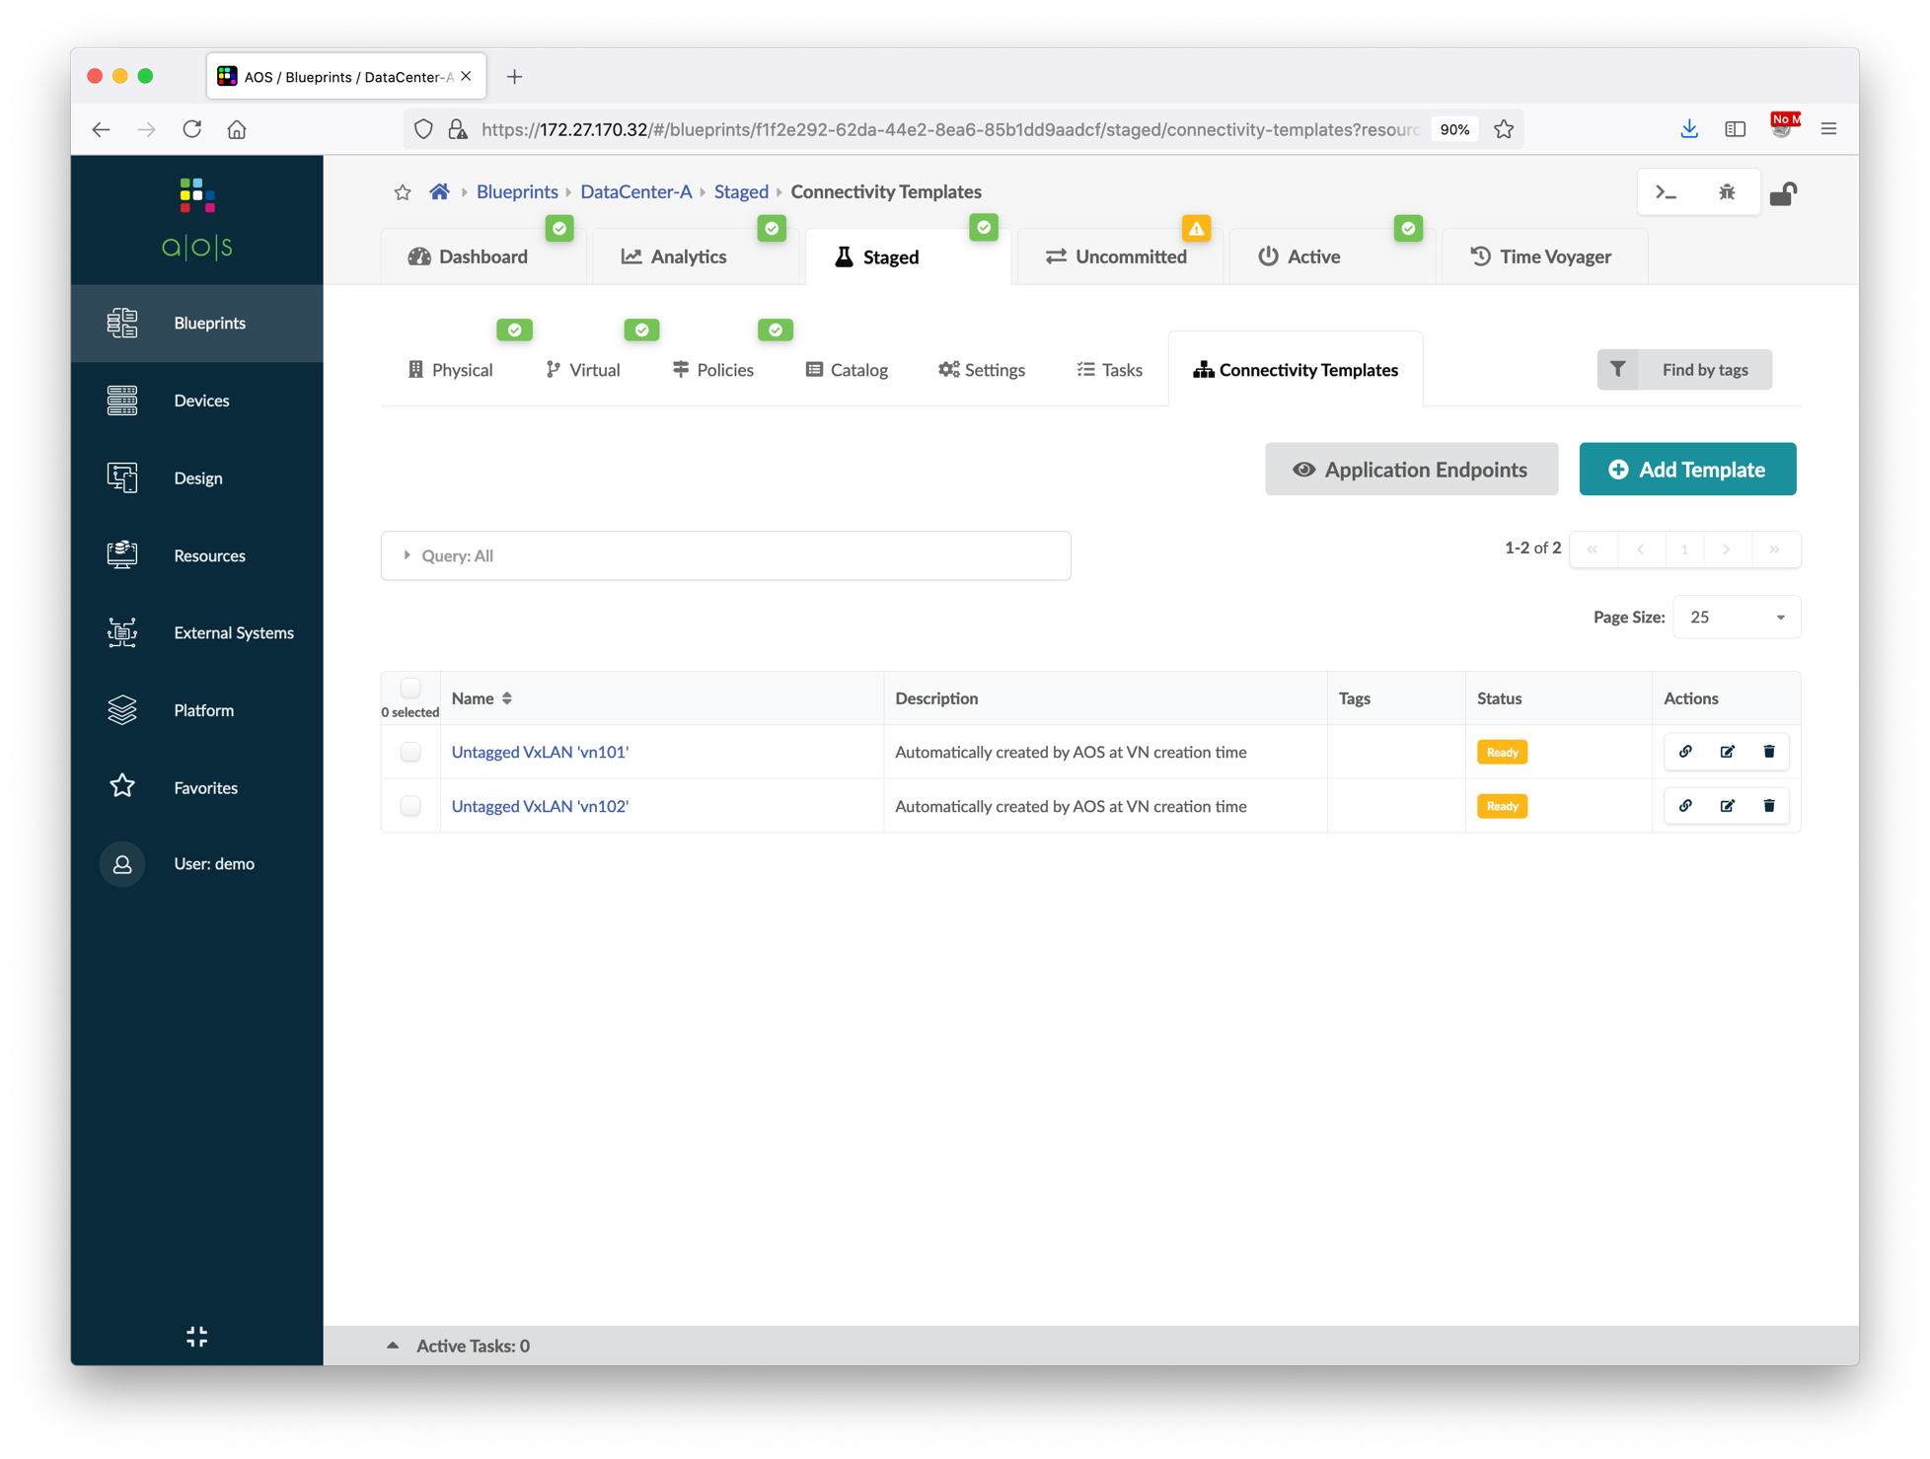
Assign Virtual Network to Switchports
Go to Blueprints > DataCenter-A > Staged > Connectivity Templates, and then click the assign button of connectivity template.
Select the target interface.
Verify the status of both connectivity templates and click Application Endpoints to view the overall status.
From the application endpoints page, you can view the assigned template for each switch ports.
Commit the blueprint.
①
VN | Switch Name | Interface
vn101 | server_rack_001_leaf1 | xe-0/0/2
vn102 | server_rack_001_leaf2 | xe-0/0/2
②

Slide 60
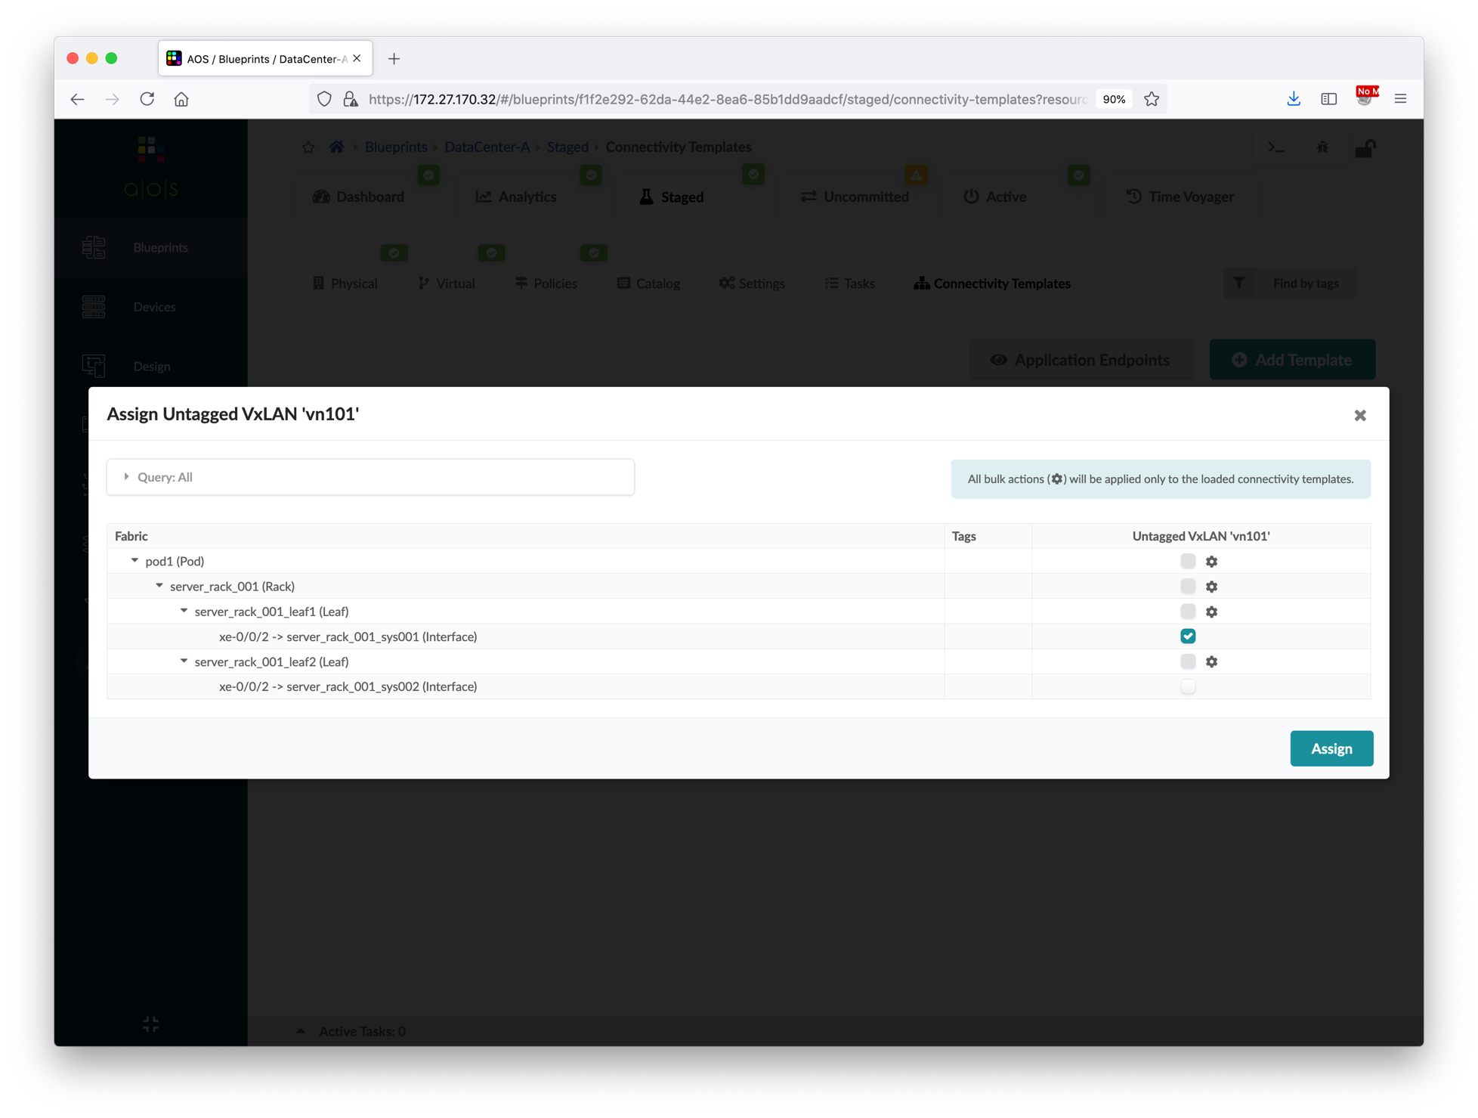
Assign Virtual Network to Switchports
Go to Blueprints > DataCenter-A > Staged > Connectivity Templates, and then click the assign button of connectivity template.
Select the target interface.
Verify the status of both connectivity templates and click Application Endpoints to view the overall status.
From the application endpoints page, you can view the assigned template for each switch ports.
Commit the blueprint.
VN | Switch Name | Interface
vn101 | server_rack_001_leaf1 | xe-0/0/2
vn102 | server_rack_001_leaf2 | xe-0/0/2
①
②

Slide 61
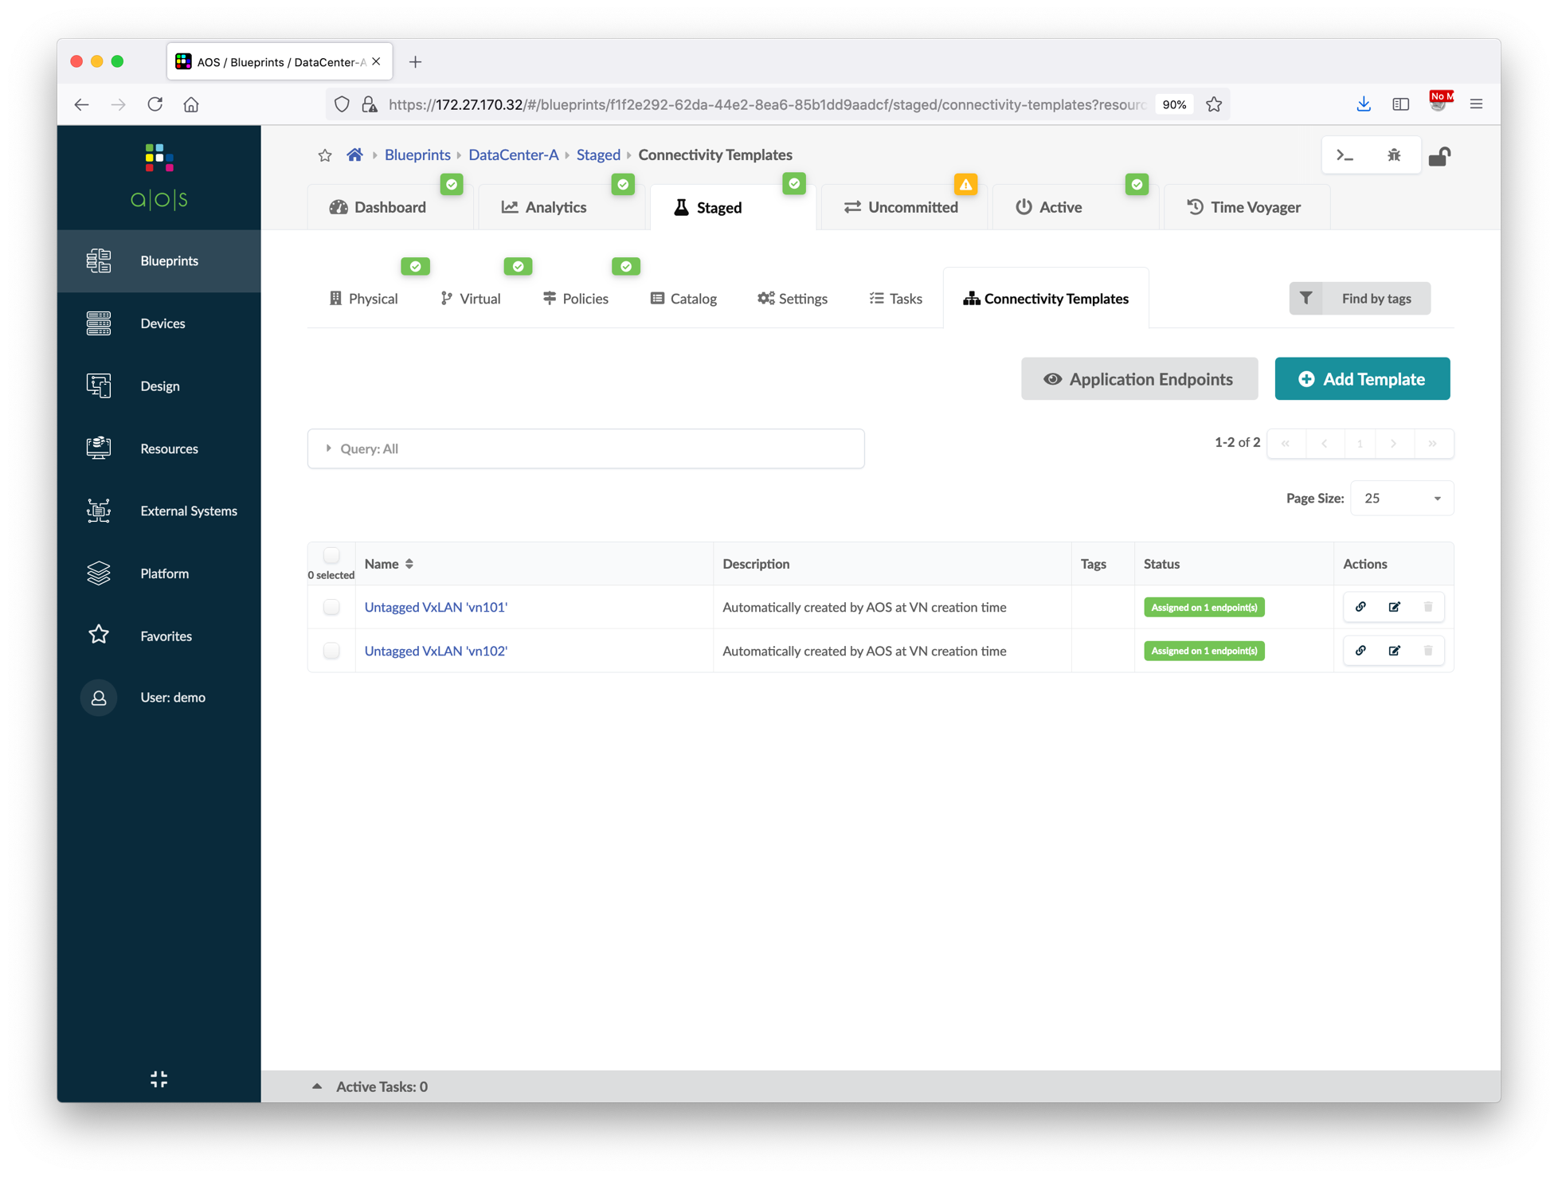
Assign Virtual Network to Switchports
Go to Blueprints > DataCenter-A > Staged > Connectivity Templates, and then click the assign button of connectivity template.
Select the target interface.
Verify the status of both connectivity templates and click Application Endpoints to view the overall status.
From the application endpoints page, you can view the assigned template for each switch ports.
Commit the blueprint.
VN | Switch Name | Interface
vn101 | server_rack_001_leaf1 | xe-0/0/2
vn102 | server_rack_001_leaf2 | xe-0/0/2
②
①
Verify the status

Slide 62
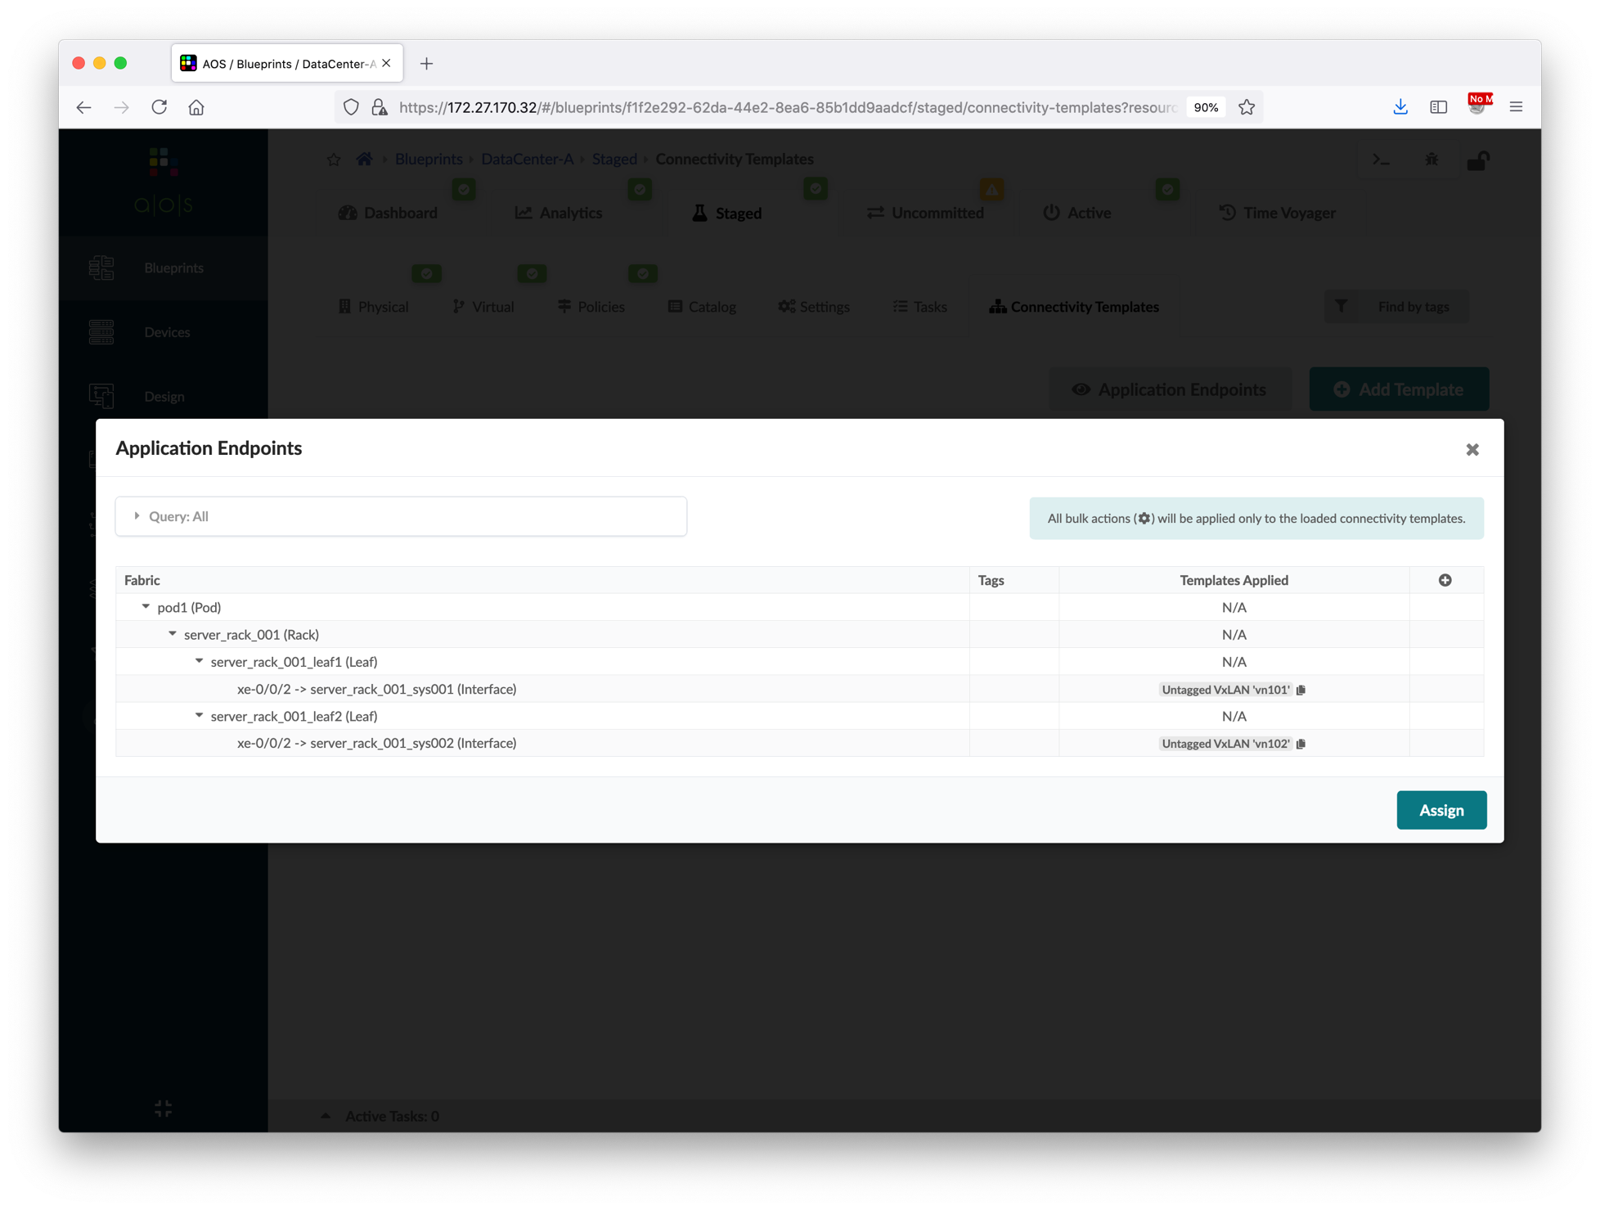
Assign Virtual Network to Switchports
Go to Blueprints > DataCenter-A > Staged > Connectivity Templates, and then click the assign button of connectivity template.
Select the target interface.
Verify the status of both connectivity templates and click Application Endpoints to view the overall status.
From the application endpoints page, you can view the assigned template for each switch ports.
Commit the blueprint.
VN | Switch Name | Interface
vn101 | server_rack_001_leaf1 | xe-0/0/2
vn102 | server_rack_001_leaf2 | xe-0/0/2

Slide 63
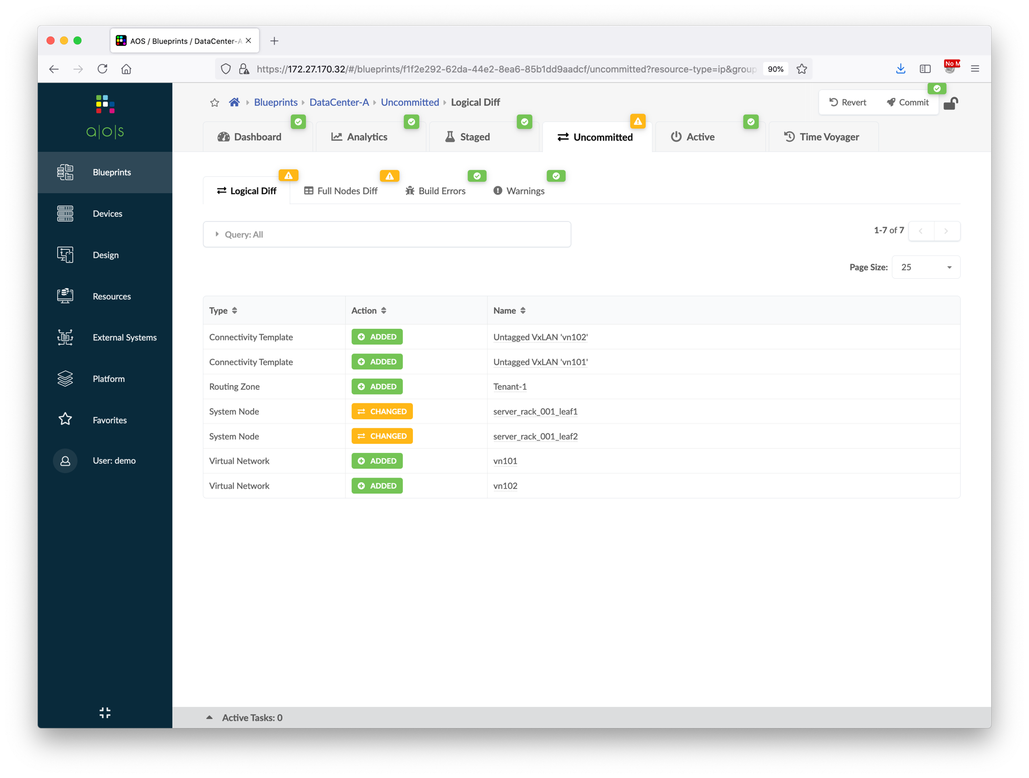
Assign Virtual Network to Switchports
Go to Blueprints > DataCenter-A > Staged > Connectivity Templates, and then click the assign button of connectivity template.
Select the target interface.
Verify the status of both connectivity templates and click Application Endpoints to view the overall status.
From the application endpoints page, you can view the assigned template for each switch ports.
Commit the blueprint.
VN | Switch Name | Interface
vn101 | server_rack_001_leaf1 | xe-0/0/2
vn102 | server_rack_001_leaf2 | xe-0/0/2
①
②

Slide 64
Traffic Verification
Login to A-leaf1 and A-leaf2, verify the configuration of interface xe-0/0/2.
Login to A-bms1, configure the IP address and default gateway. root@A-bms1:~# ifconfig eth1 192.168.101.11/24 root@A-bms1:~# ip route add default via 192.168.101.1
After configuring A-bms1 IP address, ping to the gateway of vn101. root@A-bms1:~# ping 192.168.101.1
Login to A-bms2, configure the IP address and default gateway. root@A-bms2:~# ifconfig eth1 192.168.102.22/24 root@A-bms2:~# ip route add default via 192.168.102.1
After configuring A-bms2 IP address, ping to the gateway of vn102 and A-bms1. root@A-bms2:~# ping 192.168.102.1 root@A-bms2:~# ping 192.168.101.11
All above ping tests should succeed.

Slide 65
Add Server Links
In this section, we're going to create a new LAG link in the blueprint which is connecting to A-bms3. Apstra will render and push the corresponding EVPN ESI configuration to the leaf switches.
Below diagram illustrates the topology of the data center after this section.
DataCenter-A Blueprint
Tenant-1 Routing Zone
vn101 (192.168.101.0/24)
vn102 (192.168.102.0/24)
To A-leaf1
xe-0/0/2
To A-leaf1
xe-0/0/3
To A-leaf2
xe-0/0/3
To A-leaf2
xe-0/0/2
A-bms1
A-bms3
A-bms2
192.168.101.11
192.168.101.33
192.168.102.22

Slide 66
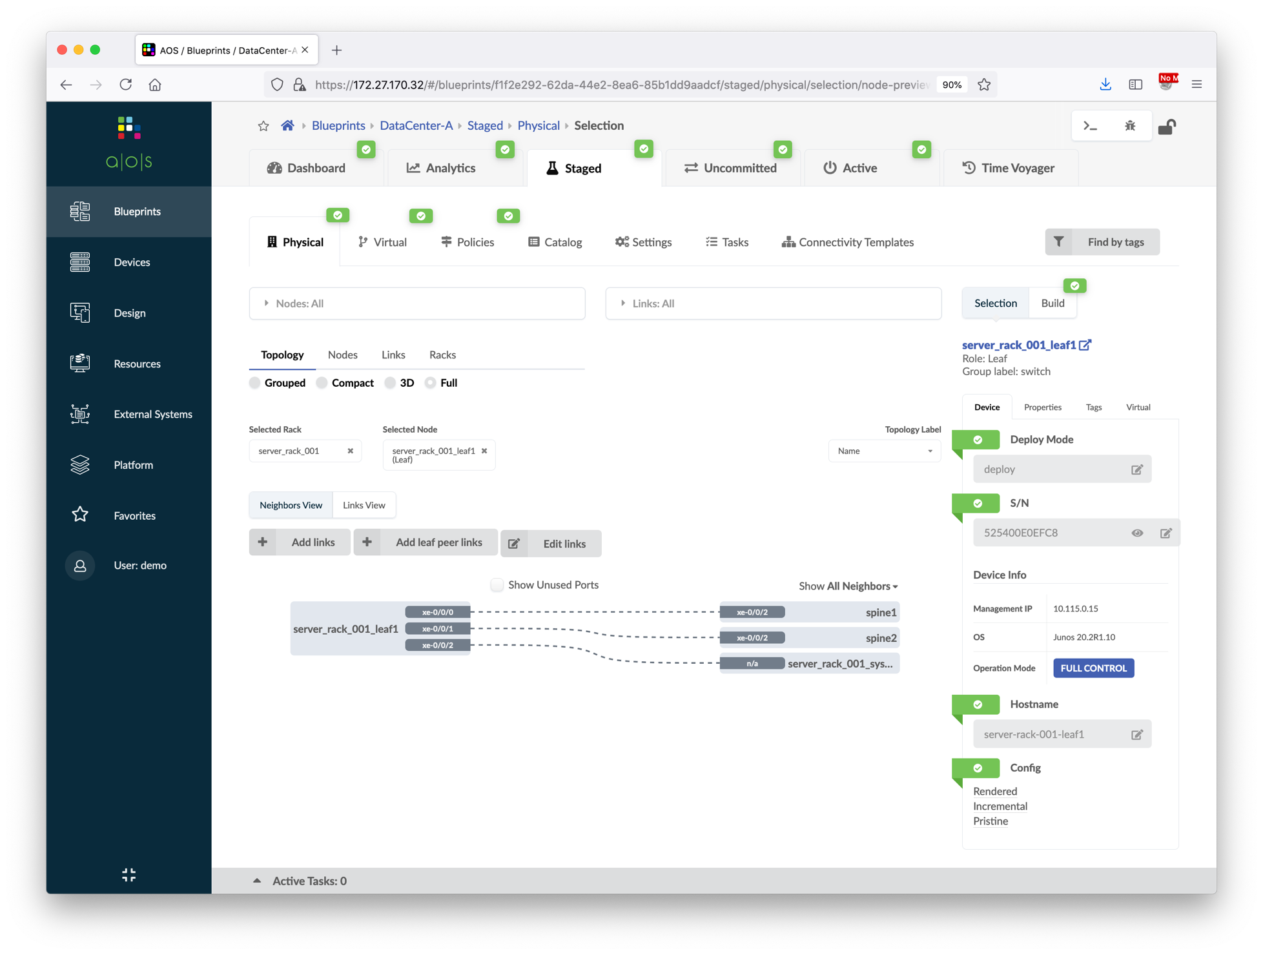
Add Server Links
Go to Blueprints > DataCenter-A > Staged > Physical, select the server_rack_001_leaf1 node.
Click the Add links button to add server links.
Follow the screenshots to add a new server.
Update the server hostnames based on LLDP info.
Now, we’re going to show another way of assigning connectivity template.
Go to connectivity template page, click Application Endpoints to view the overall assignment status.
Add vn101 connectivity template column, and then click the ae1 interface.
Commit the blueprint.
①
②
Choose server_rack_001_leaf1
③

Slide 67
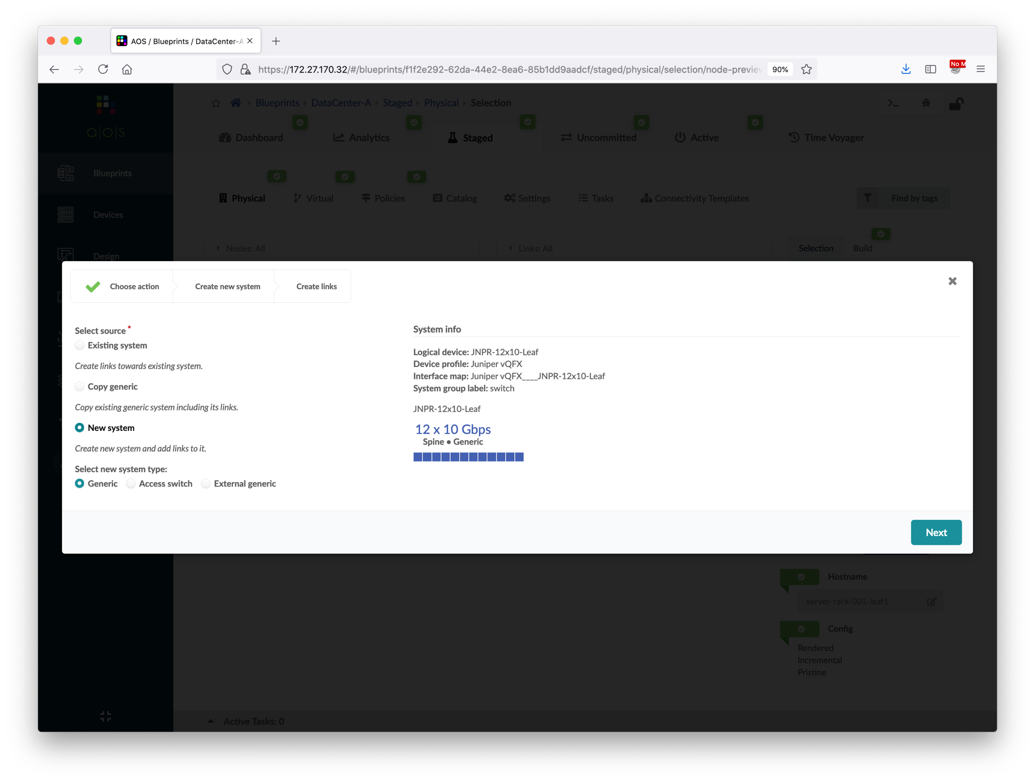
Add Server Links
Go to Blueprints > DataCenter-A > Staged > Physical, select the server_rack_001_leaf1 node.
Click the Add links button to add server links.
Follow the screenshots to add a new server.
Update the server hostnames based on LLDP info.
Now, we’re going to show another way of assigning connectivity template.
Go to connectivity template page, click Application Endpoints to view the overall assignment status.
Add vn101 connectivity template column, and then click the ae1 interface.
Commit the blueprint.
①
Choose New system
②

Slide 68
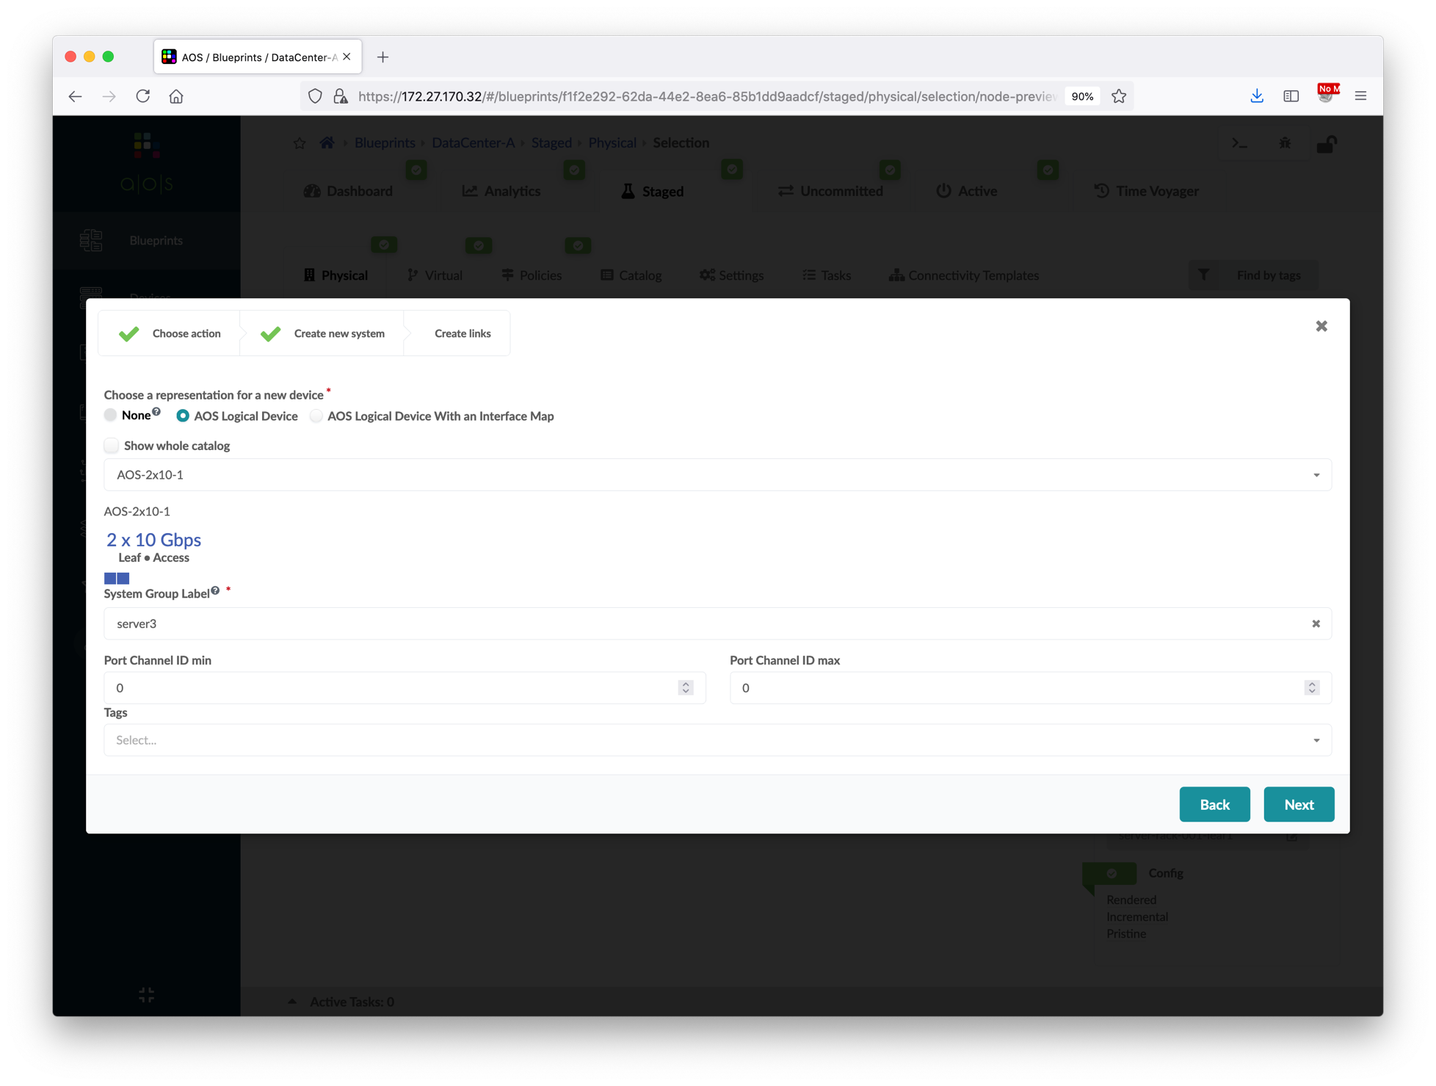
Add Server Links
Go to Blueprints > DataCenter-A > Staged > Physical, select the server_rack_001_leaf1 node.
Click the Add links button to add server links.
Follow the screenshots to add a new server.
Update the server hostnames based on LLDP info.
Now, we’re going to show another way of assigning connectivity template.
Go to connectivity template page, click Application Endpoints to view the overall assignment status.
Add vn101 connectivity template column, and then click the ae1 interface.
Commit the blueprint.
①
②
Choose AOS-2x10-1
③
Input server group label "server3"
④

Slide 69
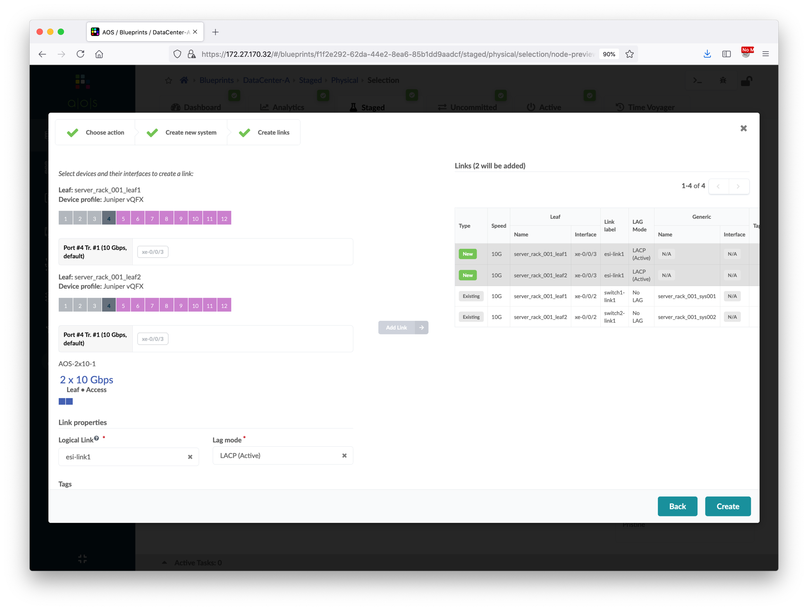
Add Server Links
Go to Blueprints > DataCenter-A > Staged > Physical, select the server_rack_001_leaf1 node.
Click the Add links button to add server links.
Follow the screenshots to add a new server.
Update the server hostnames based on LLDP info.
Now, we’re going to show another way of assigning connectivity template.
Go to connectivity template page, click Application Endpoints to view the overall assignment status.
Add vn101 connectivity template column, and then click the ae1 interface.
Commit the blueprint.
③
Click 4th port (xe-0/0/3) of leaf1
⑨
Verify both links are added
④
⑥
Click 4th port (xe-0/0/3) of leaf2
⑦
⑤
⑧
①
Input logical link "esi-link1"
②
Choose LACP Active
⑩

Slide 70
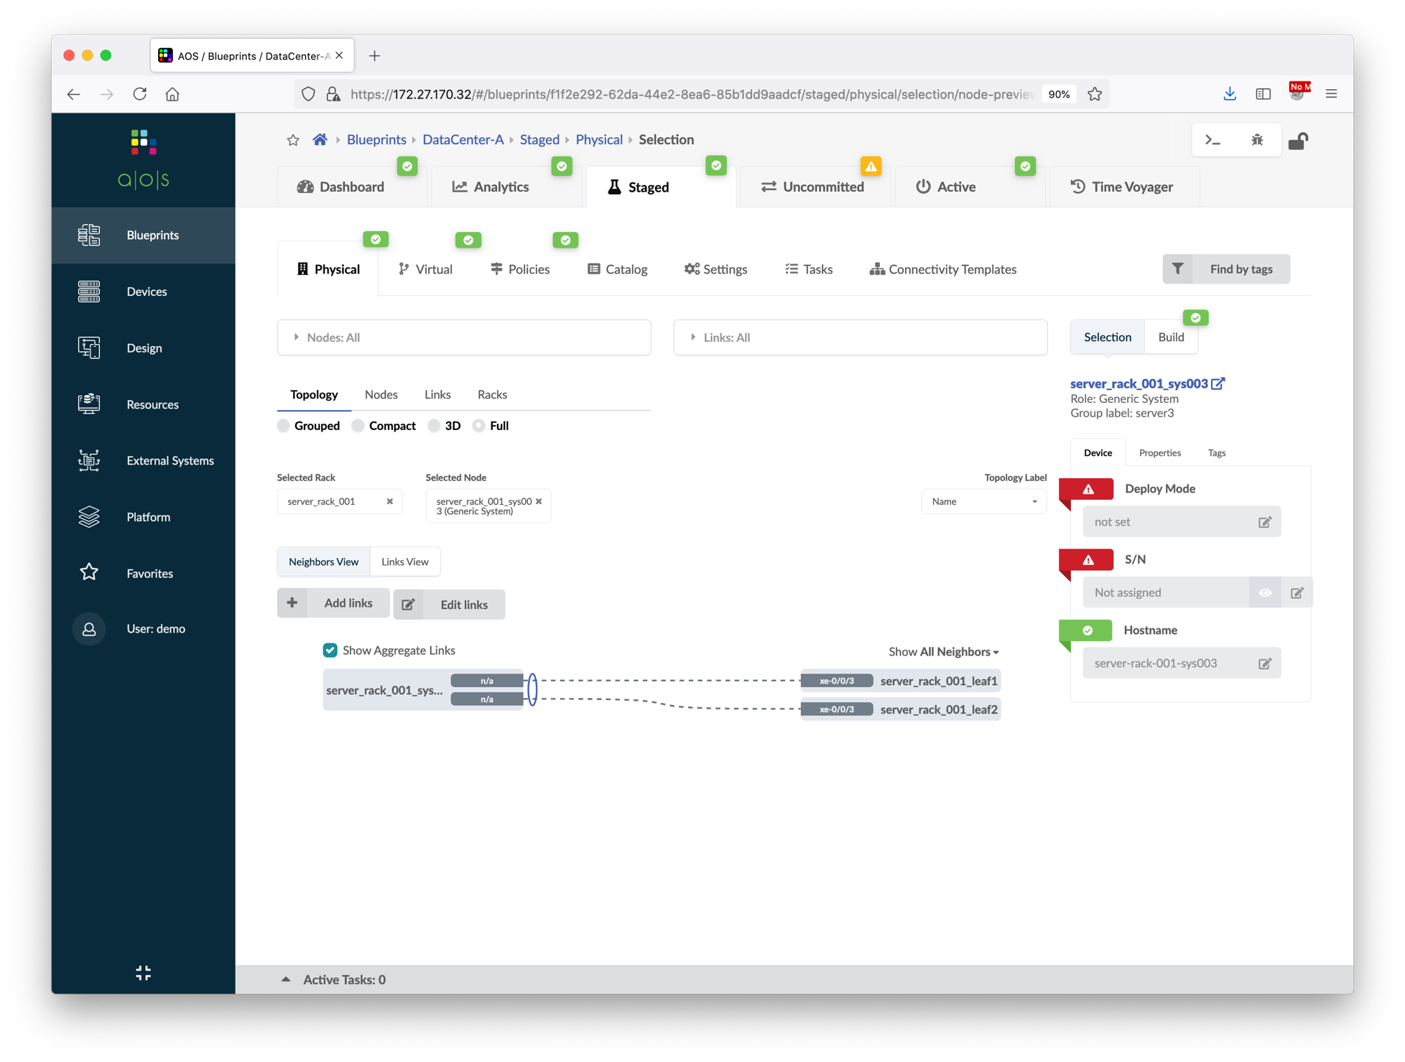
Add Server Links
Go to Blueprints > DataCenter-A > Staged > Physical, select the server_rack_001_leaf1 node.
Click the Add links button to add server links.
Follow the screenshots to add a new server.
Update the server hostnames based on LLDP info.
Now, we’re going to show another way of assigning connectivity template.
Go to connectivity template page, click Application Endpoints to view the overall assignment status.
Add vn101 connectivity template column, and then click the ae1 interface.
Commit the blueprint.
①
Choose the new server
②
Verify the switch neighbors and the intent to
configure both interfaces as bonding (by user)

Slide 71
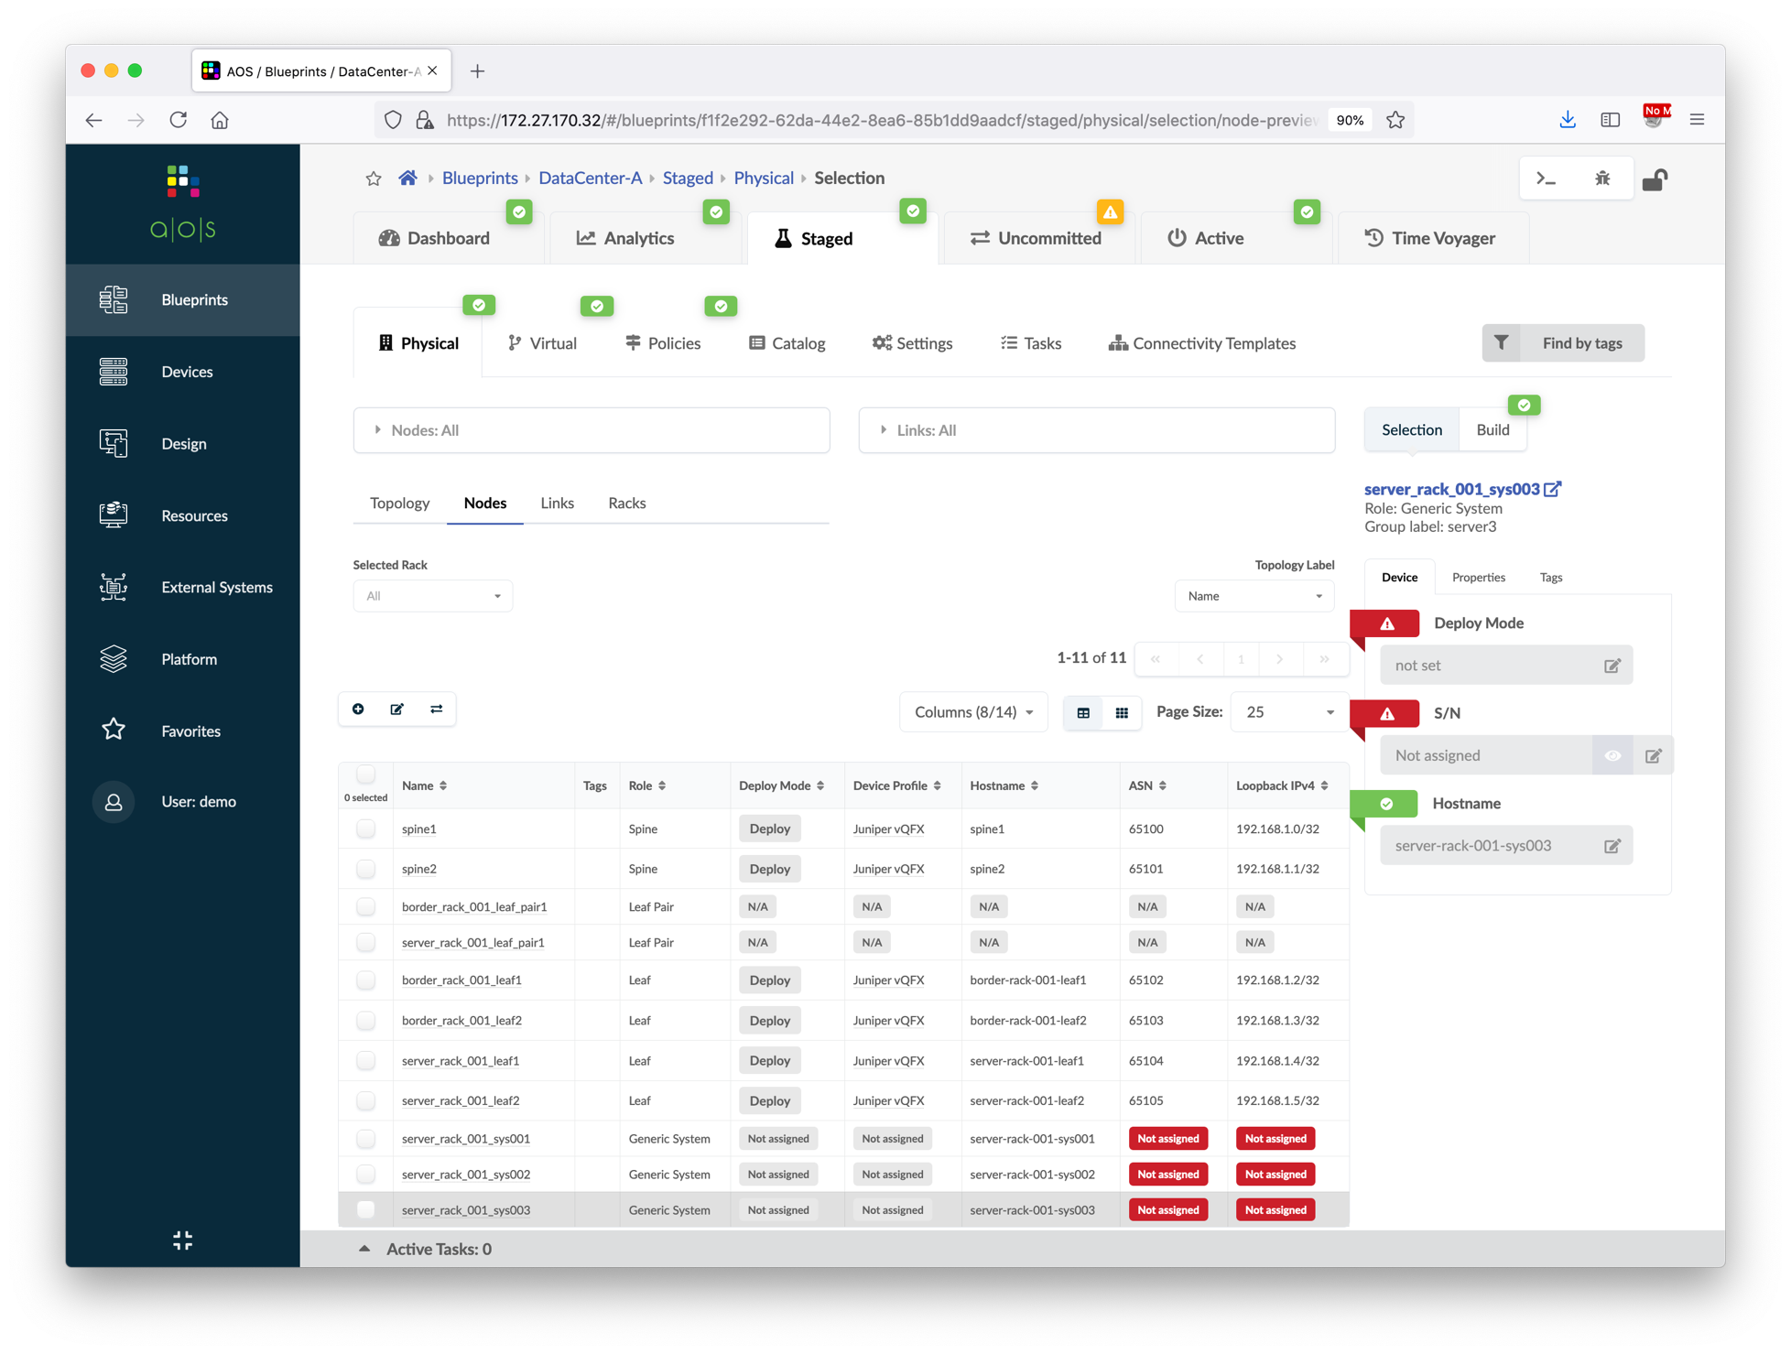
Add Server Links
Go to Blueprints > DataCenter-A > Staged > Physical, select the server_rack_001_leaf1 node.
Click the Add links button to add server links.
Follow the screenshots to add a new server.
Update the server hostnames based on LLDP info.
Now, we’re going to show another way of assigning connectivity template.
Go to connectivity template page, click Application Endpoints to view the overall assignment status.
Add vn101 connectivity template column, and then click the ae1 interface.
Commit the blueprint.
①
②
Click to edit server names and hostnames

Slide 72
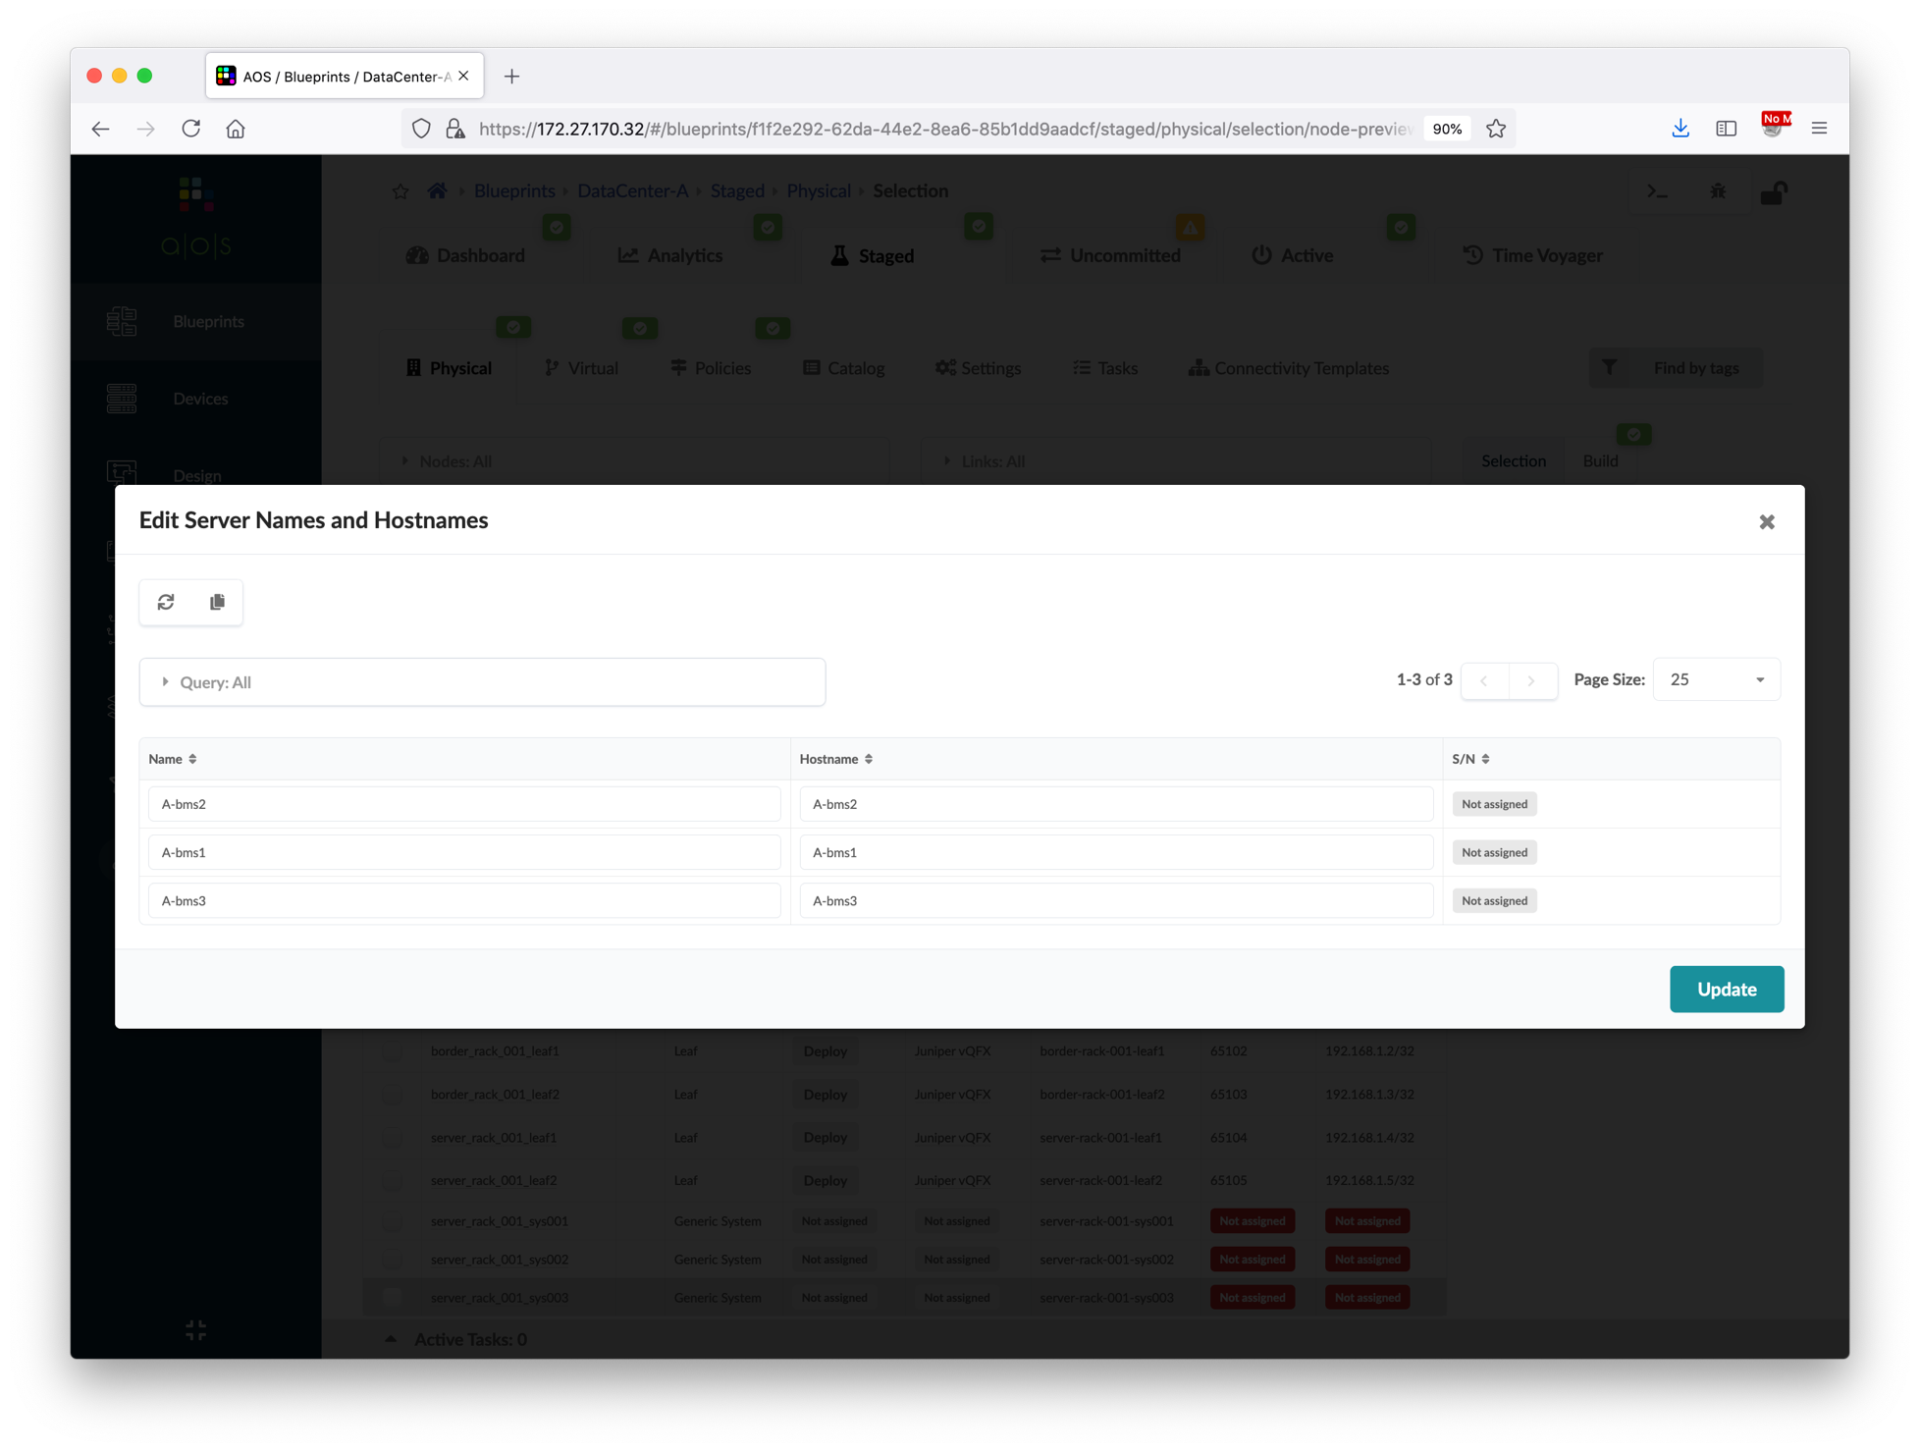
Add Server Links
Go to Blueprints > DataCenter-A > Staged > Physical, select the server_rack_001_leaf1 node.
Click the Add links button to add server links.
Follow the screenshots to add a new server.
Update the server hostnames based on LLDP info.
Now, we’re going to show another way of assigning connectivity template.
Go to connectivity template page, click Application Endpoints to view the overall assignment status.
Add vn101 connectivity template column, and then click the ae1 interface.
Commit the blueprint.
①
Click to fetch discovered LLDP hostname (LLDP is enabled in all BMS)
②
Click to update names based on the hostnames
④
③
Verify the new names and hostnames

Slide 73
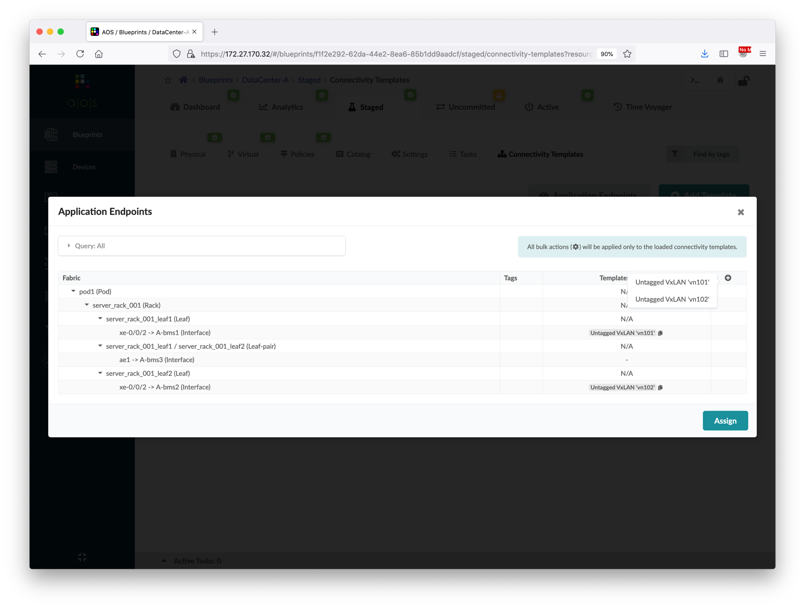
Add Server Links
Go to Blueprints > DataCenter-A > Staged > Physical, select the server_rack_001_leaf1 node.
Click the Add links button to add server links.
Follow the screenshots to add a new server.
Update the server hostnames based on LLDP info.
Now, we’re going to show another way of assigning connectivity template.
Go to connectivity template page, click Application Endpoints to view the overall assignment status.
Add vn101 connectivity template column, and then click the ae1 interface.
Commit the blueprint.
②
Click vn101 CT
①

Slide 74
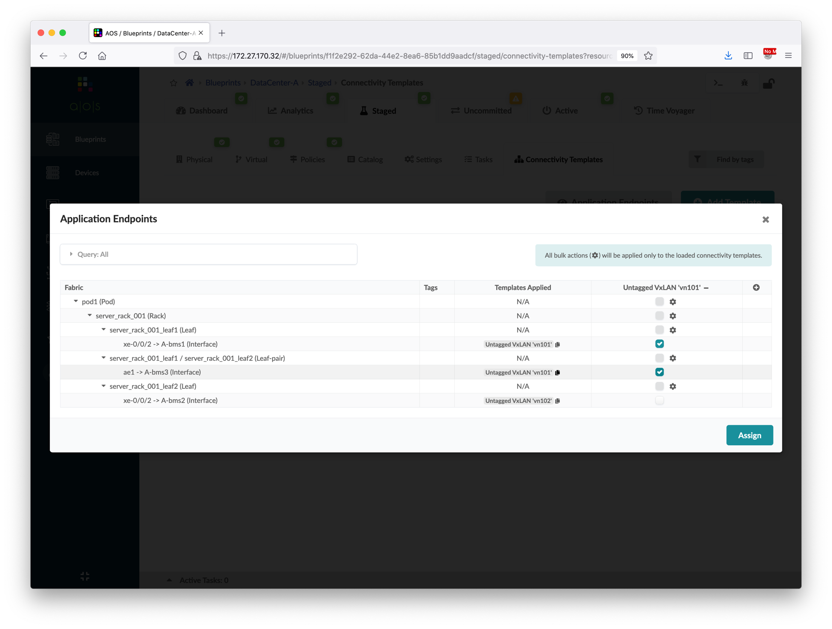
Add Server Links
Go to Blueprints > DataCenter-A > Staged > Physical, select the server_rack_001_leaf1 node.
Click the Add links button to add server links.
Follow the screenshots to add a new server.
Update the server hostnames based on LLDP info.
Now, we’re going to show another way of assigning connectivity template.
Go to connectivity template page, click Application Endpoints to view the overall assignment status.
Add vn101 connectivity template column, and then click the ae1 interface.
Commit the blueprint.
①
Click server leaf pair ae1 interface
②

Slide 75
Add Server Links
Go to Blueprints > DataCenter-A > Staged > Physical, select the server_rack_001_leaf1 node.
Click the Add links button to add server links.
Follow the screenshots to add a new server.
Update the server hostnames based on LLDP info.
Now, we’re going to show another way of assigning connectivity template.
Go to connectivity template page, click Application Endpoints to view the overall assignment status.
Add vn101 connectivity template column, and then click the ae1 interface.
Commit the blueprint.
①
②

Slide 76
Traffic Verification
Login to A-leaf1 and A-leaf2, verify the configuration of interface xe-0/0/3.
Login to A-bms3, run the prepared script to create the bonding interface. root@A-bms3:~# ./create_bonding
Configure the IP address of bond0 and default gateway. root@A-bms3:~# ifconfig bond0 192.168.101.33/24 root@A-bms3:~# ip route add default via 192.168.101.1
After configuring the A-bms3 IP address, ping to the gateway of vn101, A-bms1 and A-bms2. root@A-bms3:~# ping 192.168.101.1 root@A-bms3:~# ping 192.168.101.11 root@A-bms3:~# ping 192.168.102.22
LACP is enabled after bond0 is up and running, go to A-leaf1 and A-leaf2 to verify the ae interface LACP status.

Slide 77
Data Center Interconnect #1 – Underlay
To provision DCI, we first need to add external router to the blueprint, to establish IPv4 BGP session between border leaf and external router. The IPv4 BGP session is used to exchange the underlay loopback addresses between two data centers.
Below diagram illustrates the topology of the data center after this section.
Unmanaged by Apstra, created in blueprints as external generic systems
ext-rtr1
eBGP peer, preconfigured in the setup
ext-rtr2
External links added in this section to exchange loopback address
xe-0/0/2
xe-0/0/2
xe-0/0/2
xe-0/0/2
A-border1
A-border2
B-border1
B-border2
A-spine1
A-spine2
B-spine1
B-spine2
A-leaf1
A-leaf2
B-leaf1
B-leaf2

Slide 78
Data Center Interconnect #1 – Underlay
Go to Blueprints > DataCenter-A > Staged > Physical > Nodes, create a new external generic system called "ext-router".
Click the "ext-router", open the properties page and edit its ASN, update it to "65001". If you skip this step, Apstra will ask you to assign a ASN resource pool to external generic system at later stage.
Go to Topology page and click Add links button.
Follow the screenshots to add external links.
Go to Blueprints > DataCenter-A > Staged > Policies > Routing Policies, create a new routing policy called "ext-router-policy".
①
②
③
④

Slide 79
Data Center Interconnect #1 – Underlay
Go to Blueprints > DataCenter-A > Staged > Physical > Nodes, create a new external generic system called "ext-router".
Click the "ext-router", open the properties page and edit its ASN, update it to "65001". If you skip this step, Apstra will ask you to assign a ASN resource pool to external generic system at later stage.
Go to Topology page and click Add links button.
Follow the screenshots to add external links.
Go to Blueprints > DataCenter-A > Staged > Policies > Routing Policies, create a new routing policy called "ext-router-policy".
①
Type the name "ext-router"
②

Slide 80
Data Center Interconnect #1 – Underlay
Go to Blueprints > DataCenter-A > Staged > Physical > Nodes, create a new external generic system called "ext-router".
Click the "ext-router", open the properties page and edit its ASN, update it to "65001". If you skip this step, Apstra will ask you to assign a ASN resource pool to external generic system at later stage.
Go to Topology page and click Add links button.
Follow the screenshots to add external links.
Go to Blueprints > DataCenter-A > Staged > Policies > Routing Policies, create a new routing policy called "ext-router-policy".
②
①
Click to choose the new node
③
Update it to 65001

Slide 81
Data Center Interconnect #1 – Underlay
Go to Blueprints > DataCenter-A > Staged > Physical > Nodes, create a new external generic system called "ext-router".
Click the "ext-router", open the properties page and edit its ASN, update it to "65001". If you skip this step, Apstra will ask you to assign a ASN resource pool to external generic system at later stage.
Go to Topology page and click Add links button.
Follow the screenshots to add external links.
Go to Blueprints > DataCenter-A > Staged > Policies > Routing Policies, create a new routing policy called "ext-router-policy".
②
③
①
Verify the ASN is updated

Slide 82
Data Center Interconnect #1 – Underlay
Go to Blueprints > DataCenter-A > Staged > Physical > Nodes, create a new external generic system called "ext-router".
Click the "ext-router", open the properties page and edit its ASN, update it to "65001". If you skip this step, Apstra will ask you to assign a ASN resource pool to external generic system at later stage.
Go to Topology page and click Add links button.
Follow the screenshots to add external links.
Go to Blueprints > DataCenter-A > Staged > Policies > Routing Policies, create a new routing policy called "ext-router-policy".
①

Slide 83
Data Center Interconnect #1 – Underlay
Go to Blueprints > DataCenter-A > Staged > Physical > Nodes, create a new external generic system called "ext-router".
Click the "ext-router", open the properties page and edit its ASN, update it to "65001". If you skip this step, Apstra will ask you to assign a ASN resource pool to external generic system at later stage.
Go to Topology page and click Add links button.
Follow the screenshots to add external links.
Go to Blueprints > DataCenter-A > Staged > Policies > Routing Policies, create a new routing policy called "ext-router-policy".
①
Choose border_rack_001_leaf1
④
Click 3rd port (xe-0/0/2) of border1
⑤
⑥
②
Choose switch1-link1
③
Choose No LAG

Slide 84
Data Center Interconnect #1 – Underlay
Go to Blueprints > DataCenter-A > Staged > Physical > Nodes, create a new external generic system called "ext-router".
Click the "ext-router", open the properties page and edit its ASN, update it to "65001". If you skip this step, Apstra will ask you to assign a ASN resource pool to external generic system at later stage.
Go to Topology page and click Add links button.
Follow the screenshots to add external links.
Go to Blueprints > DataCenter-A > Staged > Policies > Routing Policies, create a new routing policy called "ext-router-policy".
⑤
Verify both links are added
②
Click 3rd port (xe-0/0/2) of border2
③
④
①
Choose switch2-link1
⑥

Slide 85
Data Center Interconnect #1 – Underlay
Go to Blueprints > DataCenter-A > Staged > Physical > Nodes, create a new external generic system called "ext-router"
Click the "ext-router", open the properties page and edit its ASN, update it to "65001”. If you skip this step, Apstra will ask you to assign a ASN resource pool to external generic system at later stage.
Go to Topology page and click Add links button.
Follow the screenshots to add external links.
Go to Blueprints > DataCenter-A > Staged > Policies > Routing Policies, create a new routing policy called "ext-router-policy".
①
②
③

Slide 86
Data Center Interconnect #1 – Underlay
Go to Blueprints > DataCenter-A > Staged > Physical > Nodes, create a new external generic system called "ext-router".
Click the "ext-router", open the properties page and edit its ASN, update it to "65001". If you skip this step, Apstra will ask you to assign a ASN resource pool to external generic system at later stage.
Go to Topology page and click Add links button.
Follow the screenshots to add external links.
Go to Blueprints > DataCenter-A > Staged > Policies > Routing Policies, create a new routing policy called "ext-router-policy".
①
Type the name "ext-router-policy"
②
④
Create first policy to deny all local loopback host routes
Prefix: 192.168.1.0/24, GE mask: 32, Action: Deny
③
⑥
Create second policy to accept all host routes
Prefix: 0.0.0.0/0, GE mask: 32, Action: Permit
⑤
⑦
Unselect all checkbox except "Loopbacks"
⑧

Slide 87
Data Center Interconnect #1 – Underlay
Go to Blueprints > DataCenter-A > Staged > Connectivity Template, create a new template called "ext-router-ct".
Follow the screenshots to create the connectivity template.
Assign the connectivity template to xe-0/0/2 interface of both border leaf switches.
After assigning the connectivity template, we need to assign a link IP address pool to it, choose External Link.
Go to Blueprints > DataCenter-A > Staged > Virtual > Protocol Sessions, get the ASN/IP address of border leaf switches and IP address of external router links.
①
②

Slide 88
Data Center Interconnect #1 – Underlay
Go to Blueprints > DataCenter-A > Staged > Connectivity Template, create a new template called "ext-router-ct".
Follow the screenshots to create the connectivity template.
Assign the connectivity template to xe-0/0/2 interface of both border leaf switches.
After assigning the connectivity template, we need to assign a link IP address pool to it, choose External Link.
Go to Blueprints > DataCenter-A > Staged > Virtual > Protocol Sessions, get the ASN/IP address of border leaf switches and IP address of external router links.
②
①
Type the name "ext-router-ct"

Slide 89
Data Center Interconnect #1 – Underlay
Go to Blueprints > DataCenter-A > Staged > Connectivity Template, create a new template called "ext-router-ct".
Follow the screenshots to create the connectivity template.
Assign the connectivity template to xe-0/0/2 interface of both border leaf switches.
After assigning the connectivity template, we need to assign a link IP address pool to it, choose External Link.
Go to Blueprints > DataCenter-A > Staged > Virtual > Protocol Sessions, get the ASN/IP address of border leaf switches and IP address of external router links.
①
②
③

Slide 90
Data Center Interconnect #1 – Underlay
Go to Blueprints > DataCenter-A > Staged > Connectivity Template, create a new template called "ext-router-ct".
Follow the screenshots to create the connectivity template.
Assign the connectivity template to xe-0/0/2 interface of both border leaf switches.
After assigning the connectivity template, we need to assign a link IP address pool to it, choose External Link.
Go to Blueprints > DataCenter-A > Staged > Virtual > Protocol Sessions, get the ASN/IP address of border leaf switches and IP address of external router links.
①
Edit IP Link
②
Choose Default routing zone
③
Turn on Untagged

Slide 91
Data Center Interconnect #1 – Underlay
Go to Blueprints > DataCenter-A > Staged > Connectivity Template, create a new template called "ext-router-ct".
Follow the screenshots to create the connectivity template.
Assign the connectivity template to xe-0/0/2 interface of both border leaf switches.
After assigning the connectivity template, we need to assign a link IP address pool to it, choose External Link.
Go to Blueprints > DataCenter-A > Staged > Virtual > Protocol Sessions, get the ASN/IP address of border leaf switches and IP address of external router links.
①
Edit BGP Peering
②
Choose Peer From Interface
③
Choose Peer To Interface/IP Endpoint

Slide 92
Data Center Interconnect #1 – Underlay
Go to Blueprints > DataCenter-A > Staged > Connectivity Template, create a new template called "ext-router-ct".
Follow the screenshots to create the connectivity template.
Assign the connectivity template to xe-0/0/2 interface of both border leaf switches.
After assigning the connectivity template, we need to assign a link IP address pool to it, choose External Link.
Go to Blueprints > DataCenter-A > Staged > Virtual > Protocol Sessions, get the ASN/IP address of border leaf switches and IP address of external router links.
①
Edit Routing Policy
②
Choose ext-router-policy
③

Slide 93
Data Center Interconnect #1 – Underlay
Go to Blueprints > DataCenter-A > Staged > Connectivity Template, create a new template called "ext-router-ct".
Follow the screenshots to create the connectivity template.
Assign the connectivity template to xe-0/0/2 interface of both border leaf switches.
After assigning the connectivity template, we need to assign a link IP address pool to it, choose External Link.
Go to Blueprints > DataCenter-A > Staged > Virtual > Protocol Sessions, get the ASN/IP address of border leaf switches and IP address of external router links.
①
Click xe-0/0/2 of both switches
②

Slide 94
Data Center Interconnect #1 – Underlay
Go to Blueprints > DataCenter-A > Staged > Connectivity Template, create a new template called "ext-router-ct".
Follow the screenshots to create the connectivity template.
Assign the connectivity template to xe-0/0/2 interface of both border leaf switches.
After assigning the connectivity template, we need to assign a link IP address pool to it, choose External Link.
Go to Blueprints > DataCenter-A > Staged > Virtual > Protocol Sessions, get the ASN/IP address of border leaf switches and IP address of external router links.
①
②
③
④

Slide 95
Data Center Interconnect #1 – Underlay
Go to Blueprints > DataCenter-A > Staged > Connectivity Template, create a new template called "ext-router-ct".
Follow the screenshots to create the connectivity template.
Assign the connectivity template to xe-0/0/2 interface of both border leaf switches.
After assigning the connectivity template, we need to assign a link IP address pool to it, choose External Link.
Go to Blueprints > DataCenter-A > Staged > Virtual > Protocol Sessions, get the ASN/IP address of border leaf switches and IP address of external router links.
①
②
③
IP address of ext-router to border1
⑤
ASN and IP address of border1
④
IP address of ext-router to border2
⑥
ASN and IP address of border2

Slide 96
Data Center Interconnect #1 – Underlay
Commit the blueprint.
Repeat the steps for DataCenter-B:
create an external generic system ext-router
assign ASN 65002 to the external router
add two links connecting to xe-0/0/2 of border1 and border2
create routing policy ext-router-policy (deny 192.168.2.0/24 GE 32 and permit 0.0.0.0/0 GE 32)
create connectivity template ext-router-ct
assign the connectivity template to xe-0/0/2 of border1 and border2
assign External Link IP address pool to generic systems
get the ASN and IP address of border leaf switches and external router
①
②

Slide 97
Data Center Interconnect #1 – Underlay
Login to ext-rtr1 and ext-rtr2, and then apply interface and routing configuration to establish underlay BGP connectivity to EVPN fabric.
ext-rtr1 configuration
ext-rtr2 configuration
Login to Spine, Border Leaf, and Leaf switches to verify the route table, you should be able to see the loopback address routes from another data center.
set interfaces xe-0/0/1.0 family inet address 10.3.0.1/31
set interfaces xe-0/0/2.0 family inet address 10.3.0.3/31
set protocols bgp group ebgp neighbor 10.3.0.0 peer-as 65102
set protocols bgp group ebgp neighbor 10.3.0.2 peer-as 65103
(interface to A-border1)
(interface to A-border2)
(BGP neighbor to A-border1)
(BGP neighbor to A-border2)
set interfaces xe-0/0/1.0 family inet address 10.3.0.5/31
set interfaces xe-0/0/2.0 family inet address 10.3.0.7/31
set protocols bgp group ebgp neighbor 10.3.0.4 peer-as 65202
set protocols bgp group ebgp neighbor 10.3.0.6 peer-as 65203
(interface to B-border1)
(interface to B-border2)
(BGP neighbor to B-border1)
(BGP neighbor to B-border2)

Slide 98
Data Center Interconnect #2 – Overlay
After exchanging the loopback addresses between data centers, we will create remote EVPN gateway in each blueprint to establish the EVPN BGP sessions between border leaf switches.
Below diagram illustrates the topology of the data center after this section.
ext-rtr1
ext-rtr2
Overlay EVPN BGP sessions created in this section to exchange EVPN routes
A-border1
A-border2
B-border1
B-border2
A-spine1
A-spine2
B-spine1
B-spine2
A-leaf1
A-leaf2
B-leaf1
B-leaf2

Slide 99
Data Center Interconnect #2 – Overlay
Go to Blueprints > DataCenter-A > Staged > Virtual > Remote EVPN Gateways, and then create the border leaf switches in data center B as the remote EVPN gateways.
Create below two EVPN BGP sessions.
Commit the blueprint.
Repeat the steps for DataCenter-B, to create two EVPN BGP sessions between its border leaf and the border leaf in data center A.
①
②
Name | IP Address | ASN | Local Gateway
B-border1 | IP of B-border1 | ASN of B-border1 | border_rack_001_leaf1
B-border2 | IP of B-border2 | ASN of B-border2 | border_rack_001_leaf2
③
④
Name | IP Address | ASN | Local Gateway
A-border1 | IP of A-border1 | ASN of A-border1 | border_rack_001_leaf1
A-border2 | IP of A-border2 | ASN of A-border2 | border_rack_001_leaf2

Slide 100
Data Center Interconnect #2 – Overlay
Go to Blueprints > DataCenter-A > Staged > Virtual > Remote EVPN Gateways, and then create the border leaf switches in data center B as the remote EVPN gateways.
Create below two EVPN BGP sessions.
Commit the blueprint.
Repeat the steps for DataCenter-B, to create two EVPN BGP sessions between its border leaf and the border leaf in data center A.
Name | IP Address | ASN | Local Gateway
B-border1 | IP of B-border1 | ASN of B-border1 | border_rack_001_leaf1
B-border2 | IP of B-border2 | ASN of B-border2 | border_rack_001_leaf2
①
Input the name, IP and ASN of
peer border leaf switch
②
Scroll down
Name | IP Address | ASN | Local Gateway
A-border1 | IP of A-border1 | ASN of A-border1 | border_rack_001_leaf1
A-border2 | IP of A-border2 | ASN of A-border2 | border_rack_001_leaf2

Slide 101
Data Center Interconnect #2 – Overlay
Go to Blueprints > DataCenter-A > Staged > Virtual > Remote EVPN Gateways, and then create the border leaf switches in data center B as the remote EVPN gateways.
Create below two EVPN BGP sessions.
Commit the blueprint.
Repeat the steps for DataCenter-B, to create two EVPN BGP sessions between its border leaf and the border leaf in data center A.
Name | IP Address | ASN | Local Gateway
B-border1 | IP of B-border1 | ASN of B-border1 | border_rack_001_leaf1
B-border2 | IP of B-border2 | ASN of B-border2 | border_rack_001_leaf2
①
Choose the local border leaf switch
Name | IP Address | ASN | Local Gateway
A-border1 | IP of A-border1 | ASN of A-border1 | border_rack_001_leaf1
A-border2 | IP of A-border2 | ASN of A-border2 | border_rack_001_leaf2
②

Slide 102
Data Center Interconnect #2 – Overlay
Go to Blueprints > DataCenter-A > Staged > Virtual > Remote EVPN Gateways, and then create the border leaf switches in data center B as the remote EVPN gateways.
Create below two EVPN BGP sessions.
Commit the blueprint.
Repeat the steps for DataCenter-B, to create two EVPN BGP sessions between its border leaf and the border leaf in data center A.
②
Commit the blueprint
Name | IP Address | ASN | Local Gateway
B-border1 | IP of B-border1 | ASN of B-border1 | border_rack_001_leaf1
B-border2 | IP of B-border2 | ASN of B-border2 | border_rack_001_leaf2
Name | IP Address | ASN | Local Gateway
A-border1 | IP of A-border1 | ASN of A-border1 | border_rack_001_leaf1
A-border2 | IP of A-border2 | ASN of A-border2 | border_rack_001_leaf2
①
Verify border1 is peering with border1 in data center B,
and border2 is peering with border2 in data center B

Slide 103
Data Center Interconnect #3 – Services
After the overlay EVPN BGP sessions between two data centers are established, we will create Tenant-1 routing zone in data center B using the same VNI (so the auto-gen RT is the same), and routes will be exchanged between Tenant-1 in both data centers. Next, we will create vn101 and vn103 in data center B to demonstrate L2 and L3 DCI connectivity.
Below diagram illustrates the topology of the data center after this section.
DataCenter-A Blueprint
DataCenter-B Blueprint
Tenant-1 Routing Zone
Tenant-1 Routing Zone
Routing by EVPN T5 route
vn101
(192.168.101.0/24)
vn102
(192.168.102.0/24)
vn103
(192.168.103.0/24)
To A-leaf1
xe-0/0/2
To A-leaf2
xe-0/0/2
To B-leaf1
xe-0/0/2
To B-leaf2
xe-0/0/2
A-bms1
A-bms2
B-bms1
B-bms2
192.168.101.11
192.168.102.22
192.168.101.44
192.168.103.55

Slide 104
Data Center Interconnect #3 – Services
Repeat the steps of creating routing zones, create the same Tenant-1 routing zone in data center B.
After creating the routing zone, assign a loopback IP address pool to it, choose DataCenter-B Loopback.
VRF Name | Tenant-1
VLAN ID | 10
VNI | 10010

Slide 105
Data Center Interconnect #3 – Services
Repeat the steps of creating virtual networks, create vn101 and vn103 in data center B.
Assign vn101 to server_rack_001_leaf1 xe-0/0/2 and vn103 to server_rack_001_leaf2 xe-0/0/2.
Commit the blueprint.
Type | VXLAN | VXLAN
Name | vn101 | vn103
Routing Zone | Tenant-1 | Tenant-1
VNI(s) | 10101 | 10103
Set same VLAN ID on all leafs? | Yes | Yes
VLAN ID (on leafs) | 101 | 103
IPv4 Subnet | 192.168.101.0/24 | 192.168.103.0/24
Virtual Gateway IPv4 | 192.168.101.1 | 192.168.103.1
Create Connectivity Template for | Untagged | Untagged
Assign To Rack | server_rack_001_leaf_pair1 | server_rack_001_leaf_pair1

Slide 106
Traffic Verification
Login to B-leaf1 and B-leaf2, verify the configuration of interface xe-0/0/2.
Login to B-bms1, configure the IP address and default gateway. root@B-bms1:~# ifconfig eth1 192.168.101.44/24 root@B-bms1:~# ip route add default via 192.168.101.1
After configuring B-bms1 IP address, ping to the gateway of vn101 and A-bms1. (L2 OTT DCI connectivity) root@B-bms1:~# ping 192.168.101.1 root@B-bms1:~# ping 192.168.101.11
Login to B-bms2, configure the IP address and default gateway. root@B-bms2:~# ifconfig eth1 192.168.103.55/24 root@B-bms2:~# ip route add default via 192.168.103.1
After configuring B-bms2 IP address, ping to the gateway of vn103 and A-bms2. (L3 DCI connectivity through EVPN RT5) root@B-bms2:~# ping 192.168.103.1 root@B-bms2:~# ping 192.168.102.22
All above ping tests should succeed.

Slide 107
Day-2 Maintenance and Monitoring
Root Cause Identification
Config Deviation Checking
Apply custom config through Configlet
View Telemetry Data

Slide 108
Root Cause Identification
Apstra supports real time closed-loop validation to ensure the system status match with our intent. For example, Apstra is actively monitoring the underlay BGP neighbors, LLDP neighbors, route table next hop entries, etc. and check whether they're matching with the intent we provided when configuring the blueprint.
In this demo, we've prepared a script to re-configure the underlying hypervisor networking to simulate the mis-connection of cables in spine switch. Next, we will show the root cause identification feature of Apstra to figure out the root cause from tons of reported anomalies.

Slide 109
Root Cause Identification
Go to Blueprints > DataCenter-A > Active > Root Causes, and then enable root cause analysis feature.
SSH to the Apstra server, run command ./swap_cabling.sh to swap the cables of A-spine1 switch.
Go to Blueprints > DataCenter-A > Dashboard, wait for 1-2 minutes and you should be able to see the BGP, Cabling and Route Table anomalies as shown in the screenshot.
Click the BGP gauge in the dashboard to view all the abnormal BGP status – expected status is up but actual is down
Click the Cabling gauge in the dashboard to view all the abnormal LLDP neighbors
Click the Route Table gauge in the dashboard to view all the abnormal route table entries
①
②
③

Slide 110
Root Cause Identification
Go to Blueprints > DataCenter-A > Active > Root Causes, and then enable root cause analysis feature.
SSH to the Apstra server, run command ./swap_cabling.sh to swap the cables of A-spine1 switch.
Go to Blueprints > DataCenter-A > Dashboard, wait for 1-2 minutes and you should be able to see the BGP, Cabling and Route Table anomalies as shown in the screenshot.
Click the BGP gauge in the dashboard to view all the abnormal BGP status – expected status is up but actual is down
Click the Cabling gauge in the dashboard to view all the abnormal LLDP neighbors
Click the Route Table gauge in the dashboard to view all the abnormal route table entries

Slide 111
Root Cause Identification
Go to Blueprints > DataCenter-A > Active > Root Causes, and then enable root cause analysis feature.
SSH to the Apstra server, run command ./swap_cabling.sh to swap the cables of A-spine1 switch.
Go to Blueprints > DataCenter-A > Dashboard, wait for 1-2 minutes and you should be able to see the BGP, Cabling and Route Table anomalies as shown in the screenshot.
Click the BGP gauge in the dashboard to view all the abnormal BGP status – expected status is up but actual is down
Click the Cabling gauge in the dashboard to view all the abnormal LLDP neighbors
Click the Route Table gauge in the dashboard to view all the abnormal route table entries

Slide 112
Root Cause Identification
Go to Blueprints > DataCenter-A > Active > Root Causes, and then enable root cause analysis feature.
SSH to the Apstra server, run command ./swap_cabling.sh to swap the cables of A-spine1 switch.
Go to Blueprints > DataCenter-A > Dashboard, wait for 1-2 minutes and you should be able to see the BGP, Cabling and Route Table anomalies as shown in the screenshot.
Click the BGP gauge in the dashboard to view all the abnormal BGP status – expected status is up but actual is down
Click the Cabling gauge in the dashboard to view all the abnormal LLDP neighbors
Click the Route Table gauge in the dashboard to view all the abnormal route table entries

Slide 113
Root Cause Identification
Go to Blueprints > DataCenter-A > Active > Root Causes, and then enable root cause analysis feature.
SSH to the Apstra server, run command ./swap_cabling.sh to swap the cables of A-spine1 switch.
Go to Blueprints > DataCenter-A > Dashboard, wait for 1-2 minutes and you should be able to see the BGP, Cabling and Route Table anomalies as shown in the screenshot.
Click the BGP gauge in the dashboard to view all the abnormal BGP status – expected status is up but actual is down
Click the Cabling gauge in the dashboard to view all the abnormal LLDP neighbors
Click the Route Table gauge in the dashboard to view all the abnormal route table entries

Slide 114
Root Cause Identification
Go to Blueprints > DataCenter-A > Active > Physical, and then show the visual display of the cable misconnection.
Go to Blueprints > DataCenter-A > Active > Root Causes, and then click the connectivity item.
Verify that Apstra can identify all the LLDP mismatch, BGP down and route missing events are triggered by the disconnection between spine1 and leaf switches.
In Apstra server shell, run command ./swap_cabling.sh again to fallback the cable connections.
②
①
③
Choose spine1
④
Display the expected and actual connections

Slide 115
Root Cause Identification
Go to Blueprints > DataCenter-A > Active > Physical, and then show the visual display of the cable misconnection.
Go to Blueprints > DataCenter-A > Active > Root Causes, and then click the connectivity item.
Verify that Apstra can identify all the LLDP mismatch, BGP down and route missing events are triggered by the disconnection between spine1 and leaf switches.
In Apstra server shell, run command ./swap_cabling.sh again to fallback the cable connections.
①
②
③

Slide 116
Root Cause Identification
Go to Blueprints > DataCenter-A > Active > Physical, and then show the visual display of the cable misconnection.
Go to Blueprints > DataCenter-A > Active > Root Causes, and then click the connectivity item.
Verify that Apstra can identify all the LLDP mismatch, BGP down and route missing events are triggered by the disconnection between spine1 and leaf switches.
In Apstra server shell, run command ./swap_cabling.sh again to fallback the cable connections.
①
③
Anomalies that are triggered
by link disconnection
②
Root cause of all events

Slide 117
Config Deviation Checking
Apstra can monitor the configuration of each device and check it with the rendered config based on our intent. In case user has modified the device config manually, Apstra will generate a config deviation anomaly to alert users about the changes.
User can choose to accept the changes to remove the anomaly.

Slide 118
Config Deviation Checking
Login to A-spine1, and then configure a NTP server. set system ntp server 172.27.171.253 routing-instance mgmt_junos
Go to Blueprints > DataCenter-A > Dashboard, wait for 1-2 minutes and you should be able to see the Config Dev. anomaly as shown in the screenshot.
Go to Blueprints > DataCenter-A > Staged > Physical, select spine1 and then click to view its info.
Scroll down to view the config deviation, and then click Accept Changes. After that, the anomaly should be removed.
①
1 Config Dev. anomaly

Slide 119
Config Deviation Checking
Login to A-spine1, and then configure a NTP server. set system ntp server 172.27.171.253 routing-instance mgmt_junos
Go to Blueprints > DataCenter-A > Dashboard, wait for 1-2 minutes and you should be able to see the Config Dev. anomaly as shown in the screenshot.
Go to Blueprints > DataCenter-A > Staged > Physical, select spine1 and then click to view its info.
Scroll down to view the config deviation, and then click Accept Changes. After that, the anomaly should be removed.
①
②
④
③
Choose spine1

Slide 120
Config Deviation Checking
Login to A-spine1, and then configure a NTP server. set system ntp server 172.27.171.253 routing-instance mgmt_junos
Go to Blueprints > DataCenter-A > Dashboard, wait for 1-2 minutes and you should be able to see the Config Dev. anomaly as shown in the screenshot.
Go to Blueprints > DataCenter-A > Staged > Physical, select spine1 and then click to view its info.
Scroll down to view the config deviation, and then click Accept Changes. After that, the anomaly should be removed.
①
②
⑤
③
④
Scroll down to view
the config deviation

Slide 121
Apply custom config through Configlet
In previous section, we have configured NTP server in one spine switch manually using CLI, and then accept the changes to remove config deviation anomaly. However, in some situations (e.g., execute Apply Full Config action), the configuration changes that were accepted may be reverted.
Therefore, the proper and recommended way to apply custom configuration is using Configlet. Configuration in Configlet will be added to device's rendered config so it is persisted in all circumstances.

Slide 122
Apply custom config through Configlet
Go to Design > Configlets, and then create below new Configlet object.
Go to Blueprints > DataCenter-A > Staged > Catalog > Configlets, and then import the NTP server Configlet.
Commit the blueprint.
Verify that NTP configuration has been pushed to all switches in data center A.
Name | NTP server
Config Style | Junos
Section | SYSTEM
Template Text | system { ntp { server 172.27.171.253 routing-instance mgmt_junos; } }
①
Type the name
②
③
Although it indicates SYSTEM here, but Configlet
doesn't limit to config under JUNOS system stanza
④
Input custom config
⑤

Slide 123
Apply custom config through Configlet
Go to Design > Configlets, and then create below new Configlet object.
Go to Blueprints > DataCenter-A > Staged > Catalog > Configlets, and then import the NTP server Configlet.
Commit the blueprint.
Verify that NTP configuration has been pushed to all switches in data center A.
①
Name | NTP server
Config Style | Junos
Section | SYSTEM
Template Text | system { ntp { server 172.27.171.253 routing-instance mgmt_junos; } }
②
④
③

Slide 124
Apply custom config through Configlet
Go to Design > Configlets, and then create below new Configlet object.
Go to Blueprints > DataCenter-A > Staged > Catalog > Configlets, and then import the NTP server Configlet.
Commit the blueprint.
Verify that NTP configuration has been pushed to all switches in data center A.
Name | NTP server
Config Style | Junos
Section | SYSTEM
Template Text | system { ntp { server 172.27.171.253 routing-instance mgmt_junos; } }
①
Choose NTP Server configlet
②
Select the target device role
③

Slide 125
Apply custom config through Configlet
Go to Design > Configlets, and then create below new Configlet object.
Go to Blueprints > DataCenter-A > Staged > Catalog > Configlets, and then import the NTP server Configlet.
Commit the blueprint.
Verify that NTP configuration has been pushed to all switches in data center A.
Name | NTP server
Config Style | Junos
Section | SYSTEM
Template Text | system { ntp { server 172.27.171.253 routing-instance mgmt_junos; } }
①
②

Slide 126
View Telemetry Data
Apstra supports displaying various telemetry data. In this section, we will show you how to perform below daily operational tasks:
Search end hosts by MAC
Search end hosts by IP address
Display interface statistics
Check the operational information of a device

Slide 127
View Telemetry Data
Go to Blueprints > DataCenter-A > Active > Query > MAC, click the Query box and input filter criteria, Apstra will display the filtered MAC addresses in the blueprint.
Go to Blueprints > DataCenter-A > Active > Query > ARP, click the Query box and input filter criteria, Apstra will display the filtered ARP table in the blueprint.
Go to Blueprints > DataCenter-A > Active > Physical, choose a device and view the interfaces counters.
Go to Blueprints > DataCenter-A > Staged > Physical, select one device and open its information page.
In the Telemetry page, click the tabs the view various information.
①
③
②
④
Input the MAC address of either one BMS

Slide 128
View Telemetry Data
Go to Blueprints > DataCenter-A > Active > Query > MAC, click the Query box and input filter criteria, Apstra will display the filtered MAC addresses in the blueprint.
Go to Blueprints > DataCenter-A > Active > Query > ARP, click the Query box and input filter criteria, Apstra will display the filtered ARP table in the blueprint.
Go to Blueprints > DataCenter-A > Active > Physical, choose a device and view the interfaces counters.
Go to Blueprints > DataCenter-A > Staged > Physical, select one device and open its information page.
In the Telemetry page, click the tabs the view various information.
①
②
Input the IP address of either one BMS

Slide 129
View Telemetry Data
Go to Blueprints > DataCenter-A > Active > Query > MAC, click the Query box and input filter criteria, Apstra will display the filtered MAC addresses in the blueprint.
Go to Blueprints > DataCenter-A > Active > Query > ARP, click the Query box and input filter criteria, Apstra will display the filtered ARP table in the blueprint.
Go to Blueprints > DataCenter-A > Active > Physical, choose a device and view the interfaces counters.
Go to Blueprints > DataCenter-A > Staged > Physical, select one device and open its information page.
In the Telemetry page, click the tabs the view various information.
①
②
Choose A-bms3
⑥
Click the link the view its counters
③
④
Choose ext-router
⑤
Display all the possible paths and
status between bms3 and ext-router

Slide 130
View Telemetry Data
Go to Blueprints > DataCenter-A > Active > Query > MAC, click the Query box and input filter criteria, Apstra will display the filtered MAC addresses in the blueprint.
Go to Blueprints > DataCenter-A > Active > Query > ARP, click the Query box and input filter criteria, Apstra will display the filtered ARP table in the blueprint.
Go to Blueprints > DataCenter-A > Active > Physical, choose a device and view the interfaces counters.
Go to Blueprints > DataCenter-A > Staged > Physical, select one device and open its information page.
In the Telemetry page, click the tabs the view various information.
②
①
Choose spine1

Slide 131
View Telemetry Data
Go to Blueprints > DataCenter-A > Active > Query > MAC, click the Query box and input filter criteria, Apstra will display the filtered MAC addresses in the blueprint.
Go to Blueprints > DataCenter-A > Active > Query > ARP, click the Query box and input filter criteria, Apstra will display the filtered ARP table in the blueprint.
Go to Blueprints > DataCenter-A > Active > Physical, choose a device and view the interfaces counters.
Go to Blueprints > DataCenter-A > Staged > Physical, select one device and open its information page.
In the Telemetry page, click the tabs the view various information.
①
②
Click these tabs

Slide 132
THANK YOU

