Slide 1
Juniper Apstra 4.2.1 EVE-NG Virtual Lab Demo Video series companion guide Video 4: Day-0 Building the Fabric
Colin Doyle, Sr. CE AMER
See the complete video walkthrough on YouTube at: https://www.youtube.com/@5minutejunos
Ask questions at the Juniper Elevate Community using the hashtag #5minutejunos
Adapted from v4.0.0 documentation originally compiled by: - Raymond Lam, SSE APAC - Tony Chan, SSE APAC

Slide 2
Agenda
Prepping your Lab
Day-0 Fabric Onboarding
Virtual Device Profile Verification
Virtual Device Profile Cloning
Onboarding Virtual Nodes
Create ASN Pool and IP Pools
Create Logical Devices and Interface Maps
Create Rack Types
Create Templates
Create Blueprints
Day-1 Service Provisioning
Create Routing Zones
Create Virtual Networks
Assign Virtual Network to Switchports
Add Server Links
Data Center Interconnect
DCI Addendum: Direct Peering
Core/WAN Connectivity
Internet Connectivity
Day-2 Operational Scenarios
Incorrect Cable Patch (RCA, LLDP Link Discovery, Time Voyager)
Config Deviation Checking
Apply custom config through Configlet
View Telemetry Data
Hardware Replacement
Future Documentation
Firewall Service Chaining
Cluster with Service Block
Type-5 Route (fabric integrated) with MNHA
VLAN Stitching
vEvo Fabric

Slide 3
Day-0 Fabric Onboarding
Virtual Device Profile Verification
Virtual Device Profile Cloning
Onboarding Virtual Nodes
Create ASN Pool and IP Pools
Create Logical Devices and Interface Maps
Create Rack Types
Create Templates
Create Blueprints

Slide 4
Create ASN Pools and IP Pools
Some resource pools are pre-defined in Apstra and can be used directly in the blueprint. If you want to have better control over the ASN and IP address range, or if you want to separate the ranges between different sites, you can define custom resource pools and reference them in the Blueprint.
There are two data centers in our lab setup. For each data center, we will define one ASN pool, one IP subnet for device loopback addresses, and one IP subnet for inter-device fabric links. In addition, we will create one IP subnet for external links that is shared by both data centers.

Slide 5
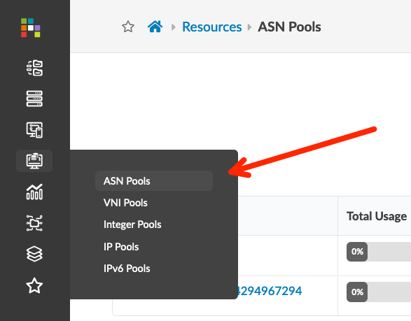
Create ASN Pools and IP Pools
Go to Resources > ASN Pools, and create the following two ASN pools
Go to Resources > IP Pools and create the following five IP address pools
Name | Ranges
DC-A | 65100 – 65199
DC-B | 65200 – 65299
Name | Subnets
DC-A Loopback | 192.168.1.0/24
DC-B Loopback | 192.168.2.0/24
DC-A Fabric | 10.1.0.0/16
DC-B Fabric | 10.2.0.0/16
External Link | 10.3.0.0/16

Slide 6
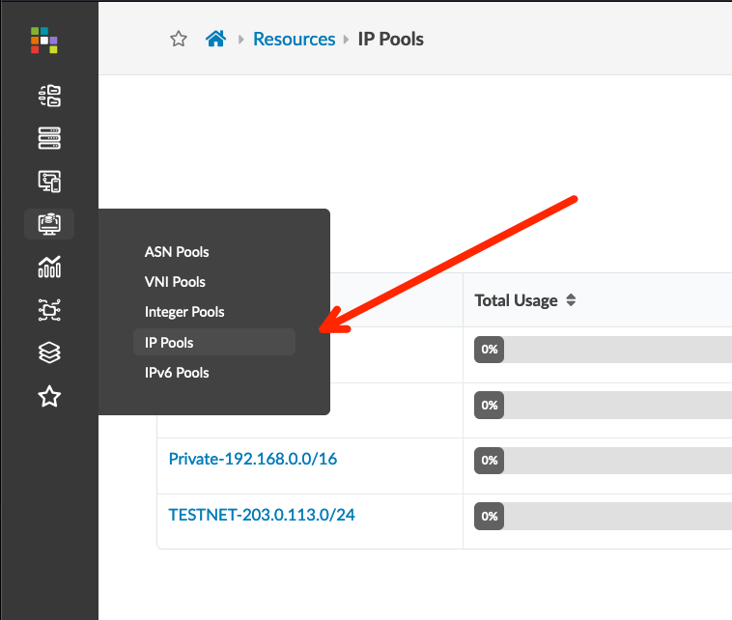
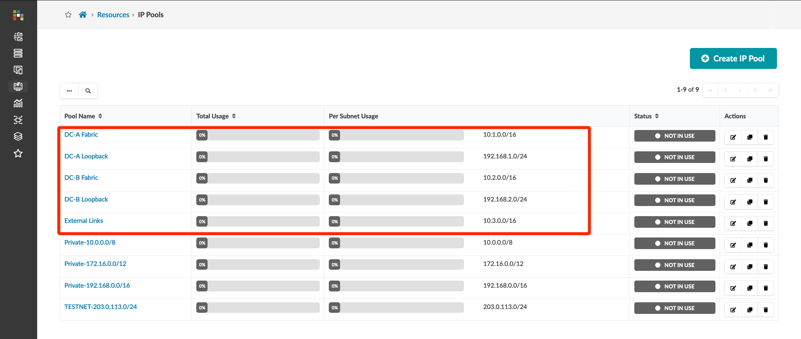
Create ASN Pools and IP Pools
Go to Resources > ASN Pools, and create the following two ASN pools
Go to Resources > IP Pools and create the following five IP address pools
Name | Ranges
DC-A | 65100 – 65199
DC-B | 65200 – 65299
Name | Subnets
DC-A Loopback | 192.168.1.0/24
DC-B Loopback | 192.168.2.0/24
DC-A Fabric | 10.1.0.0/16
DC-B Fabric | 10.2.0.0/16
External Links | 10.3.0.0/16

Slide 7
Create Logical Devices and Interface Maps
Apstra uses Logical Devices as abstractions of physical devices, and Interface Maps to create a link between physical devices (Device Profiles) and Logical Devices.
Logical Devices specify common device form factors such as number of ports, speeds, and role of each ports.
For the vJunos-switch nodes used in this lab, we will create a 10x1G port Device Profile. For vJunosEvolved nodes, we will create a 12x100G port Device Profile (if you choose to deploy vEvo sometime in the future). We will then create one Logical Device for each fabric role per Device Profile – Spine and Leaf.
vJunos-10x1-Spine
vEvo-12x100-Spine
10x 10G ports to Leaf
12x 100G ports to Leaf
(if using vEvo)
vJunos-10x1-Leaf
vEvo-12x100-Leaf
10x 10G ports to Spine, Generic
12x 100G ports to Spine, Generic

Slide 8
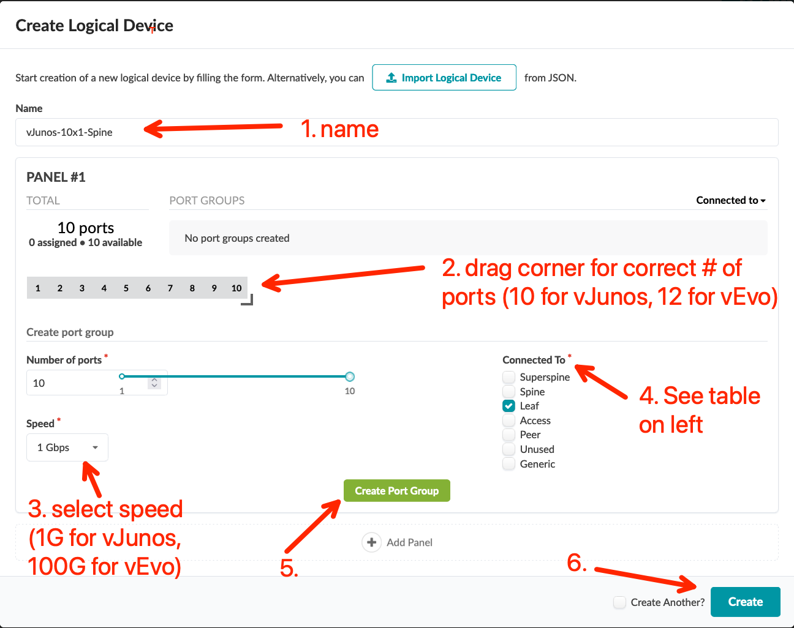
Create Logical Devices and Interface Maps
Go to Design > Logical Devices, and then create the following Logical Devices
Click the Query box and filter the name with “v” and verify the four newly created logical devices
Go to Design > Interface Maps, and then create below two Interface Maps
Click the Query box and filter the Device Profile with “vjunos” and verify the four newly created interface maps
Name | # of Ports | Connected To
vJunos-10x1-Spine | 10 | Leaf
vJunos-10x1-Leaf | 10 | Spine, Generic
vEvo-12x100-Spine | 12 | Leaf
vEvo-12x100-Leaf | 12 | Spine, Generic
Logical device | Device profile
vJunos-10x1-Spine | vJunos-lab
vJunos-10x1-Leaf | vJunos-lab
vEvo-12x100-Spine | vJunosEvo-lab
vEvo-12x100-Leaf | vJunosEvo-lab

Slide 9
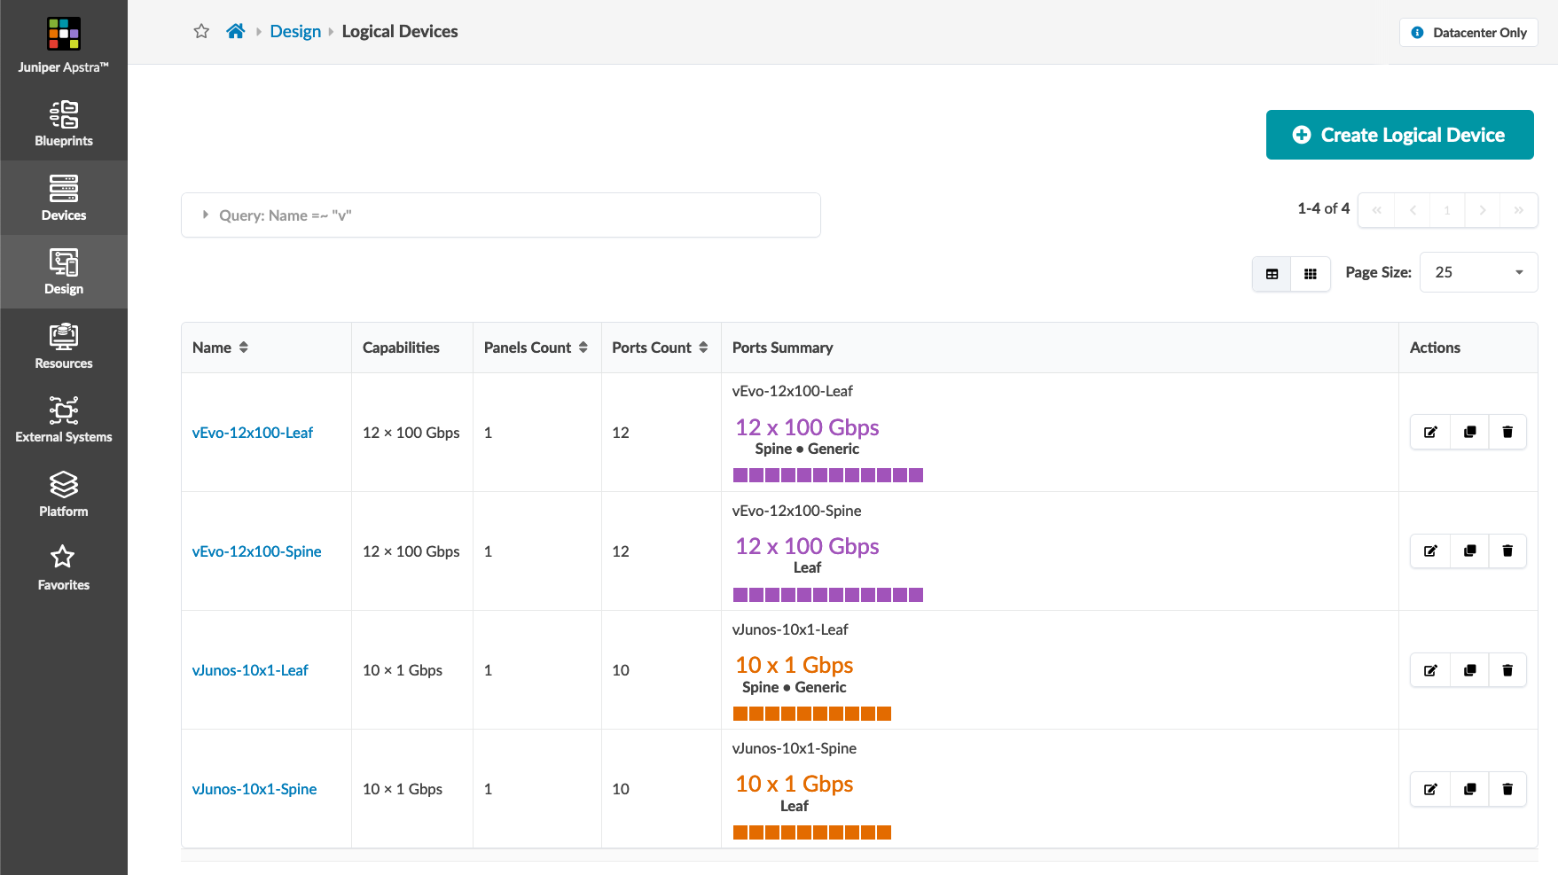
Create Logical Devices and Interface Maps
Go to Design > Logical Devices, and then create the following Logical Devices
Click the Query box and filter the name with “v” and verify the four newly created logical devices
Go to Design > Interface Maps and create the Interface Maps using the info in the table below
Click the Query box and filter the Device Profile with “vjunos” and verify the four newly created interface maps
Name | # of Ports | Connected To
vJunos-10x1-Spine | 10 | Leaf
vJunos-10x1-Leaf | 10 | Spine, Generic
vEvo-12x100-Spine | 12 | Leaf
vEvo-12x100-Leaf | 12 | Spine, Generic
Logical device | Device profile
vJunos-10x1-Spine | vJunos-lab
vJunos-10x1-Leaf | vJunos-lab
vEvo-12x100-Spine | vJunosEvo-lab
vEvo-12x100-Leaf | vJunosEvo-lab

Slide 10
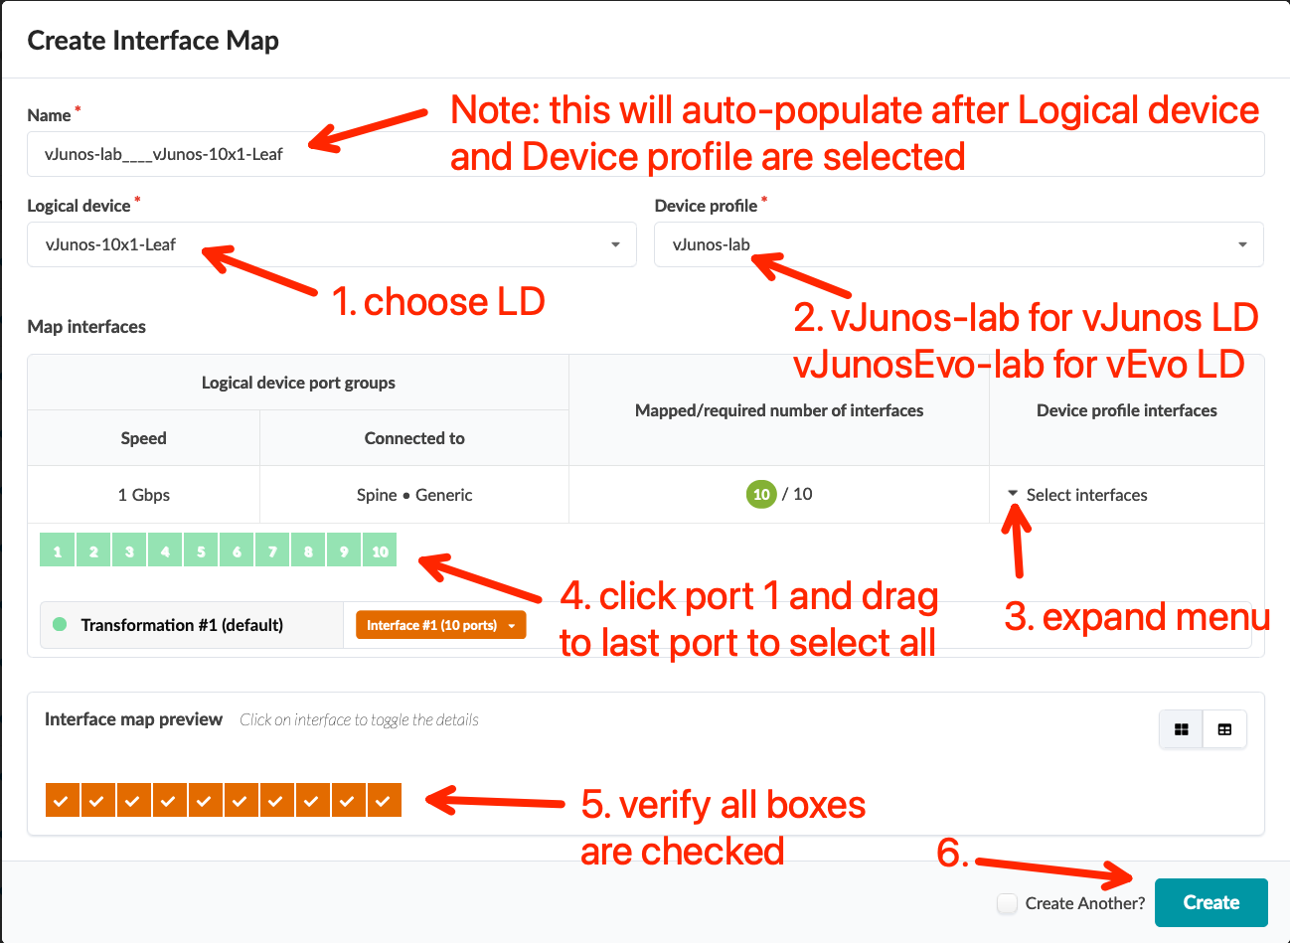
Create Logical Devices and Interface Maps
Go to Design > Logical Devices, and then create the following Logical Devices
Click the Query box and filter the name with ”v” and verify the four newly created logical devices
Go to Design > Interface Maps and create the Interface Maps using the info in the table below
Click the Query box and filter the Device Profile with “vjunos” and verify the four newly created interface maps
Name | # of Ports | Connected To
vJunos-10x1-Spine | 10 | Leaf
vJunos-10x1-Leaf | 10 | Spine, Generic
vEvo-12x100-Spine | 12 | Leaf
vEvo-12x100-Leaf | 12 | Spine, Generic
Logical device | Device profile
vJunos-10x1-Spine | vJunos-lab
vJunos-10x1-Leaf | vJunos-lab
vEvo-12x100-Spine | vJunosEvo-lab
vEvo-12x100-Leaf | vJunosEvo-lab

Slide 11
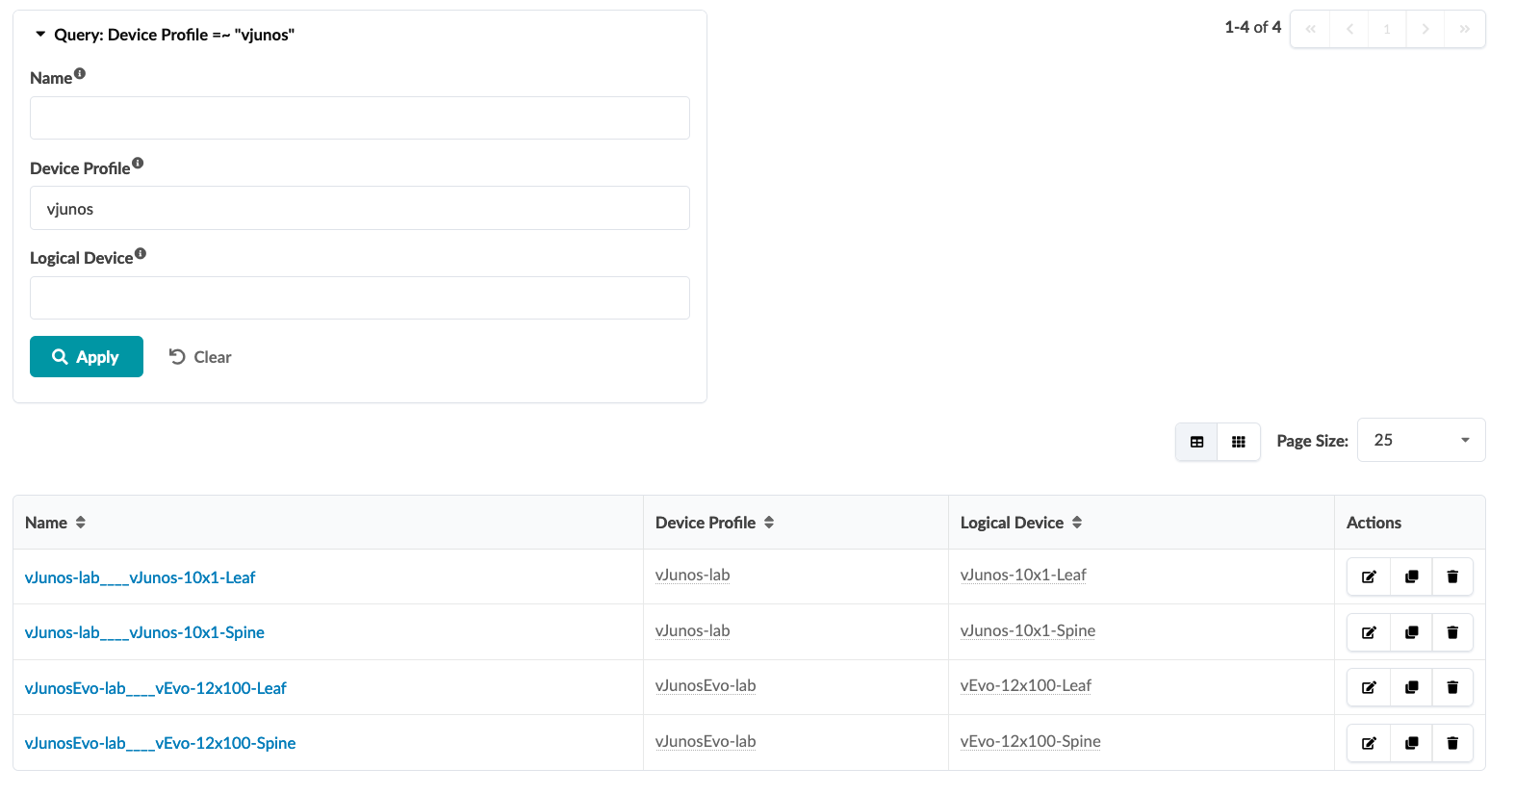
Create Logical Devices and Interface Maps
Go to Design > Logical Devices, and then create the following Logical Devices.
Click the Query box and filter the name with ”v” and verify the four newly created logical devices.
Go to Design > Interface Maps and create the Interface Maps using the info in the table below
Click the Query box and filter the Device Profile with “vjunos” and verify the four newly created interface maps
Name | # of Ports | Connected To
vJunos-10x1-Spine | 10 | Leaf
vJunos-10x1-Leaf | 10 | Spine, Generic
vEvo-12x100-Spine | 12 | Leaf
vEvo-12x100-Leaf | 12 | Spine, Generic
Logical device | Device profile
vJunos-10x1-Spine | vJunos-lab
vJunos-10x1-Leaf | vJunos-lab
vEvo-12x100-Spine | vJunosEvo-lab
vEvo-12x100-Leaf | vJunosEvo-lab

Slide 12
Create Rack Types
Apstra uses Rack Types as logical representations of racks. In this lab, there are two types of rack; a border rack used to connect external systems like DCI gateway and firewall, and a server rack used to connect compute resources like bare metal servers.
External generic systems must be added in the Blueprint, so we will create a border rack with two leaf switches. For the server rack, we will define three servers, with two serves multi-homed using ESI-LAG, and one server single-homed.
Apstra 4.2 introduced a new Designer workflow for creating racks. This will be used for DC-B. The original Builder workflow will be used for DC-A.
Border Rack
Define two switches per rack, without any external connections.
Server Rack
Define two switches per rack, and then define two servers in the rack type definition, each server has one single uplink to a leaf switch.
border1
border2
leaf1
leaf2
fw1
fw2
ext-rtr
bms-1
bms-2
bms-3
(These will be created inside the blueprint later)
(DC-A only)

Slide 13
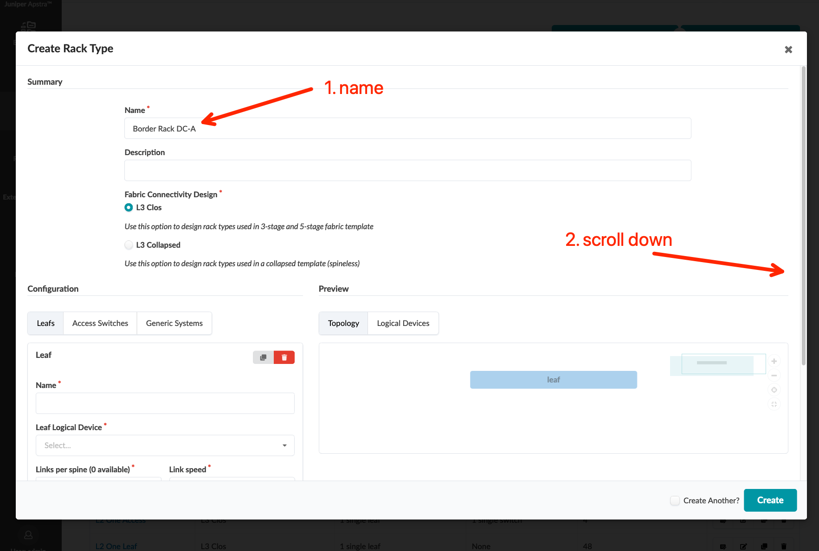
Create Border Rack Types – DC-A (using Builder workflow)
Go to Design > Rack Types, click the “Create In Builder” button, and create below border rack type
Name | Border Rack DC-A
Fabric Connectivity Design | L3 Clos
Leaf Name | switch
Leaf Logical Device | vJunos-10x1-Leaf
Redundancy Protocol | ESI

Slide 14
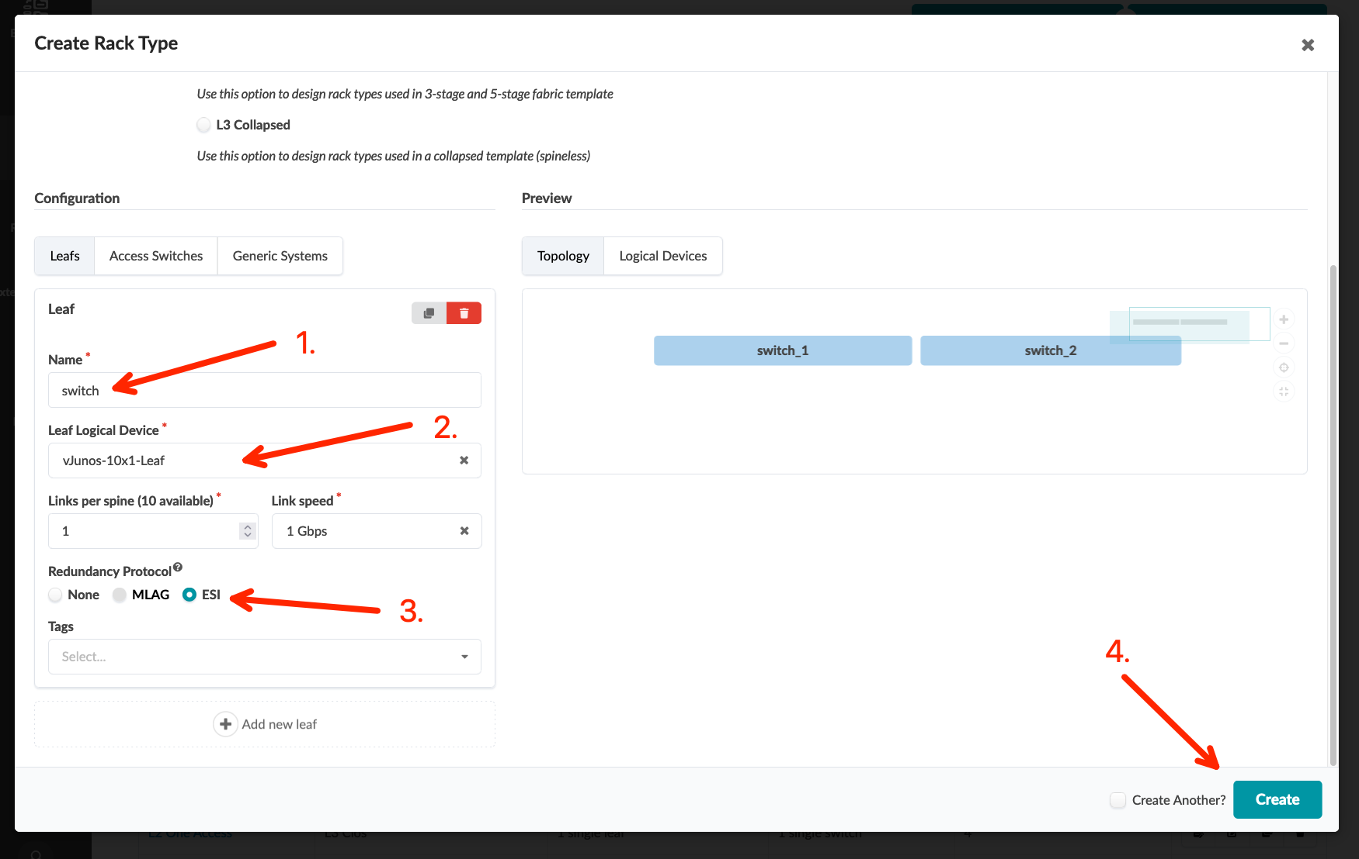
Create Border Rack Types – DC-A (using Builder workflow)
Go to Design > Rack Types, click the “Create In Builder” button, and create below border rack type
Name | Border Rack DC-A
Fabric Connectivity Design | L3 Clos
Leaf Name | switch
Leaf Logical Device | vJunos-10x1-Leaf
Redundancy Protocol | ESI

Slide 15
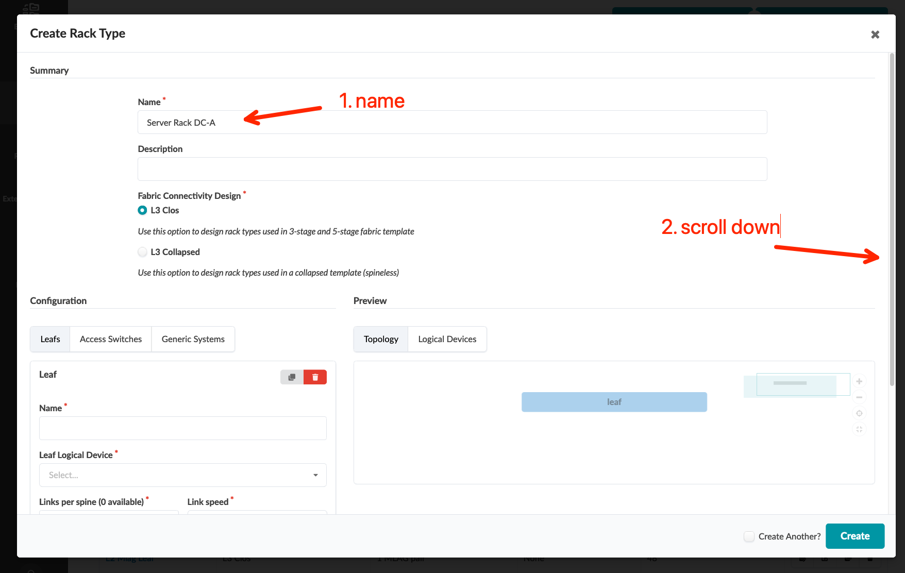
Create Server Rack Types – DC-A (using Builder workflow)
Go to Design > Rack Types, click the “Create In Builder” button, and create below server rack type
Click “Add new generic system group” and input server information
Click “Add logical link” and input server link information, then click to add another generic system
Name | Server Rack DC-A
Fabric Connectivity Design | L3 Clos
Leaf Name | switch
Leaf Logical Device | vJunos-10x1-Leaf
Redundancy Protocol | ESI
Generic System Name | A-BMS-1
Generic System Count | 1
Logical Device | AOS-2x1-1
Logical Link Name | A-switch-LAG1
Attachment Type | Dual-Homed
LAG Mode | LACP (Active)

Slide 16
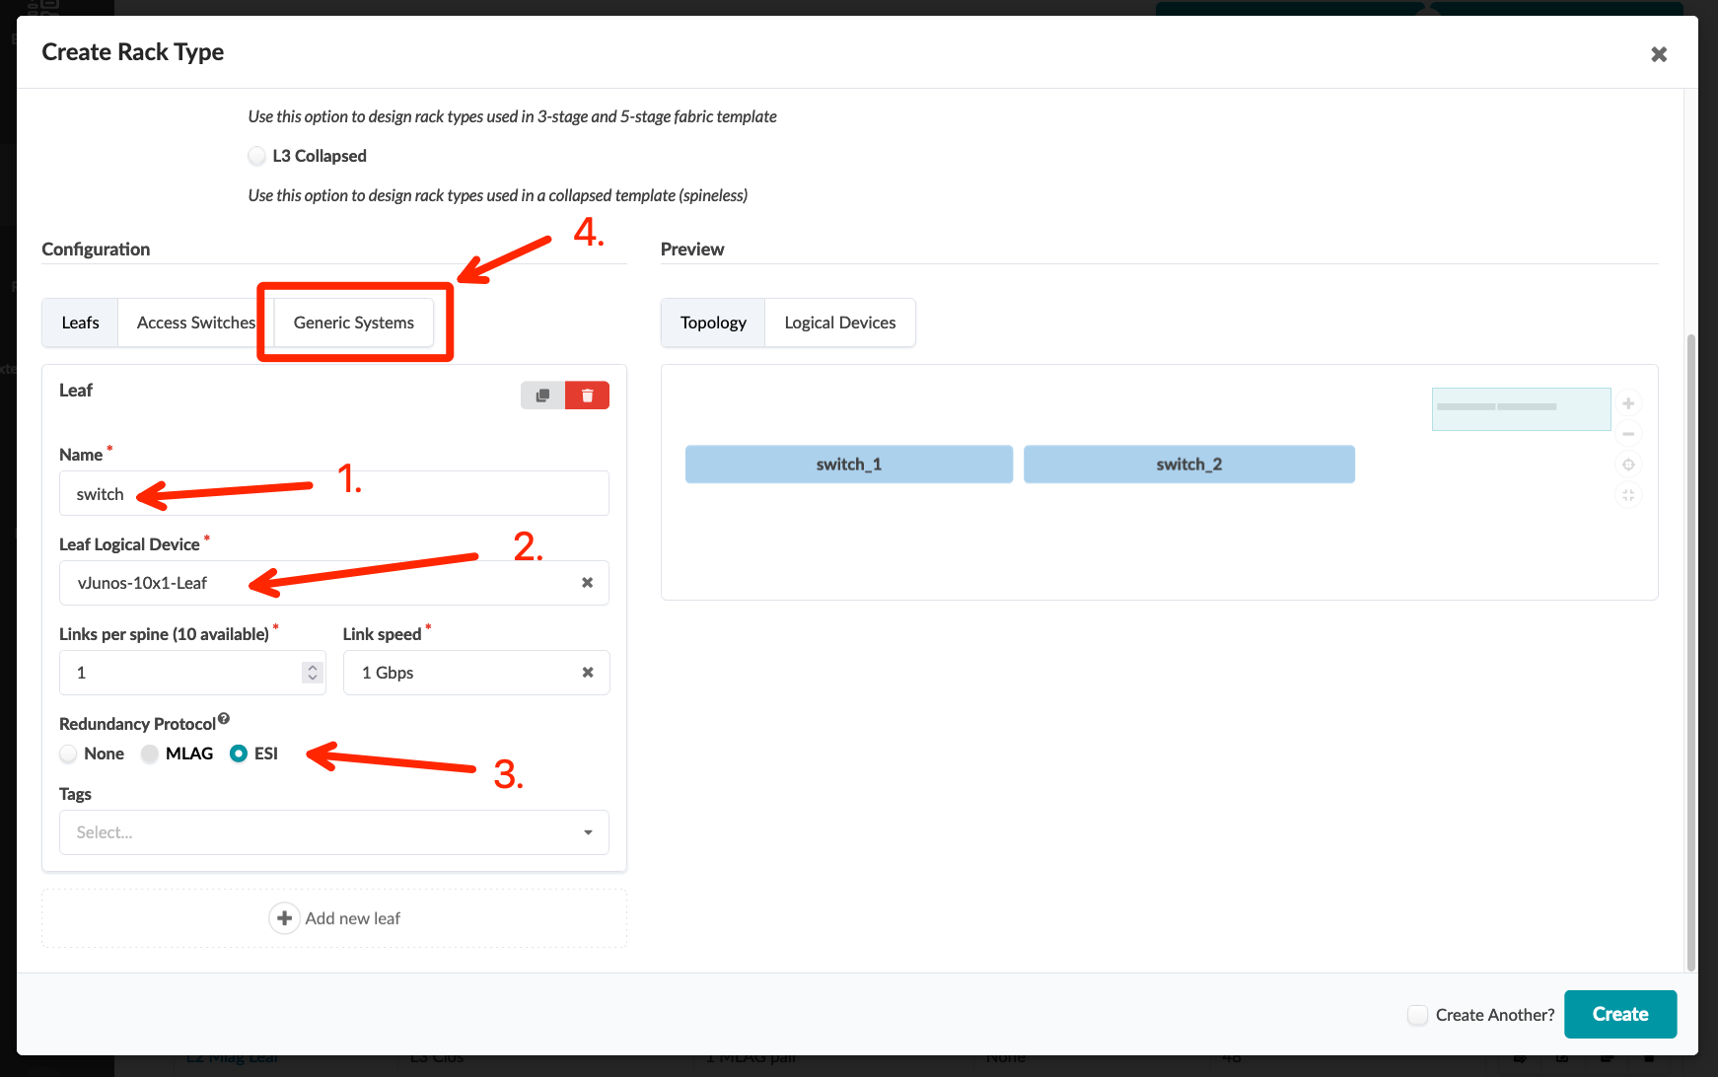
Create Server Rack Types – DC-A (using Builder workflow)
Go to Design > Rack Types, click the “Create In Builder” button, and create below server rack type
Click “Add new generic system group” and input server information
Click “Add logical link” and input server link information, then click to add another generic system
Name | Server Rack DC-A
Fabric Connectivity Design | L3 Clos
Leaf Name | switch
Leaf Logical Device | vJunos-10x1-Leaf
Redundancy Protocol | ESI
Generic System Name | A-BMS-1
Generic System Count | 1
Logical Device | AOS-2x1-1
Logical Link Name | A-switch-LAG1
Attachment Type | Dual-Homed
LAG Mode | LACP (Active)

Slide 17
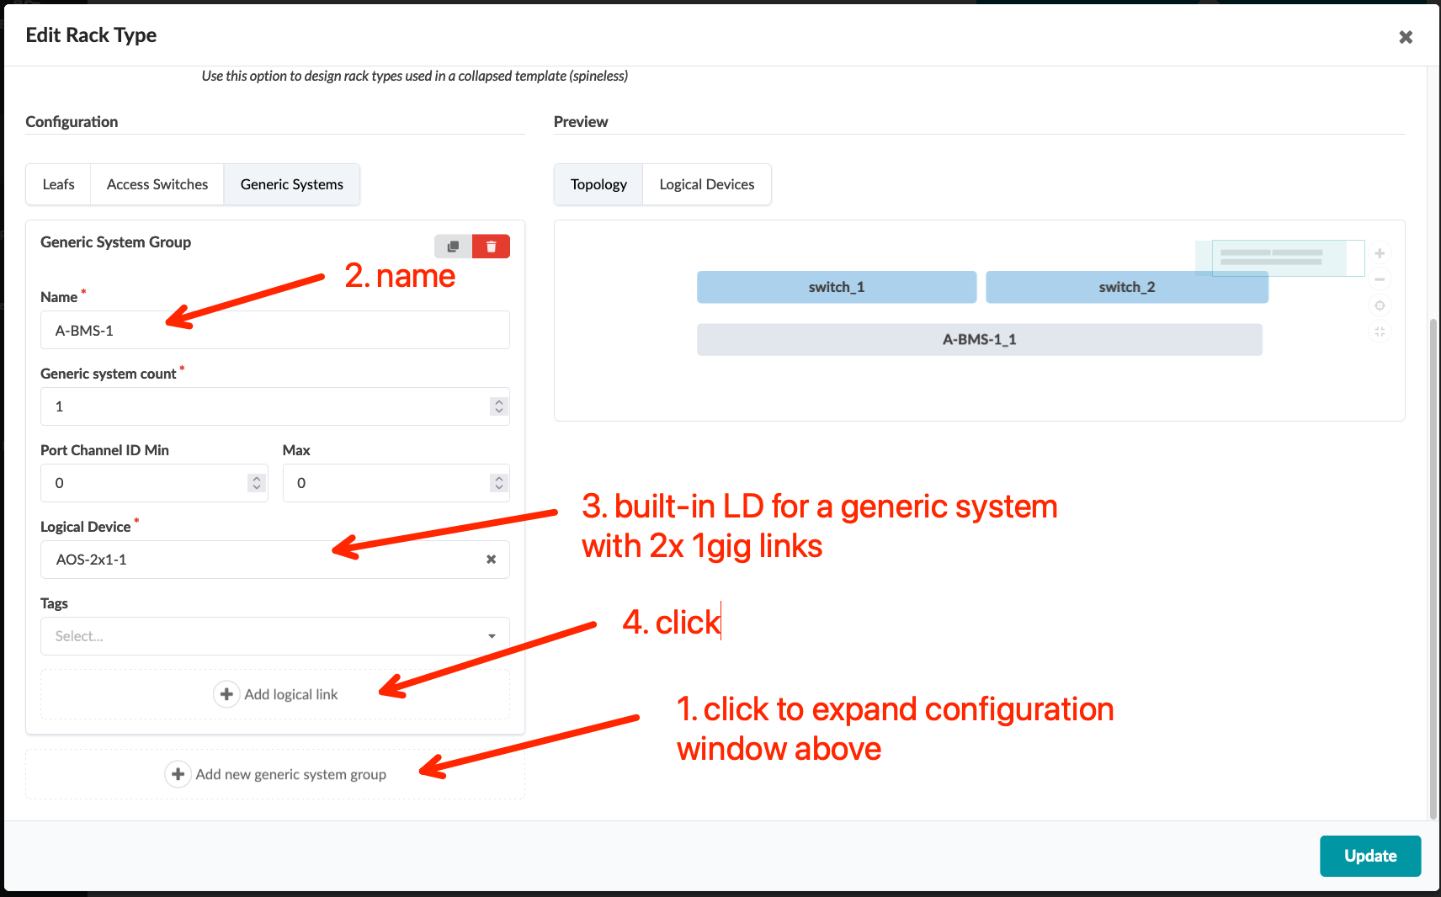
Create Server Rack Types – DC-A (using Builder workflow)
Go to Design > Rack Types, click the “Create In Builder” button, and create below server rack type
Click “Add new generic system group” and input server information
Click “Add logical link” and input server link information, then click to add another generic system
Name | Server Rack DC-A
Fabric Connectivity Design | L3 Clos
Leaf Name | switch
Leaf Logical Device | vJunos-10x1-Leaf
Redundancy Protocol | ESI
Generic System Name | A-BMS-1
Generic System Count | 1
Logical Device | AOS-2x1-1
Logical Link Name | A-switch-LAG1
Attachment Type | Dual-Homed
LAG Mode | LACP (Active)

Slide 18
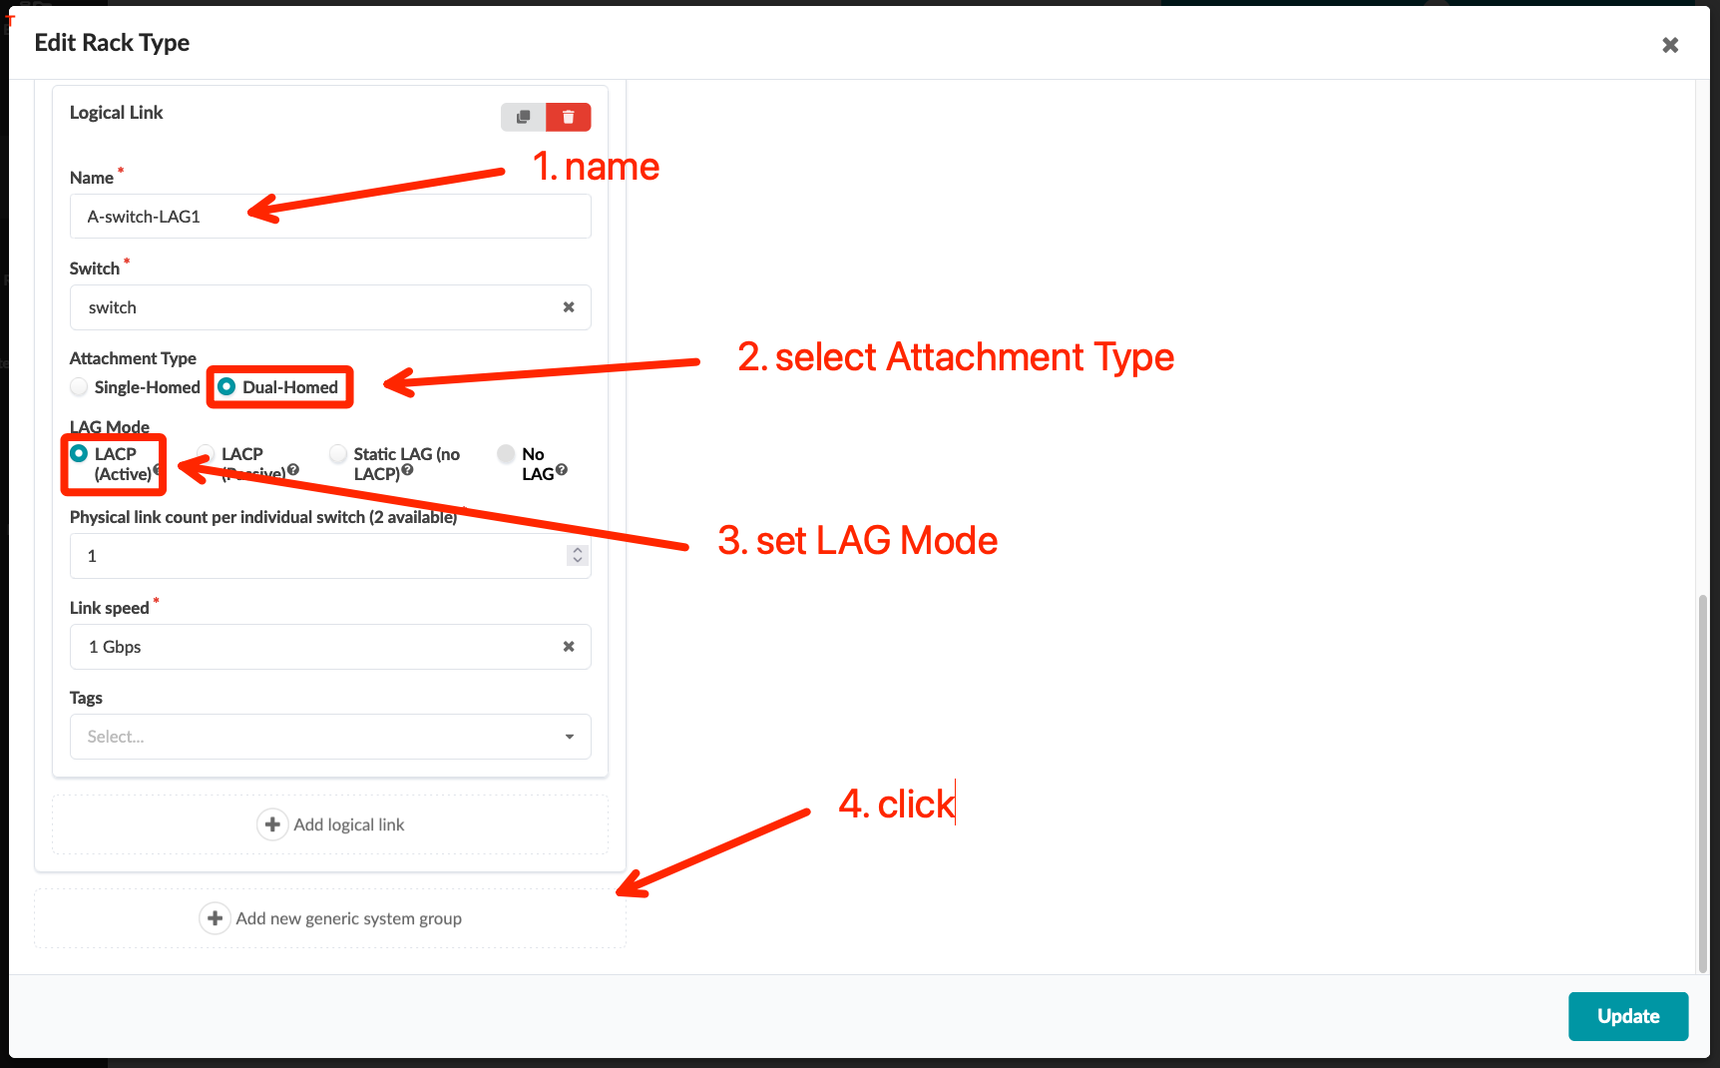
Create Server Rack Types – DC-A (using Builder workflow)
Go to Design > Rack Types, click the “Create In Builder” button, and create below server rack type
Click “Add new generic system group” and input server information
Click “Add logical link” and input server link information, then click to add another generic system
Name | Server Rack DC-A
Fabric Connectivity Design | L3 Clos
Leaf Name | switch
Leaf Logical Device | vJunos-10x1-Leaf
Redundancy Protocol | ESI
Generic System Name | A-BMS-1
Generic System Count | 1
Logical Device | AOS-2x1-1
Logical Link Name | A-switch-LAG1
Attachment Type | Dual-Homed
LAG Mode | LACP (Active)

Slide 19
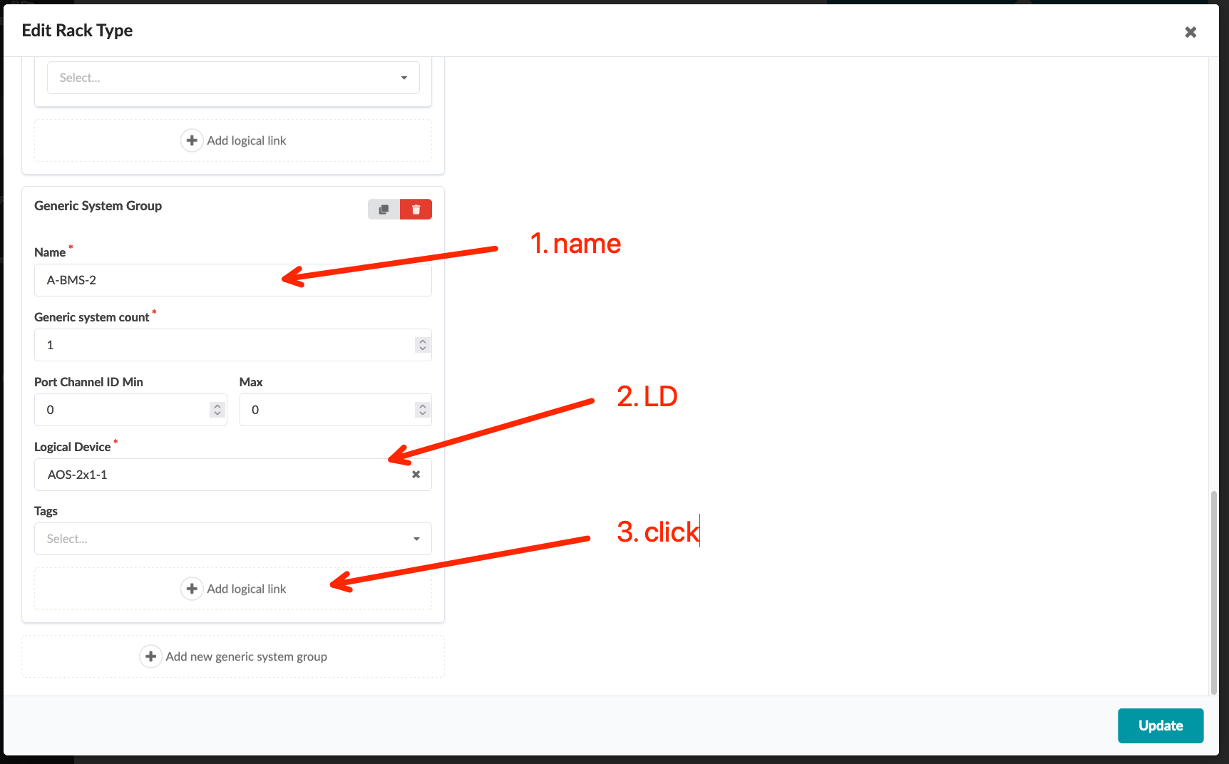
Create Server Rack Types – DC-A (Builder workflow)
Click “Add new generic system group” to add another server
Click “Add logical link” and input server link information of another server, then click to add another generic system
Generic System Name | A-BMS-2
Generic System Count | 1
Logical Device | AOS-2x1-1
Logical Link Name | A-switch-LAG2
Attachment Type | Dual-Homed
LAG Mode | LACP (Active)

Slide 20
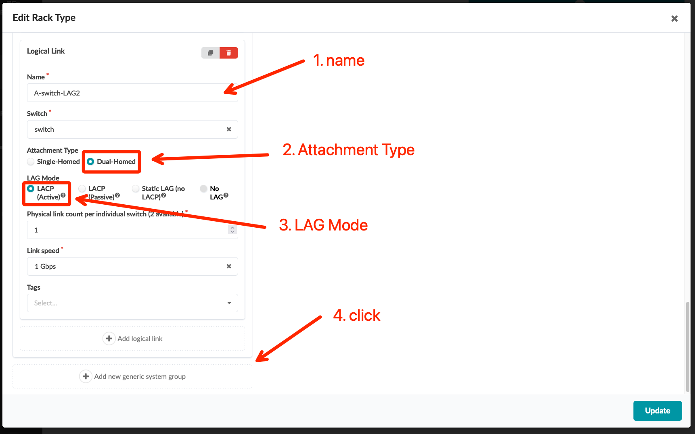
Create Server Rack Types – DC-A (using Builder workflow)
Click “Add new generic system group” to add another server
Click “Add logical link” and input server link information of another server, then click to add another generic system
Generic System Name | A-BMS-2
Generic System Count | 1
Logical Device | AOS-2x1-1
Logical Link Name | A-switch-LAG2
Attachment Type | Dual-Homed
LAG Mode | LACP (Active)

Slide 21
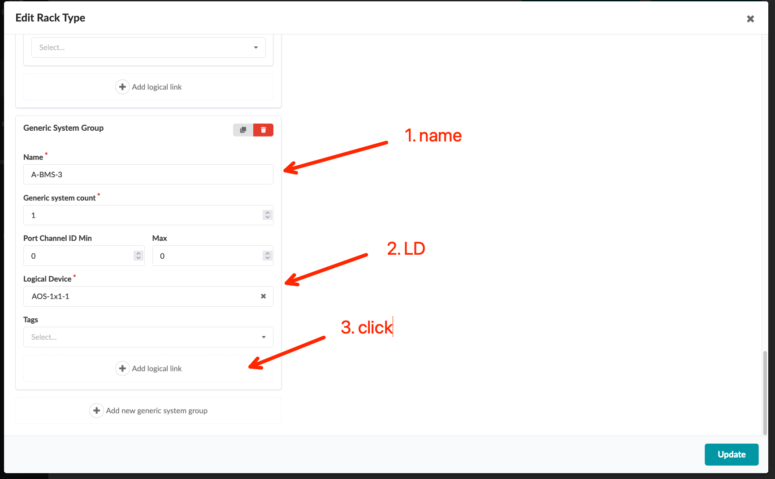
Create Server Rack Types – DC-A (using Builder workflow)
Click “Add new generic system group” to add another server
Click “Add logical link” and input server link information of another server
Verify the topology is the same as the screenshot and click the “Create” button
Generic System Name | A-BMS-3
Generic System Count | 1
Logical Device | AOS-1x1-1
Logical Link Name | A-switch-1
Attachment Type | Single-Homed
Peer Leaf | First

Slide 22
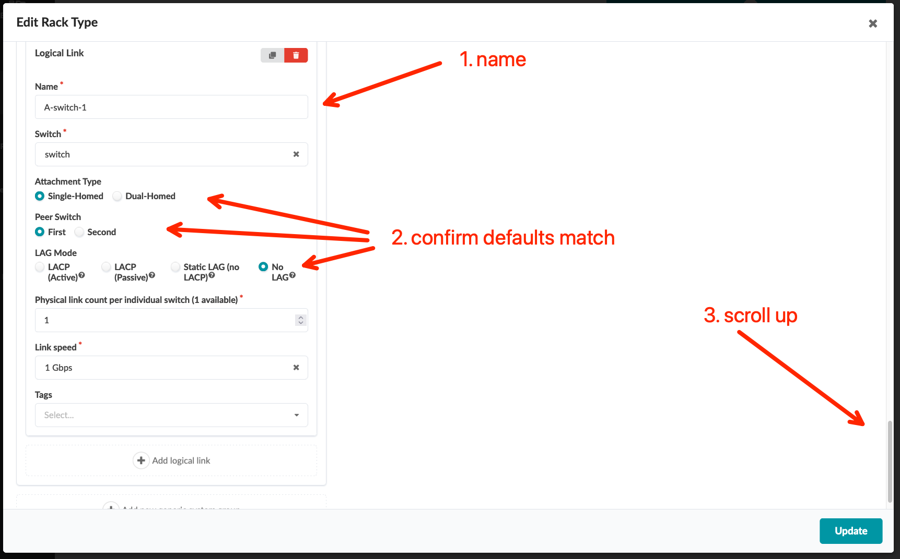
Create Server Rack Types – DC-A (using Builder workflow)
Click “Add new generic system group” to add another server
Click “Add logical link” and input server link information of another server
Verify the topology is the same as the screenshot and click the “Create” button
Generic System Name | A-BMS-3
Generic System Count | 1
Logical Device | AOS-1x1-1
Logical Link Name | A-switch-1
Attachment Type | Single-Homed
Peer Leaf | First

Slide 23
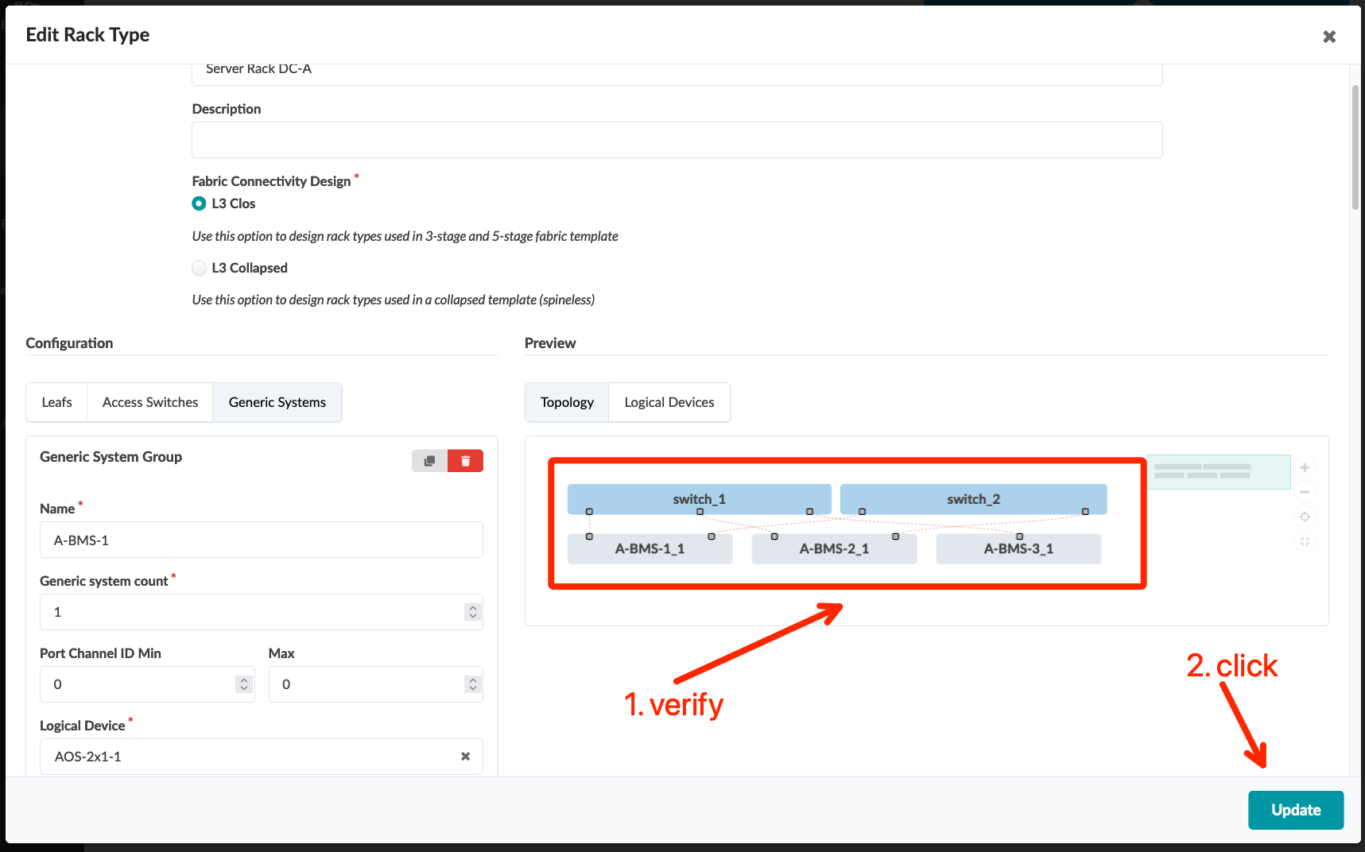
Create Server Rack Types – DC-A (using Builder workflow)
Click “Add new generic system group” to add another server
Click “Add logical link” and input server link information of another server
Verify the topology is the same as the screenshot and click the “Create” button
Generic System Name | A-BMS-3
Generic System Count | 1
Logical Device | AOS-1x1-1
Logical Link Name | A-switch-1
Attachment Type | Single-Homed
Peer Leaf | First

Slide 24
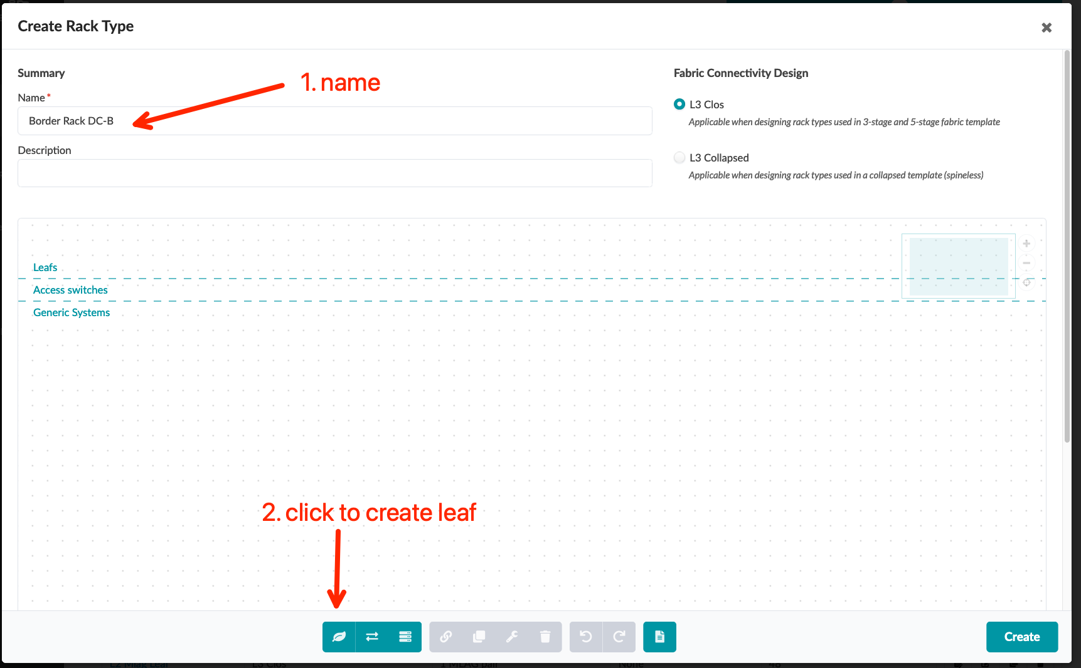
Create Border Rack Types – DC-B (using Designer workflow)
Go to Design > Rack Types, click the “Create In Designer” button, and create below border rack type
Name | Border Rack DC-B
Fabric Connectivity Design | L3 Clos
Leaf Label | switch
Leaf Logical Device | vJunos-10x1-Leaf
Redundancy Protocol | ESI

Slide 25
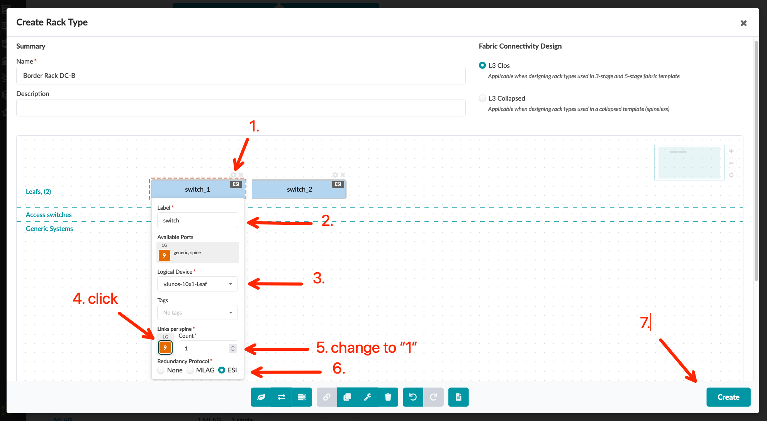
Create Border Rack Types – DC-B (using Designer workflow)
Go to Design > Rack Types, click the “Create In Designer” button, and create below border rack type
Name | Border Rack DC-B
Fabric Connectivity Design | L3 Clos
Leaf Label | switch
Leaf Logical Device | vJunos-10x1-Leaf
Redundancy Protocol | ESI

Slide 26
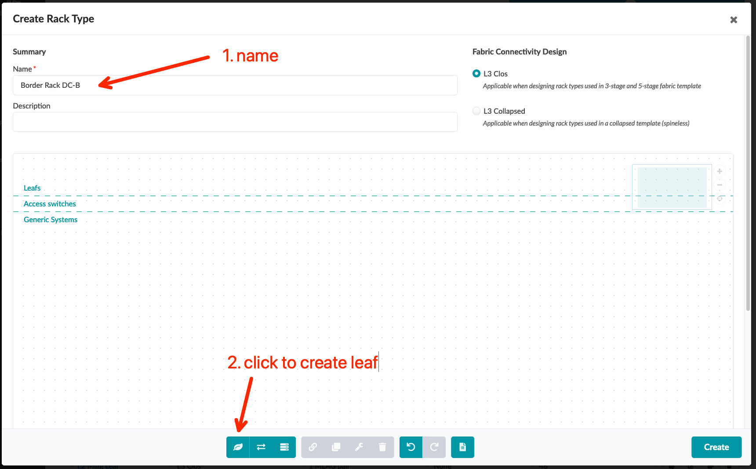
Create Server Rack Types – DC-B (using Designer workflow)
Go to Design > Rack Types, click the “Create In Designer” button, and create below border rack type
Click “Add new generic system group” and input server information
Follow the instructions in the screenshot to input server link information, then click to add another generic system
Name | Server Rack DC-B
Fabric Connectivity Design | L3 Clos
Leaf Label | switch
Leaf Logical Device | vJunos-10x1-Leaf
Redundancy Protocol | ESI
Label | B-BMS-1
Logical Device | AOS-2x1-1
Label | B-switch-LAG1
Peer Switch | First & Second
LAG Mode | LACP (Active)

Slide 27
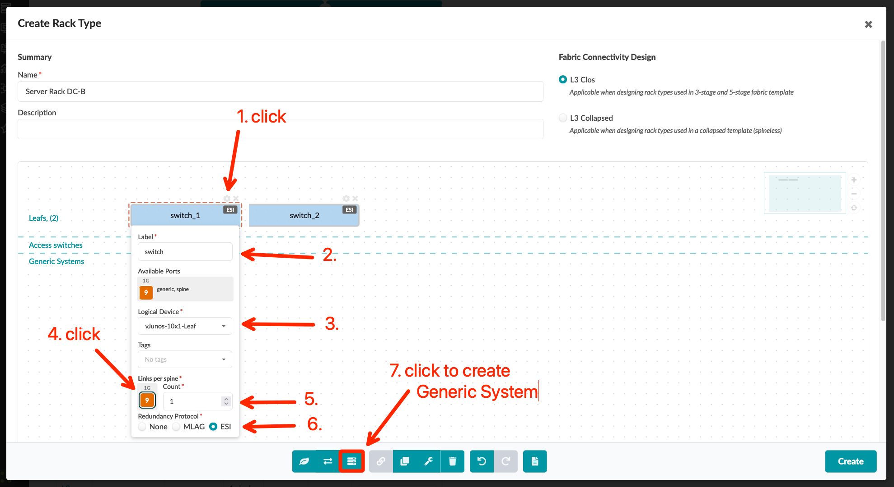
Create Server Rack Types – DC-B (using Designer workflow)
Go to Design > Rack Types, click the “Create In Designer” button, and create below border rack type
Click “Add new generic system group” and input server information
Follow the instructions in the screenshot to input server link information, then click to add another generic system
Name | Server Rack DC-B
Fabric Connectivity Design | L3 Clos
Leaf Label | switch
Leaf Logical Device | vJunos-10x1-Leaf
Redundancy Protocol | ESI
Label | B-BMS-1
Logical Device | AOS-2x1-1
Label | B-switch-LAG1
Peer Switch | First & Second
LAG Mode | LACP (Active)

Slide 28
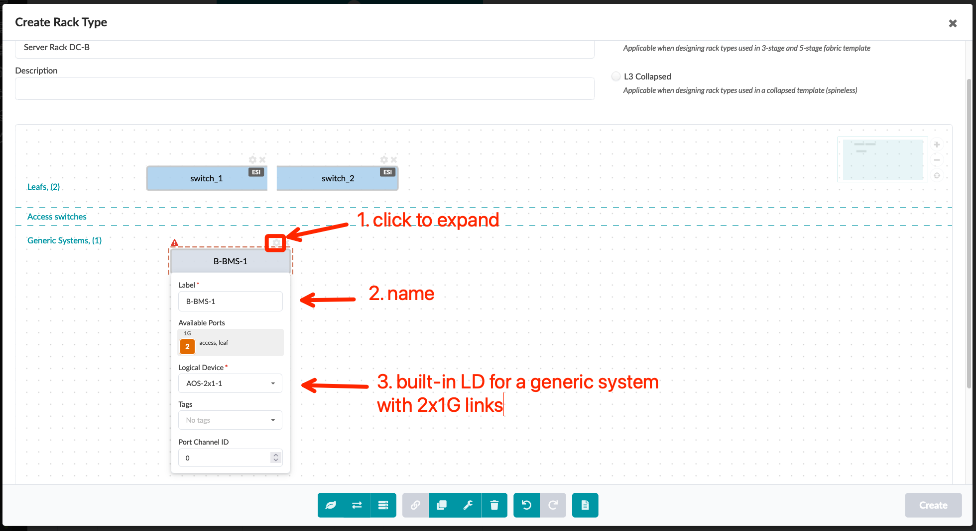
Create Server Rack Types – DC-B (using Designer workflow)
Go to Design > Rack Types, click the “Create In Designer” button, and create below border rack type
Click “Add new generic system group” and input server information
Follow the instructions in the screenshot to input server link information, then click to add another generic system
Name | Server Rack DC-B
Fabric Connectivity Design | L3 Clos
Leaf Label | switch
Leaf Logical Device | vJunos-10x1-Leaf
Redundancy Protocol | ESI
Label | B-BMS-1
Logical Device | AOS-2x1-1
Label | B-switch-LAG1
Peer Switch | First & Second
LAG Mode | LACP (Active)

Slide 29
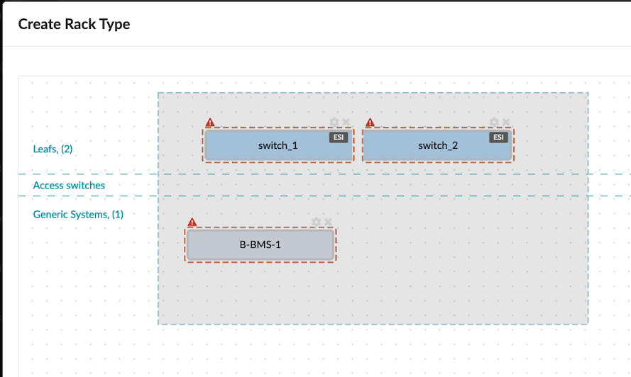
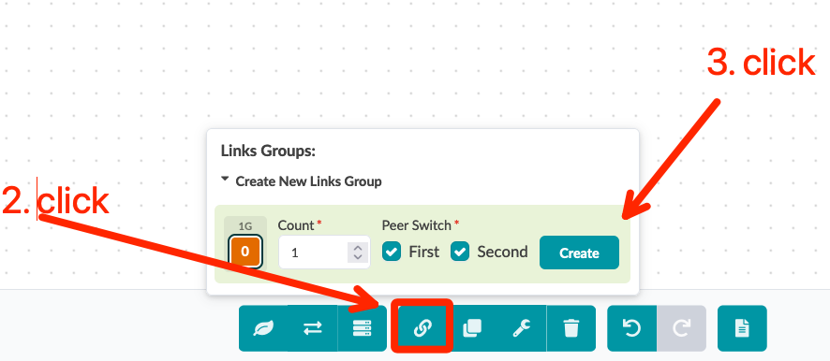
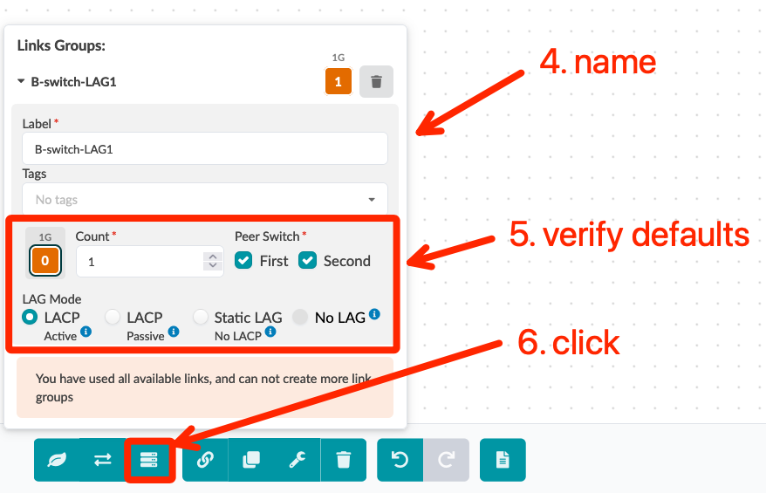
Create Server Rack Types – DC-B (using Designer workflow)
Go to Design > Rack Types, click the “Create In Designer” button, and create below border rack type
Click “Add new generic system group” and input server information
Follow the instructions in the screenshot to input server link information, then click to add another generic system
1. Click and hold while drawing a box around the two leaf switches and the generic system so all are highlighted with red dashed lines.
Name | Server Rack DC-B
Fabric Connectivity Design | L3 Clos
Leaf Label | switch
Leaf Logical Device | vJunos-10x1-Leaf
Redundancy Protocol | ESI
Label | B-BMS-1
Logical Device | AOS-2x1-1
Label | B-switch-LAG1
Peer Switch | First & Second
LAG Mode | LACP (Active)

Slide 30
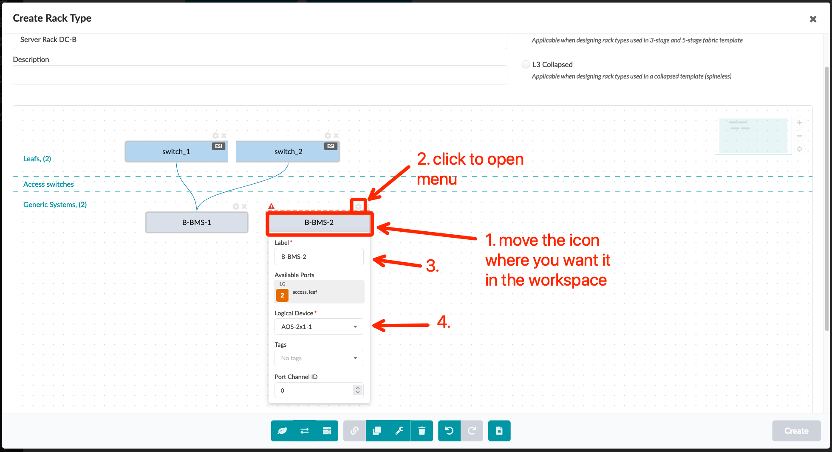
Create Server Rack Types – DC-B (using Designer workflow)
Click “Add new generic system group” to add another server
Follow the instructions in the screenshot to input server link information, then click to add another generic system
Verify topology and click the “Create” button
Label | B-BMS-2
Logical Device | AOS-2x1-1
Label | B-switch-LAG2
Peer Switch | First & Second
LAG Mode | LACP (Active)

Slide 31
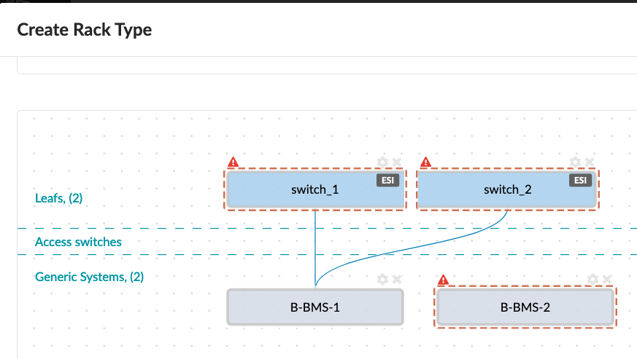
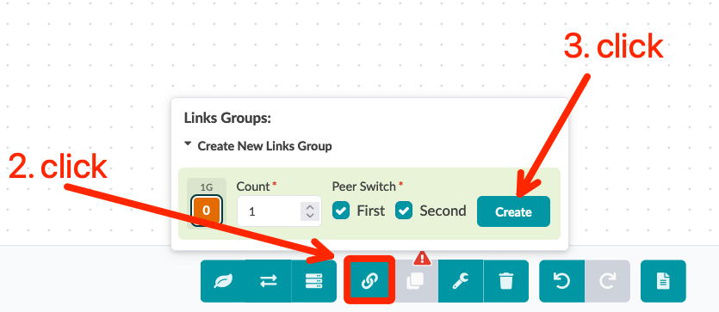
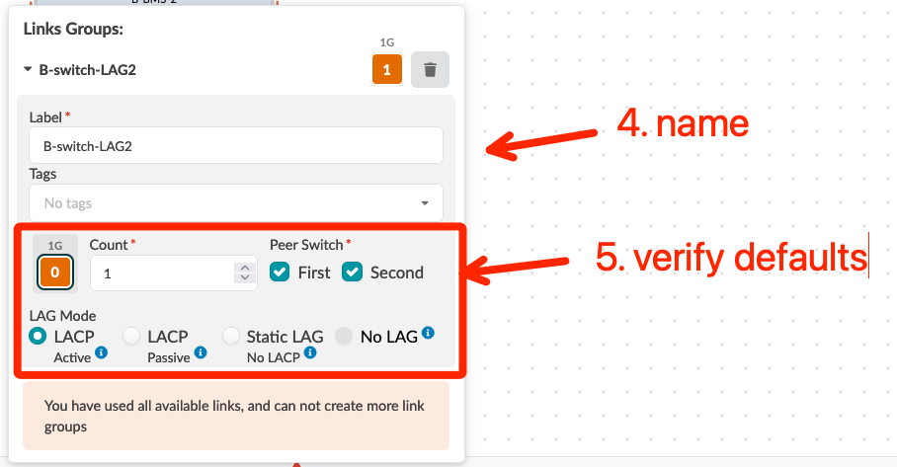
Create Server Rack Types – DC-B (using Designer workflow)
Click “Add new generic system group” to add another server
Follow the instructions in the screenshot to input server link information, then click to add another generic system
Verify topology and click the “Create” button
1. Hold the Alt-key and click the two leaf switches and the generic system so all are highlighted with red dashed lines.
Label | B-BMS-2
Logical Device | AOS-2x1-1
Label | B-switch-LAG2
Peer Switch | First & Second
LAG Mode | LACP (Active)

Slide 32
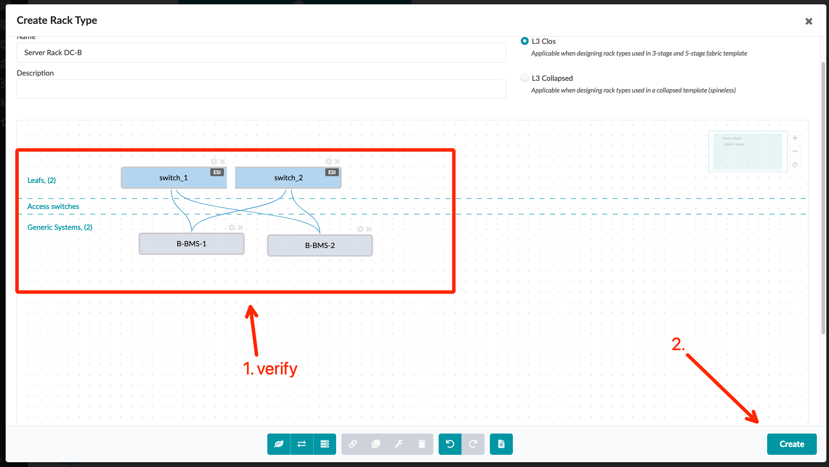
Create Server Rack Types – DC-B (using Designer workflow)
Click “Add new generic system group” to add another server
Follow the instructions in the screenshot to input server link information, then click to add another generic system
Verify topology and click the “Create” button
Label | B-BMS-2
Logical Device | AOS-2x1-1
Label | B-switch-LAG2
Peer Switch | First & Second
LAG Mode | LACP (Active)

Slide 33
Create Templates
A Templates combines racks into a logical representation of a data center. In our lab setup, each data center has one pair of spine switches, one border rack, and one server rack.
JNPR EVPN Template
spine1
spine2
border1
border2
leaf1
leaf2
bms1
bms2
bms3
(DC-A only)
Border Rack
Server Rack

Slide 34
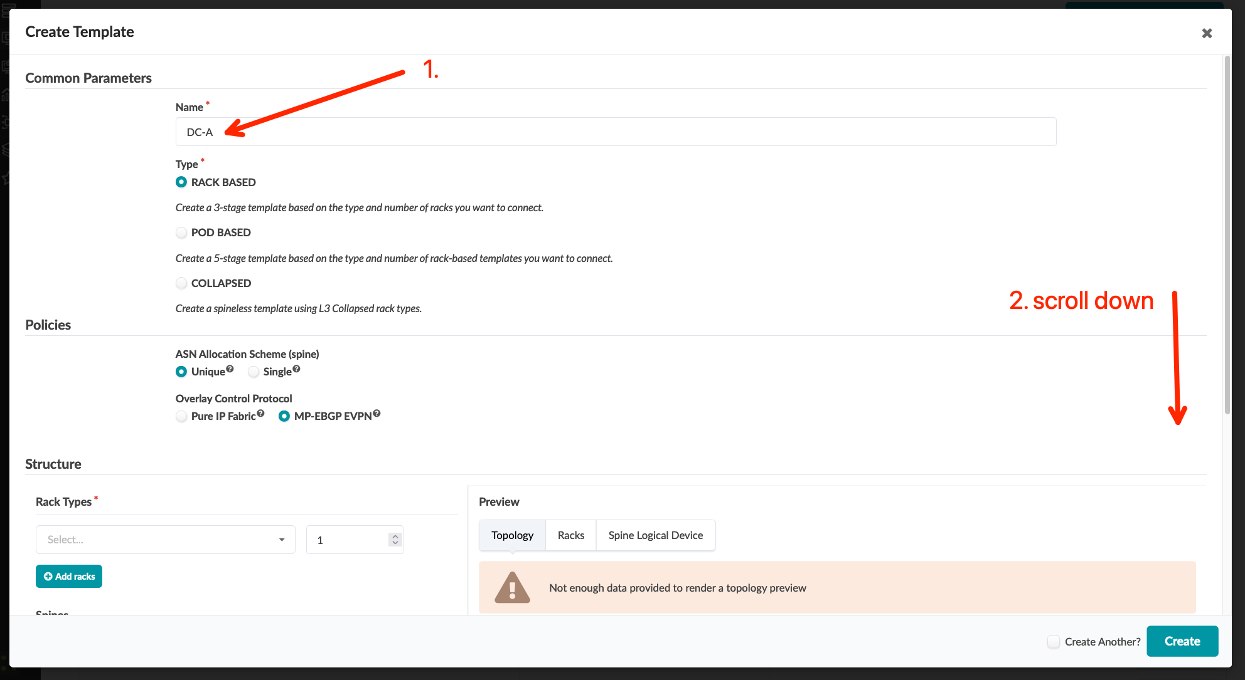
Create Templates – DC-A
Go to Design > Templates and the create a new template
Continue the template configuration as below
Name | DC-A
Type | RACK BASED
ASN Allocation Scheme | Unique
Overlay Control Protocol | MP-EBGP EVPN
Rack Types #1 | Border Rack DC-A
Rack Count #1 | 1
Rack Types #2 | Server Rack DC-A
Rack Count #2 | 1
Spine Logical Device | vJunos-10x1-Spine
Spines Count | 2

Slide 35
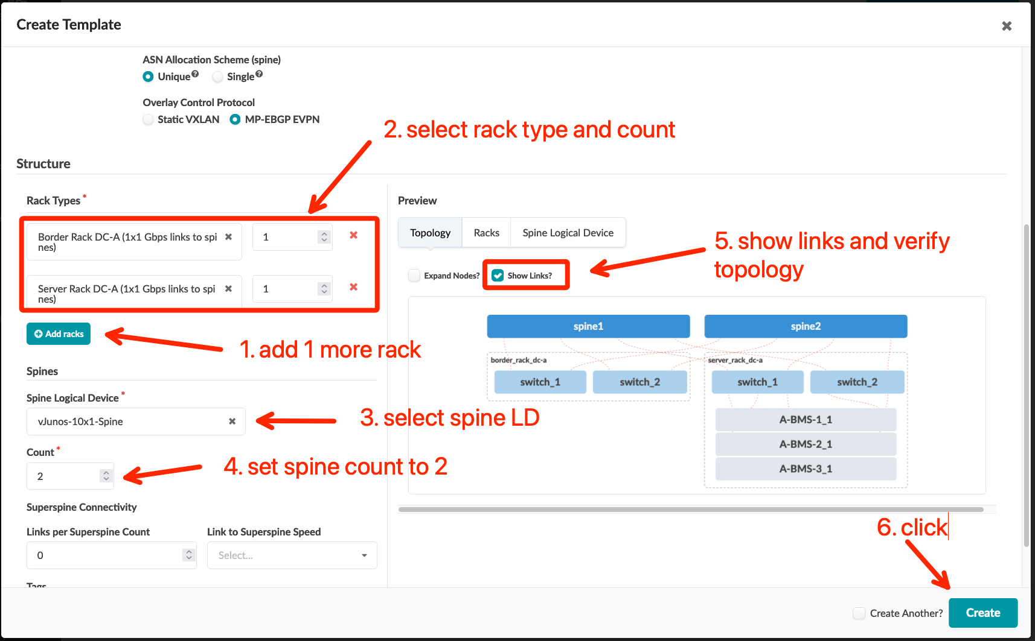
Create Templates – DC-A
Go to Design > Templates and the create a new template
Continue the template configuration as below
Name | DC-A (vJunos)
Type | RACK BASED
ASN Allocation Scheme | Unique
Overlay Control Protocol | MP-EBGP EVPN
Rack Types #1 | Border Rack DC-A
Rack Count #1 | 1
Rack Types #2 | Server Rack DC-A
Rack Count #2 | 1
Spine Logical Device | vJunos-10x1-Spine
Spines Count | 2

Slide 36
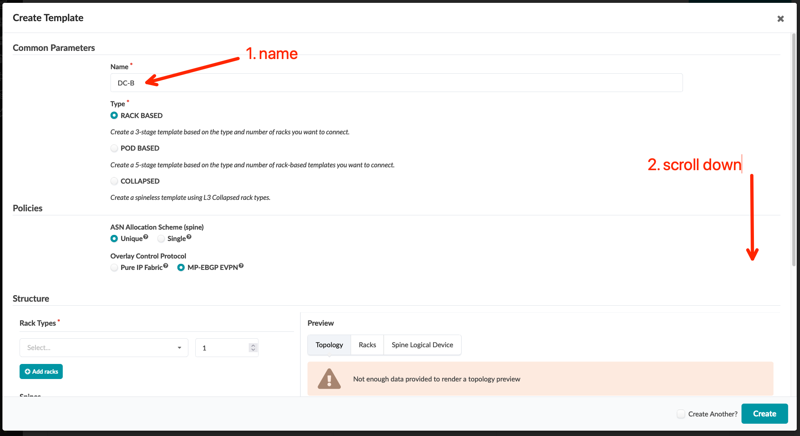
Create Templates – DC-B
Go to Design > Templates and the create a new template
Continue the template configuration as below
Name | DC-B
Type | RACK BASED
ASN Allocation Scheme | Unique
Overlay Control Protocol | MP-EBGP EVPN
Rack Types #1 | Border Rack DC-B
Rack Count #1 | 1
Rack Types #2 | Server Rack DC-B
Rack Count #2 | 1
Spine Logical Device | vJunos-10x1-Spine
Spines Count | 2

Slide 37
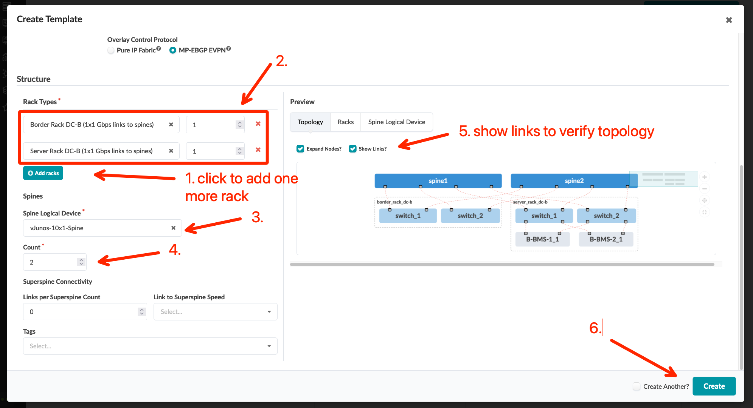
Create Templates – DC-B
Go to Design > Templates, and the create a new template
Continue the template configuration as below
Name | DC-B (vEvo)
Type | RACK BASED
ASN Allocation Scheme | Unique
Overlay Control Protocol | MP-EBGP EVPN
Rack Types #1 | Border Rack DC-B
Rack Count #1 | 1
Rack Types #2 | Server Rack DC-B
Rack Count #2 | 1
Spine Logical Device | vJunos-10x1-Spine
Spines Count | 2

Slide 38
Create Blueprints
A Blueprint represents a logical fabric in its initial state. The Blueprint is a sort of scaffolding that we us to build our operational Intent. In our lab setup, there are two data centers, so we will create two Blueprints based on the templates we created in previous step.
After creating the Blueprint, the first task is to assign the ASN and IP pool resources to various objects like spine/leaf ASN, spine/leaf loopback address, and fabric link address.
Next, we will assign the Interface Map to link the Logical Devices in the Blueprint to a Device Profile (vJunos). Finally, we will select the physical device from the Managed Devices list and assign to each Logical Device.
DC-A Blueprint
DC-B Blueprint
A-spine1
A-spine2
B-spine1
B-spine2
A-border1
A-border1
A-leaf1
A-leaf2
B-border1
B-border1
B-leaf1
B-leaf2
A-bms-1
A-bms-2
A-bms-3
B-bms-1
B-bms-2
Border Rack
Server Rack
Border Rack
Server Rack

Slide 39
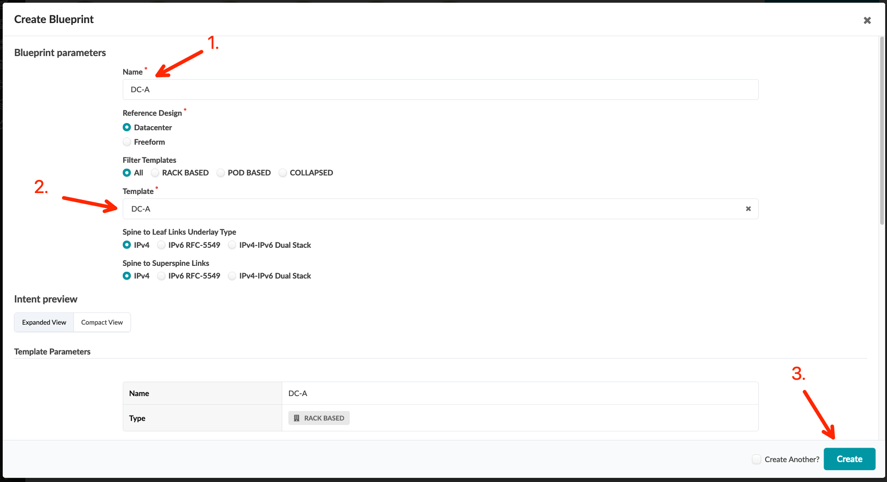
Create Blueprints
Go to Blueprints and create a new Blueprint
Click the new Blueprint to edit basic parameters such as ASN, IP, device, etc
Select the ASN Pool and IP Pools that were defined in previous steps and assign them to Build Resource Types as shown in the screenshot
Name | DC-A
Template | DC-A
Resource Type | Pool Name
ASNs – Spines | DC-A
ASNs – Leafs | DC-A
Loopback IPs – Spines | DC-A Loopback
Loopback IPs – Leafs | DC-A Loopback
Link IPs – Spines<->Leafs | DC-A Fabric

Slide 40
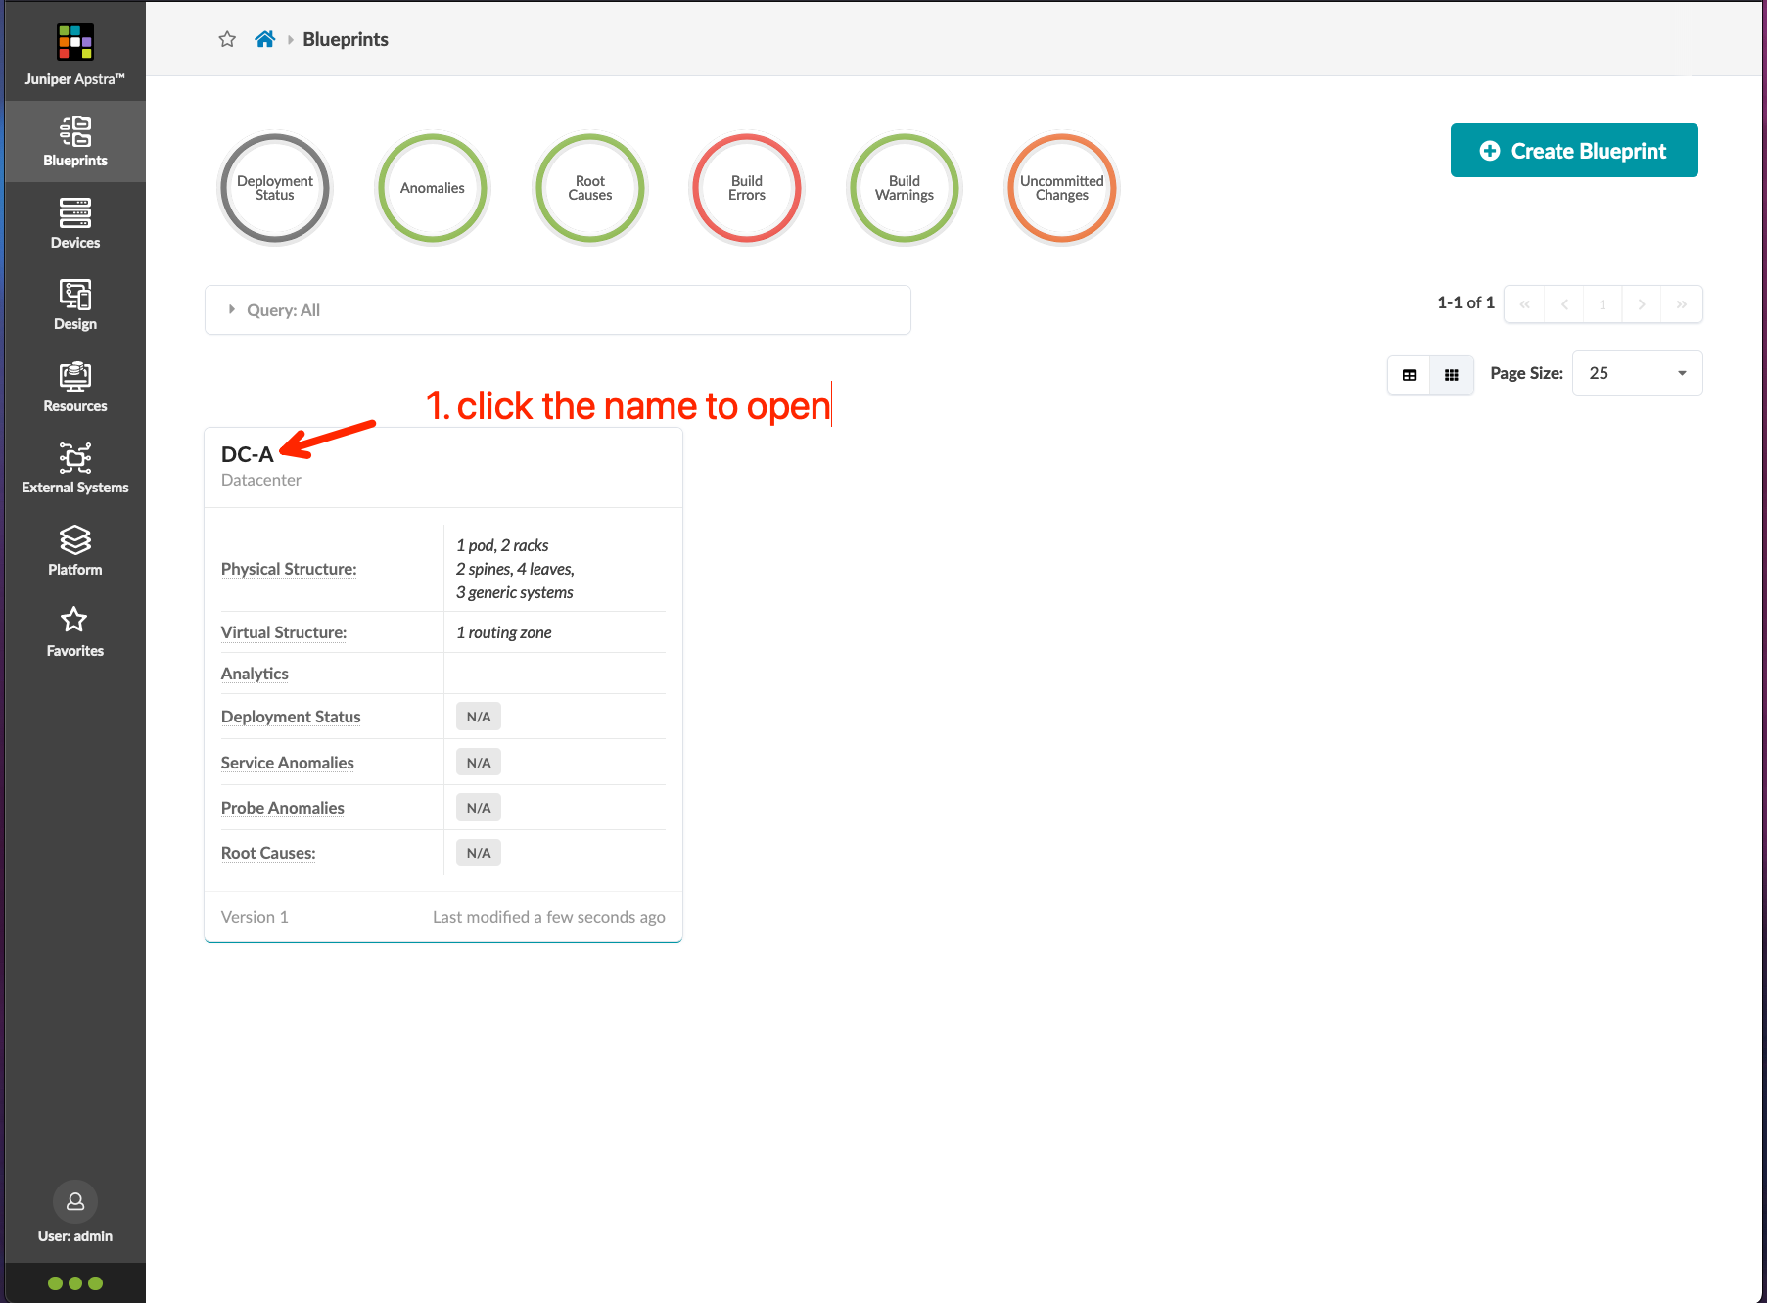
Create Blueprints
Go to Blueprints and create a new Blueprint
Click the new Blueprint to edit basic parameters such as ASN, IP, device, etc
Select the ASN Pool and IP Pools that were defined in previous steps and assign them to Build Resource Types as shown in the screenshot
Name | DC-A
Template | DC-A (vJunos)
Resource Type | Pool Name
ASNs – Spines | DC-A
ASNs – Leafs | DC-A
Loopback IPs – Spines | DC-A Loopback
Loopback IPs – Leafs | DC-A Loopback
Link IPs – Spines<->Leafs | DC-A Fabric

Slide 41
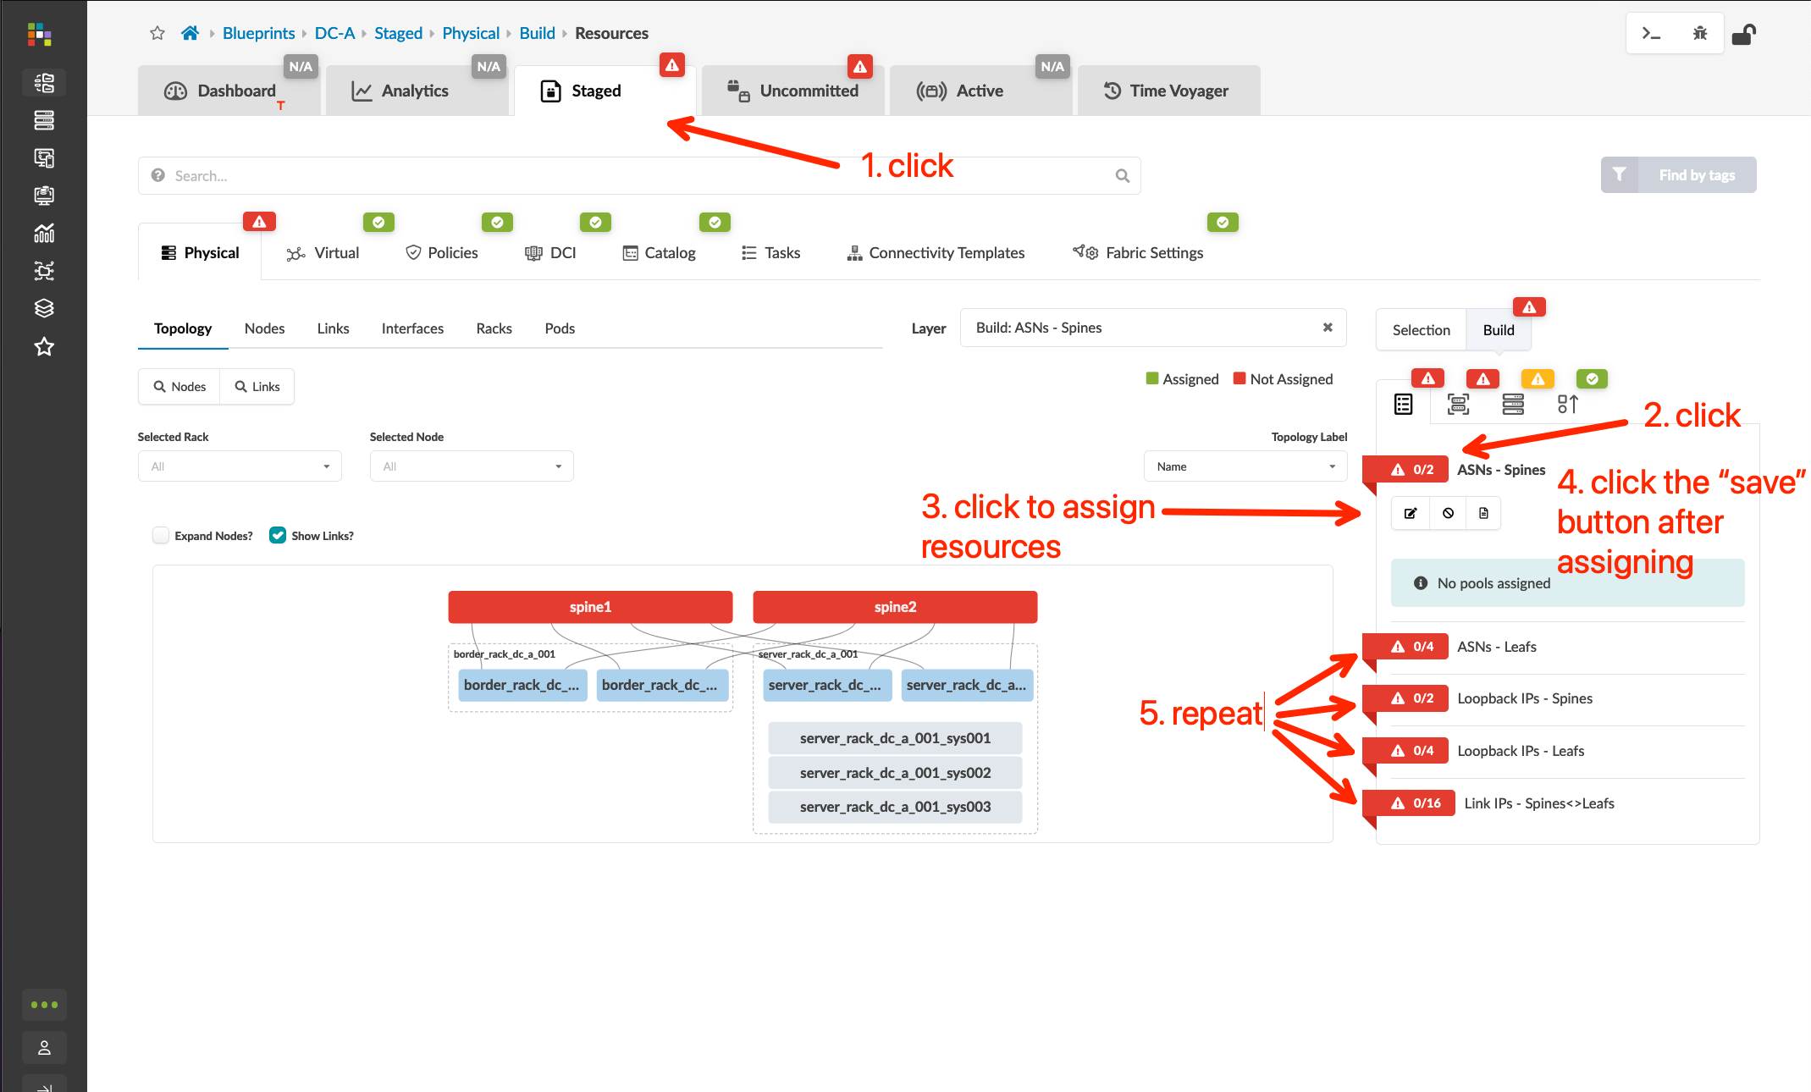
Create Blueprints
Go to Blueprints and create a new Blueprint
Click the new Blueprint to edit basic parameters such as ASN, IP, device, etc
Select the ASN Pool and IP Pools that were defined in previous steps and assign them to Build Resource Types as shown in the screenshot
Name | DC-A
Template | DC-A (vJunos)
Resource Type | Pool Name
ASNs – Spines | DC-A
ASNs – Leafs | DC-A
Loopback IPs – Spines | DC-A Loopback
Loopback IPs – Leafs | DC-A Loopback
Link IPs – Spines<->Leafs | DC-A Fabric

Slide 42
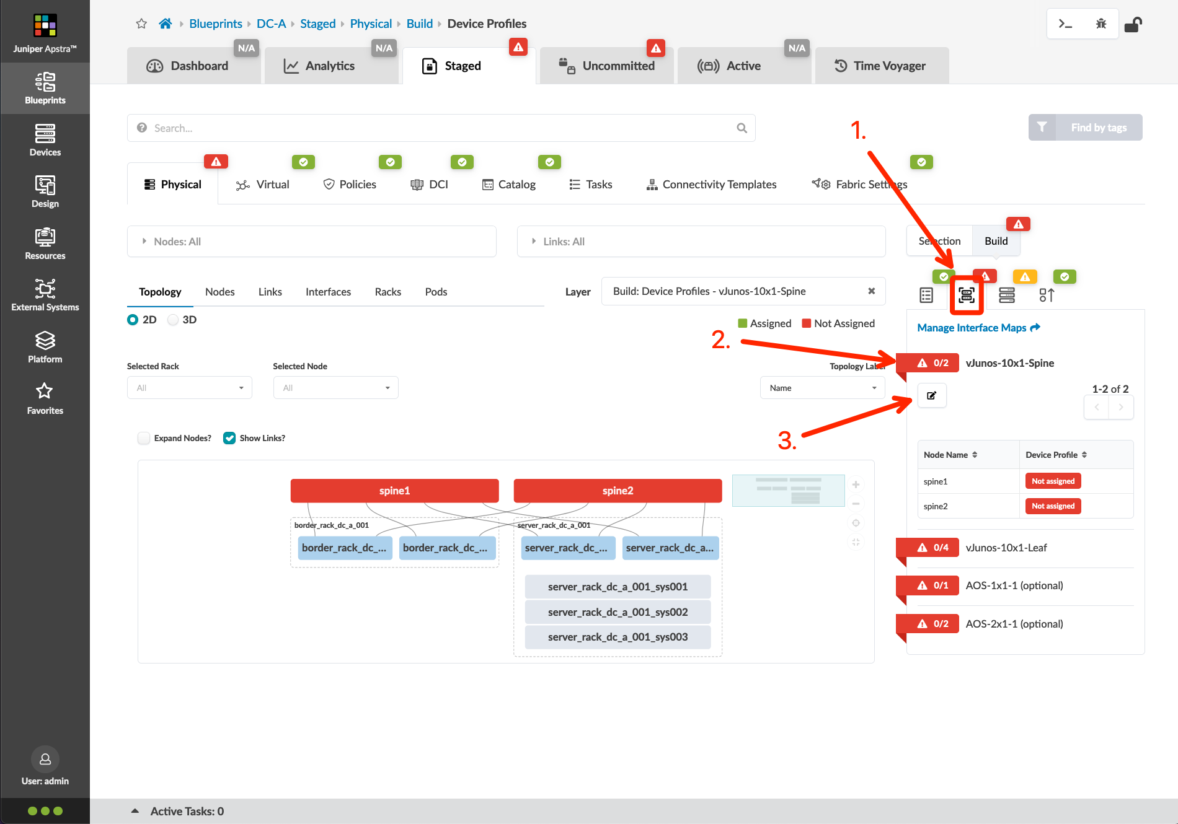
Create Blueprints
Select the Interface Map and Device Profile of each Logical Device NOTE: There is no need to assign the interface map of AOS-1x1-1
Device Name | Interface Map
spine1 | vJunos-lab____vJunos-10x1-Spine
spine2 | vJunos-lab____vJunos-10x1-Spine
border_rack_001_leaf1 | vJunos-lab____vJunos-10x1-Leaf
border_rack_001_leaf2 | vJunos-lab____vJunos-10x1-Leaf
server_rack_001_leaf1 | vJunos-lab____vJunos-10x1-Leaf
server_rack_001_leaf2 | vJunos-lab____vJunos-10x1-Leaf

Slide 43
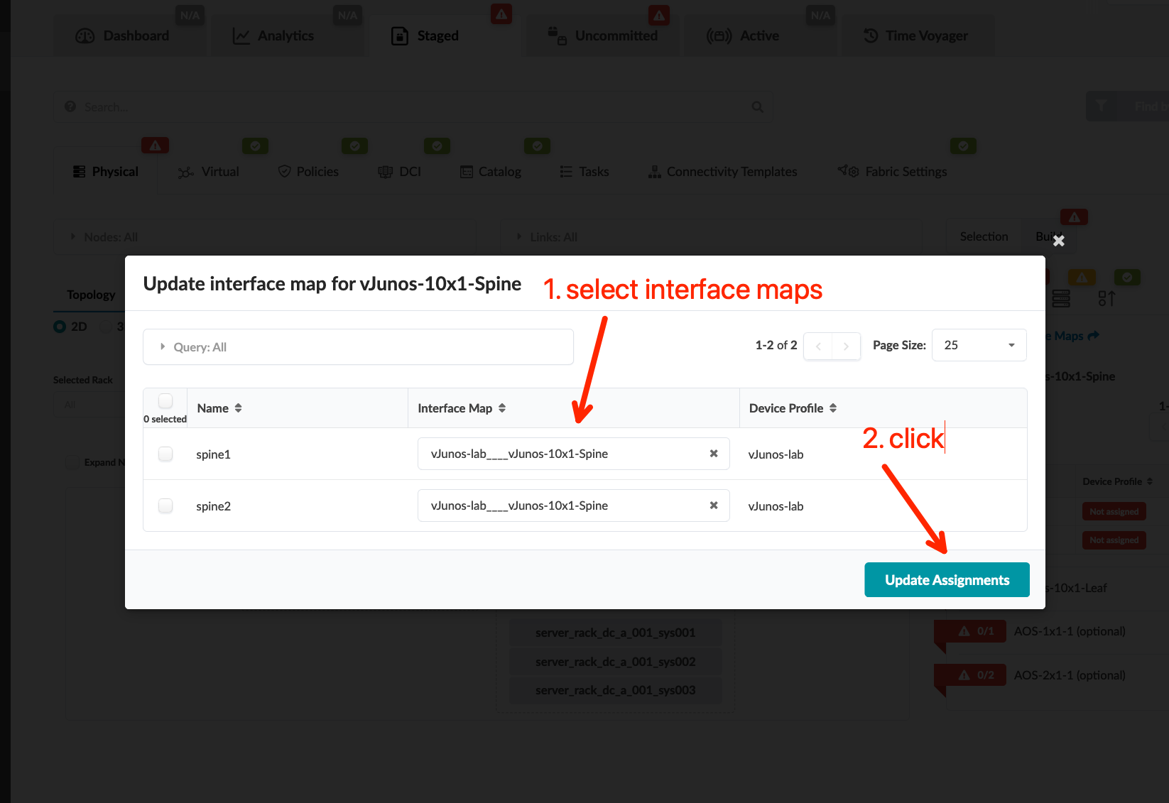
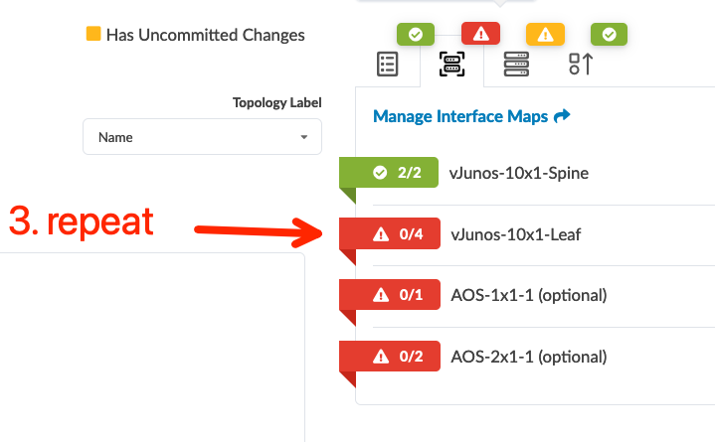
Create Blueprints
Select the Interface Map and Device Profile of each Logical Device NOTE: There is no need to assign the interface map of AOS-1x1-1
Device Name | Interface Map
spine1 | vJunos-lab____vJunos-10x1-Spine
spine2 | vJunos-lab____vJunos-10x1-Spine
border_rack_001_leaf1 | vJunos-lab____vJunos-10x1-Leaf
border_rack_001_leaf2 | vJunos-lab____vJunos-10x1-Leaf
server_rack_001_leaf1 | vJunos-lab____vJunos-10x1-Leaf
server_rack_001_leaf2 | vJunos-lab____vJunos-10x1-Leaf

Slide 44
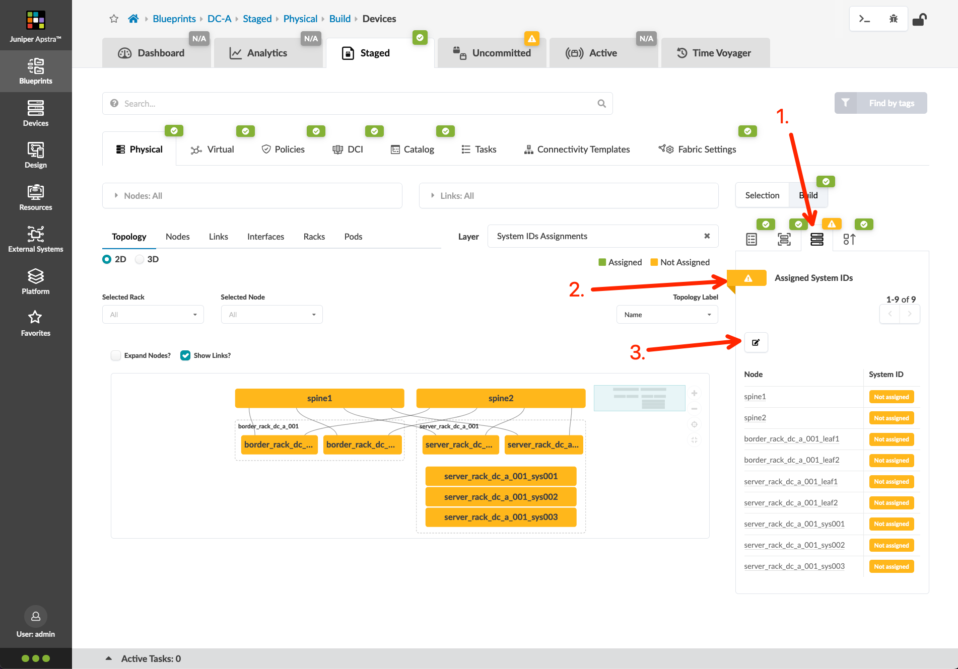
Create Blueprints
Select the Physical Device of each node NOTE: There is no need to assign the physical device of generic system nodes NOTE: The below table assumes you have configured your lab nodes with the management IP’s and MAC address assignments defined in the diagrams at the start of this documentation!
Device Name | System ID (MAC & IP)
A-border1 | 50:00:10:a1:00:00 (10.0.10.11)
A-border2 | 50:00:10:a2:00:00 (10.0.10.12)
A-spine1 | 50:00:10:a3:00:00 (10.0.10.13)
A-spine2 | 50:00:10:a4:00:00 (10.0.10.14)
A-leaf1 | 50:00:10:a5:00:00 (10.0.10.15)
A-leaf2 | 50:00:10:a6:00:00 (10.0.10.16)

Slide 45
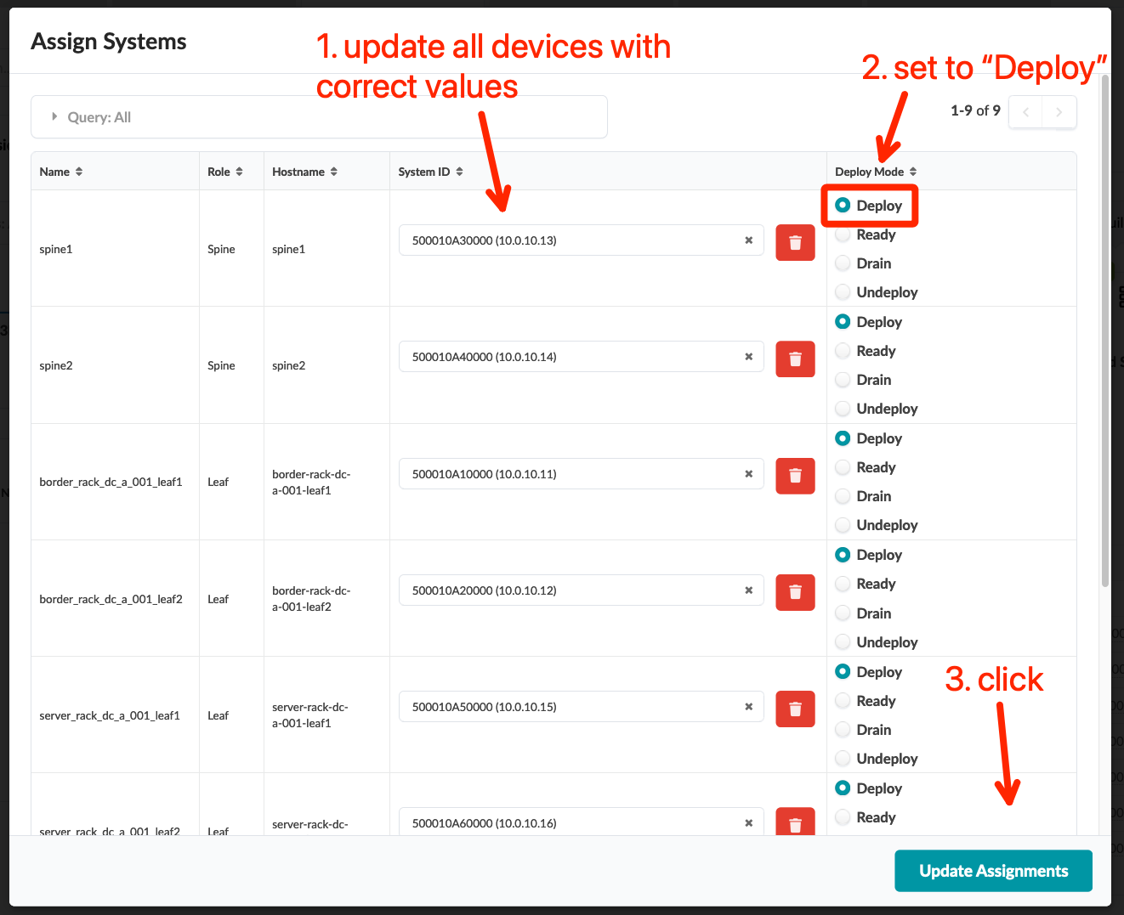
Create Blueprints
Select the Physical Device of each node NOTE: There is no need to assign the physical device of generic system nodes NOTE: The below table assumes you have configured your lab nodes with the management IP’s and MAC address assignments defined in the diagrams at the start of this documentation!
Device Name | System ID (MAC & IP)
A-border1 | 50:00:10:a1:00:00 (10.0.10.11)
A-border2 | 50:00:10:a2:00:00 (10.0.10.12)
A-spine1 | 50:00:10:a3:00:00 (10.0.10.13)
A-spine2 | 50:00:10:a4:00:00 (10.0.10.14)
A-leaf1 | 50:00:10:a5:00:00 (10.0.10.15)
A-leaf2 | 50:00:10:a6:00:00 (10.0.10.16)

Slide 46
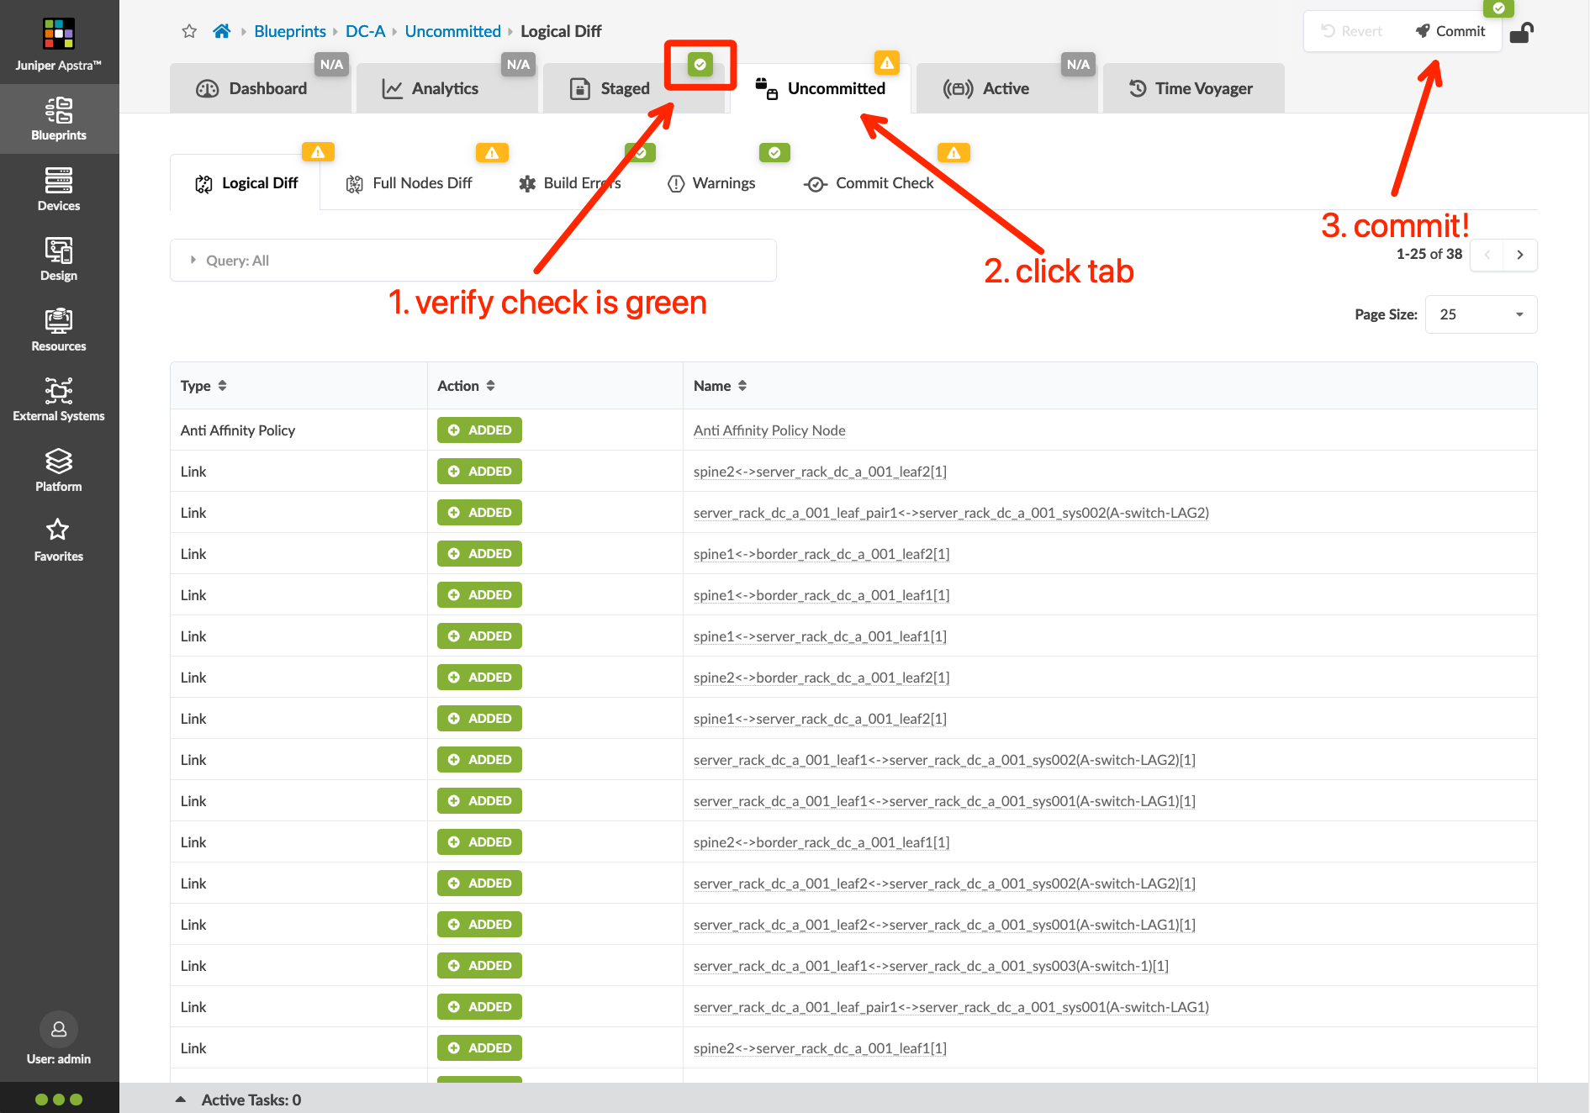
Create Blueprints
Verify the Staged icon is in green
Commit the Blueprint
The memory utilization of a virtual switch RE can periodically average ~90%. This is expected but does trigger an alarm. By default, the memory threshold of the Device System Health probe is 80%. We will raise the threshold value of this probe to get rid of the high memory anomaly.
Navigate to Analytics > Probes and click the “Edit” button for the Device System Health probe
Change the Memory utilization threshold to 95 and click “Update”
Verify all the status are green in the Blueprints > Dashboard

Slide 47
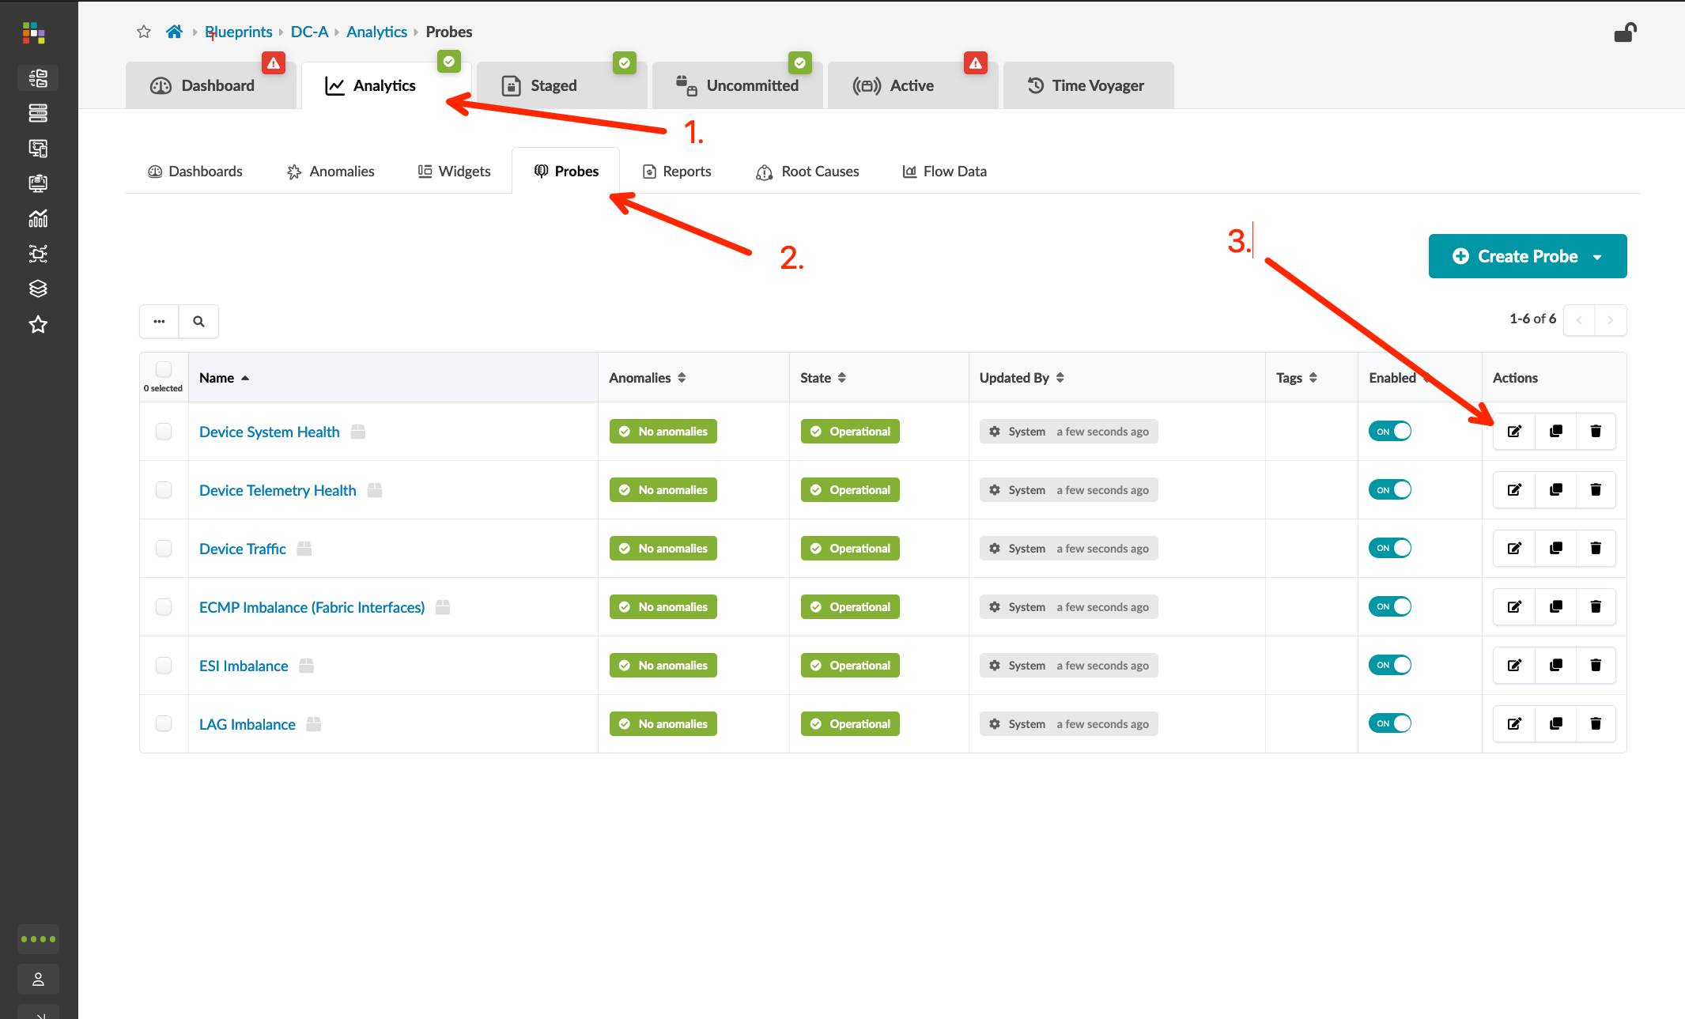
Create Blueprints
Verify the Staged icon is in green
Commit the Blueprint
The memory utilization of a virtual switch RE can periodically average ~90%. This is expected but does trigger an alarm. By default, the memory threshold of the Device System Health probe is 80%. We will raise the threshold value of this probe to get rid of the high memory anomaly.
Navigate to Analytics > Probes and click the “Edit” button for the Device System Health probe
Change the Memory utilization threshold to 95 and click “Update”
Verify all the status are green in the Blueprints > Dashboard

Slide 48
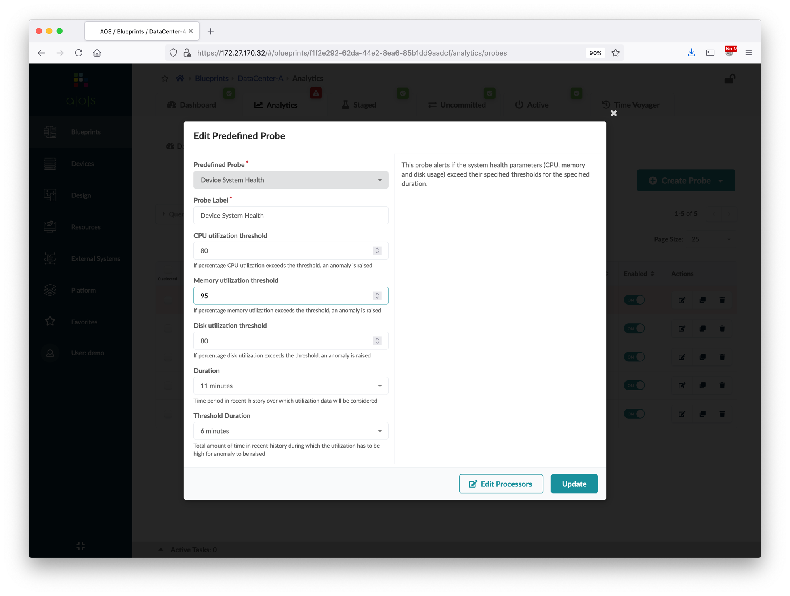
Create Blueprints
Verify the Staged icon is in green.
Commit the blueprint.
The memory utilization of a virtual switch RE can periodically average ~90%. This is expected but does trigger an alarm. By default, the memory threshold of the Device System Health probe is 80%. We will raise the threshold value of this probe to get rid of the high memory anomaly.
Navigate to Analytics > Probes and click the “Edit” button for the Device System Health probe
Change the Memory utilization threshold to 95 and click “Update”
Verify all the status are green in the Blueprints > Dashboard
①
Change to 95
②

Slide 49
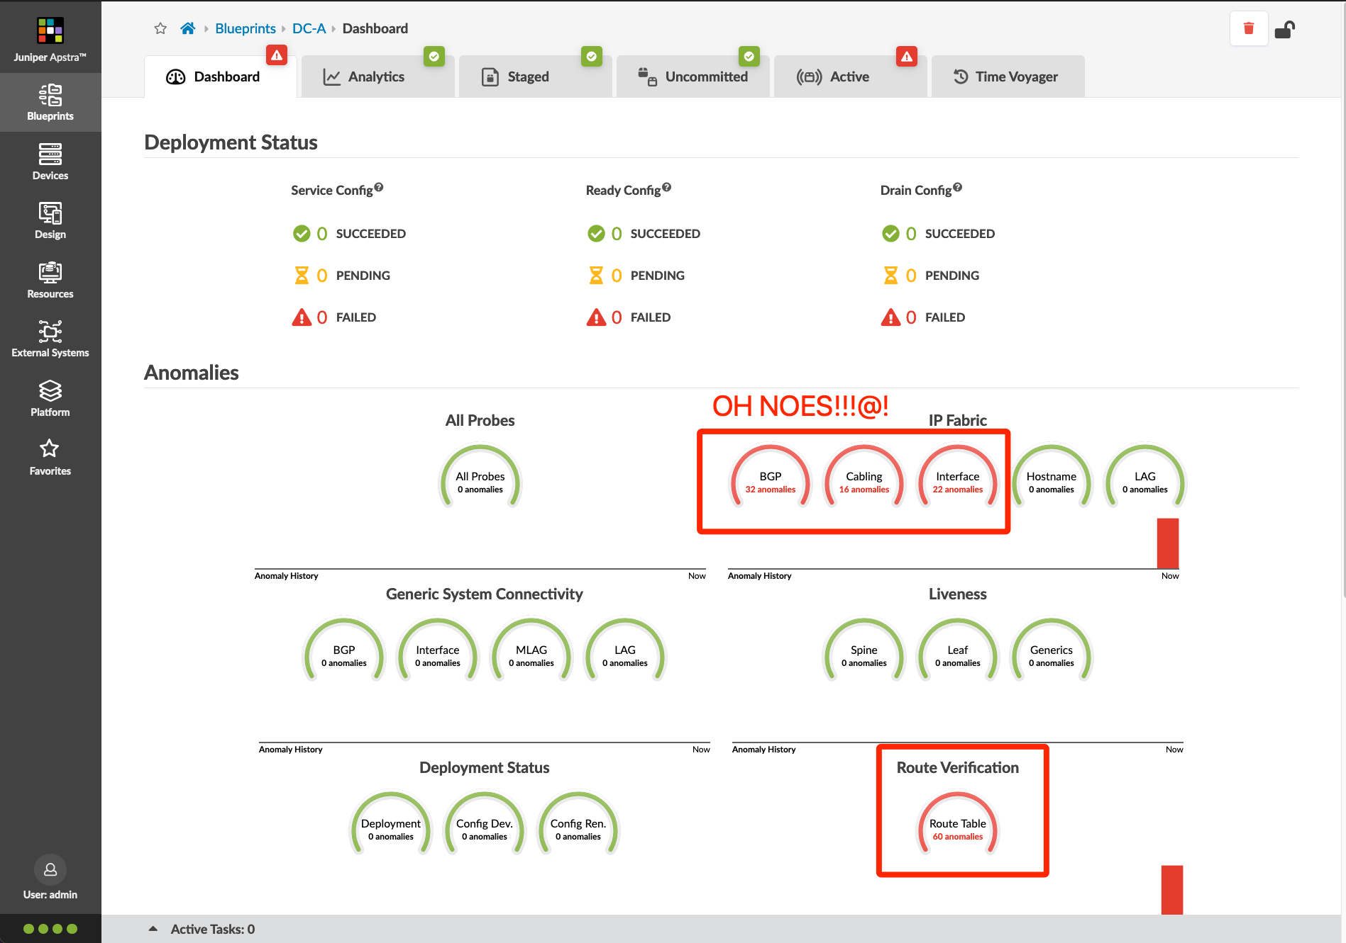
Create Blueprints
Verify the Staged icon is in green.
Commit the blueprint.
The memory utilization of a virtual switch RE can periodically average ~90%. This is expected but does trigger an alarm. By default, the memory threshold of the Device System Health probe is 80%. We will raise the threshold value of this probe to get rid of the high memory anomaly.
Navigate to Analytics > Probes and click the “Edit” button for the Device System Health probe
Change the Memory utilization threshold to 95 and click “Update”
Verify all the status are green in the Blueprints > Dashboard

Slide 50
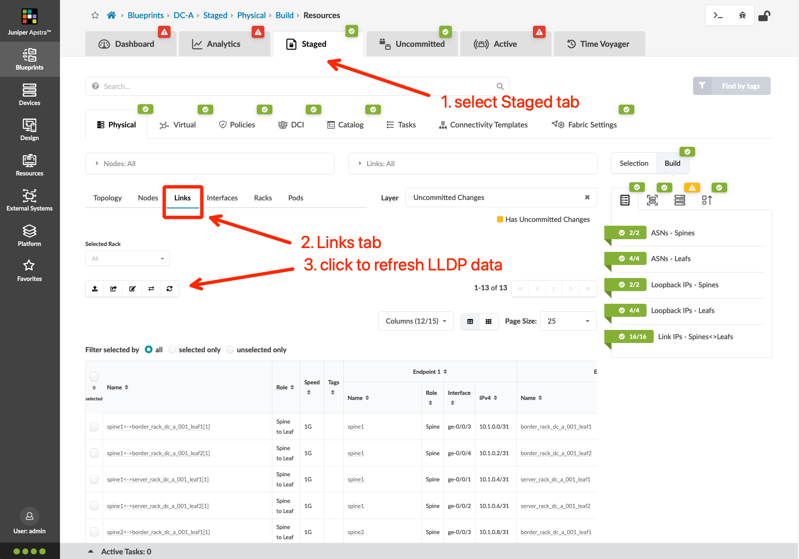
Updating the Cable Map!
Did you catch it? We never told the DC-A blueprint what interfaces were interconnecting our fabric devices!
Go to Staged > Links and click the swirling arrows to fetch/sync the LLDP information
Update the cable map so it matches the physical topology of your lab
Screenshot

Slide 51
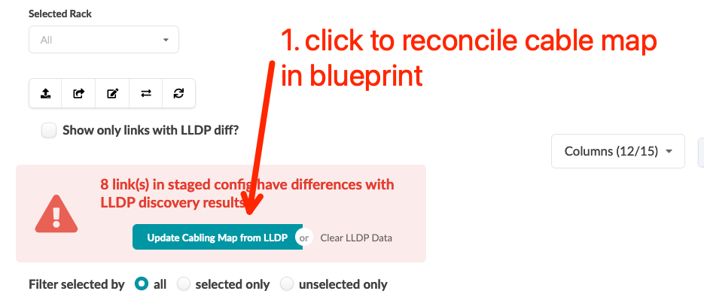
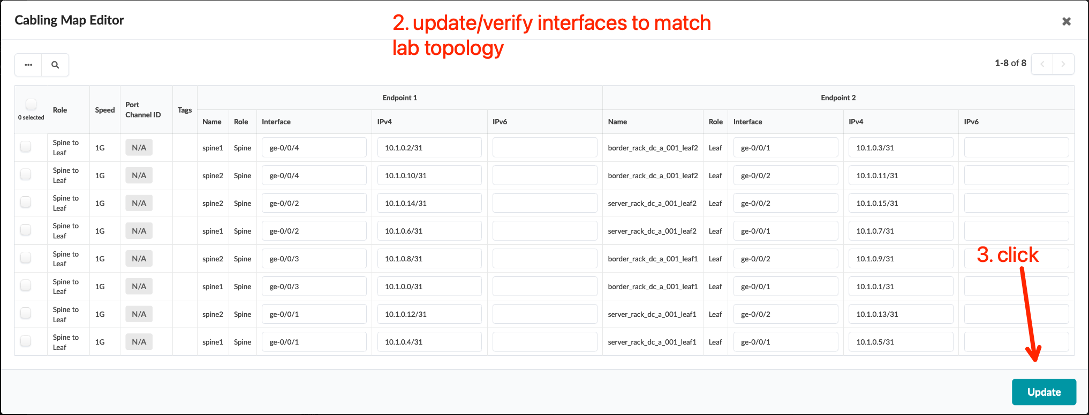
Updating the Cable Map!
Did you catch it? We never told the DC-A blueprint what interfaces were interconnecting our fabric devices!
Go to Staged > Links and click the swirling arrows to fetch/sync the LLDP information
Update the cable map so it matches the physical topology of your lab
NOTE: We will update the cable map links after defining services in the next section to better match a production workflow

Slide 52
JUST IN CASE: Dealing With Grumpy Eve Nodes
You may discover that even after updating your cable map, you still see cabling anomalies. As mentioned in the Caveats section of this documentation, this is always an issue with the node in your lab. If you update your cable map and still have problems, follow these steps:
Identify any suspect nodes
First, did you DISABLE UKSM? (see slide 15)
In my lab, I can see that all links to “spine1” are not reporting LLDP information (that’s what the pink fill means – we’ll deal with spine2 in a second)
I will gracefully shutdown spine1, and bring it back online (this worked for me while bringing this lab online)
If this doesn’t work, I will shutdown, delete the link, recreate them, then bring back online
In some cases, you need to gracefully shut everything down, restart your server, and bring it all back up. Then…

Slide 53
Create Blueprints
Verify the Staged icon is in green.
Commit the blueprint.
By default, the memory threshold of device system health probe is 80%, and sometimes the memory utilization of vQFX RE is ~90%, raise the threshold value to get rid of the high memory anomaly.
Verify all the status are green in the Blueprints > Dashboard.
(Optional) - Login to the virtual nodes and verify all BGP neighbors are established if you must see it in CLI (kinda beside the point with Apstra…)

Slide 54
Create Blueprints
Repeat the steps to create another Blueprint for DC-B
Use the resource pools with "DC-B" prefix in the resource assignment
Assign the physical devices with IP address 10.xxx.1.21 to 10.xxx.1.26 to DC-B
OPTIONAL: Before deploying your fabric configuration, go to the Staged tab, and from the Physical sub-tab, click the Links menu option, and click the button that looks like a square with a pencil in it to update your cabling map. This is an alternative workflow to allowing Apstra to define physical links, then updating the cable map using LLDP. You can do this after the initial deployment, but before is faster.
Your dashboard should look like the screenshot on the right when you are done

